Slide 1
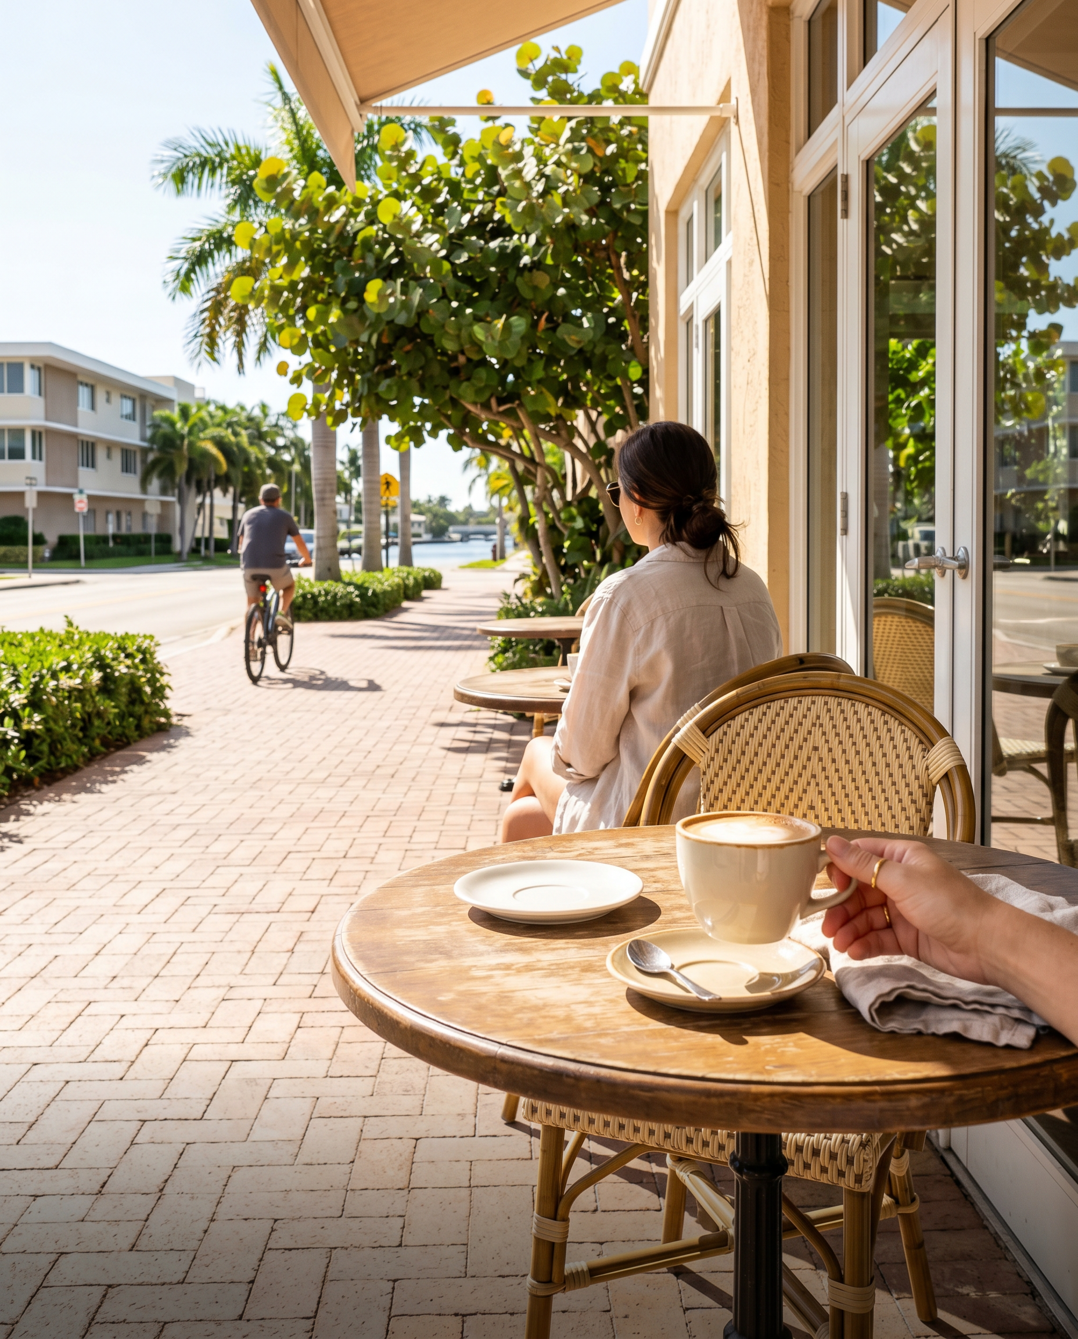
MAGNOLIA CAFFEE — NE 4TH AVE
a pick
The almond croissant earns the detour.
Corner café, soft light, proper espresso. Magnolia Caffee sits at NE 4th Ave — one of those spots buyers find on their second visit to a neighborhood, not their first. The patio is the move when the light is right. Worth building your morning around.
— Laurène

