Slide 1
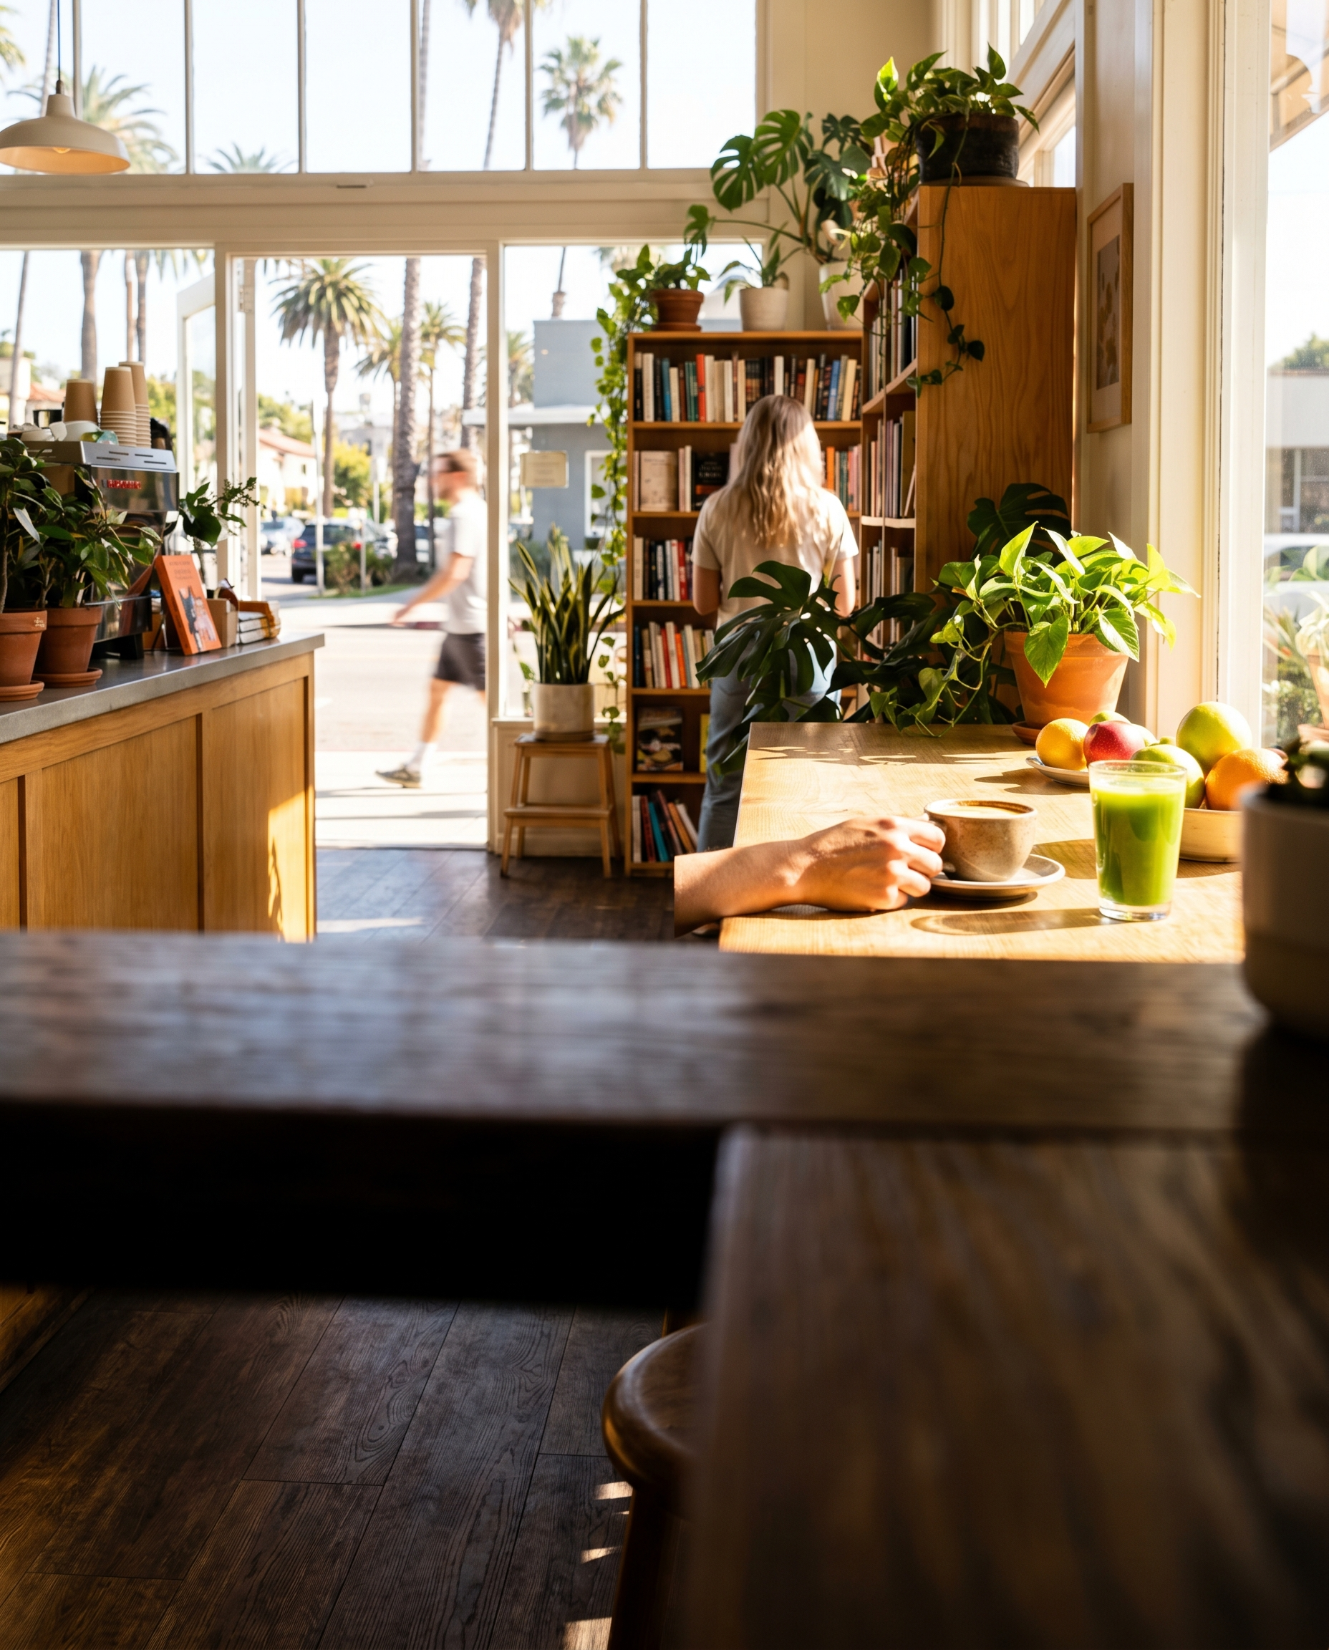
PULP & PRESS — 20TH AVE CORRIDOR
a pick
Cold-press café with a small bookshop built into the corner.
909 NE 20th Ave. Scratch kitchen, serious juice program, and a bookshop that doesn't feel like an afterthought. The 20th Ave corridor is the quieter axis of Victoria Park — this is what it looks like from the inside. Open early, stays calm.

