Slide 1
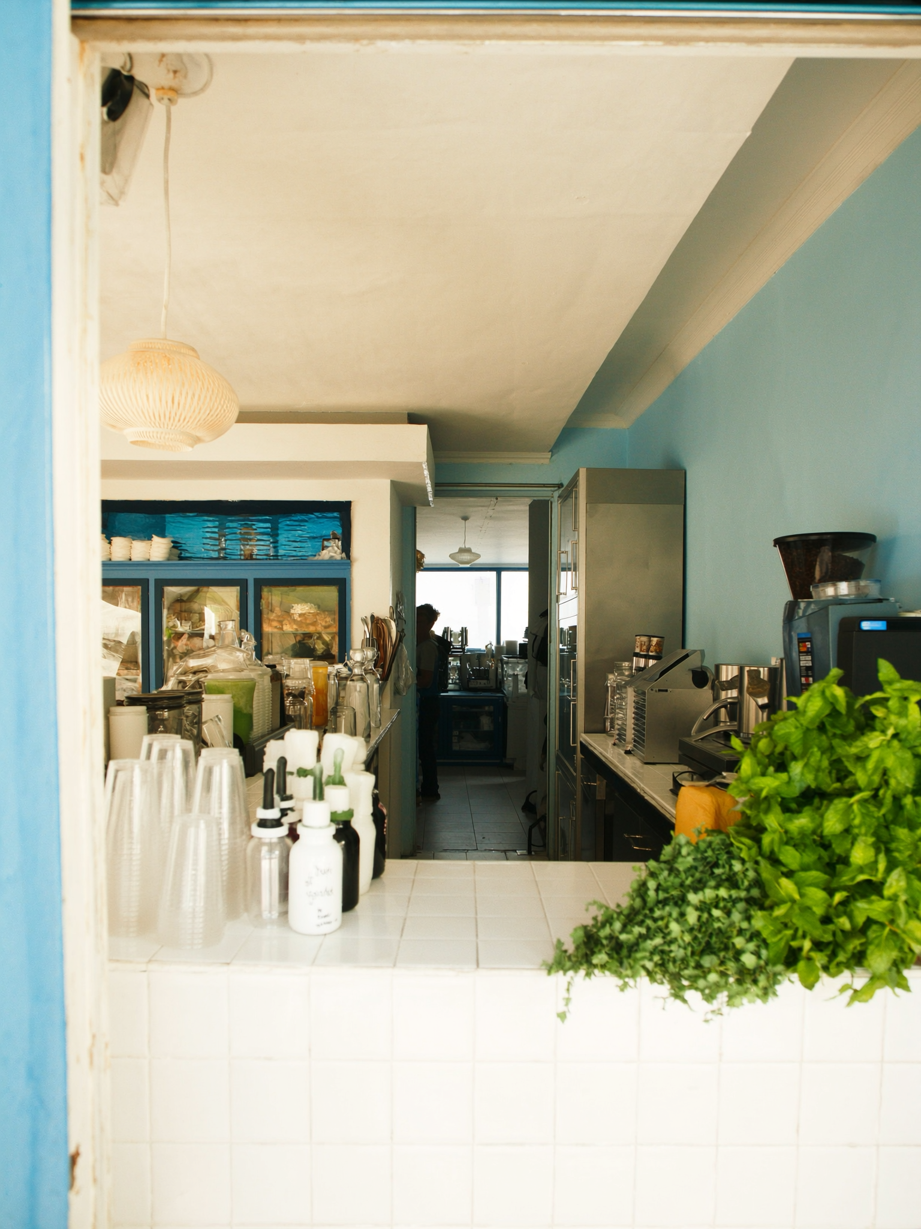
VICTORIA PARK
903 NE 5th Ave
The house on NE 5th Ave has been converted. The sign is small. The waitlist isn't.
Heritage sits in a residential block of Victoria Park — a converted house that opens its doors for dinner and fills almost every night. Michelin Bib Gourmand. The kind of place that answers the question 'what's actually here to eat?' in the neighborhood buyers are evaluating.

