Slide 1
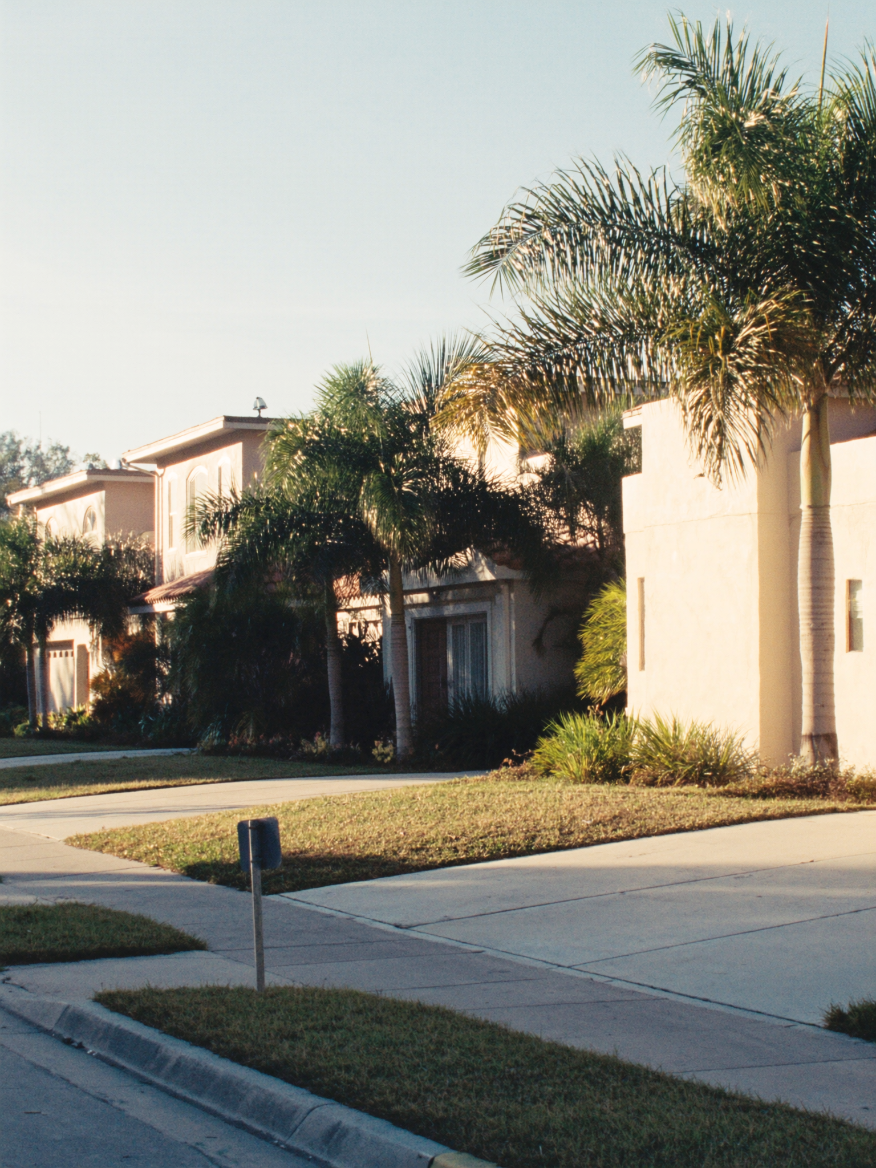
THE ROOM
handmade pasta, Michelin Bib Gourmand
No printed frills. Handmade pasta. Tables close enough that you learn your neighbor's order.
Heritage is compact by design — the converted-house footprint means intimacy is built in. The menu rotates. The pasta is made in-house. This is not the kind of place that exists because a restaurant group decided Fort Lauderdale needed Italian — it's here because the neighborhood can support it.

