Slide 1
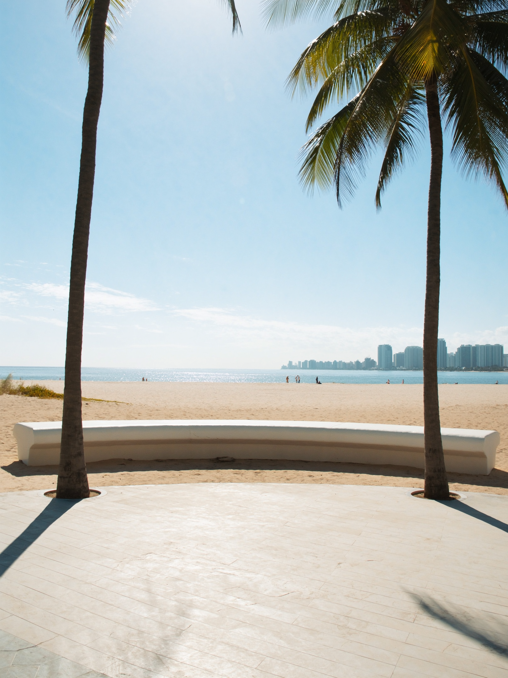
A THURSDAY IN VICTORIA PARK
walkability, Victoria Park
You walk four blocks from a mid-century home on NE 7th to a Michelin-recognized dinner. That's not a special occasion — that's the neighborhood.
Victoria Park's radius includes Heritage, Gulf Stream Distillery a few blocks north, the Las Olas boulevard five minutes south. What buyers from the Northeast recognize immediately: this is what it means to live in a walkable neighborhood with actual texture — not just proximity to a highway.

