Slide 1
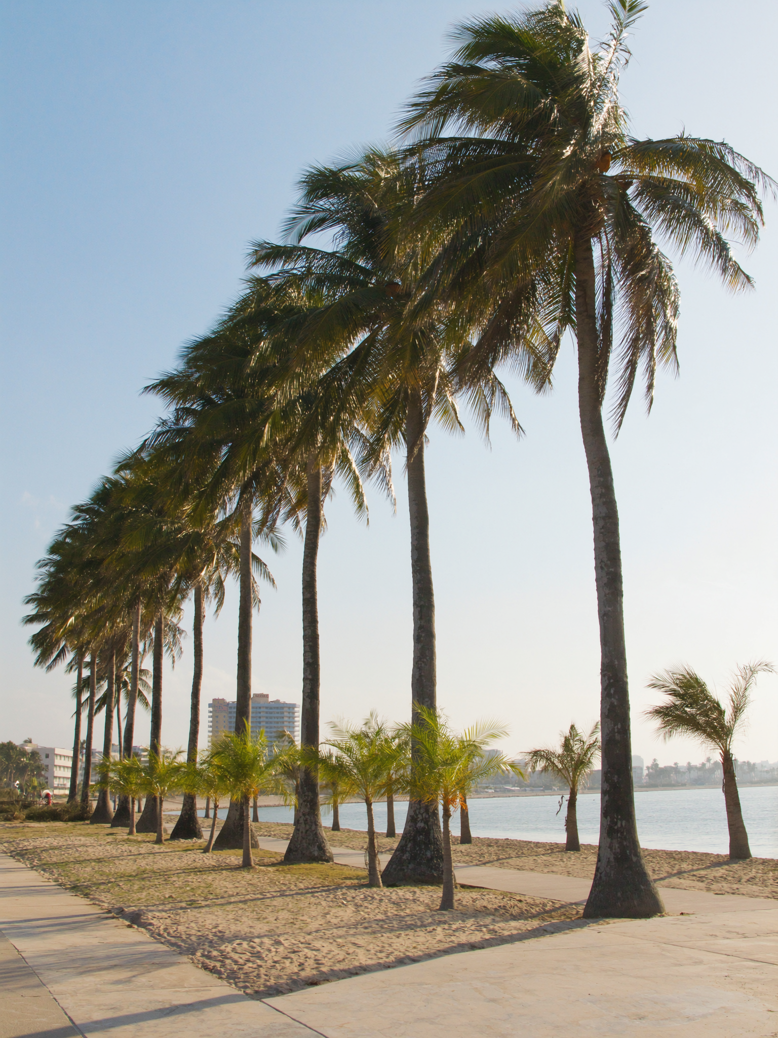
THE BUYER READ
Victoria Park, 33304 / 33301
Most people don't realize what's within walking distance of a home in Victoria Park until they're standing in it.
33304 and 33301 are where Heritage is. Mid-tier ZHVI: $604K (33304) and $871K (33301). Active inventory: 553 and 365. New pending April: 61 and 44. The Michelin guide doesn't factor into the listing sheet — but it factors into quality of life. For buyers evaluating a neighborhood on feel rather than data alone, an evening at Heritage is a better data point than the comps.
— Laurène

