Slide 1
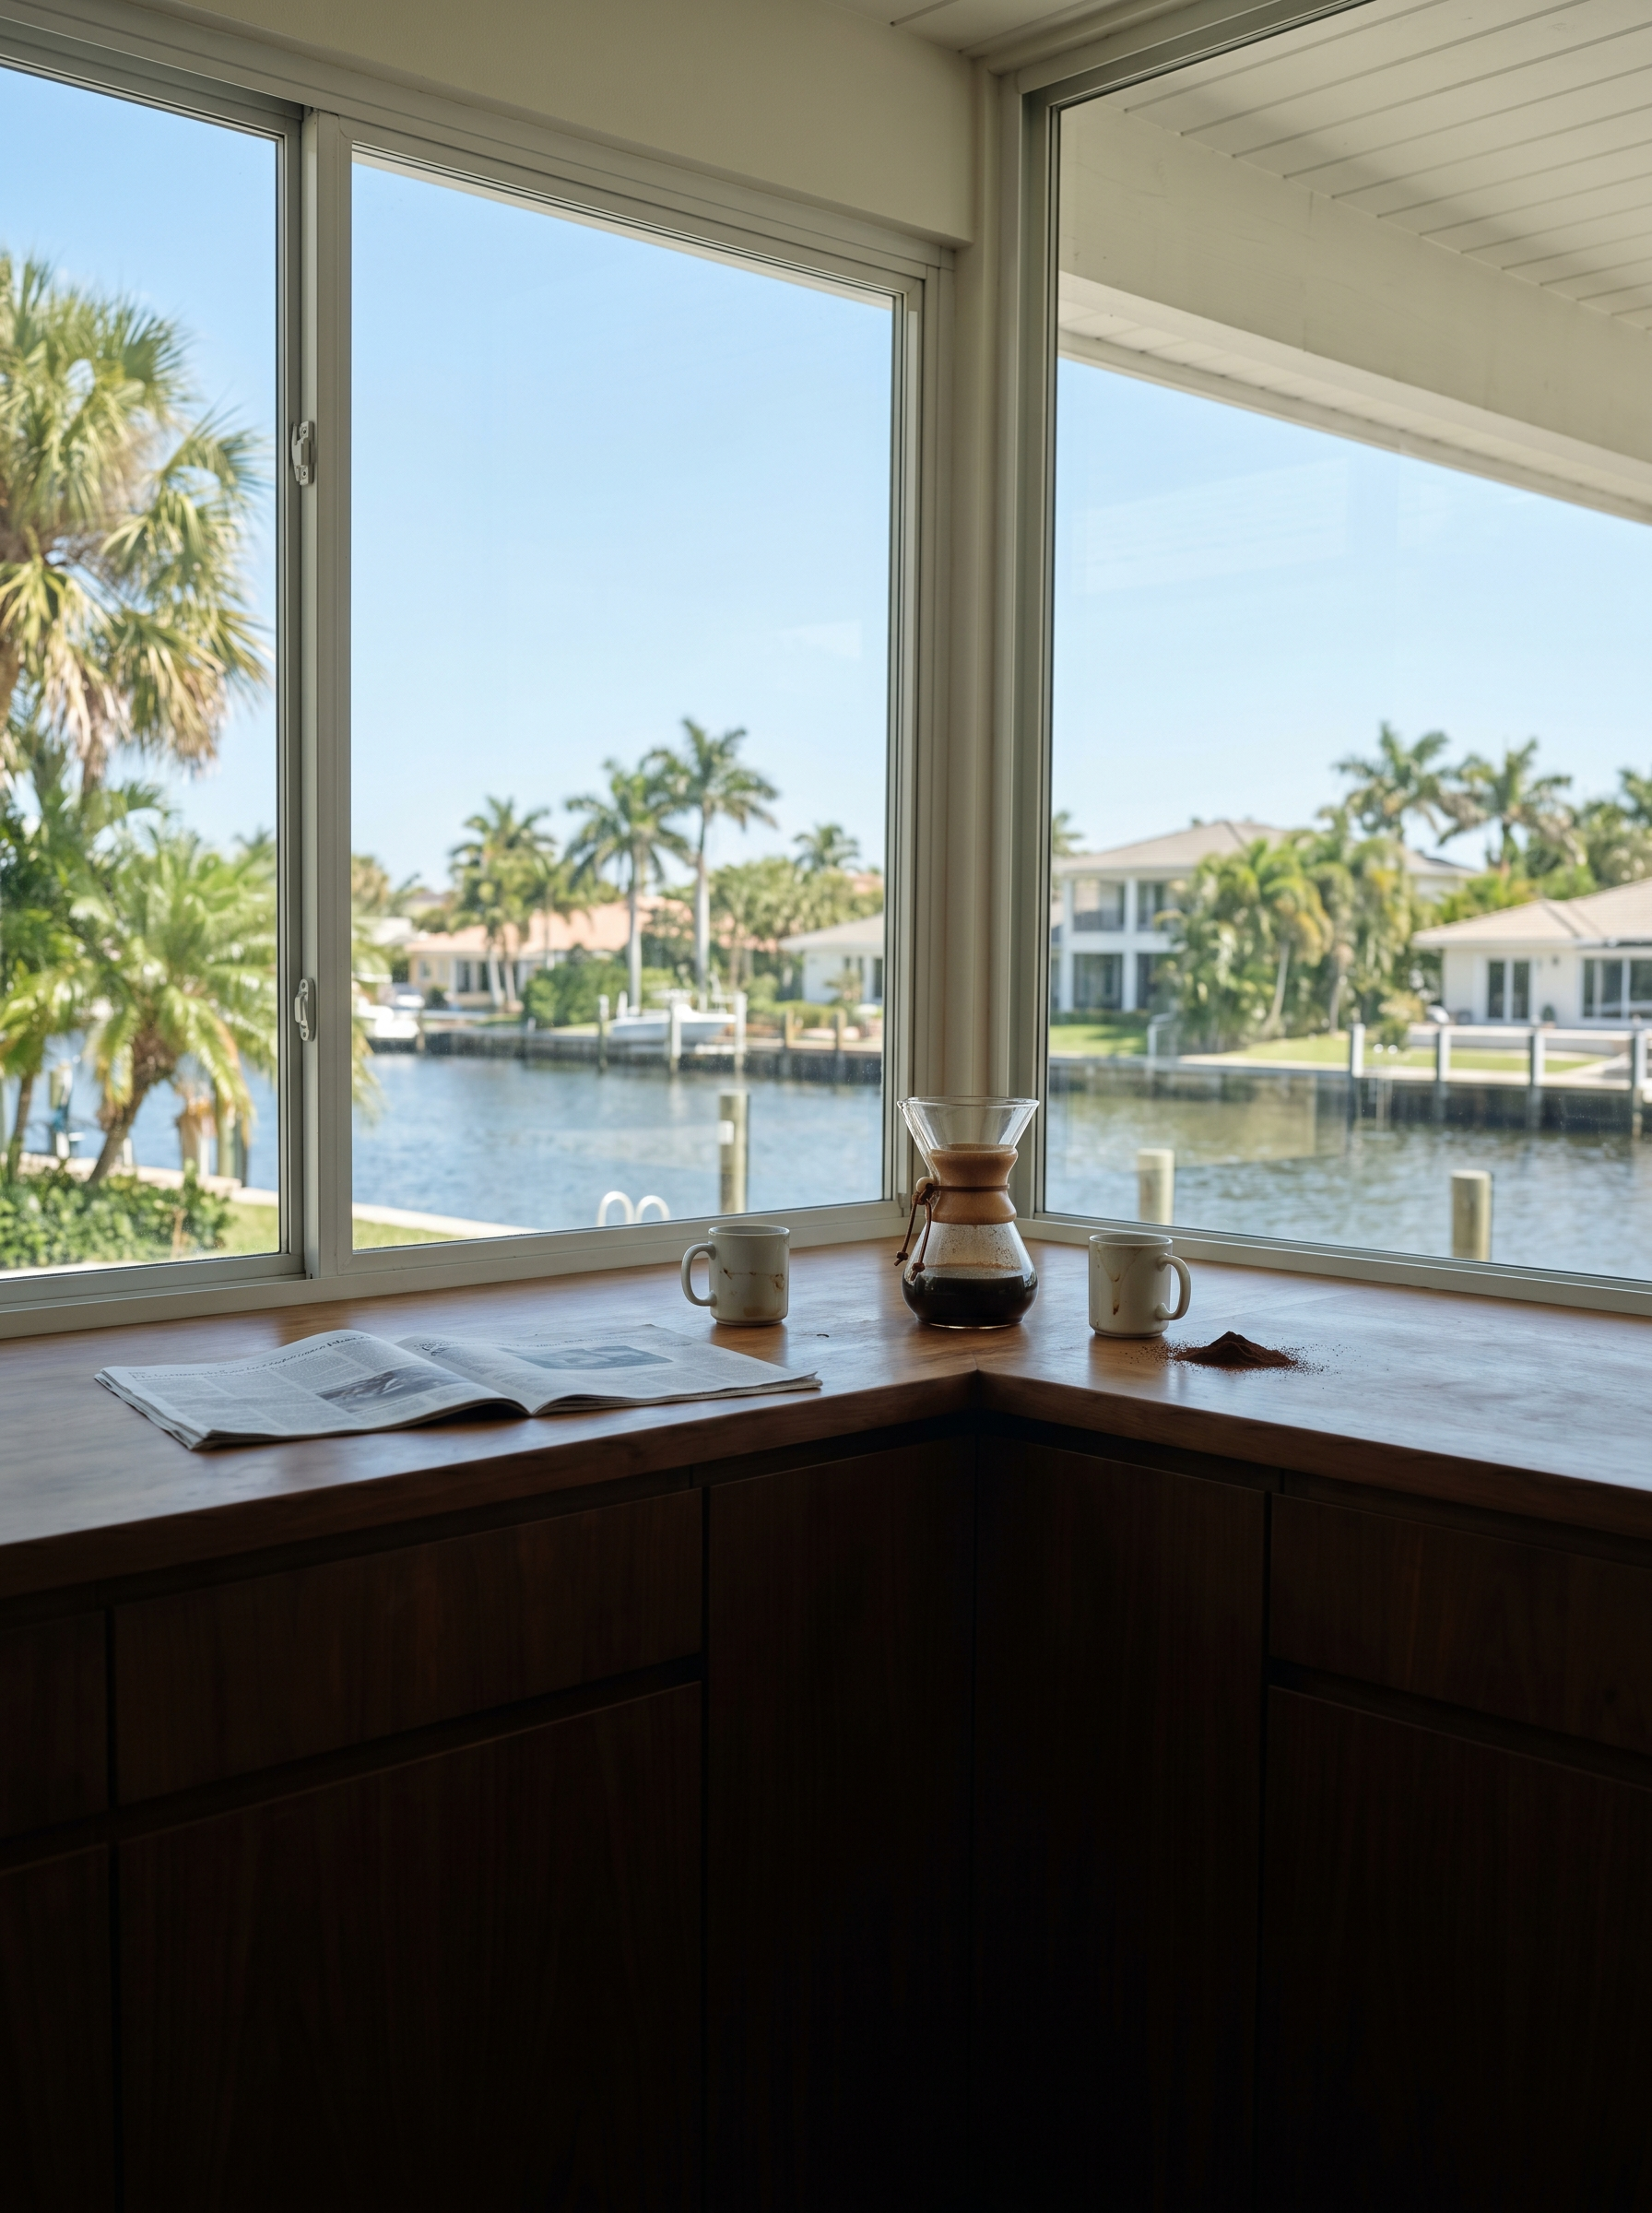
WHAT I'M WATCHING FOR
OK
GREEN FLAG
Rio Vista: pending contracts up 118% year-over-year
WHY IT MATTERS
33316 (Rio Vista / Harbor Beach): 24 new pending contracts this month vs. approximately 11 last April. New supply flat. Inventory barely moved. Demand arrived before the narrative did — this is what a ZIP looks like right before it gets competitive. The window for early entry is narrowing.
2 / 6

