Slide 1
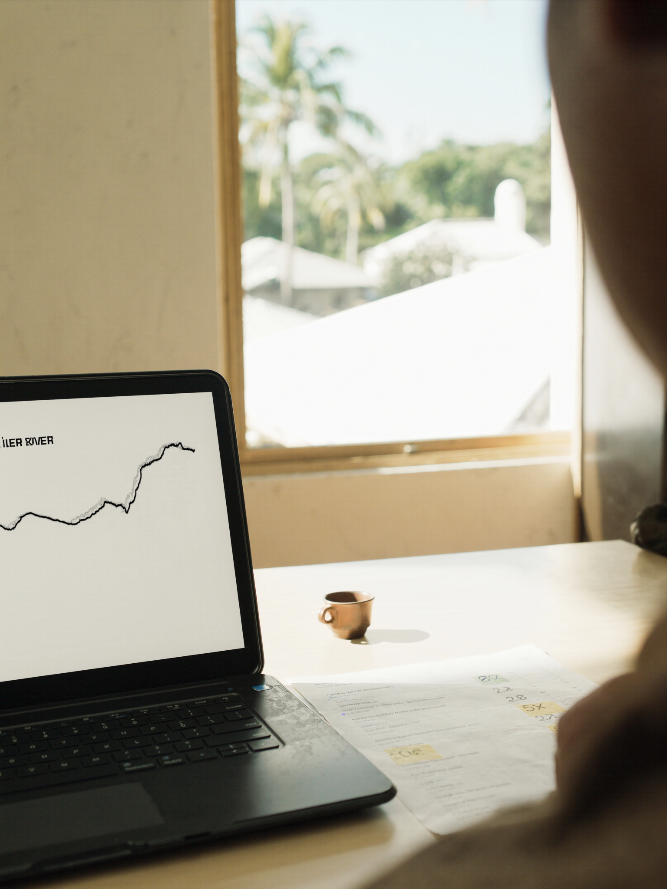
RATES — JUNE 2026
The market isn't going to get cheaper. Here's the data behind that.
May CPI came in at 4.2%. Mortgage rates ticked up. What buyers waiting on rate relief need to know.
— Laurène

