Slide 1
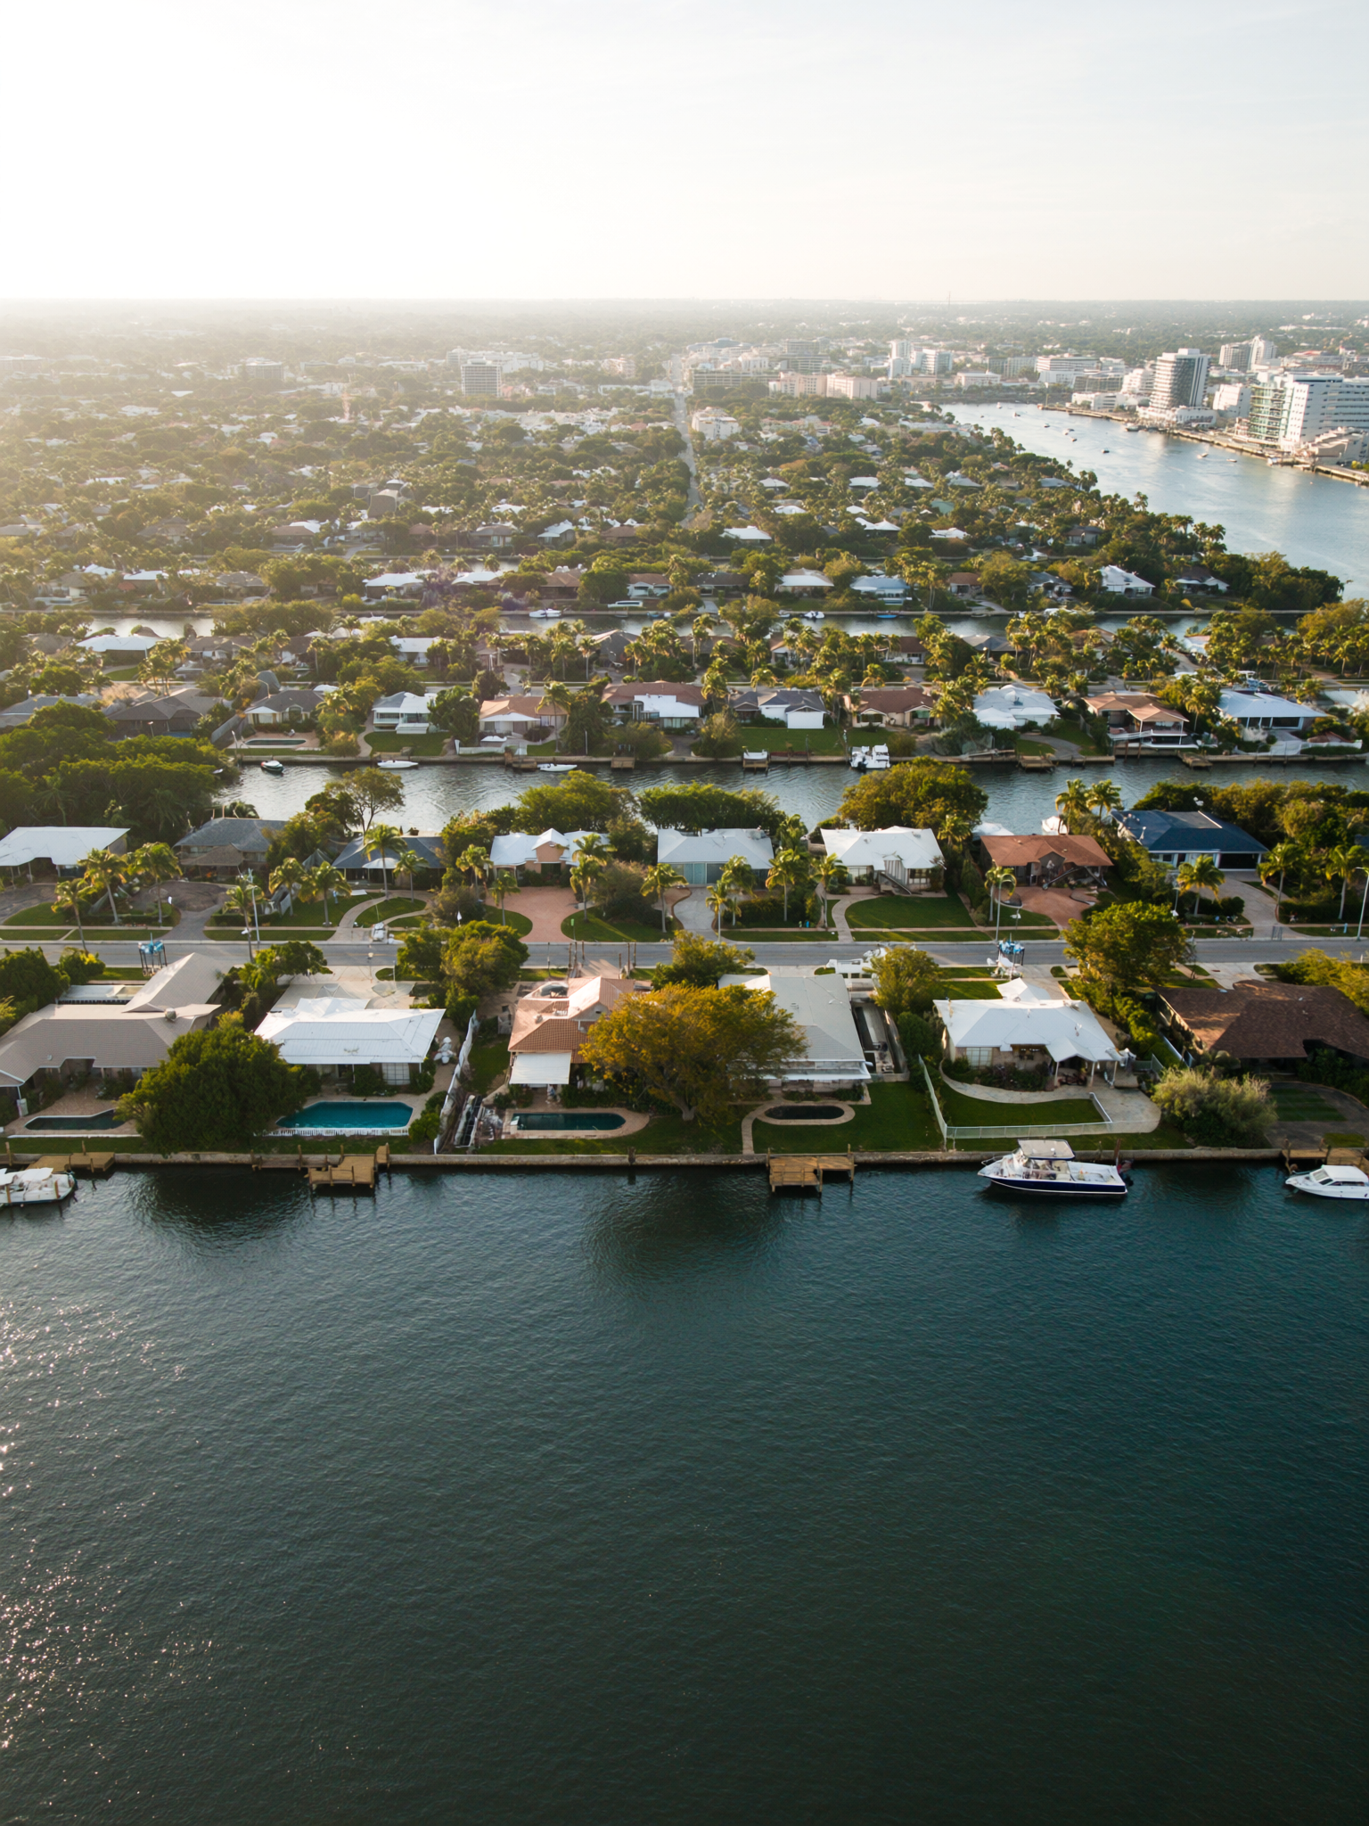
RATES — JUNE 2026
1
"30yr PMMS: 6.52% this week. Up 4 bps from last week. The trend right now is the wrong direction."
— what 'Mortgage rates are coming down — I should wait.' usually means
Freddie Mac PMMS: 6.52% (June 12, 2026) vs 6.48% (June 5). A year ago: ~6.87%. Rates are lower YoY but rising WoW. "Coming down" was last quarter's narrative.

