Slide 1
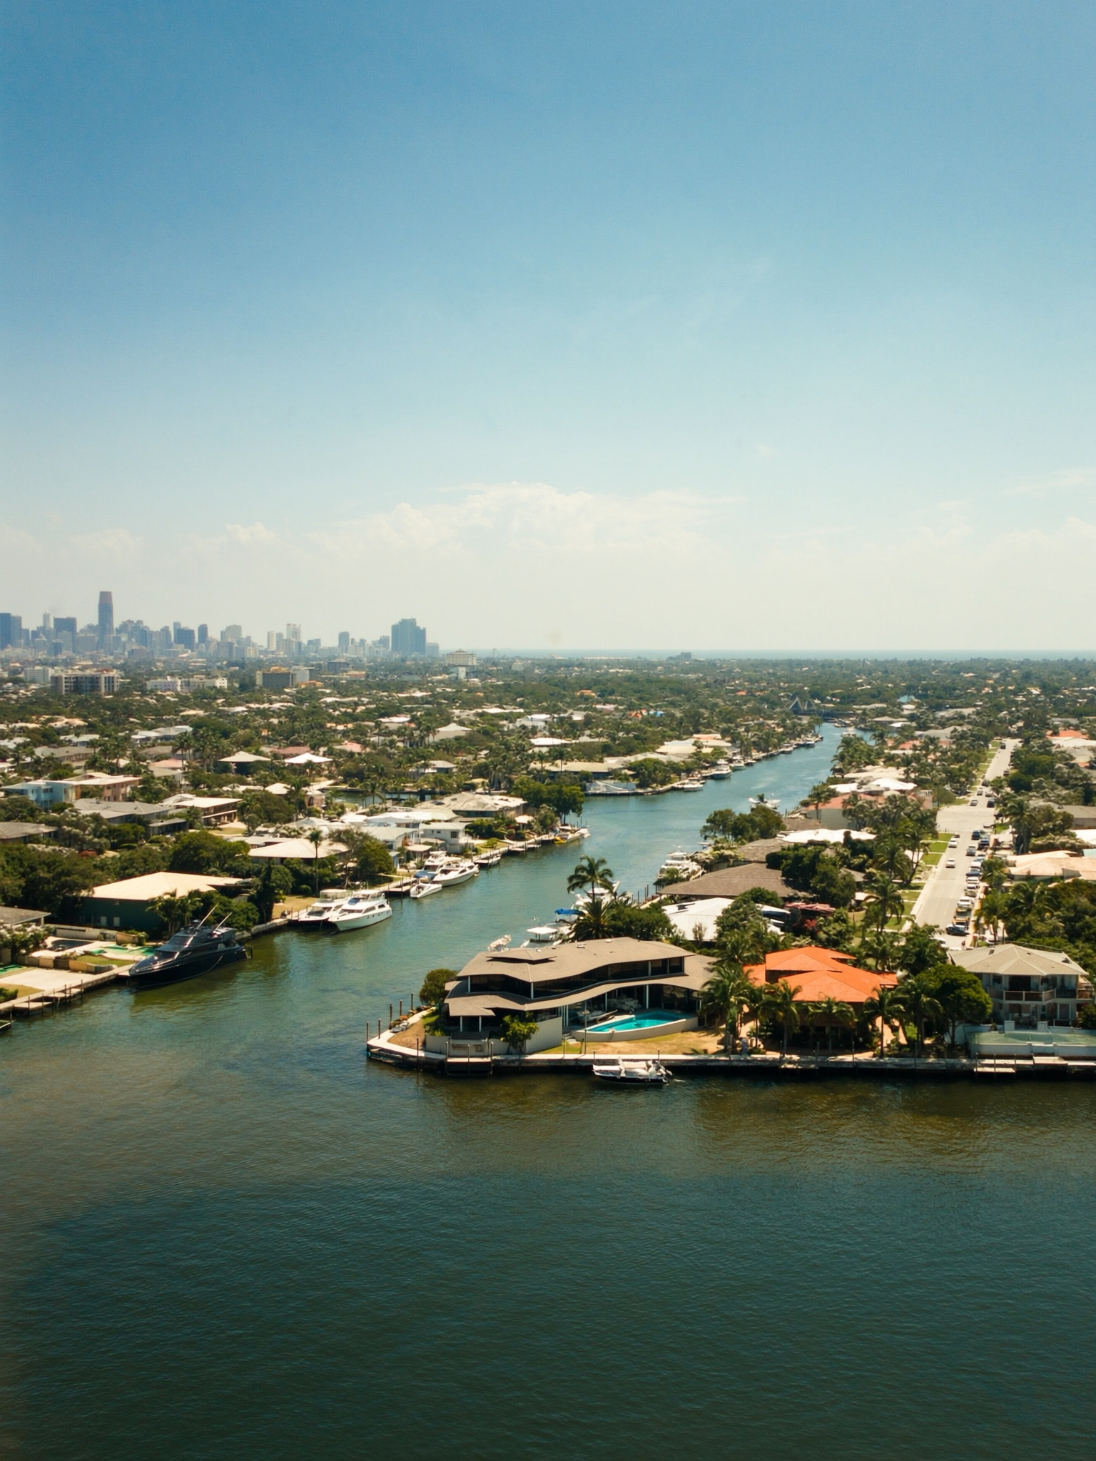
RATES — JUNE 2026
3
"4.2% YoY CPI in May 2026 is a 3-year high. Cooling from where?"
— what 'Inflation is cooling — that's good for rates.' usually means
May 2026 CPI: 4.2% YoY (Bankrate, June 13 report). The Fed's target is 2.0%. At 4.2%, rate-cut expectations are being pushed out — not pulled in. This is a re-acceleration, not a softening.

