Slide 1
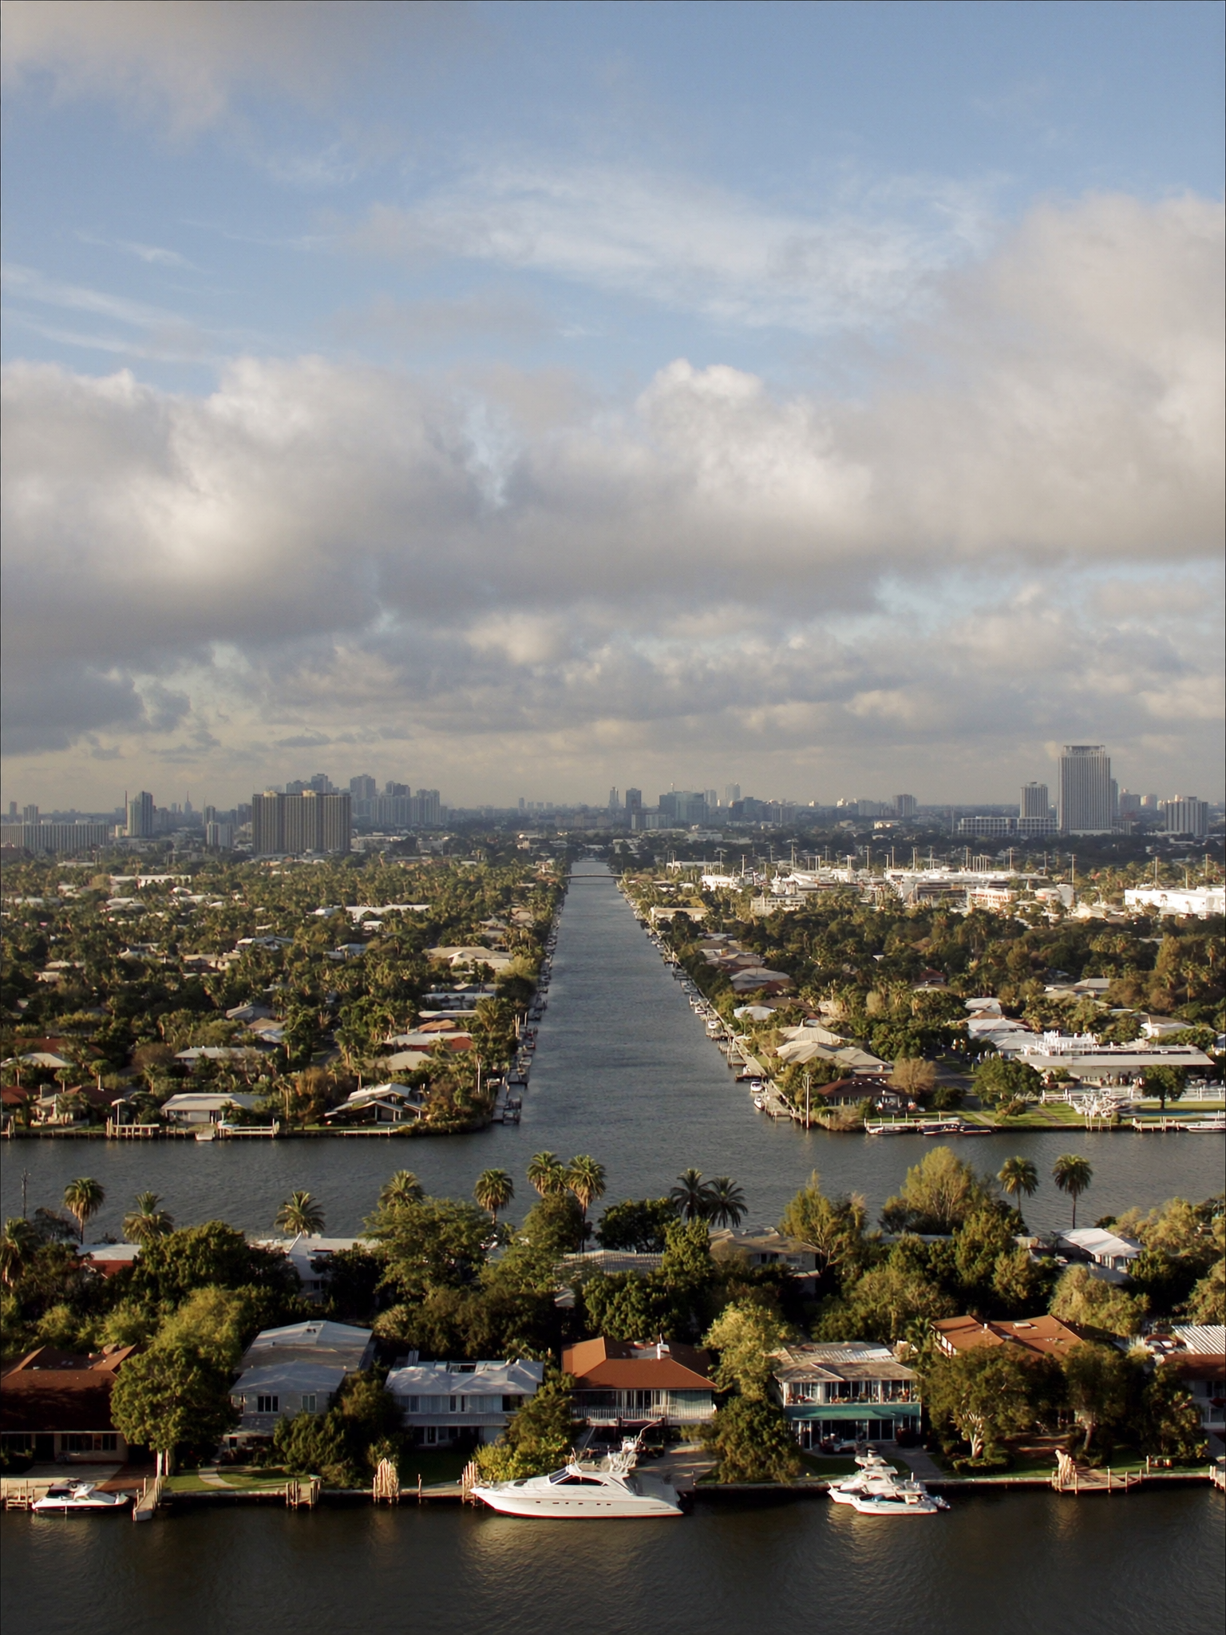
RATES — JUNE 2026
4
WHAT THEY SAY
"I'll just refinance later when rates drop."
WHAT IT USUALLY MEANS
That's a valid plan. The question is what you pay for the home in the meantime.
HOW I'D ANSWER IT
Prices in FTL Tier 1 are down YoY (-2.5% to -5.1%) but holding MoM. 5 of 9 ZIPs are tightening on inventory. Waiting on rates in a tightening market trades a lower monthly payment for a potentially higher purchase price. Refinancing later costs ~$3K–$6K in closing costs; price appreciation is permanent.

