Slide 1
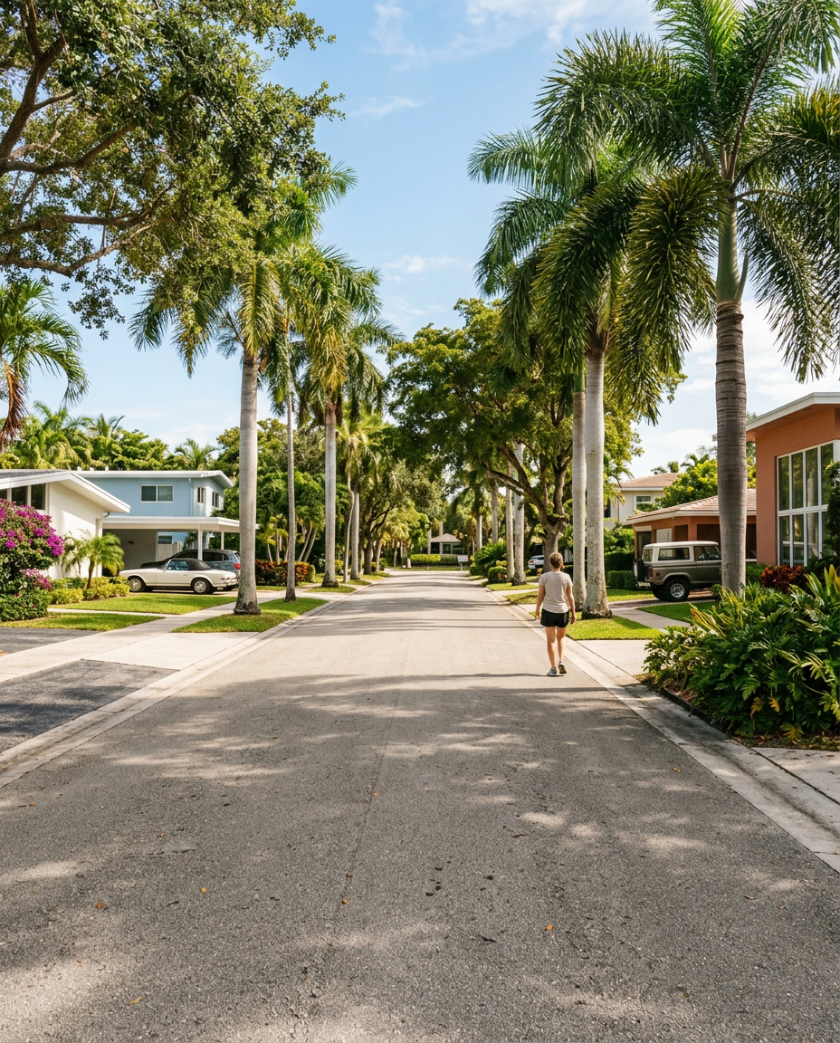
WHAT I'M WATCHING FOR
Red flags and green flags when buying in Fort Lauderdale
Six signals worth knowing before you make an offer
— Laurène

