Slide 1
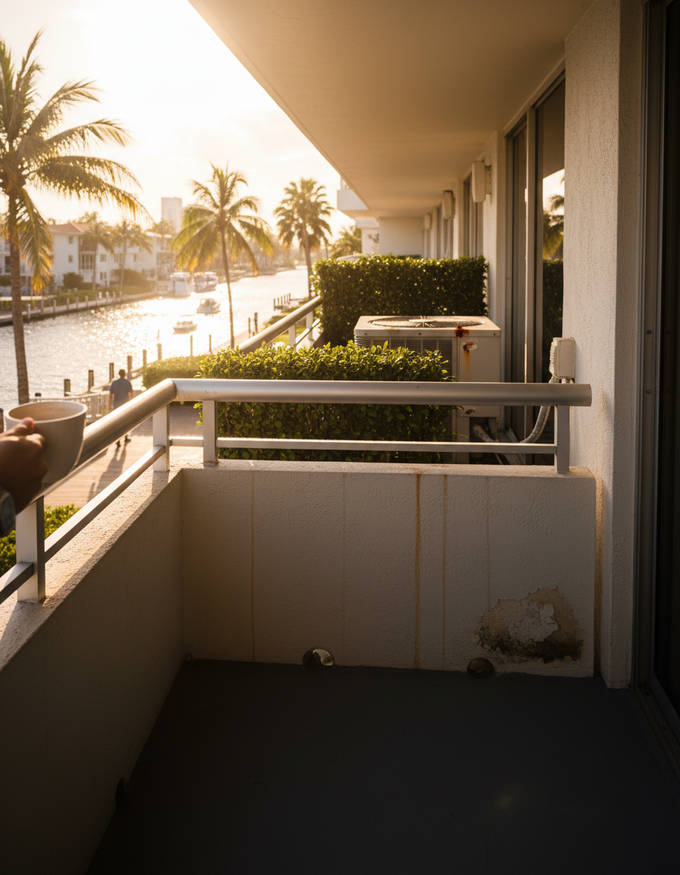
WHAT I'M WATCHING FOR
X
RED FLAG
LBTS: 798 listings and demand accelerating — the window closes faster than it looks
WHY IT MATTERS
33308 (Lauderdale-by-the-Sea): 798 active units sounds like ample choice. Pending contracts are up 39.3% YoY while new listings are down 17.3% YoY. The choice window is real — and it has an expiration date. When supply contracts faster than demand, inventory drops before prices recover.
5 / 6

