Slide 1
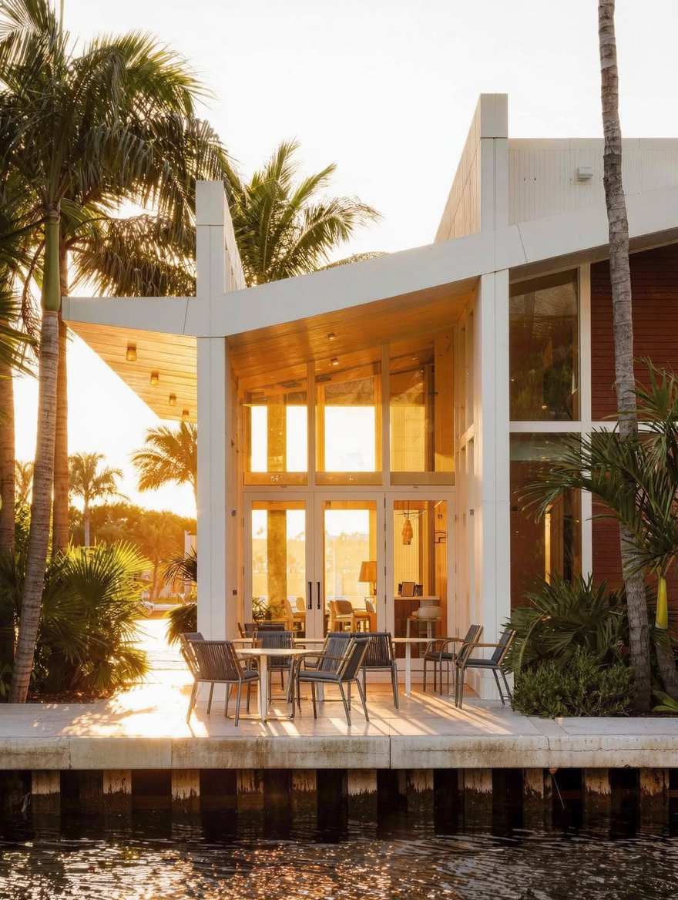
WHAT I'M WATCHING FOR
OK
GREEN FLAG
Victoria Park supply is tightening even as the market corrects
WHY IT MATTERS
33304 (Victoria Park / Coral Ridge edge): new listings down 39.8% YoY. New pending contracts up 52.5% YoY. Prices are -4.5% YoY but the forward signal is a supply-demand squeeze forming. This is a ZIP where the correction is closer to its floor than the headline YoY suggests.
6 / 6

