Slide 1
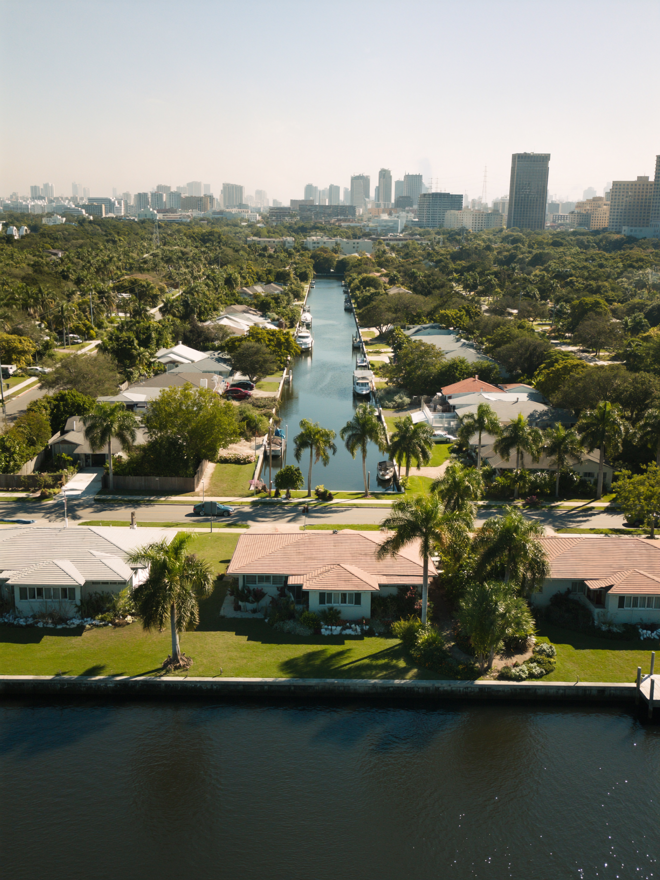
FORT LAUDERDALE — BUYER EXPECTATIONS
What buyers say they want. What I actually show them first.
3 things that surprise almost every relocator who hasn't been here recently.
— Laurène

