Slide 1
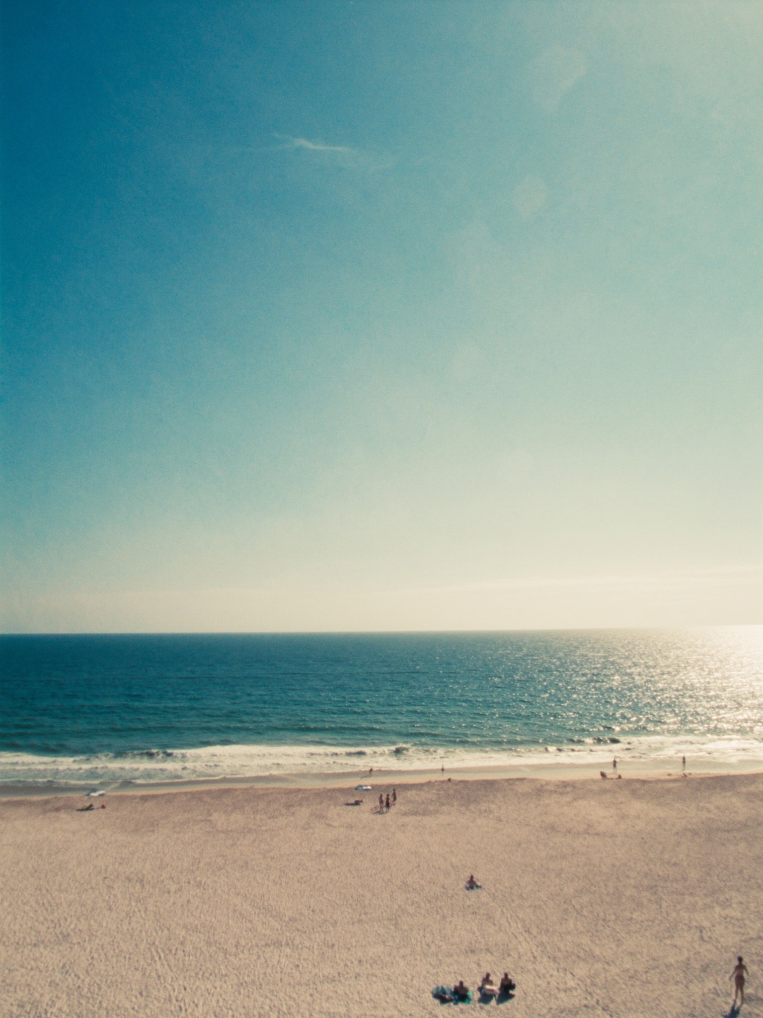
YOU SEE
FORT LAUDERDALE — BUYER EXPECTATIONS
Fort Lauderdale is a beach city. I want to be near the water.
— what almost every Northeast relocator says on the first call
1 / 3

