Slide 1
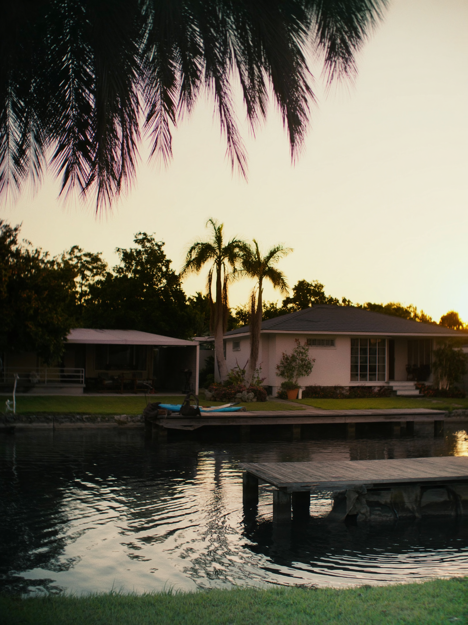
I SEE
FORT LAUDERDALE — BUYER EXPECTATIONS
There are two kinds of water in FTL. One is for tourists. One is why people stay.
WHAT I'D SHOW FIRST
—
Fort Lauderdale has 165 miles of canals — more than Venice. Most of the residential waterfront isn't near the beach. It's the Intracoastal and its fingers.
—
Coral Ridge, Victoria Park, Las Olas Isles, Rio Vista — all waterfront without a beach address. Canal access, docks, a kayak launch from your backyard.
—
The buyers who wanted 'beachfront' and ended up canal-front almost never regret the switch. The lifestyle is different. The price is lower. The maintenance is quieter.
1 / 3

