Slide 1
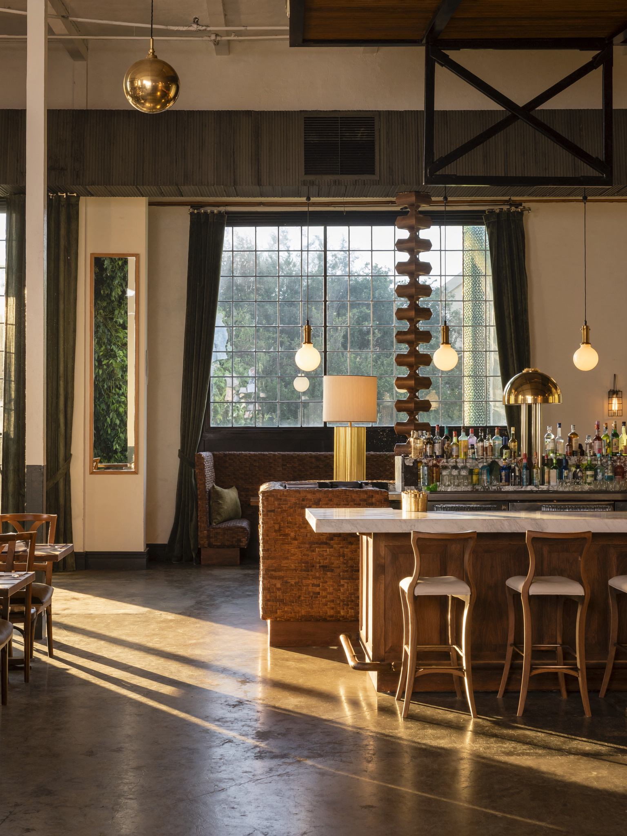
YOU SEE
FORT LAUDERDALE — BUYER EXPECTATIONS
I want to be near the Las Olas corridor — restaurants, walking, that's the lifestyle.
— before they've been shown what's five blocks off the boulevard
2 / 3

