Slide 1
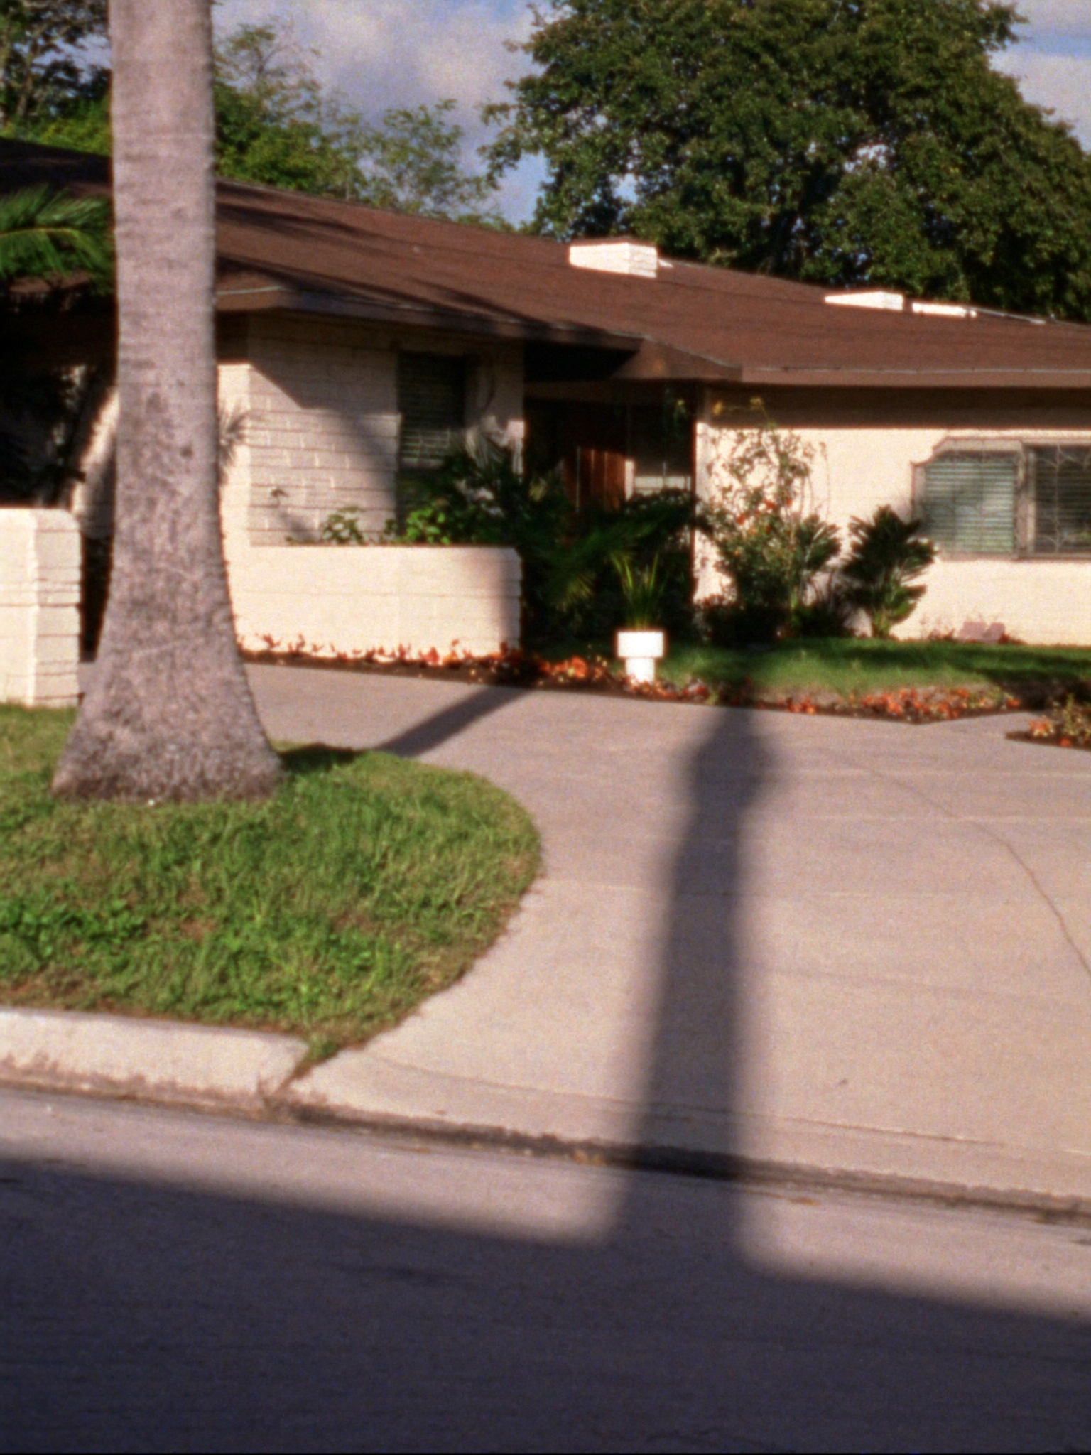
I SEE
FORT LAUDERDALE — BUYER EXPECTATIONS
The boulevard is the shop window. The neighborhood behind it is where people live.
WHAT I'D SHOW FIRST
—
Las Olas Blvd is where buyers look first. Las Olas Isles — the residential streets that run off it — is where they end up. Different product, different price, same address.
—
Victoria Park is two minutes from the west end of Las Olas. Heritage (Michelin Bib Gourmand) is on a residential block in Victoria Park. Gulf Stream Distillery is four blocks north.
—
The buyers who need 'walkable to good food' discover that Victoria Park and Las Olas Isles both answer the question — at different price points and different street energy.
2 / 3

