Slide 1
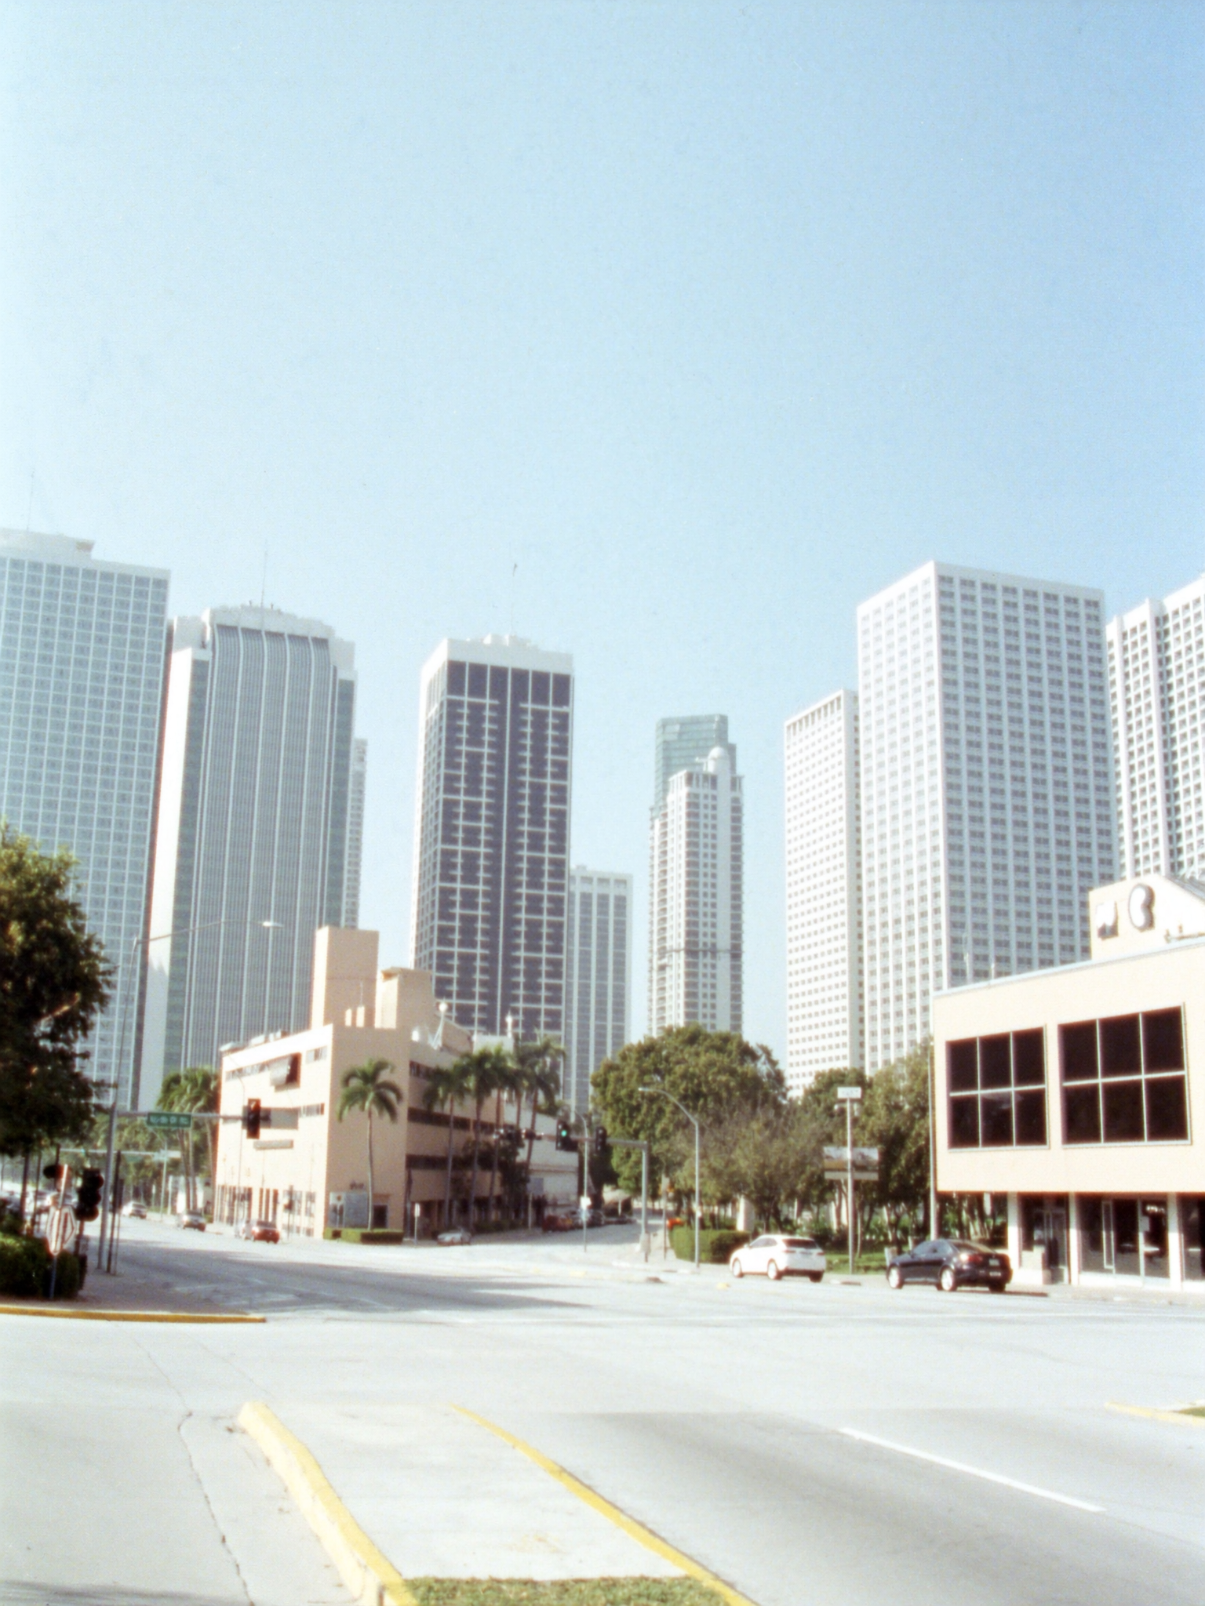
YOU SEE
FORT LAUDERDALE — BUYER EXPECTATIONS
FTL is too expensive for what I'd get.
— buyers comparing FTL to Miami prices without the neighborhood breakdown
3 / 3

