Slide 1
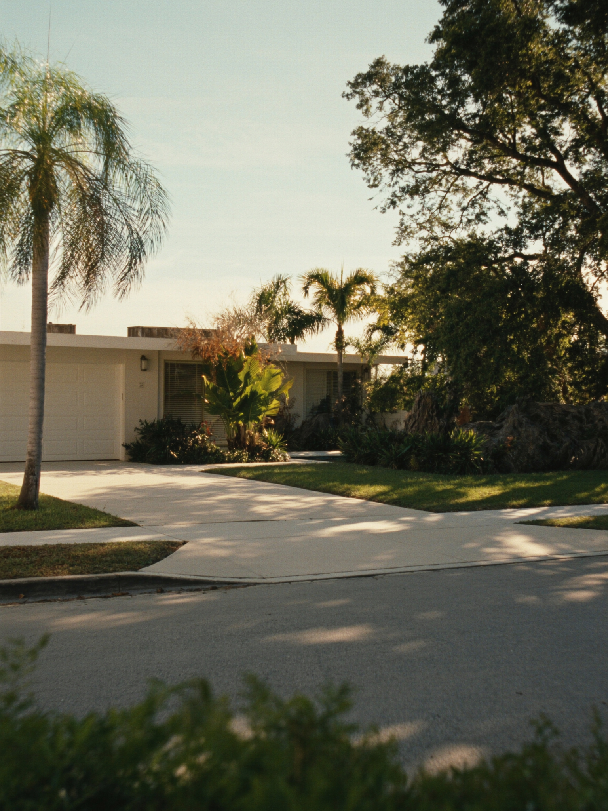
I SEE
FORT LAUDERDALE — BUYER EXPECTATIONS
Miami and Fort Lauderdale are 30 miles apart and two different pricing universes.
WHAT I'D SHOW FIRST
—
Coral Ridge interior (33305): $681K mid-tier. That's a 3-bedroom canal-adjacent mid-century home in a Michelin-restaurant neighborhood, with the beach 10 minutes away.
—
Lauderdale-by-the-Sea (33308): $519K mid-tier. Direct beach access, rental yield 5.9% gross, 798 active listings to choose from.
—
The comparison that sticks: similar product in coastal Miami commands 40-60% more. FTL is not expensive. FTL is underpriced relative to what you get.
3 / 3

