Slide 1
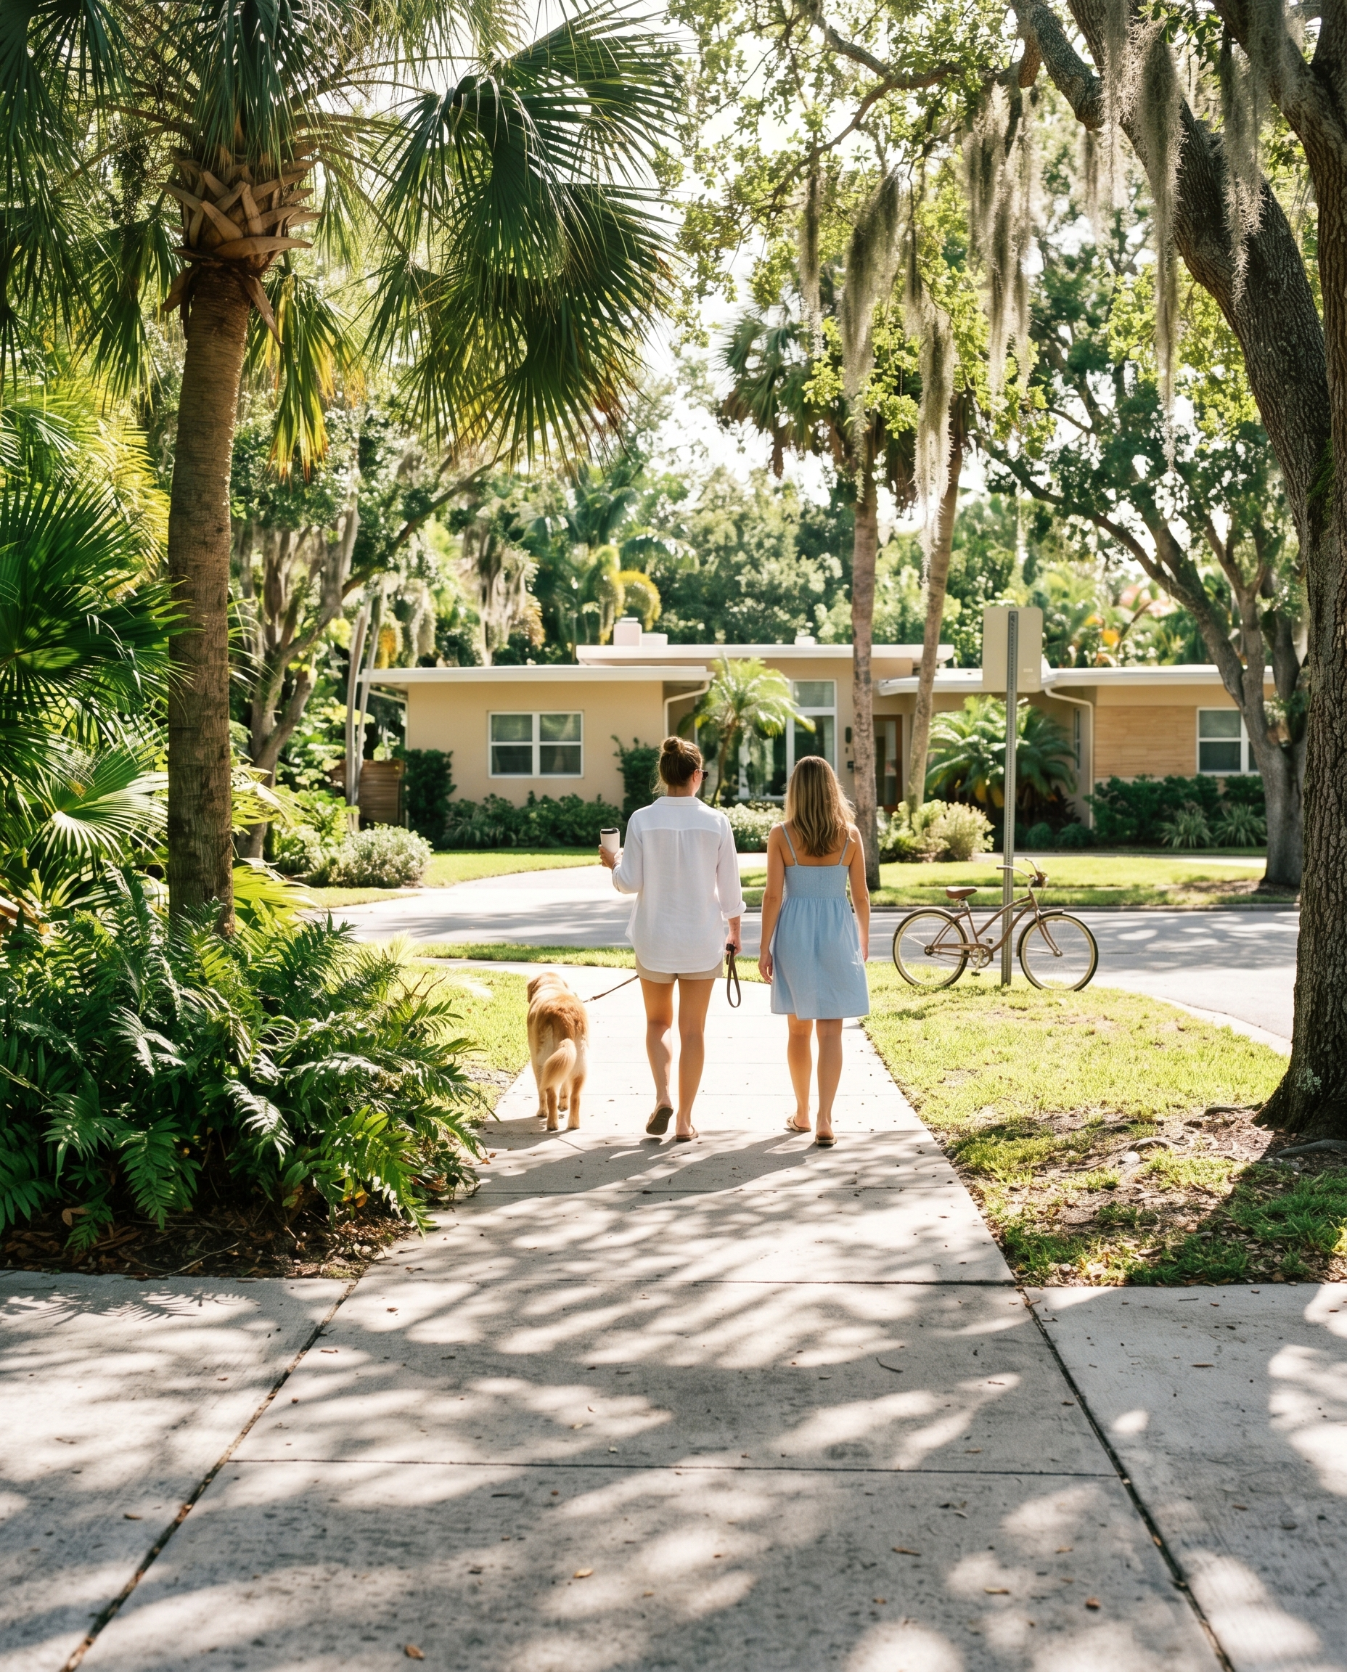
THE PARK RHYTHM
Holiday Park sits two blocks away.
Victoria Park runs between two different worlds: the Las Olas corridor to the south, Holiday Park and Coral Ridge to the north. The morning pace here — dogs, coffee, the occasional jogger — reflects both and hurries toward neither. Buyers who've lived in cities that move faster than they want tend to find their footing here.

