Slide 1
Farming Assistance Service
Course teacher: Dr. md. Razib hayat khan

Slide 2
Project Idea:
Project name: Farm Assistance Service
Background knowledge:
In many countries like Bangladesh, farm related person suffer most. To reduce suffering, we select project idea about farm assistance.
Benefits of Project:
Know about govt. free service
Get best seed
Share about all problem via post
Find all farming tutorial easily
Buy and sell product

Slide 3
What we have done for project modeling:
Overall Design :
Use case diagram
Mock design
Activity diagram
Class diagram
Project Management:
Jira
Github
Time Scheduling
Project Estimation

Slide 4
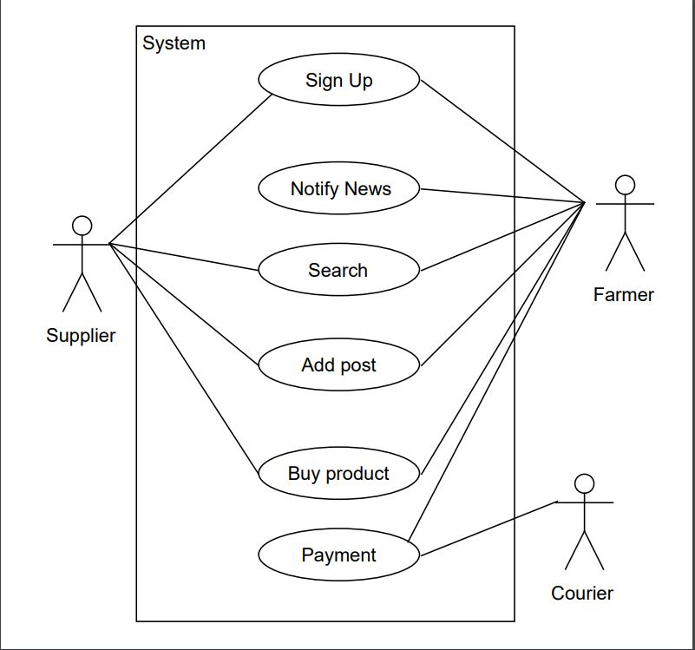
Use Case Diagram:
Actor:
Supplier
Farmer
Courier
System
Actions:
Sign up
Notify news
Search
Add post
Buy products
Payment

Slide 5
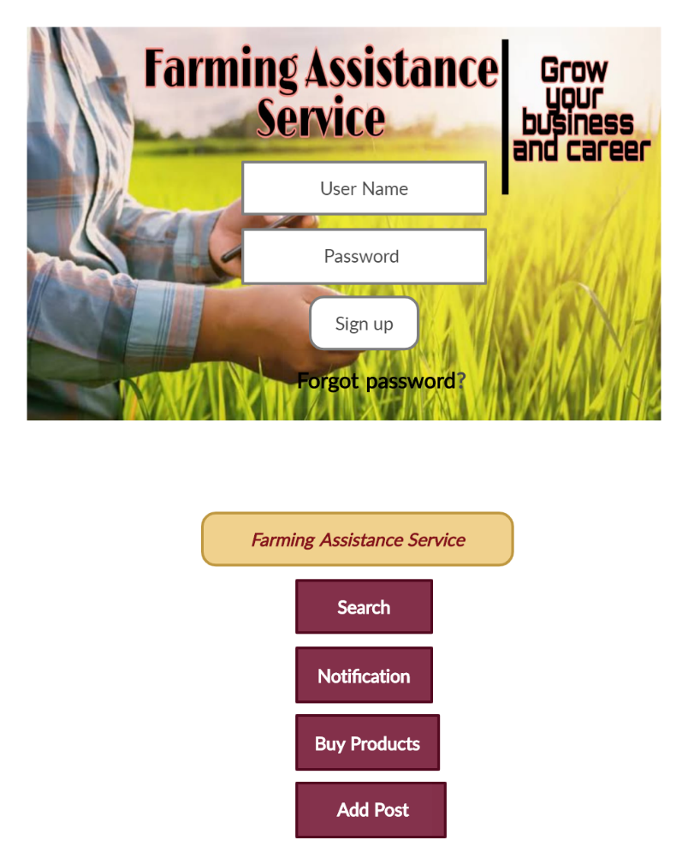
Mock Design:
Interface:
Search
Notification
Buy products
Add post

Slide 6
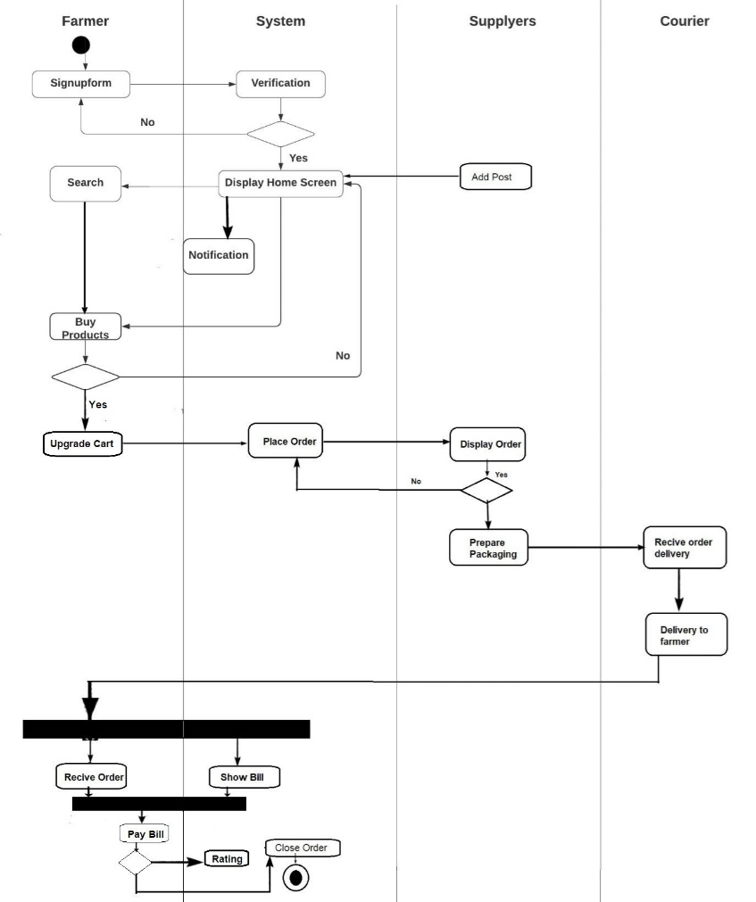
Activity Diagram:

Slide 7
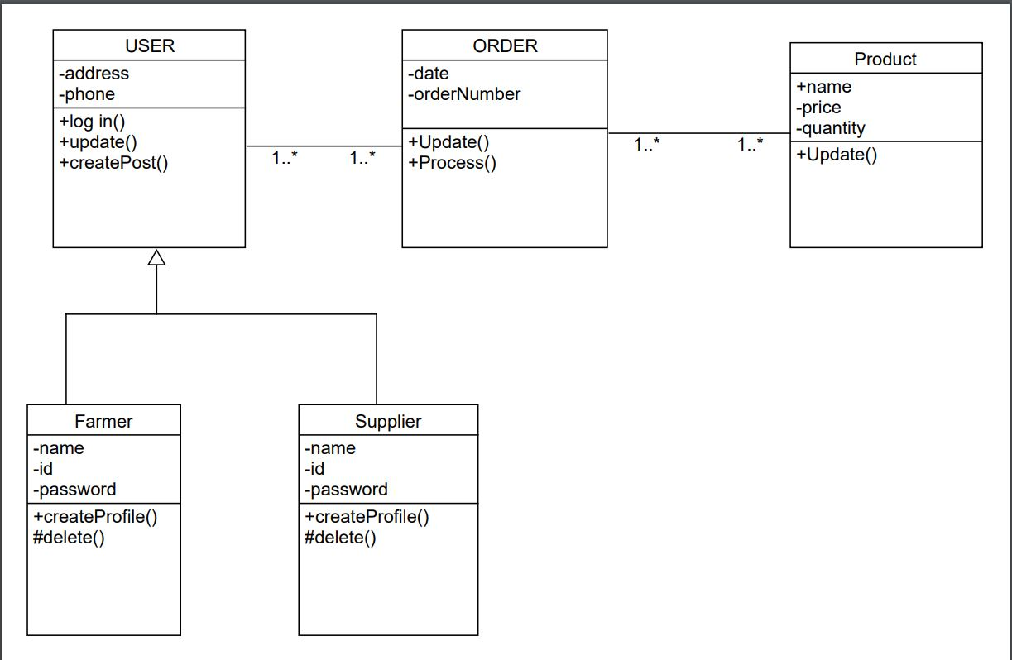
Class Diagram:

Slide 8
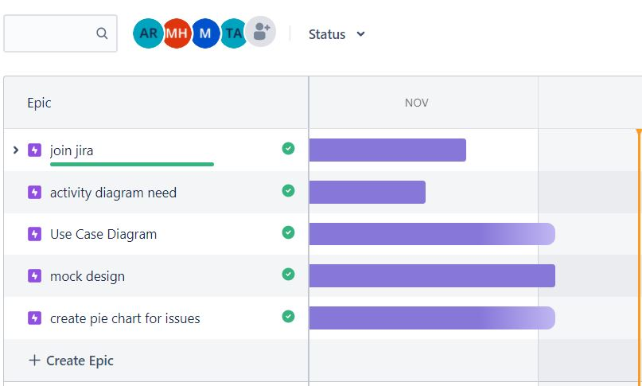
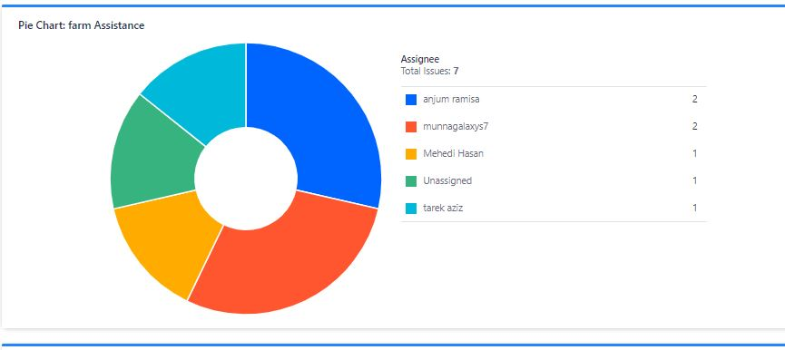
Jira:

Slide 9
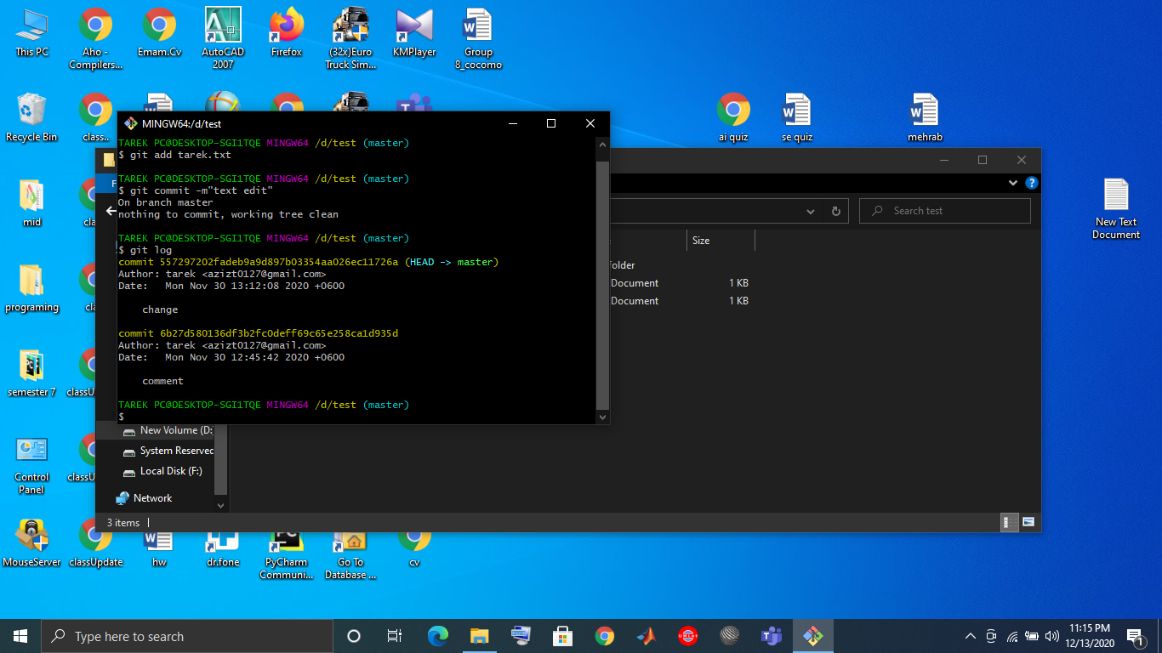
GitHub:
Some basic commands
git init (for initialization)
git add filename
git add .
git commit –m “message”
git log
git status
Some benefits of git :
Code reuse
Know about change and so on

Slide 10
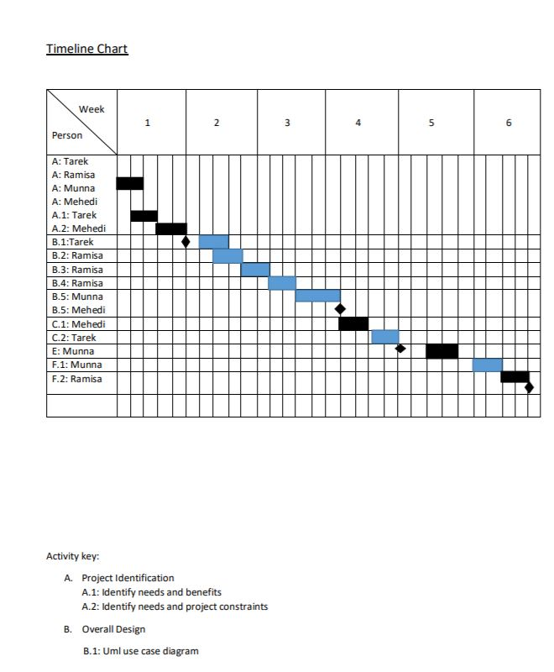
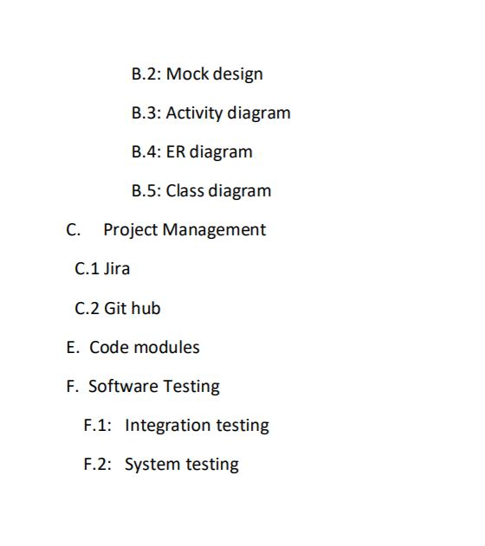
Time Scheduling:

Slide 11
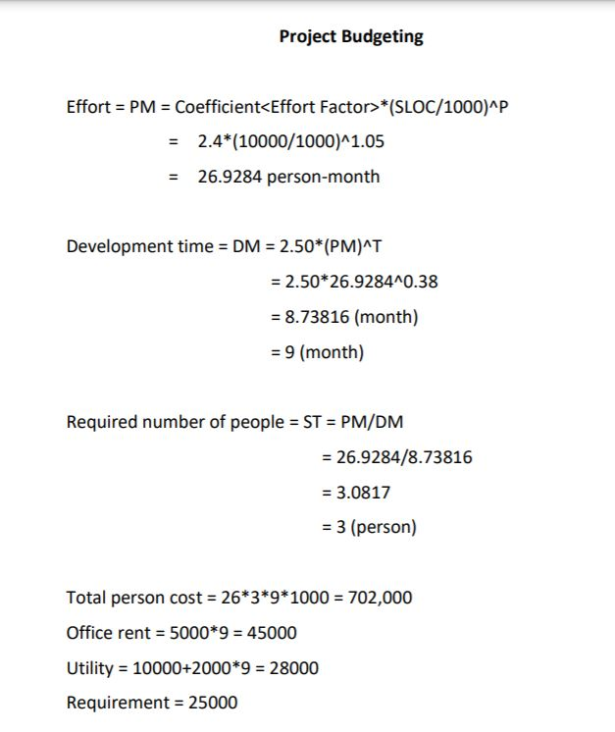
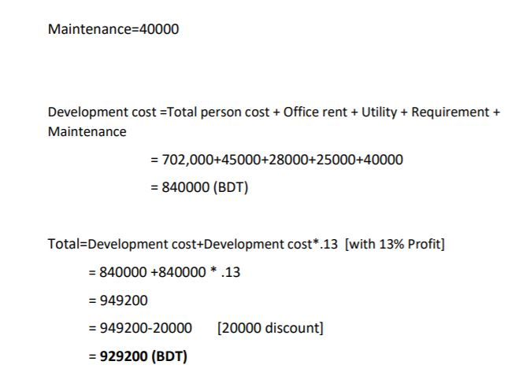
Project Budget Estimation:

