Slide 1
Does Commonsense help in detecting Sarcasm?
By Somnath Basu Roy Chowdhury, Snigdha Chaturvedi
Link to the paper:
https://aclanthology.org/2021.insights-1.2/
Group Number:
15
Group Members:
Ramisa Anan (ID: 19201101)
Ifrit Jamal Sneha(ID: 19201136)
Elizabeth Antora Modhu (ID: 18301075)
Arjun Suter (ID: 18101419)
Nuhash Ahmed Chowdhury (ID: 16301037)

Slide 2

What is sarcasm?
Sarcasm is the use of language that normally signifies the opposite in order to mock or convey contempt.
We have probably made this face when we try to know if someone is being sarcastic. It’s not easy to detect it for humans, how about machines?
Introduction
NLP tasks
Related work
Datasets
Example
COMET output, “I loved the movie so much that I left during the interval”. The common sense sequences capture the contrast between intent and action of the subject.

Slide 3

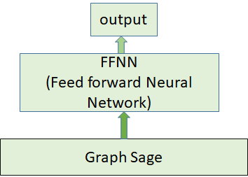
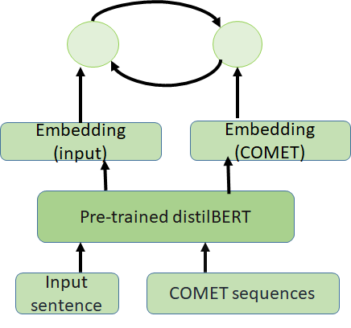
Model and Dataset
Proposed model architecture
DATASET | TRAINING | TEST
SemEval Irony | 3833 | 958
News Headline | 27691 | 27691
FigLang 2020 Reddit | 3520 | 880

Slide 4
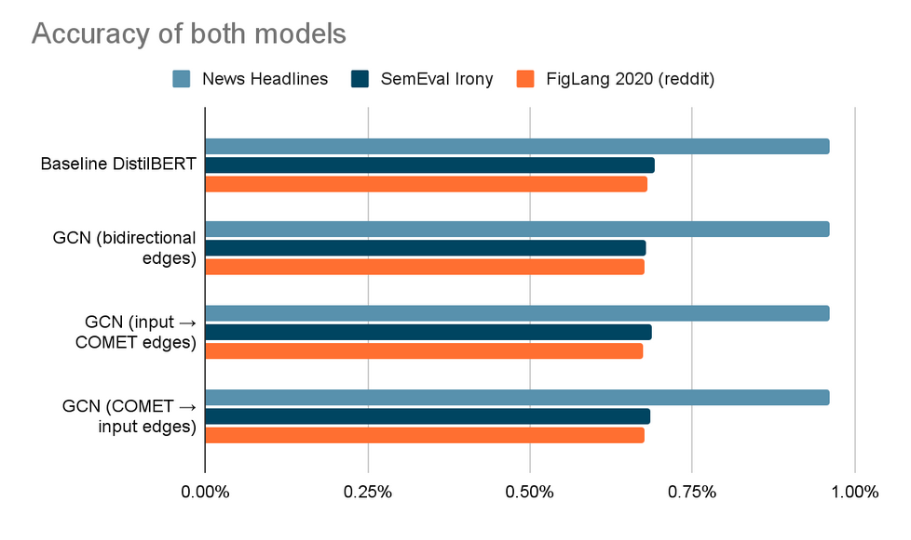
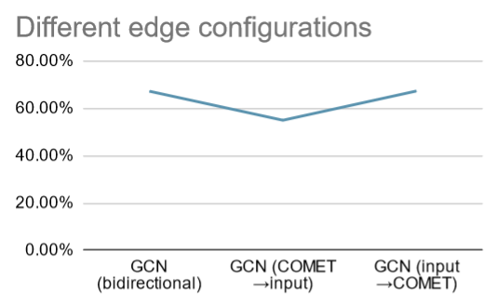
Experimental Setup and Results
In the Performance Chart of the proposed model (GCN) for different edge configurations, we observe a sharp performance drop in (COMET →input) configuration.
In the bar diagram of accuracy of the baseline DistilBERT and GCN model (in various edge configurations), we do not observe any significant change in sarcasm detection performance with the incorporation of commonsense sequences.

Slide 5

Saliency Test
(a) Gradient-based saliency
(b) Occlusion-based saliency
DATASET CNS GCN
News Headline 83.8%
SemEval Irony 64.6%
FigLang 2020 Reddit 96.8%
Efficacy of Commonsense
To measure the efficacy, a new measure non-sarcastic class coverage has been used:
Commonsense is only useful in detecting sarcasm with polarity contrast but struggles with other types of sarcasm.

Slide 6
Qualitative Analysis And Conclusion and Future work
Sequence cannot predict non-sarcasm.
COMET Sequence does capture contrast between intention and effect.
Even when detecting polarity contrast it still cannot properly detect or predict sarcasm,irony or satire.
In conclusion implementations and testing has proved that COMET sequencing is not better than the baseline models. Common sense knowledge is still important and needs to be explored further along with the inclusion of factual world knowledge in the future.

