Slide 1
MACHINE
LEARNING
Patient Segmentation
Using K-Means and
Hierarchical Clustering
Data Analysis
Healthcare Analytics
Unsupervised learning approach for discovering groups of similar patients from healthcare data.
Dataset
2,000 patients
Features
16 columns
Clustering
K-Means + Hierarchical
TEAM – 2
2520030031 –
2520030033 –
2520030045 –

Slide 2
1. Abstract
Project Overview
Abstract
This project applies unsupervised machine learning to segment patients into groups with similar characteristics. A dataset containing 2,000 patient records and 16 features is cleaned and preprocessed using missing-value handling, categorical encoding, and numerical feature scaling. K-Means clustering is used to form patient groups, while Hierarchical Clustering provides a second clustering approach for comparison. The Elbow Method and Silhouette Score are used to evaluate different cluster counts. PCA and a dendrogram are used to visualize the clustering structure. The final analysis identifies two clusters in the tested configuration and produces cluster profiles that highlight differences in age, BMI, chronic conditions, healthcare visits, billing, and preventive-care behavior.
Patient Segmentation | 2

Slide 3
2. Problem Statement & Objectives
Problem Statement
Healthcare datasets contain many patient characteristics, but predefined labels are not always available. The project aims to discover natural patient groups from demographic, physical, utilization, financial, and preventive-care features.
Objective
• Prepare and clean patient data
• Explore important patient characteristics
• Apply K-Means clustering
• Apply Hierarchical Clustering
• Evaluate cluster quality using Silhouette Score
• Visualize and interpret the resulting patient groups
Patient Segmentation | 3

Slide 4
3. Dataset & Features
Records
2,000 patient records
Features
16 columns
Learning Type
Unsupervised learning — no predefined cluster labels
Main Numerical Features
Age • Height • Weight • BMI
Chronic conditions • Annual visits
Average billing amount • Days since last visit
Preventive-care flag
Categorical Features
Gender • State • Insurance type • Primary condition
PatientID is treated as an identifier rather than a clustering feature.
Dataset file: patient_segmentation_dataset.csv
Patient Segmentation | 4

Slide 5
4. Data Preprocessing
1. Data Loading
Read the CSV dataset
2. Missing Values
Median for numerical data; most-frequent for categorical data
3. Encoding
One-hot encode categorical variables
4. Scaling
Standardize numerical features
5. Model Input
Create the final feature matrix for clustering
→
→
→
→
Why preprocessing matters: clustering is distance-based, so inconsistent scales or raw categories can distort similarity.
Patient Segmentation | 5

Slide 6
5. Exploratory Data Analysis
Age Distribution
The dataset contains patients across a broad adult age range.
BMI Distribution
BMI provides a physical-health feature that contributes to patient similarity.
Healthcare Utilization
Annual visits, billing, and days since last visit capture healthcare-use patterns.
EDA helps identify distributions and possible patterns before clustering.
Patient Segmentation | 6

Slide 7
6. Clustering Algorithms
K-Means Clustering
• Chooses K cluster centers
• Assigns each patient to the nearest center
• Recalculates centers iteratively
• Efficient for large datasets
• In this project, the tested scores selected K = 2
Hierarchical Clustering
• Builds a hierarchy of groups
• Starts from individual observations and merges similar groups
• Ward linkage is used
• Dendrogram visualizes the hierarchy
• K = 2 is used for direct comparison
Patient Segmentation | 7

Slide 8
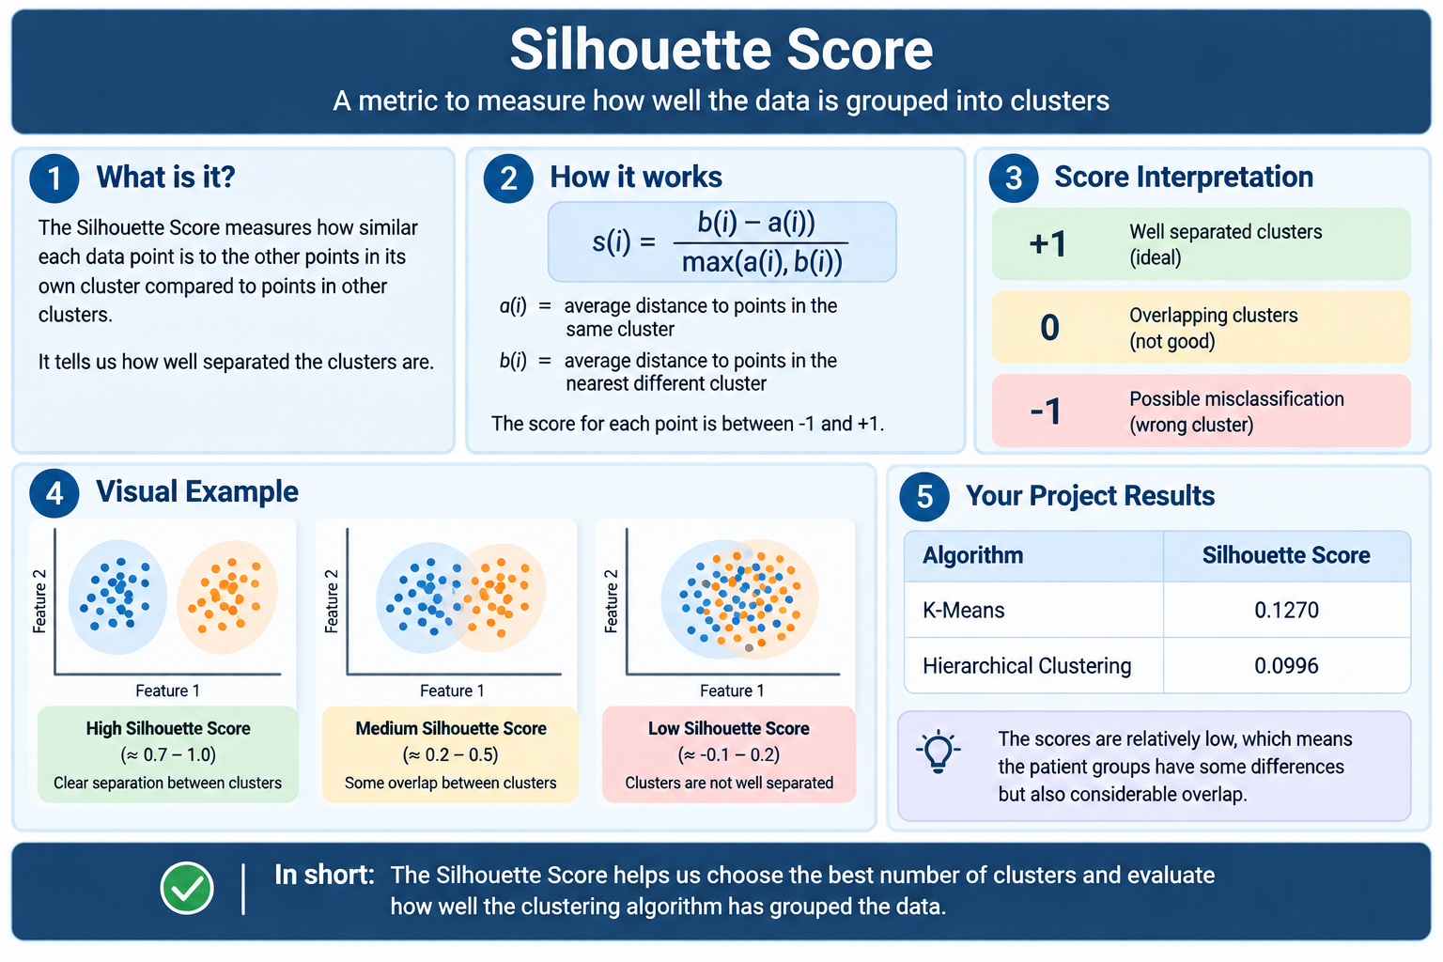
7. Silhouette Score
Cluster Evaluation
Patient Segmentation | 8

Slide 9
8. Results & Algorithm Comparison
Observed Result
Both methods produced 2 clusters in the final configuration. The K-Means score was 0.1270 and the Hierarchical score was 0.0996.
Interpretation
The scores indicate that the patient groups have some structure but also considerable overlap. Therefore, the clusters should be interpreted as broad data-driven segments rather than sharply separated clinical categories.
Patient Segmentation | 9

Slide 10
9. K-Means Cluster Profiles
Feature | Cluster 0 (Avg.) | Cluster 1 (Avg.)
Average Age | 35.90 | 59.35
Height (cm) | 169.90 | 166.74
Weight (kg) | 81.86 | 87.06
BMI | 28.88 | 31.82
Chronic Conditions | 1.42 | 2.31
Annual Visits | 3.12 | 5.67
Avg. Billing | 3420.15 | 5287.43
Days Since Last Visit | 78.62 | 142.36
Preventive Care Flag | 0.38 | 0.21
Patient Segmentation | 10

Slide 11
10. Cluster Interpretation
Cluster 0 — Profile
• Average age: 35.90 years
• Average BMI: 28.88
• Chronic conditions: 1.42
• Annual visits: 3.12
• Average billing: 3420.15
• Preventive-care flag: 0.38
Cluster 1 — Profile
• Average age: 59.35 years
• Average BMI: 31.82
• Chronic conditions: 2.31
• Annual visits: 5.67
• Average billing: 5287.43
• Preventive-care flag: 0.21
These labels describe observed data profiles; they are not medical diagnoses or treatment recommendations.
Patient Segmentation | 11

Slide 12
11. Applications & Benefits
Targeted Analysis
Identify broad patient groups with similar patterns for analytics and reporting.
Resource Planning
Use utilization and billing patterns to support data-driven planning.
Future Extensions
Add more clinical features, compare alternative clustering methods, and validate segments on external data.
The project demonstrates how unsupervised ML can reveal patterns that are difficult to see from raw records alone.
Patient Segmentation | 12

Slide 13
12. Conclusion & Future Scope
Conclusion
The project successfully processed 2,000 patient records and applied two unsupervised clustering techniques. K-Means and Hierarchical Clustering produced two broad patient segments in the tested configuration. Silhouette analysis and visualizations were used to evaluate and interpret the clustering structure. The resulting profiles show differences in age, BMI, chronic conditions, healthcare utilization, billing, and preventive-care behavior.
Future Scope
• Try K-Medoids, DBSCAN, or other clustering approaches
• Use clinically richer features and validated labels where available
• Explore mixed-data methods such as Gower distance or k-prototypes
• Build an interactive dashboard
• Validate segments on new patient data
Thank You
Patient Segmentation | 13

