Slide 1
Intrusion Detection Prevention Systems

Slide 2
Introduction
Intrusion Detection Systems (IDSs) will be obsolete very soon (if they aren't already). In it's place is something much more capable, an Intrusion Prevention System (IPS).
IPSs are not a new technology, they are simply an evolved version of IDS.
IPSs combine IDSs and improved firewall technologies, they make access control decisions based on application content, rather than IP address or ports as traditional firewalls had done.
Because IDS and IPS technologies offer many of the same capabilities, administrators can usually disable prevention features in IPS products, causing them to function as IDSs.

Slide 3
Definitions
Intrusions: attempts to compromise the confidentiality, integrity, availability, or to bypass the security mechanisms of a computer system or network( illegal access).
Intrusions have many causes, such as malware (worms, spyware, etc…), attackers gaining unauthorized access to systems from the Internet, and authorized users of systems who misuse their privileges or attempt to gain additional privileges for which they are not authorized.
Although many intrusions are malicious in nature, many others are not; for example: a person might mistype the address of a computer and accidentally attempt to connect to a different system without authorization.

Slide 4
Definitions
Intrusion detection: is the process of monitoring the events occurring in a computer system or network and analyzing them for signs of possible intrusions (incidents).
Intrusion detection system (IDS): is software that automates the intrusion detection process. The primary responsibility of an IDS is to detect unwanted and malicious activities.
Intrusion prevention system (IPS): is software that has all the capabilities of an intrusion detection system and can also attempt to stop possible incidents.

Slide 5
Why Intrusion Detection
Prevention Systems should be used?
It’s a dire fact that while every enterprise has a firewall, most still suffer from network security problems. IT professionals are acutely aware of the need for additional protective technologies, and network equipment vendors are anxious to fill in the gap.
Intrusion Prevention Systems have been promoted as cost-effective ways to block malicious traffic, to detect and contain worm and virus threats, to serve as a network monitoring point, to assist in compliance requirements, and to act as a network sanitizing agent.

Slide 6
Why Intrusion Detection
Prevention Systems should be used?
IDPSs are primarily focused on:
Identifying possible incidents, logging information about them, attempting to stop them, and reporting them to security administrators.
Identifying problems with security policies
Documenting existing threats
Deterring individuals from violating security policies.  

Slide 7
In addition, all types of IDPSs perform the following:
Recording information related to observed events. Information is usually recorded locally, and might also be sent to separate systems such as centralized logging servers, security information and event management (SIEM) solutions, and enterprise management systems.
Notifying security administrators of important observed events. This notification, known as an alert, may take the form of audible signals, e-mails, pager notifications, or log entries. A notification message typically includes only basic information regarding an event; administrators need to access the IDPS for additional information.
Producing reports. Reports summarize the monitored events or provide details on particular events of interest.

Slide 8
An IDPS might also alter the settings for when certain alerts are triggered or what priority should be assigned to subsequent alerts after a particular threat is detected.
IPSs respond to a detected threat by attempting to prevent it from succeeding. They use several response techniques:
The IPS stops the attack itself. Examples:
Terminate the network connection or user session that is being used for the attack. Block access to the target (or possibly other likely targets) from the offending user account, IP address, or other attacker attribute. Block all access to the targeted host, service, application, or other resource.

Slide 9
The IPS changes the security environment. The IPS could change the configuration of other security controls to disrupt an attack. Such as reconfiguring a network device (e.g., firewall, router, switch) to block access from the attacker or to the target, and altering a host-based firewall on a target to block incoming attacks. Some IPSs can even cause patches to be applied to a host if the IPS detects that the host has vulnerabilities.
The IPS changes the attack’s content. Some IPS technologies can remove or replace malicious portions of an attack to make it benign. An example is an IPS removing an infected file attachment from an e-mail and then permitting the cleaned email to reach its recipient.

Slide 10
Most IDPSs also offer features that compensate for the use of common evasion techniques. Evasion is modifying the format or timing of malicious activity so that its appearance changes but its effect is the same. Attackers use evasion techniques to try to prevent IDPSs from detecting their attacks.
For example: an attacker could encode text characters in a particular way, knowing that the target understands the encoding and hoping that any monitoring IDPSs do not. Most IDPSs can overcome common evasion techniques by duplicating special processing performed by the targets. If the IDPS can “see” the activity in the same way that the target would, then evasion techniques will generally be unsuccessful at hiding attacks.

Slide 11
Classes of detection methodologies:
Signature-based: compares known threat signatures to observed events to identify incidents.
This is very effective at detecting known threats but largely ineffective at detecting unknown threats and many variants on known threats.
Signature-based detection cannot track and understand the state of complex communications, so it cannot detect most attacks that comprise multiple events. Examples:
A telnet attempt with a username of “root”, which is a violation of an organization’s security policy
An e-mail with a subject of “Free pictures!” and an attachment filename of “freepics.exe”, which are characteristics of a known form of malware

Slide 12
Anomaly-based detection: sample network activity to compare to traffic that is known to be normal.
When measured activity is outside baseline parameters or clipping level, IDPS will trigger an alert.
Anomaly-based detection can detect new types of attacks.
Requires much more overhead and processing capacity than signature-based .
May generate many false positives.

Slide 13
For example: a profile for a network might show that Web activity comprises an average of 13% of network bandwidth at the Internet border during typical workday hours. The IDPS then uses statistical methods to compare the characteristics of current activity to thresholds related to the profile, such as detecting when Web activity comprises significantly more bandwidth than expected and alerting an administrator of the anomaly. Profiles can be developed for many behavioral attributes, such as the number of e-mails sent by a user, the number of failed login attempts for a host, and the level of processor usage for a host in a given period of time.

Slide 14
Stateful protocol analysis: A key development in IDPS technologies was the use of protocol analyzers.
Protocol analyzers can natively decode application-layer network protocols, like HTTP or FTP. Once the protocols are fully decoded, the IPS analysis engine can evaluate different parts of the protocol for anomalous behavior or exploits against predetermined profiles of generally accepted definitions of benign protocol activity for each protocol state.
Problems with this type include that it is often very difficult or impossible to develop completely accurate models of protocols, it is very resource-intensive, and it cannot detect attacks that do not violate the characteristics of generally acceptable protocol behavior.

Slide 15
For example: the existence of a large binary file in the User-Agent field of an HTTP request would be very unusual and likely an intrusion. A protocol analyzer could detect this anomalous behavior and instruct the IPS engine to drop the offending packets.
IDPS technologies cannot provide completely accurate detection. When an IDPS incorrectly identifies benign activity as being malicious, a false positive has occurred. When an IDPS fails to identify malicious activity, a false negative has occurred. It is not possible to eliminate all false positives and negatives; in most cases, reducing the occurrences of one increases the occurrences of the other.

Slide 16
Many organizations choose to decrease false negatives at the cost of increasing false positives, which means that more malicious events are detected but more analysis resources are needed to differentiate false positives from true malicious events. Altering the configuration of an IDPS to improve its detection accuracy is known as tuning.

Slide 17
Types of IDPSs
Network-based: perform packet sniffing and analyze network traffic to identify and stop suspicious activity. They are typically deployed inline. Like a network firewall. They receive packets, analyze them, decide whether they should be permitted, and allow acceptable packets to pass through.
Allow some attacks ,such as network service worms, e-mail.borne worms and viruses with easily recognizable characteristics (e.g., subject, attachment filename), to be detected on networks before they reach their intended targets (e.g., e-mail servers, Web servers).
Most products use a combination of attack signatures and analysis of network and application protocols.

Slide 18
Network-based products might be able to detect and stop some unknown threats through application protocol analysis.
Some products allow administrators to create and deploy attack signatures for many major new malware threats in a matter of minutes. Although poorly written signature triggers false positives that block benign activity, a custom signature can block a new malware threat hours before antivirus signatures become available.
However, network-based products are generally not capable of stopping malicious mobile code or Trojan horses.

Slide 19
Placement of Network IDPSs
Deployment options:
Outside firewall
Just inside firewall
-Combination of both will detect attacks getting through
firewall and may help to refine firewall rule set.
Behind remote access server
Between business units
Between corporate network and partner networks
Sensors may need to be placed in all switched
network segments

Slide 20
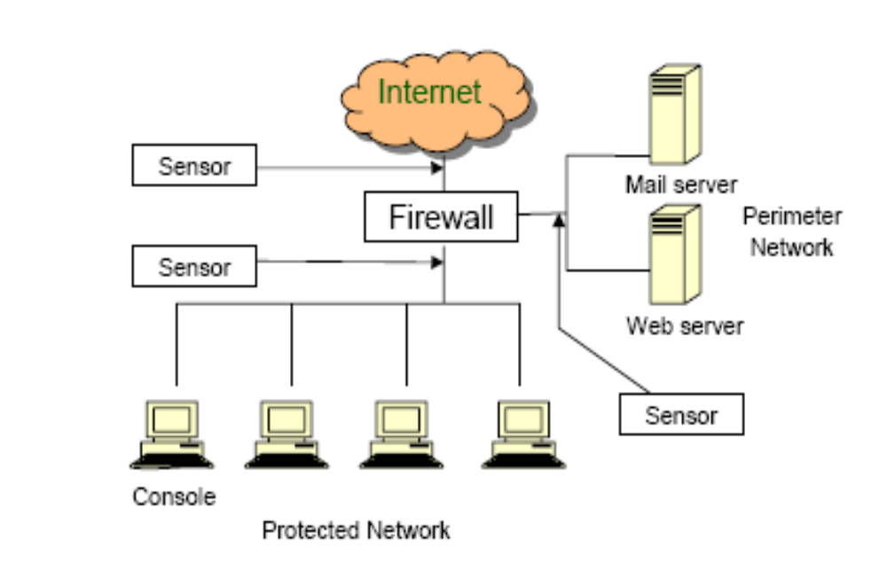

Slide 21
Types of IDPSs
Host-based: are similar in principle and purpose to network-based , except that a host-based product monitors the characteristics of a single host and the events occurring within that host, such as monitoring network traffic (only for that host), system logs, running processes, file access and modification, and system and application configuration changes.
They often use a combination of attack signatures and knowledge of expected or typical behavior to identify known and unknown attacks on systems.
If a host-based product monitors the host’s network traffic, it offers detection capabilities similar to a network-based.

Slide 22
Host-based IDPSs are most commonly deployed on critical hosts such as publicly accessible servers and servers containing sensitive information.
For example: attempted changes to files can be effective at detecting viruses attempting to infect files and Trojan horses attempting to replace files, as well as the use of attacker tools, such as rootkits, that often are delivered by malware.

Slide 23
Placement of host IDPSs
Deployment options:
Key servers that contain mission-critical and
sensitive information.
Web servers.
FTP and DNS servers.
E-commerce database servers, etc.
Other high value assets.
May also emplace these randomly to obtain probabilistic measure of hosts becoming compromised.

Slide 24
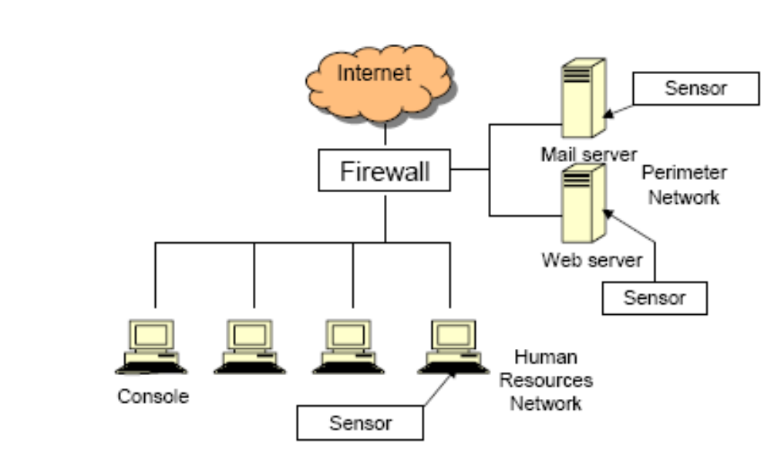

Slide 25
Types of IDPSs
Network Behavior Analysis (NBA): examines network traffic to identify threats that generate unusual traffic flows, such as denial of service (DoS) and distributed denial of service (DDoS) attacks, certain forms of malware (e.g., worms, backdoors), and policy violations (e.g., a client system providing network services to other systems).
NBA systems are most often deployed to monitor flows on an organization’s internal networks, and are also sometimes deployed where they can monitor flows between an organization’s networks and external networks (e.g., the Internet, business partners’ networks).

Slide 26
Before evaluating IDPS products organizations need to understand the characteristics of their system and network environments, so that a compatible IDPS can be selected that can monitor the events of interest on the systems and/or networks.
Organizations should articulate the goals and objectives they wish to attain by using an IDPS, such as stopping common attacks, identifying misconfigured wireless network devices, and detecting misuse of the organization’s system and network resources.
Organizations should also review their existing security policies, which serve as a specification for many of the features that the IDPS products need to provide.

Slide 27
Organizations should determine if they require IDPSs or other specific system security resources.
Organizations also need to define specialized sets of requirements for the following:
Security capabilities: including information gathering, logging, detection, and prevention.
Performance: including maximum capacity and performance features
Management: including design and implementation (e.g., reliability, interoperability, scalability, product security), operation and maintenance (including software updates), and training, documentation, and technical support Life cycle costs, both initial and maintenance costs.

