Slide 1
Audio2Tool
Speak, Call, Act — A Dataset for Benchmarking Speech Tool Use
Ramit Pahwa*, Apoorva Beedu*, Parivesh Priye, Rutu Gandhi†, Saloni Takawale†, Aruna Baijal, Zengli Yang
Rivian and Volkswagen Group Technologies * equal contribution · † equal contribution
Interspeech 2026 · Sydney · Oral session
arXiv:2604.22821 · audio2tool.github.io
Notes:
[0:00] Good afternoon. I am Ramit Pahwa from Rivian and Volkswagen Group Technologies. Today I will present Audio2Tool: a benchmark for a capability that is quickly becoming the centre of voice assistants: going straight from speech to an executable tool call. The title says it all: the user speaks, the model calls a tool, the device acts.

Slide 2

MOTIVATION
Voice assistants are becoming agents: the output is now an action
THEN · classify the intent
Speech
ASR
NLU
intent + slots
Rules / dialog
manager
intent = set_temperature
slot: value = 72
a label the app has to interpret
NOW · emit the executable call
Speech
SpeechLM
audio-native, single model
setZoneTemperature(zone="Driver",
temperature=72)
an action the device executes
Stricter correctness than SLU. A tool call must be schema-valid, fully specified, and correctly ordered. A semantically plausible output with one wrong argument is not "almost right"; it is the wrong action.
Audio2Tool · Interspeech 2026 · Sydney
2
Notes:
[0:30] For a decade, spoken language understanding meant classification. ASR produced text, an NLU module produced an intent and a few slots, and hand-written logic did the rest. Speech language models change the contract. The model now emits the action itself: an API call with typed arguments. That raises the bar for correctness. The call must be schema-valid, every argument must be right, and for multi-step requests the order matters. A near-miss is not partially right. It is a wrong action, in a car, at highway speed.

Slide 3




MOTIVATION
Speech adds failure modes that text benchmarks never see
Phonetic ambiguity
In-the-wild acoustics
Self-repair
Competing speakers
"Fifteen" vs. "fifty", "seventy-two" vs. "seventy". Arguments are where sound-alikes bite.
Engine, road, wind, HVAC, rain, turn signals, babble. Signal-to-noise can go negative.
People change their mind mid-sentence. The final state, not the first mention, is the intent.
Background speech carries valid commands. Only the primary speaker should be obeyed.
"Set the fan to fifteen" → setCabinFanLevel(50)?
−5 dB SNR on the highway
"Set an alarm for 7… wait, make it 8."
Driver: "Navigate home."
Radio: "Set temperature to 72."
Errors here do not produce a wrong label. They produce a wrong action: the wrong temperature, the wrong door, the wrong destination.
Audio2Tool · Interspeech 2026 · Sydney
3
Notes:
[1:30] And speech adds failure modes that text never sees. "Fifteen" and "fifty" are one phoneme apart, but one is a comfortable cabin and the other is not. Real cabins have engine, wind and HVAC noise. People repair themselves mid-utterance: "set an alarm for seven... wait, make it eight". And there are other voices in the room: a podcast, a passenger, a radio ad, carrying perfectly valid commands that the system must not execute. In every one of these cases the error does not produce a wrong label. It produces a wrong action.

Slide 4
MOTIVATION
Existing benchmarks each cover part of the problem
 | Speech input | Executable tool calls | Multi-intent & multi-turn | Accent & noise diversity | Diagnostic complexity tiers
Text function calling BFCL, ComplexFuncBench | No | Yes | Yes | No | Limited
Spoken language understanding SLURP, STOP, MAC-SLU | Yes | No (intents + slots) | Limited | Limited | No
Audio tool use BFCL-Audio, VoiceAgentBench, MFCL | Yes | Yes | Limited | Limited | No
Audio2Tool this work | Yes | Yes | Yes (8 tiers) | Yes (330 voices, noise) | Yes
Complementary, not competing. Audio2Tool keeps the executable-call formalism of BFCL, but makes the input spoken, acoustically diverse, and organised so each tier isolates a distinct failure mode.
Audio2Tool · Interspeech 2026 · Sydney
4
Notes:
[2:30] Existing resources cover pieces of this. Text function-calling benchmarks such as BFCL define the executable formalism, but have no audio. Classic SLU corpora, SLURP, STOP, MAC-SLU, are spoken, but they label intents and slots rather than executable calls. Recent audio tool-use sets, BFCL-Audio, VoiceAgentBench, MFCL, bring speech and executable calls together, but they are narrow in domain and acoustic conditions, and they do not tell you why a model fails. We wanted all five columns at once, and we wanted the benchmark to be diagnostic: to isolate failure modes rather than report one aggregate number.

Slide 5
BENCHMARK
Audio2Tool at a glance
~30K
152
23
3
spoken queries, each with a gold tool call
verified tools grounded in real APIs
functional categories
domains: smart car · smart home · wearables
8
330
2
8+
complexity tiers, one failure mode each
cloned voices from 4 corpora, 4 regions
zero-shot voice-cloning TTS engines
noise sources: engine, road, wind, HVAC, rain…
Dataset, benchmark code and audio samples: audio2tool.github.io
Audio2Tool · Interspeech 2026 · Sydney
5
Notes:
[3:30] So here is Audio2Tool in numbers. Roughly thirty thousand queries, each with a gold tool call, over 152 tools in 23 categories across three domains: smart car, smart home and wearables. Eight complexity tiers. 330 cloned voices produced by two zero-shot TTS engines, mixed with real in-car and indoor noise. To our knowledge this is the first speech-to-tool benchmark with this combination of domain breadth, acoustic diversity and tiered complexity. Samples are at audio2tool.github.io.

Slide 6
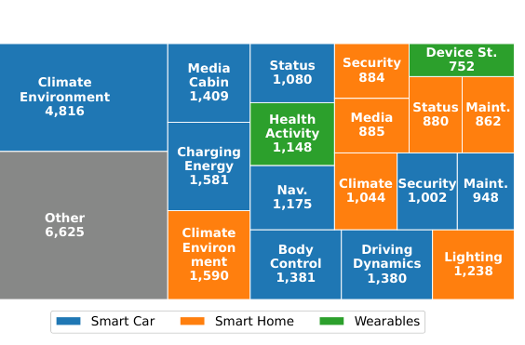



BENCHMARK
Taxonomy grounded in real APIs: 3 domains, 23 categories, 152 tools
Smart Car
setZoneTemperature(zone, temp)
openFrontTrunk()
14 categories · climate, driving dynamics, charging, body control, navigation, maintenance…
Smart Home
setLightState(device, state)
armSecuritySystem(mode)
lighting, appliances, automation sensors, security, media…
Wearables
startWorkout(activity)
setDoNotDisturb(enabled, mode)
health & activity tracking, device state and connectivity
Query share by category (paper Fig. 2c)
Operational intent state-altering ("set temperature") vs. monitoring ("check battery")
Domain specificity device-specific categories kept (driving dynamics, activity tracking)
Audio2Tool · Interspeech 2026 · Sydney
6
Notes:
[4:15] The taxonomy is grounded in real, public APIs: Android Automotive functionality, smart-home device standards, wearable SDKs. Smart Car is the largest domain with 14 categories, from climate and driving dynamics to charging and maintenance, because hands-free in-cabin use is where mistakes are most costly. Two design rules. First, operational intent: we separate state-altering commands like "set temperature" from passive monitoring like "check battery". Second, domain specificity: device-specific categories such as driving dynamics or activity tracking are kept, not flattened. The treemap on the right shows how queries distribute over categories; climate and environment dominate, as they do in real usage.

Slide 7
BENCHMARK
Eight tiers, eight failure modes
1
Direct
2
Parametric
3
Multi-intent
4
Implicit
Short command, no parameters (2–6 words)
Explicit slot values to extract (3–12 words)
2–3 tool calls in one utterance, in order
State or complaint; the tool is only implied
"Open the trunk."
"Set the temperature to 72."
"Defrost the windshield and find a charger."
"I'm freezing."
5
Needle in a haystack
6
Correction
7
Conversation
8
Intent blending
Intent buried in 25–60 words of tangent
Mid-utterance repair; the final state wins
Multi-turn USER/AGENT dialogue, 20–200 words, persistent state
Background speaker carries a second, valid command
"…anyway, long day, could you… oh, lock the doors."
"Set an alarm for 7… wait, make it 8."
"…and the same for the passenger seat."
Driver: "Navigate home."
Radio: "Set temperature to 72."
● Basics (T1–T2) ● Composition & inference (T3–T4) ● Realism: long context, repair, dialogue, competing speakers (T5–T8)
Audio2Tool · Interspeech 2026 · Sydney
7
Notes:
[5:15] Queries are organised into eight tiers, and each tier isolates a failure mode. Tiers 1 and 2 test the basics: pick the right tool, extract explicit parameters. Tiers 3 and 4 test composition and pragmatic inference; "I am freezing" contains no tool name at all. Tiers 5 to 8 test realism: an intent buried in 25 to 60 words of rambling, mid-utterance corrections, multi-turn USER/AGENT dialogue with persistent state, and, unique to audio, intent blending, where a background speaker issues a valid but unwanted command. Tier 8 is fundamentally a speaker-attribution problem, and it cannot be posed in text.

Slide 8




BENCHMARK
From taxonomy to ~30K verified queries
Queries per tier
1. Tier-specific prompting
GPT-5.2 · Gemini 2.5 Pro · Claude Opus generate queries over the 152-tool taxonomy, with gold tool call(s) and arguments
2. LLM-as-judge (disjoint models)
GPT-5.1 · Gemini 2.5 Pro score correctness, difficulty and variability; never the same models that generated
3. Manual verification
Every query a judge failed was checked by hand, together with its ground-truth tools
4. Gold labels per tier
Tier 3 composition: 2 calls 61.8% · 3 calls 36.2% · 4–5 calls 1.9%
Smart Car is the majority domain in every tier (paper Fig. 2a).
tool call(s) + arguments, plus correction type (T6), reasoning (T4/T5/T7), primary-speaker calls (T8)
Audio2Tool · Interspeech 2026 · Sydney
8
Notes:
[6:30] How were the queries built? Tier-specific prompts over the 152-tool taxonomy, using three frontier LLMs: GPT-5.2, Gemini 2.5 Pro and Claude Opus. A disjoint set of judge models, GPT-5.1 and Gemini 2.5 Pro, scored every query for correctness, difficulty and variability, and every query a judge flagged was manually checked, including its ground-truth tool call. On the right you see the distribution. Tiers 3 to 7 have 4,560 queries each. Tier 2 is the largest, 5,800, because parameter coverage needs volume. Tier 8 has 1,000. Within Tier 3, 62% of queries need two calls, 36% need three, and a small tail needs four or five.

Slide 9



BENCHMARK
Making it sound real: 330 cloned voices, real noise
Speaker pool: ~60K voices, 4 corpora
Speaker corpora (paper Table 2)
SPGISpeech 2.0 · Emilia-YODAS · 3D-Speaker · VoxPopuli
Corpus | Speakers | Regions | Selected
SPGISpeech 2.0 | 41,593 | US, Asia, Latin America | 100
Emilia-YODAS | 7,092 | US, China | 100
3D-Speaker | 10,000 | China | 30
VoxPopuli | 1,180 | US, Europe | 100
Total | 59,865 | 4 regions | 330
Stratified + farthest-point sampling
on speaker embeddings → 330 speakers, US · Europe · Asia · Latin America
Zero-shot voice-cloning TTS
Qwen3-TTS and CosyVoice-3 render every query in m sampled voices
Algorithm 1, in one line
S ← FPS({f(s)}, K)
for q in Q: for s in sample(S, m):
ã ← Mix(TTS(q, s), n), n ~ N
Noise mixing
engine · road · wind · HVAC · rain · turn signal · cabin · room
Every query is heard in several voices and acoustic conditions.
Audio2Tool · Interspeech 2026 · Sydney
9
Notes:
[7:15] For the audio, we clone 330 voices selected from a pool of almost 60,000 speakers across four public corpora covering the US, Europe, Asia and Latin America. Selection is stratified by region, then farthest-point sampling on speaker embeddings, so we keep maximal accent diversity while controlling benchmark size. Two zero-shot voice-cloning TTS engines, Qwen3-TTS and CosyVoice-3, render each query in several voices, and we mix in automotive and indoor noise: engine, road, wind, HVAC, rain, turn signals, cabin and room sounds. Synthetic speech is a limitation we state openly, and real recordings are the next step; but this is, to our knowledge, the broadest accent and acoustic coverage in a speech tool-calling benchmark.

Slide 10


EXPERIMENTS
Evaluation protocol: two system families, three metrics
End-to-end SpeechLMs · audio → tool call
Three metrics, one worked example
gold setZoneTemperature(zone="Driver", temperature=72)
pred setZoneTemperature(zone="Driver", temperature=27)
Qwen3-Omni-30B · Qwen2.5-Omni-7B · Kimi-Audio-7B
Step-Audio-2-7B · Audio-Flamingo-3-8B
Open weights only · 7B to 30B · zero-shot with tool definitions in the prompt
1
Tool Accuracy
Right tool name(s), in the right order
Cascaded · audio → Whisper-v3 → text LLM
0
Exact Match
Qwen3 1.7B / 4B / 8B · Gemma-3 12B / 27B
Whole call identical after normalisation
+ Oracle transcript: gold text → same LLMs. Upper bound that isolates ASR damage.
0.5
Parameter F1
Tier 8 (intent blending) is audio-only and is not scored for text/oracle systems.
Micro-averaged over arguments (1 of 2 correct)
Audio2Tool · Interspeech 2026 · Sydney
10
Notes:
[8:00] We evaluate two families, zero-shot, open weights only. End-to-end SpeechLMs from 7 to 30 billion parameters: Qwen3-Omni, Qwen2.5-Omni, Kimi-Audio, Step-Audio-2 and Audio Flamingo 3. And cascades: Whisper-v3 transcripts fed with the tool definitions to Qwen3 or Gemma-3 text models. Plus an oracle that feeds the gold transcript to the same text models, which isolates the damage done by ASR. Three metrics. Tool accuracy: did you pick the right tool, in the right order? Exact match: is the entire call, tools and every argument, exactly right after normalisation? And parameter F1 over arguments. In the worked example, one of two arguments is right, so tool accuracy is 1, exact match is 0, and parameter F1 is 0.5.

Slide 11
RESULTS · FINDING 1
Tool accuracy collapses when the query needs composition or inference
92% → 33%
best model, direct command (T1) → implicit intent (T4)
T5 ≈ 91%
long, rambling input alone is not the problem
≤ 56%
everyone, on conversation (T7) and intent blending (T8)
Length is cheap; reasoning is expensive.
Audio2Tool · Interspeech 2026 · Sydney
11
Notes:
[9:00] Finding one. On direct commands the best model, Qwen3-Omni-30B, picks the right tool 92% of the time. Add composition, two or three calls in one utterance, and it drops to 75%. Implicit intent, "I am freezing", drops it to 33%. Notice Tier 5: a long rambling input alone is fine, 91%. So length is not the problem; reasoning is. Conversation and intent blending land at 55 and 42%. The same shape holds for every model, with smaller 7B models 15 to 20 points lower across the board.

Slide 12
RESULTS · FINDING 2
Right tool, wrong arguments: exact match ≤ 16% even on plain parametric commands
~80%
pick the right tool
10–16%
get every argument right
Not an ASR problem. With a perfect transcript (oracle), Gemma-3-12B still reaches only 12.3% exact match.
The bottleneck is argument grounding: units, ranges, enumerations, defaults.
Audio2Tool · Interspeech 2026 · Sydney
12
Notes:
[10:00] Finding two, and the one I would underline. Look at Tier 2, plain parametric commands like "set the temperature to 72". Tool accuracy is around 80% for everyone. Exact match is 10 to 16%. Models know what to call; they get the arguments wrong. And crucially, look at the last pair: Gemma with a perfect, oracle transcript is at 12%. So this is not an ASR problem. It is argument grounding and normalisation: units, ranges, enumerations, defaults. If you build voice agents, this is where the work is.

Slide 13
RESULTS · FINDING 3
End-to-end SpeechLMs do not yet beat a strong cascade
Tool accuracy (%) · end-to-end wins 6 of 8 tiers
Parameter F1 (%) · cascade wins 5 of 7 tiers
Audio-native models hear the intent; text models still fill the arguments better. And ASR is not free: gold transcripts add 10–14 points of tool accuracy to the cascade (backup).
Audio2Tool · Interspeech 2026 · Sydney
13
Notes:
[11:00] Finding three: end-to-end has not yet earned its promise. Compare the best SpeechLM, Qwen3-Omni-30B, with the strongest cascade, Whisper plus Gemma-3-27B. On the left, tool accuracy: the SpeechLM picks the right tool more often on six of eight tiers. On the right, parameter F1: the cascade fills arguments better on five of seven tiers, by 10 to 20 points on corrections and dialogue. So audio-native models hear the intent, but the text model is still the better argument filler. ASR is far from free, though: replacing Whisper with gold transcripts buys the cascade 10 to 14 points of tool accuracy on Tiers 2 to 7; that is in the backup slides.

Slide 14
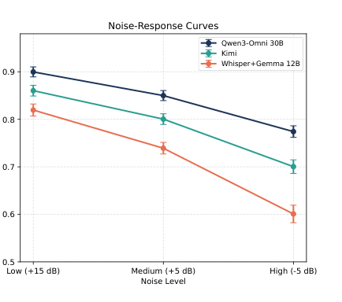

RESULTS · FINDING 4
Noise degrades every system, and the cascade degrades fastest
3 noise families × 3 SNR levels
Babble, mechanical hum, impulsive (MS-SNSD) at +15, +5 and −5 dB
Monotonic degradation for everyone
F1 falls steadily from low to high noise for every system tested
Cascades compound ASR errors
Whisper + Gemma-3-12B loses the most; Qwen3-Omni-30B is the most robust
So noise is in the benchmark
Multiple noise types and levels are part of the released data, not just this ablation
Intent-classification F1 vs. noise level (paper Fig. 3, right). Error bars: std. over noise types.
Audio2Tool · Interspeech 2026 · Sydney
14
Notes:
[12:00] Finding four: noise. We ablate three noise families from MS-SNSD, babble, mechanical hum and impulsive noise, at three levels: plus 15, plus 5 and minus 5 dB SNR. Every system degrades monotonically as SNR falls. The cascade degrades fastest, because Whisper errors compound downstream. Qwen3-Omni-30B is the most robust, but still loses substantially at minus 5 dB. That is exactly why noise is built into the benchmark distribution, not left as an ablation: a voice agent that only works in a quiet lab is not a voice agent.

Slide 15



TAKEAWAYS
What Audio2Tool tells us about speech tool use today
Tool selection is nearly solved for direct commands
Next
>90% for the best model on Tier 1
Real recordings
beyond zero-shot cloned speech
Argument grounding is the bottleneck (not ASR)
Exact match ≤16% on parametric commands, even with gold transcripts
Safety-critical scenarios
where a wrong action has real cost
Composition, implicit intent, competing speakers: open
Broader domains, languages
Tiers 3–4 and 7–8 sit at 33–75% tool accuracy; long input alone is fine
and per-accent, per-noise breakdowns
End-to-end does not yet beat a strong cascade
Use the tiers
report where a model fails, not just its average
SpeechLMs pick tools better; text LLMs fill arguments better; noise hurts cascades most
Audio2Tool · Interspeech 2026 · Sydney
15
Notes:
[12:45] So, four takeaways. Tool selection on simple commands is nearly solved; argument grounding is not, and it is not an ASR problem. Composition, implicit intent and multi-speaker audio are the open problems; long input by itself is fine. End-to-end SpeechLMs do not yet beat a strong cascade, so the audio-native promise is still unrealised. And robustness has to be measured, not assumed. Next, we are adding real recordings, safety-critical scenarios and more domains, and we hope the community will use the tiers to report where their models fail, not just how well they do on average.

Slide 16





Speak. Call. Act.
Dataset, evaluation harness and audio samples are released.
We would love to see your model on the leaderboard, one tier at a time.
audio2tool.github.io samples, dataset, benchmark
arXiv:2604.22821 paper
audio2tool.github.io
github.com/RamitPahwa/Audio2Tool code
listen to Tier 6, 7 and 8 samples
ramitpahwa@rivianvw.tech contact
Thank you · Questions?
Notes:
[13:45] Data, benchmark code and audio samples are at audio2tool dot github dot io; the QR code takes you there. Thank you, and thanks to my co-authors Apoorva, Parivesh, Rutu, Saloni, Aruna and Zengli. I am happy to take questions.

Slide 17
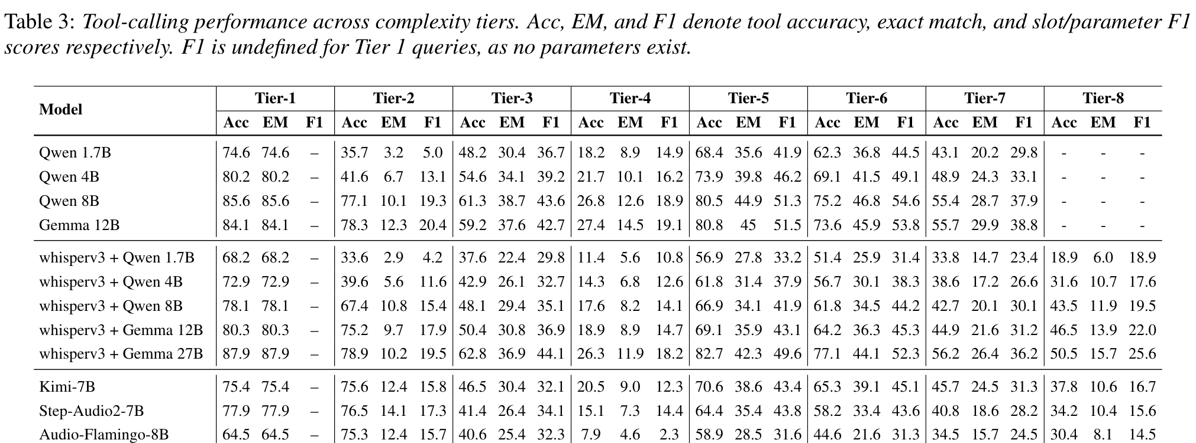
BACKUP
Full results by tier (paper Table 3)
Rows 1–4: oracle (gold transcript) + text LLM · rows 5–9: Whisper-v3 + text LLM · rows 10–14: end-to-end SpeechLMs. Acc = tool accuracy, EM = exact match, F1 = parameter F1. F1 undefined for Tier 1 (no parameters).
Audio2Tool · Interspeech 2026 · Sydney
17
Notes:
Backup. Full Table 3 from the paper. Top block: oracle transcripts fed to text LLMs. Middle: Whisper-v3 cascades. Bottom: end-to-end SpeechLMs. Tier 8 is not scored for text systems because intent blending is an audio phenomenon.

Slide 18
BACKUP
The ASR tax: gold transcripts add 10–14 points of tool accuracy to the same LLM
Qwen3-8B gap
(gold − Whisper)
T1 +7.5
T2 +9.7
T3 +13.2
T4 +9.2
T5 +13.6
T6 +13.4
T7 +12.7
points of tool accuracy recovered with perfect ASR
Audio2Tool · Interspeech 2026 · Sydney
18
Notes:
Backup. Same text LLM, two inputs: Whisper-v3 transcript versus the gold transcript. For Qwen3-8B the gap is 7 points on direct commands and 10 to 14 points on Tiers 2 to 7; Gemma-3-12B shows the same pattern. This is the cost the cascade pays for ASR, and it is the headroom an audio-native model could in principle recover.

Slide 19
BACKUP
Audio2Tool vs. SLU corpora (paper Table 1)
Dataset | Domains | Intents / tools | Slots / parameters | Multi-intent | Output
ATIS | 1 | 16 | 41 | No | intent + slots
SNIPS | 2 | 7 | 4 | No | intent + slots
FSC | 2 | 6 | 2 | No | intent + slots
SLURP | 18 | 46 | 56 | No | intent + slots
MixATIS | 1 | 16 | 41 | Yes | intent + slots
MixSNIPS | 2 | 7 | 4 | Yes | intent + slots
MAC-SLU | 8 | 81 | 192 | Yes | intent + slots
Audio2Tool | 3 | 152 | 22 | Yes | executable tool call(s)
Slot count is lower by construction: tool arguments are typed parameters with constrained ranges, not free-text spans.
Audio2Tool · Interspeech 2026 · Sydney
19
Notes:
Backup. Against classic SLU corpora, Audio2Tool spans fewer domains but a much larger intent space, 152 tools, and it explicitly models multi-intent queries. The slot count is lower because tool arguments are typed parameters rather than free-text slots.

Slide 20
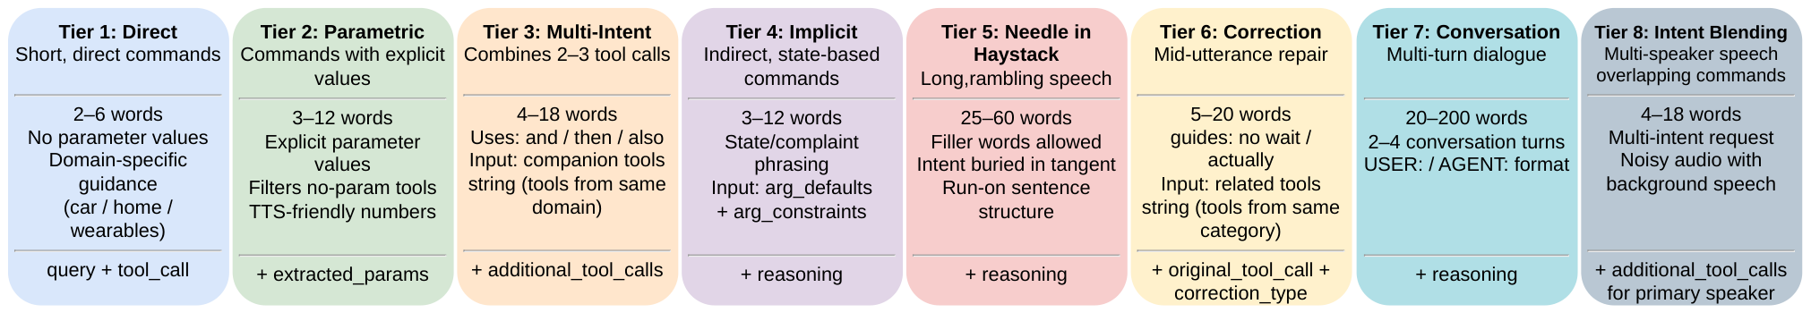
BACKUP
Tier generation details: word budgets, prompt inputs and label fields (paper Fig. 1)
Generators GPT-5.2 · Gemini 2.5 Pro · Claude Opus
Judges (disjoint) GPT-5.1 · Gemini 2.5 Pro: correctness, difficulty, variability
Verification manual check of every judge-flagged query and its gold tools
TTS Qwen3-TTS · CosyVoice-3, zero-shot voice cloning; noise mixed per Algorithm 1
Audio2Tool · Interspeech 2026 · Sydney
20
Notes:
Backup. The generation recipe per tier: word budgets, what the generator sees, and which extra fields the gold label carries. Tier 6 labels store both the original call and the correction type; Tier 8 labels store additional tool calls attributed to the primary speaker only.

