Slide 1
COVID VACCINATION PROGRESS
Ramiz Khatib

Slide 2
Data Content with Link
SLIDE 12
SLIDE 3
Next Steps
SLIDE 4
Data Exploration
SLIDE 21
References

Slide 3








1
8
Country- this is the country for which the vaccination information is provided
Vaccines used in the country - total number of vaccines used in the country (up to date);
7
2
Daily vaccinations - for a certain data entry, the number of vaccination for that date/country;
Country ISO Code - ISO code for the country
Data Content
Link
6
Daily vaccinations (raw) - for a certain data entry, the number of vaccination for that date/country;
3
Date - date for the data entry; for some of the dates we have only the daily vaccinations, for others, only the (cumulative) total;
5
Total number of people vaccinated - a person, depending on the immunization scheme, will receive one or more (typically 2) vaccines; at a certain moment, the number of vaccination might be larger than the number of people;
4
Total number of vaccinations - this is the absolute number of total immunizations in the country;

Slide 4
 | Total vaccinations | People Vaccinated | People Fully Vaccinated | Daily Vaccinations Raw
Count | 5.688000e+03 | 5.091000e+03 | 3.551000e+03 | 4.748000e+03
Mean | 3.176061e+06 | 2.367437e+06 | 1.053113e+06 | 1.106803e+05
Std | 1.181939e+07 | 7.980747e+06 | 4.272632e+06 | 3.991290e+05
Min. | 00000000e+00 | 00000000e+00 | 1.000000e+00 | 00000000e+00
25% | 4.538375e+04 | 4.150600e+04 | 1.962800e+04 | 2.942750e+03
50% | 3071805e+05 | 2.691020e+05 | 1.236860e+05 | 1.453450e+04
75% | 1.495076e+06 | 1.136175e+06 | 5.389345e+05 | 6.027850e+04
Summary Statistics
Code to generate results:
Df.describe ()

Slide 5
 | People Fully Vaccinated | Daily Vaccinations Raw
0 | Moderna, Oxford/AstraZeneca, Pfizer/BioNTech | 2230
1 | Pfizer/BioNTech | 1509
2 | Oxford/AstraZeneca | 1307
3 | Oxford/AstraZeneca, Pfizer/BioNTech | 1143
Which vaccination combination has been administered the most?
Code to generate results:
most_common_vaccine = df.value_counts()
data_reset_index = df.reset_index().drop_duplicates(["country","vaccines"])
most_common_vaccine = data_reset_index.groupby(['vaccines'])['country'].count().sort_values(ascending=False).reset_index()
print('Most commonly used vaccine (combination) used worldwide is:')
display(most_common_vaccine)

Slide 6
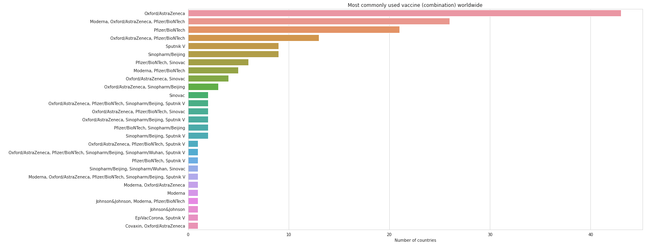
Which vaccination combination has been administered the most?
Code to generate results:
plt.figure(figsize=(20, 10))
plt.title('Most commonly used vaccine (combination) worldwide')
sns.barplot(y=most_common_vaccine.vaccines, x=most_common_vaccine.country)
plt.ylabel(' ')
plt.xlabel('Number of countries');

Slide 7
 | Country | Daily Vaccinations Raw
0 | United States | 5.587212e+09
1 | China | 1.603845e+09
2 | India | 1.573936e+09
3 | United Kingdom | 1.473238e+09
4 | England | 1.246003e+09
Which country have the most effective programme?
Code to generate results:
top5=df.groupby("country").total_vaccinations.sum().sort_values(ascending=False).head(5)
print(top5)

Slide 8
 | Vaccines | Total Vaccinations
3 | Johnson&Johnson, Moderna, Pfizer/BioNTech | 5.587212e+09
10 | Oxford/AstraZeneca, Pfizer/BioNTech | 3.097429e+09
6 | Moderna, Oxford/AstraZeneca, Pfizer/BioNTech | 2.280828e+09
23 | Sinopharm/Beijing, Sinopharm/Wuhan, Sinovac | 1.603845e+09
0 | Covaxin, Oxford/AstraZeneca | 1.573936e+09
Which type of vaccine has been administered the most?
Code to generate results:
vaccines = df.groupby(['vaccines','date']).sum().reset_index()
vaccines_top5 = vaccines.groupby('vaccines’).sum()['total_vaccinations'].reset_index()
vaccines_top5 = vaccines_top5.nlargest(5, columns=['total_vaccinations'])
vaccines_top5

Slide 9
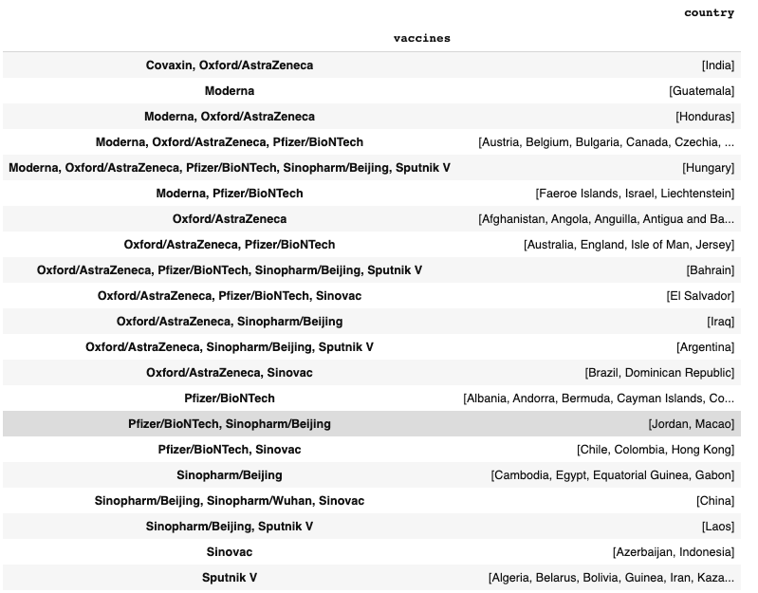
What vaccines are used in which countries?
Code to generate results:
vaccines = df.loc[:,['country', 'vaccines']]
vaccines = vaccines.groupby('vaccines')['country'].unique()
vaccines = pd.DataFrame(vaccines)
vaccines

Slide 10
 | Country | People Fully Vaccinated
0 | United States | 62392065
1 | India | 10833617
2 | Turkey | 7197068
3 | United Kingdom | 5432126
4 | Israel | 4861451
5 | Brazil | 4832020
6 | Russia | 4638702
7 | England | 4344251
8 | Germany | 4334150
9 | Chile | 4042671
The top 10 countries with the highest rate of fully vaccinated people?
Code to generate results:
jd= df.groupby('country').people_fully_vaccinated.max().sort_values(ascending=False)
print(jd.head(10))

Slide 11
 | Country | People Fully Vaccinated
0 | Afghanistan | 0
1 | Myanmar | 0
2 | Mozambique | 0
3 | Mongolia | 0
4 | Moldova | 0
5 | Mauritius | 0
6 | Mauritania | 0
7 | Mali | 0
8 | Maldives | 0
9 | Malawi | 0
The top 10 countries with the lowest rate of fully vaccinated people?
Code to generate results:
lowest10=df.groupby("country").people_fully_vaccinated.sum().sort_values().head(10)
print(lowest10)

Slide 12



Suggestions of Improvement
1
3
2
A population field of each country could be useful as it will determine the number of vaccinations needed for each country
A death rate column should be included so we can determine if the vaccinations decreased the covid-19 death rate of people
Adding a column of daily numbers of infections could be beneficial to see the results of the vaccinations.

Slide 13
Benefits of Combining Vaccines
Researchers suspect that a pair of different vaccines might work better than two doses of the same one.
1
Every vaccine is known to have their own benefits. so, in essence, combining vaccines could really provide a lot of health benefits to the vaccinator.
2
For decades, researchers have investigated the approach, hoping to find potent combinations against a range of viruses, such as influenza, H.I.V. and Ebola.
3
This practice of combining vaccines is nothing new and has been effective in the past. Researchers at the Gamaleya Research Institute in Russia created an Ebola vaccine whose first dose contained a virus called an adenovirus with the second shot being another virus, called vesicular stomatitis virus.
4

Slide 14
Why are there potential drawbacks to the vaccination progress rate?
1
Corruption poses significant risks to equal access to COVID-19 vaccines.
5
High income countries have purchases more than 50% of the supply of Covid-19 vaccines
2
Vigorous distribution plans are needed to ensure equal distribution of vaccines.
Access to information can help prevent corruption
6
3
Bribery is a also a huge challenge.
7
Developing countries lack sufficient data about citizens to ensure an effective vaccination program
Lack of transparency over the development of the covid-19 vaccine rollout
4

Slide 15
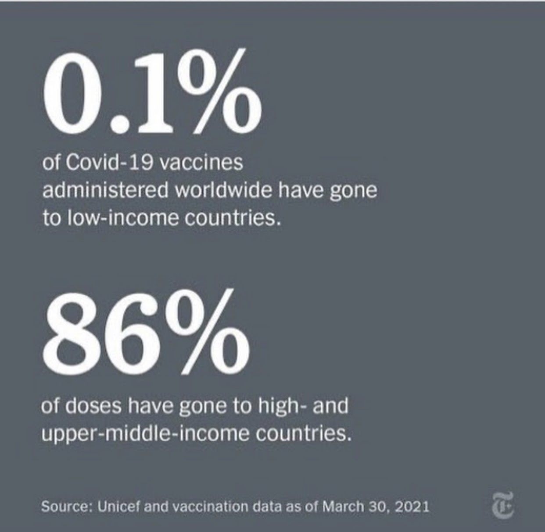
Why are there potential drawbacks to the vaccination progress rate?
There is an unequal access to the distribution of COVID-19 vaccinations around the world.

Slide 16
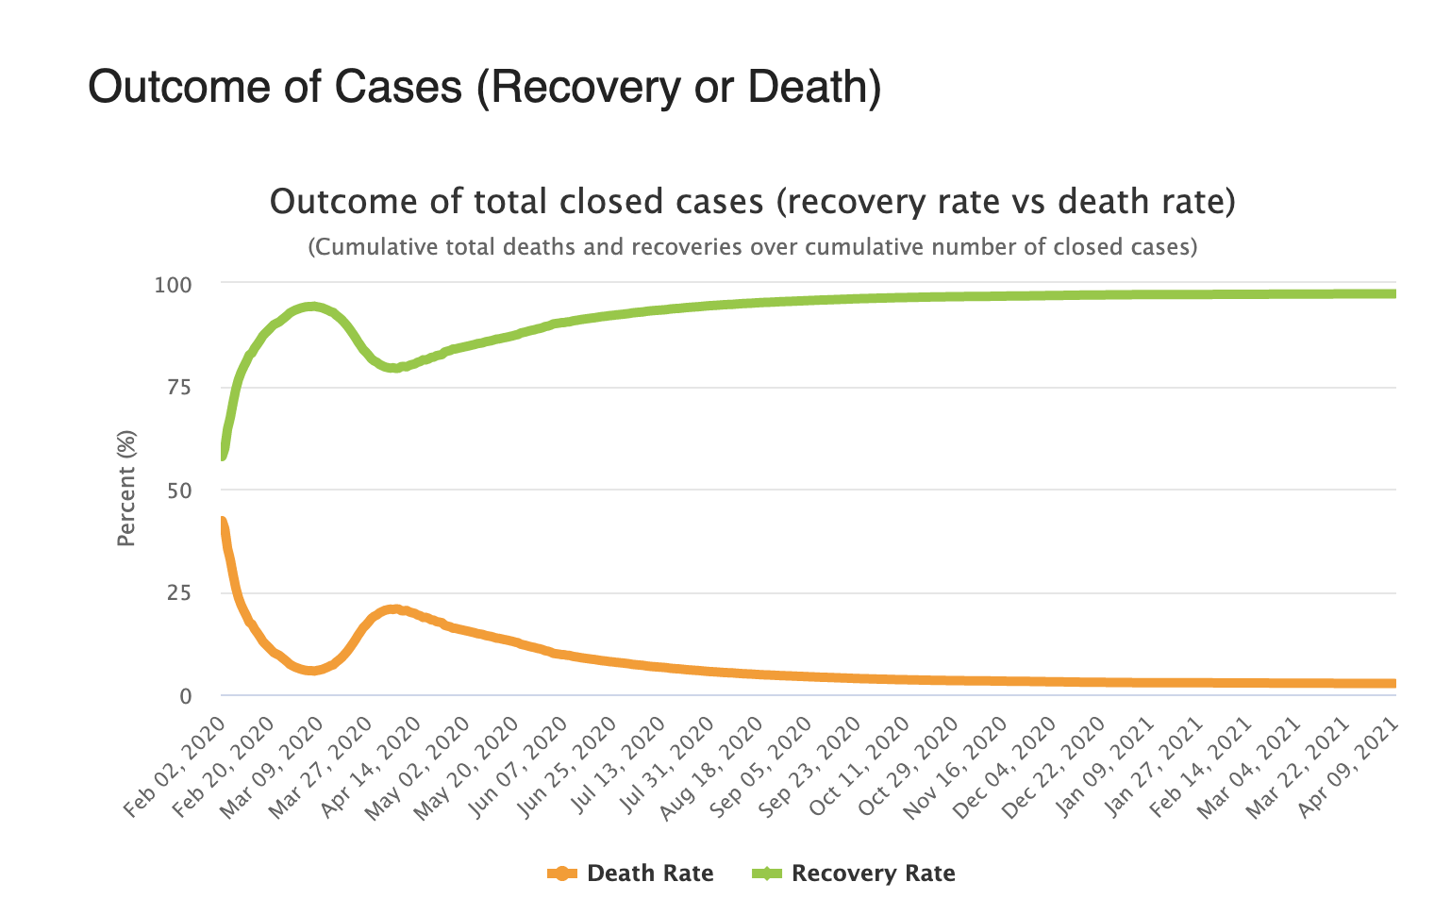
Has the death rate due to the coronavirus decreased since the coronavirus vaccinations?

Slide 17
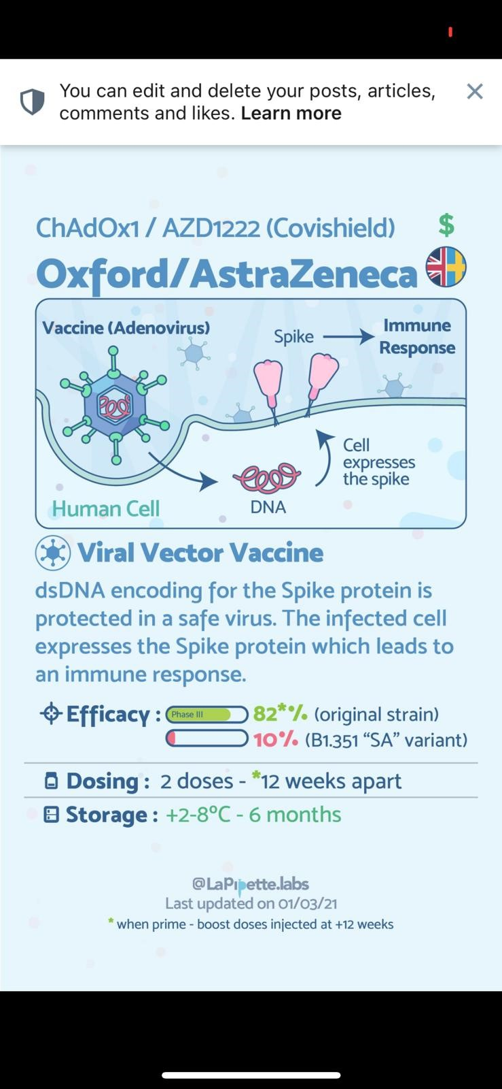
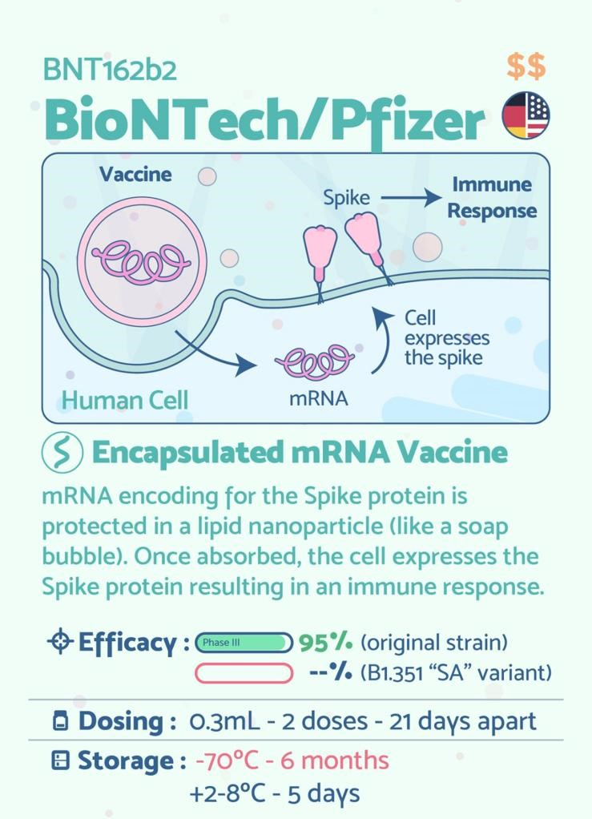
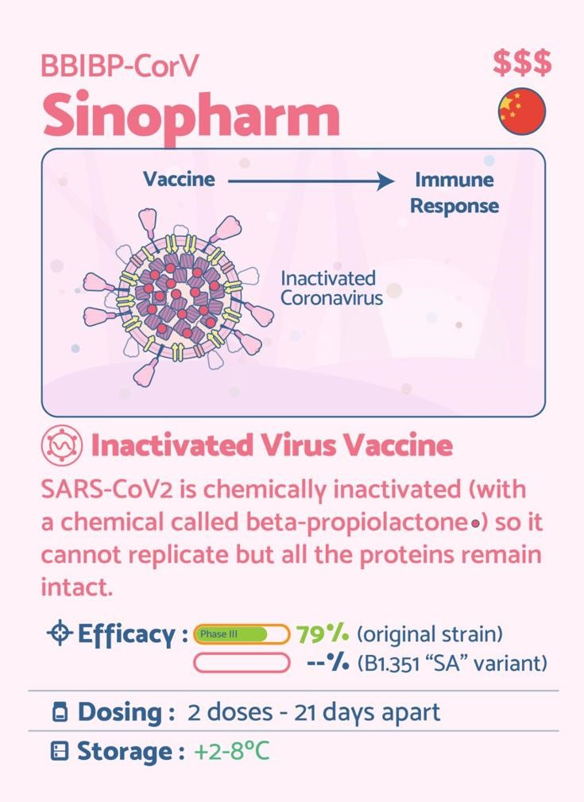
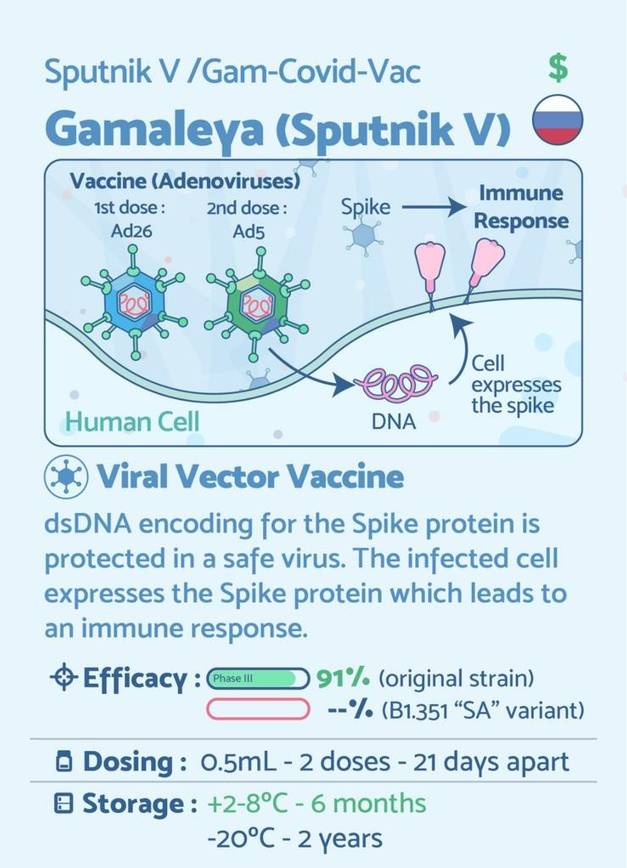
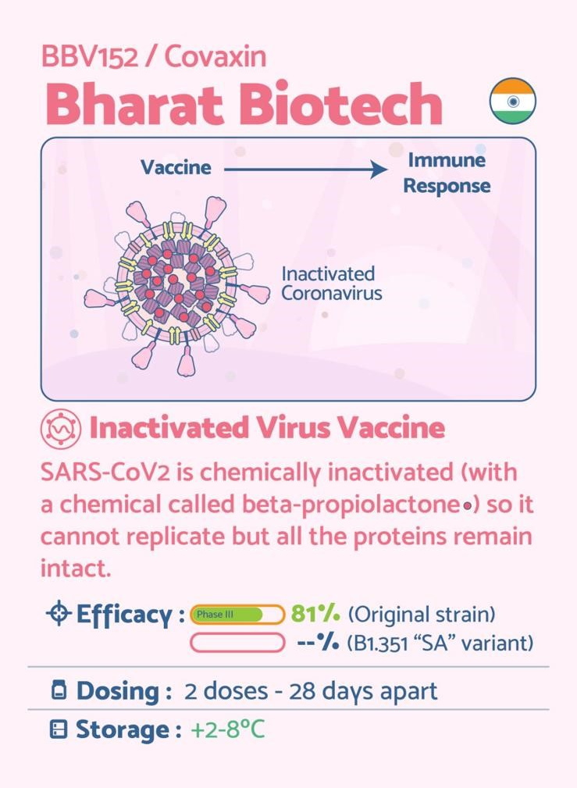
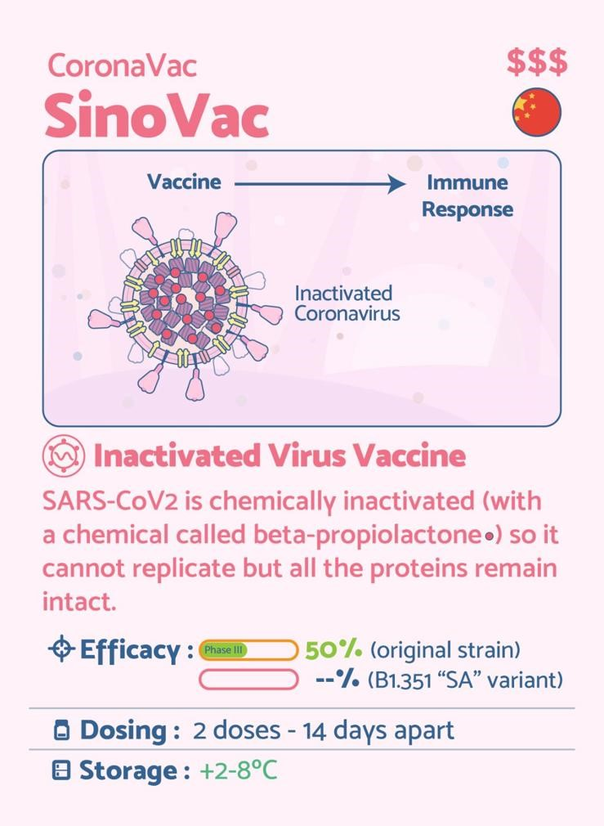
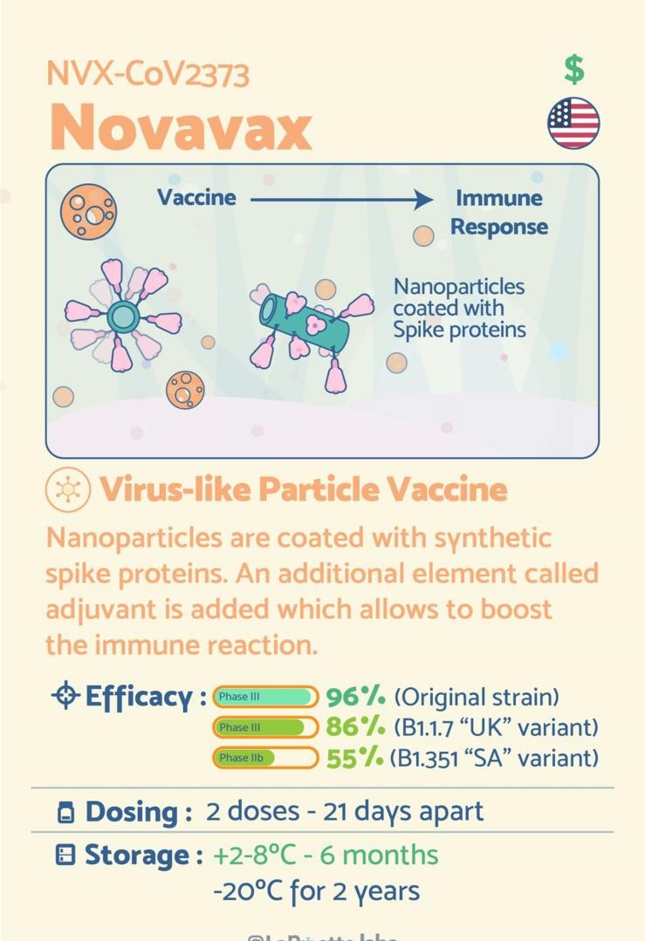
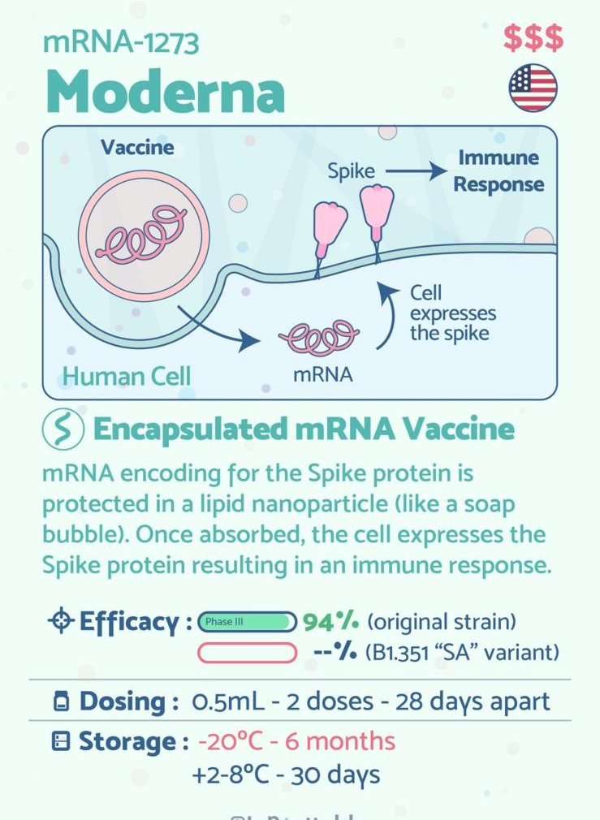
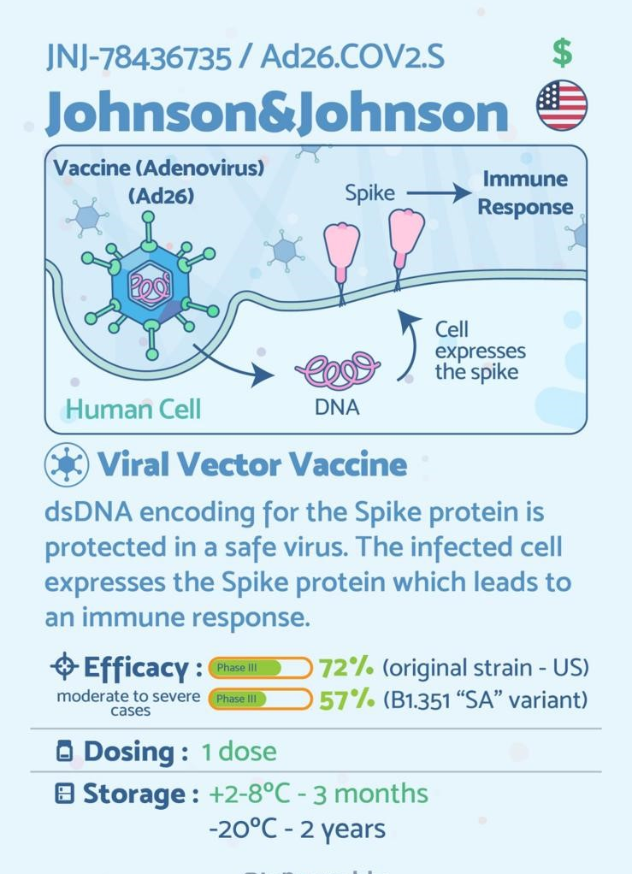
Vaccine Breakdowns

Slide 18




More than 100 economies received life-saving COVID-19 vaccines from COVAX.
1
COVAX, the only global organization through which donor-funded COVID-19 vaccines have been distributed to 92 lower-income countries
2
COVAX: Making global equitable access to COVID-19 vaccines
3
COVAX expects to have delivered at least 2 billion doses of vaccines by the end of 2021
4
COVAX delivered more than 38 million doses of vaccines to 104 countries

Slide 19
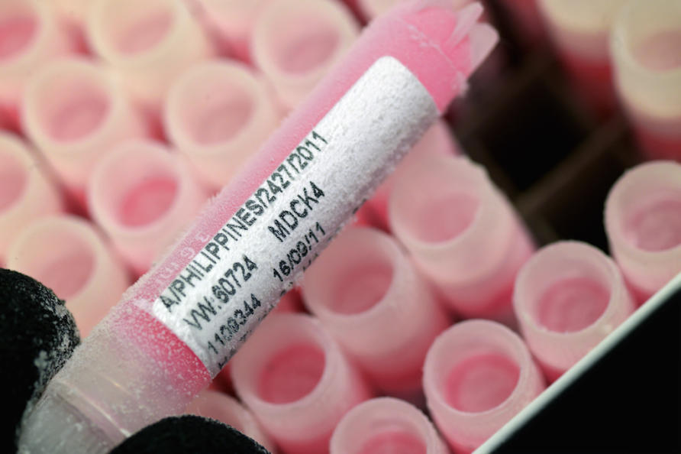
Countries with the fastest Vaccination programs
ONE
TWO
United Kingdom with a population 66.65 million, has vaccinated more than 50% of people with at least one vaccine shot.
More than 3.6 million people have received both doses of vaccine
THREE
FOUR
The UK aims to vaccinate all eligible people by the end of July.
The UK had a 7-day average of 60,000 cases a day in January and the 7-day average in Match dropped to 2,865 cases a day

Slide 20
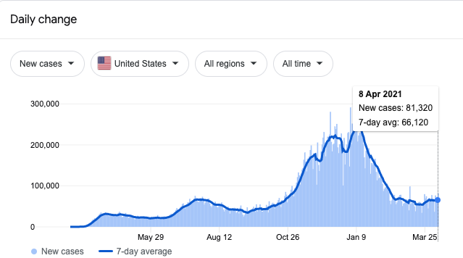
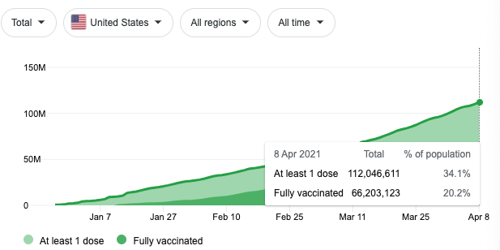
Countries with the fastest Vaccination programs
With a population of 328.2 million people, 28.9% of the U.S population has received one covid vaccination shot.

Slide 21
References
https://globalnews.ca/news/7728050/covid-mass-vaccination-countries-canada/
https://www.healthcareitnews.com/news/ai-has-advantages-covid-19-vaccine-rollout-potential-dangers-too
https://www.gavi.org/covax-facility/protecting-human-rights
https://www.who.int/news/item/08-04-2021-covax-reaches-over-100-economies-42-days-after-first-international-delivery
https://www.kaggle.com/jeeperscreepers/cv19-vaccine-progress
https://www.bbc.com/news/world-europe-56361840
https://www.healthcareitnews.com/news/ai-has-advantages-covid-19-vaccine-rollout-potential-dangers-too
https://www.transparency.org/en/news/covid-19-vaccine-transparency#
https://www.nytimes.com/2021/03/30/health/coronavirus-vaccine-astrazeneca-pfizer.html
https://www.nature.com/articles/d41586-021-00315-5
https://www.worldometers.info/coronavirus/worldwide-graphs/#case-outcome

