Slide 1

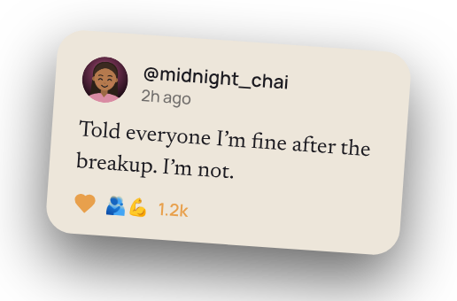


Say it. Stay anonymous.
Confessions · reactions · stories

