Slide 1

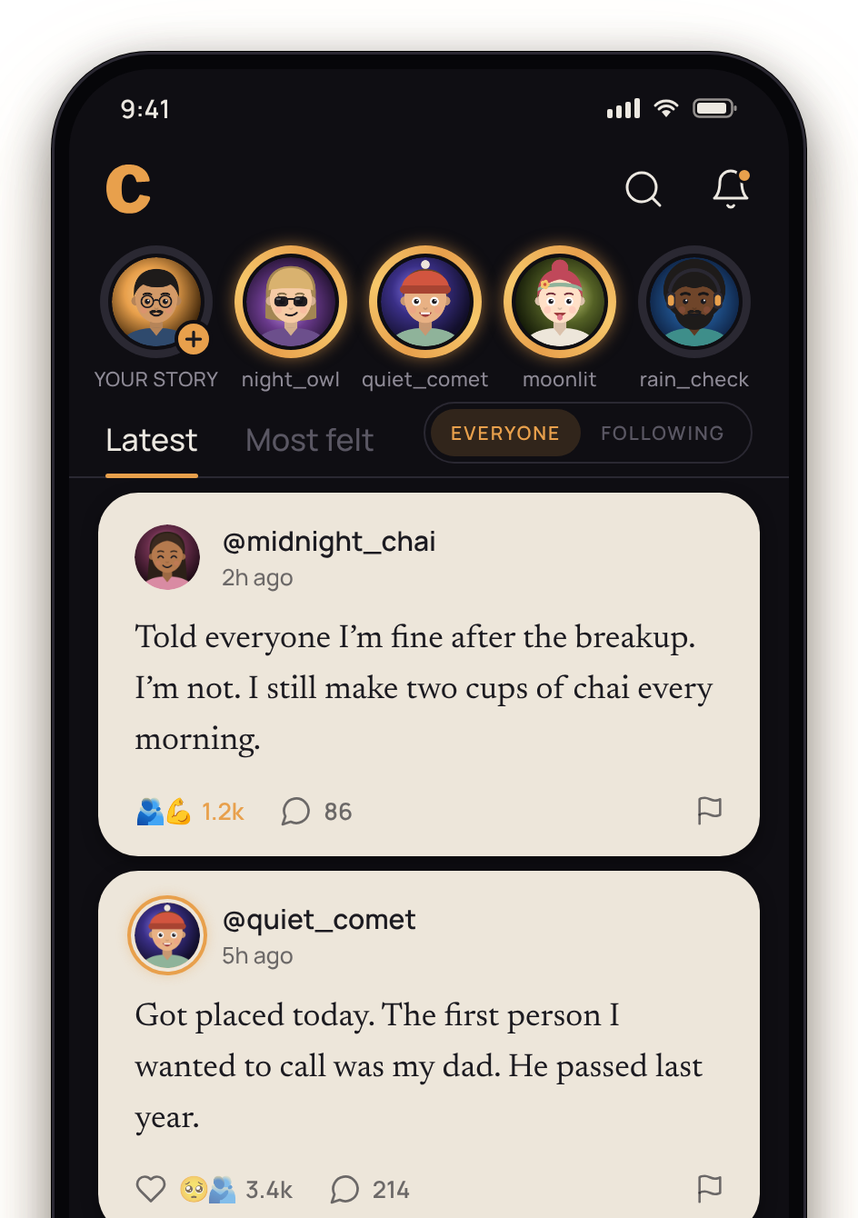
ANONYMOUS CONFESSIONS
Say what you can’t say out loud.
Write it like a letter. Your alias is the only name anyone will ever see.

Slide 2
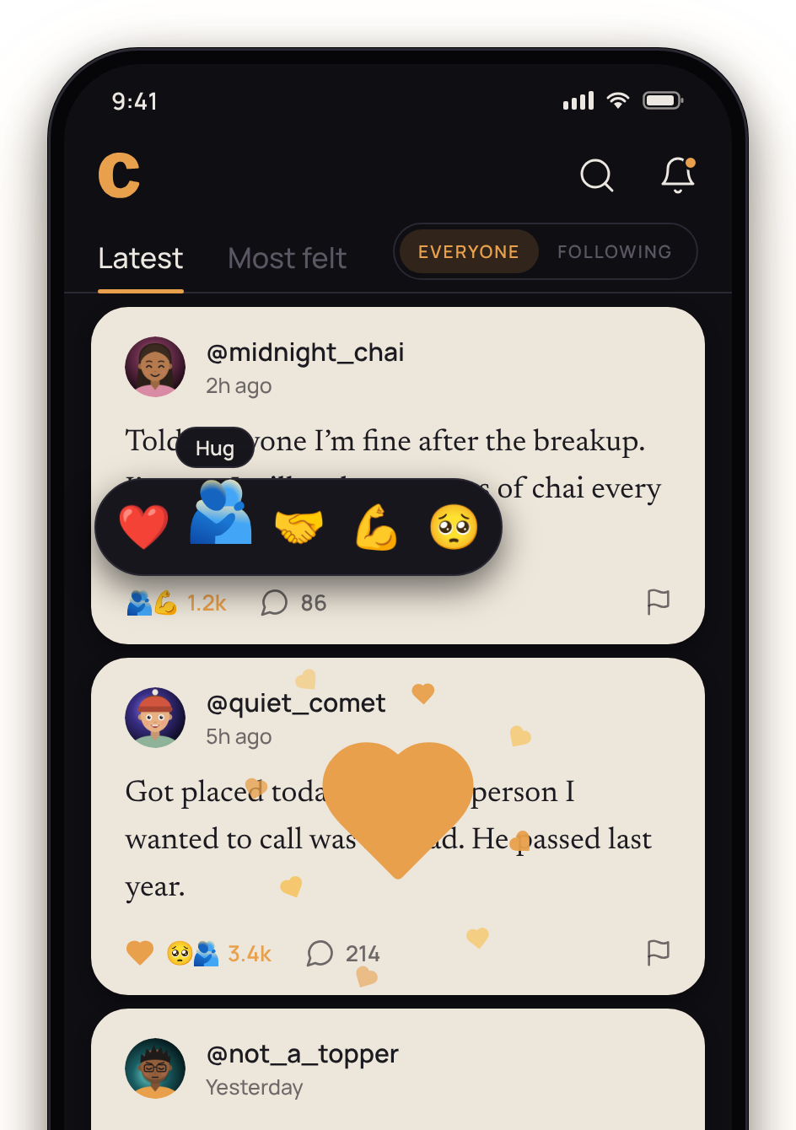
FEEL IT
Feel it. Hug it. Say “same”.
Double-tap to feel a confession — or hold for a hug, strength or tears.

Slide 3
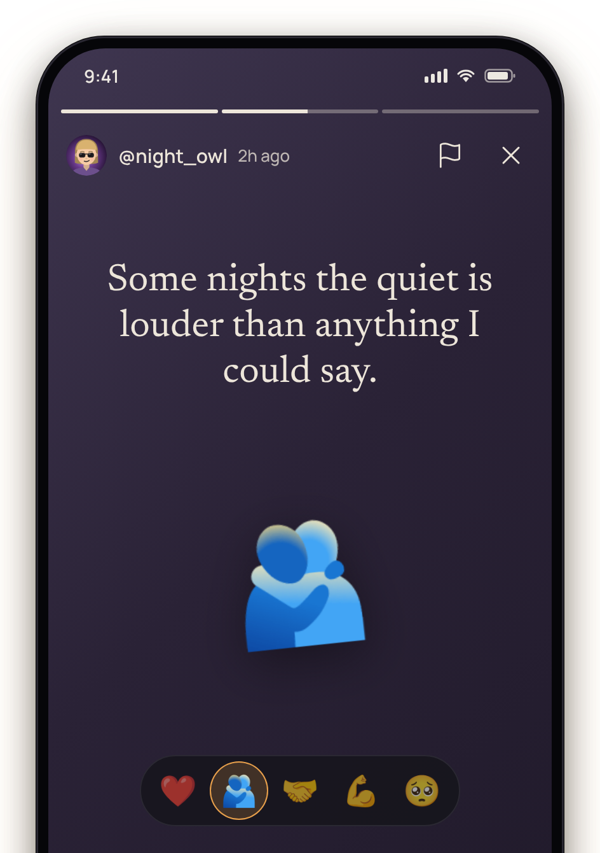
STORIES
Stories that fade in 24 hours.
A line, a mood, a colour. Gone by tomorrow night.

Slide 4
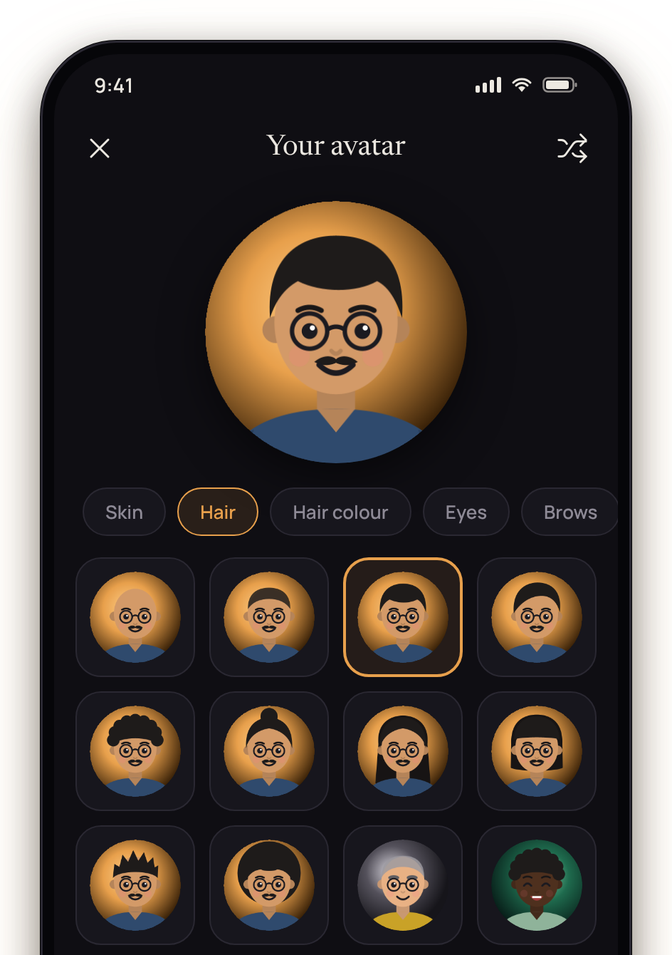
YOUR AVATAR
Be you — just not the real you.
Design an illustrated avatar. No photos, no faces, no giveaways.

Slide 5
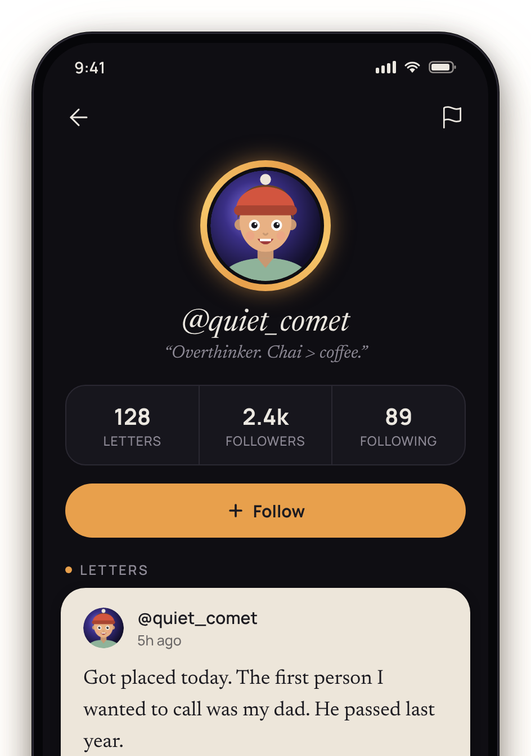
FOLLOW
Find voices that feel like yours.
Follow writers you relate to and read their letters first.

Slide 6
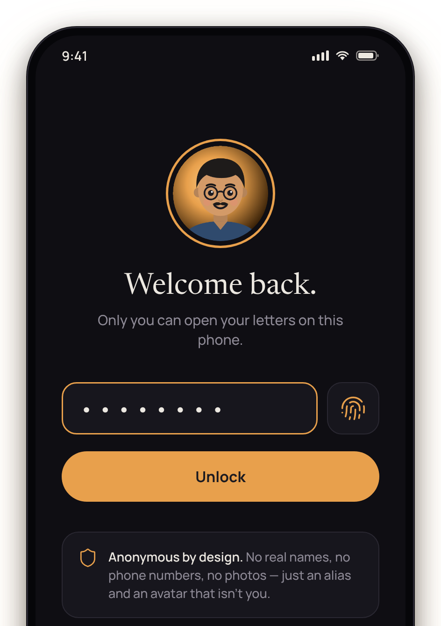
PRIVATE
Your words, locked to you.
Password and fingerprint lock. Nothing that says who you are.

