Slide 1

MICROPROCESSOR-MICROCONTROLLER SESSIONAL PROJECT CSE-306
GROUP-16

Slide 2


GROUP MEMBERS
1. 201914015 Ramiza Rumaisa Aliya Sec-A
2. 170214144 Sowad Ahmed Sec-B

Slide 3
PROJECT Smoke Detection System
Objective: To achieve a fast response, low false alarm and low failure rate and efficient smoke detection system

Slide 4
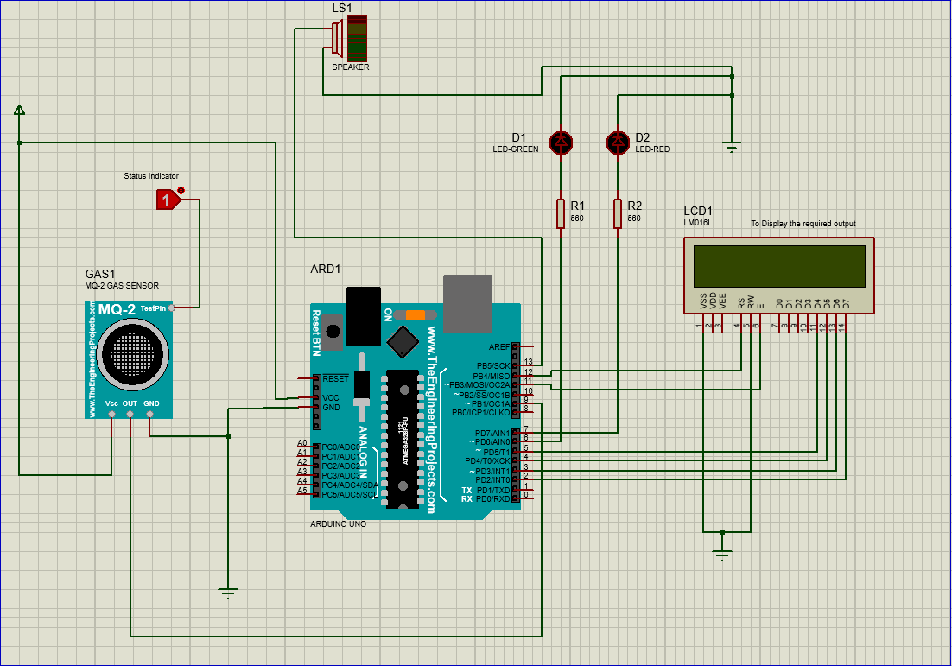
PROject diagram

Slide 5

COMPONENTS
Arduino uno
MQ-2 Smoke detector
Resistors
Voltage source
Led (GREEN AND RED)
16 X 2 ALPHANUMERIC LCD DISPLAY (To display the output)
STATUS INDICATOR (TO INDICATE THE PRESENCE OF GAS OR SMOKE)

Slide 6
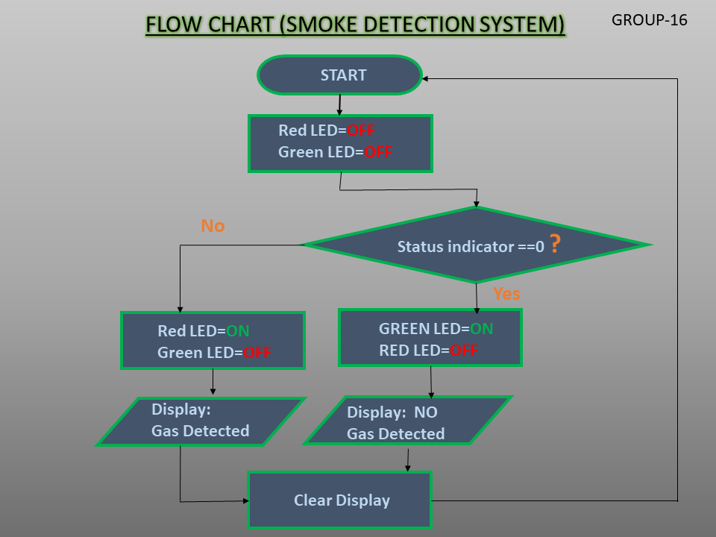
Flowchart:

Slide 7
Working procedure
We use MQ-2 sensor for smoke detection. The voltage that the sensor gives as output changes according to the smoke level that exists in the atmosphere.
The sensor will give an output voltage that is proportional to the concentration of smoke.
That is, the greater the smoke concentration in the atmosphere, the greater will be the output voltage; conversely the lower the smoke concentration, the lower will be the output voltage.

Slide 8
Working procedure(cont…)
Here we use a Logic Toggle as a Status Indicator to indicate the concentration of smoke present in the atmosphere.
When Status Indicator is ‘1’, it denotes that the atmospheric concentration of smoke is high, and the MQ-2 sensor will give high output voltage. But when Status Indicator is ‘0’, it will denote that the atmospheric concentration of smoke is low, and thus the MQ-2 sensor will give low output voltage. This voltage comes as input to Pin-9 of the Arduino UNO.

Slide 9
Working procedure(cont…)
Here,
If the value of the digital input is High, The red LED is turned on, and the speaker makes a sound to denote that smoke is detected. Then the message “Smoke Detected! Alert....!!!” is shown on the LCD Display .
Else, the value of the digital input is Low. Then the green led is turned on, and the speaker remains off. Then the message “No Smoke Detected. SAFE!” is shown on the LCD Display. Since this process will execute infinite times, we ensure that after each loop, there is a delay of 0.5 seconds and that the LCD Display is cleared.

Slide 10
FEATURES
1. MQ-2 Smoke Sensor is used to detect the concentration of smoke. The MQ-2 Sensor is sensitive to smoke and different flammable gases like LPG, Methane, Alcohol, Butane, Hydrogen, and Propane. So it can easily detect whether concentration of smoke is high or low.

Slide 11
FEATURES(cont…)
2. A Status Indicator is used to denote the level of concentration of smoke (High or Low).
3. Red and Green LED’s are used to indicate the presence or absence of smoke.
4. A Speaker is used which produces a sound when smoke is detected.
5. A 16X2 LCD display is used to show whether smoke is detected or not.

Slide 12
FEATURES(cont…)
6. The Arduino takes the voltage from the sensor as input, and conversely helps to generate the required output depending on whether the input is high or low.
The green and red LED are connected to the Pin-6 and Pin-7, the speaker is connected to the Pin-13 of the Arduino respectively.

Slide 13
That would be all…..
THANK YOU!

