Slide 1

MINI PROJECT PRESENTATION
REPORT

Slide 2
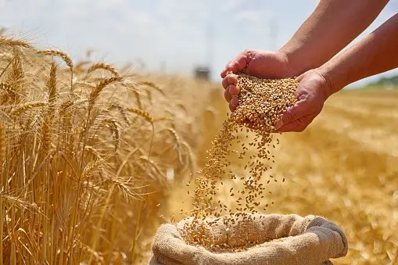
Presentation
On
Building a website of Weather forcasting
Presentation
On
Building a website of
Smart Agricultural System

Slide 3
NAME OF THE GROUP MEMBERS
RAM JI DIXIT (2115000823, C-51)
RAVI KUMAR (2115000835, C-52)
VIVEK ( 2115001141 , C-72)
KESHAW (2115000527, C-32)

Slide 4
Introduction
Our MERN Agricultural Web Application is a comprehensive solution designed to revolutionize the agricultural sector by leveraging modern technology. With a focus on facilitating interactions between farmers, sellers, and consumers, our platform integrates key features to streamline processes and improve efficiency throughout the agricultural supply chain.

Slide 5
Problem Statement
Limited Market Access: Many small-scale farmers struggle to access wider markets beyond their local communities. Limited transportation infrastructure and market information contribute to their inability to reach buyers beyond geographical constraints.
Price Volatility: Fluctuations in crop prices due to factors like seasonal variations, weather conditions, and market demand can result in income uncertainty for both farmers and buyers. Lack of price transparency exacerbates this issue.
Middleman Exploitation: Intermediaries often play a significant role in connecting farmers with buyers, but their involvement can lead to unfair pricing practices and exploitation, reducing the profitability for farmers and increasing costs for buyers.

Slide 6
Project Goals:
Empower Agriculture Ecosystem
Enhanced User Experience
Efficient Transactions
Promote Sustainability
Community Engagement

Slide 7
Features
Product Catalog Management
User Authentication and Authorization
Order Management and Tracking
Inventory Management
Responsive User Interface

Slide 8
Technology Stack:
Built on the MERN Stack:
MongoDB: NoSQL database used for storing data.
Express.js: Backend web application framework for Node.js.
React.js: Frontend JavaScript framework for building user interfaces.
Node.js: JavaScript runtime environment for executing server-side code.

Slide 9
Implementation
Database Design and Setup
Backend Development with Node.js and Express.js
Frontend Development with React.js
User Authentication and Authorization
Integration of Payment Gateway
Testing and Quality Assurance
User Training and Support

Slide 10
Conclusion & Future Scope:
Agricultural platform optimizing transactions, enhancing user experience, and paving way for future innovations.
AI Integration
IoT Expansion
Mobile Development
Offline Functionality

Slide 11
Challenges and Solutions
Security Vulnerabilities
Payment Gateway Integration
User Experience Optimization
Data Management and Compliance

Slide 12

Q&A

Slide 13

THANK YOU!

Slide 14
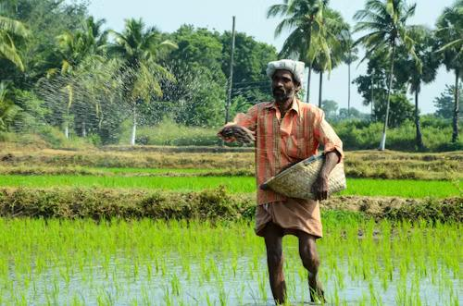
THANK YOU
.

