Slide 1

MINI PROJECT PRESENTATION
REPORT

Slide 2
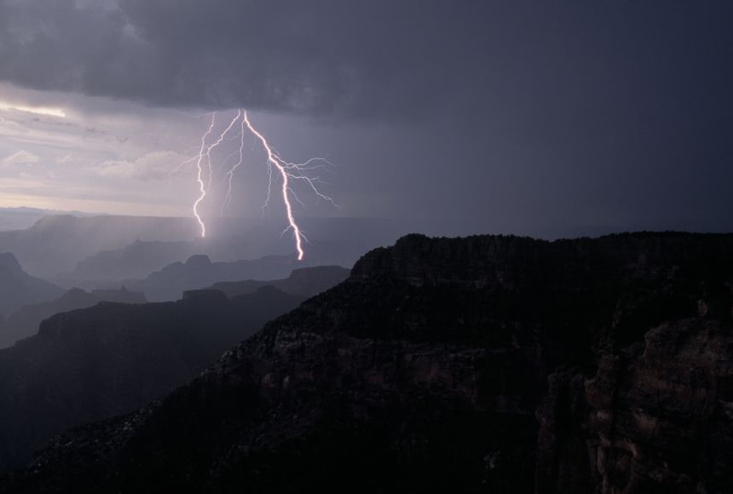
Presentation
On
Building a website of Weather forcasting
Presentation
On
Building a website of
Weather forcasting

Slide 3
NAME OF THE GROUP MEMBERS
RAM JI DIXIT (2115000823, C-51)
RAVI KUMAR (2115000835, C-52)
PARTH SINGH CHAUHAN ( 2115000698 , H-48 )

Slide 4
WEATHER FORCASTING
Knowing what the day will bring is one good way to making a perfect plan for each day. Sometimes this is usually a difficult one for all us because nobody really knows for certain what is likely to be happen in the nearest minutes. Even in the area of the weather, this is paramount.
In order to minimize the risk of distorted daily plans and arrangements, owing to changes in weather, there is need to take close looks daily weather conditions.

Slide 5
Why we need this ?
To plan journeys ahead.
To plan meeting/commute timings.
To decide what to wear.
To know when rain comes/stops.
To receive alerts/warnings during cyclones, sandstorms,typhoons etc.

Slide 6
Methodology
Software Requirements:
1. Visual Studio Code
2. Windows / Mac
Language Used:
1.HTML
2.CSS
3.JAVASCRIPT
4.API

Slide 7
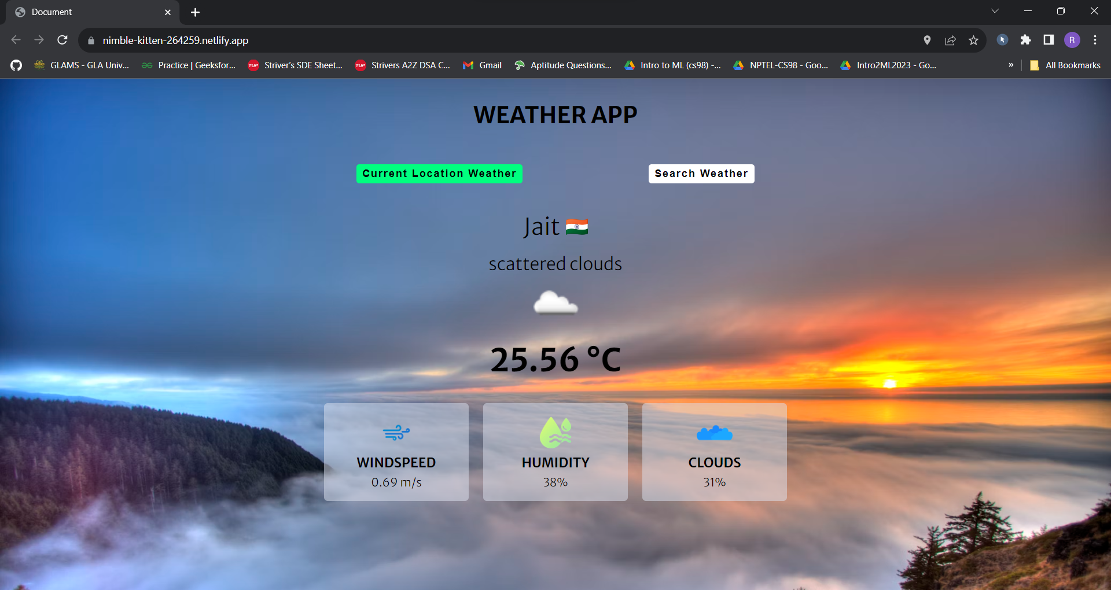
IMPLEMENTATION

Slide 8
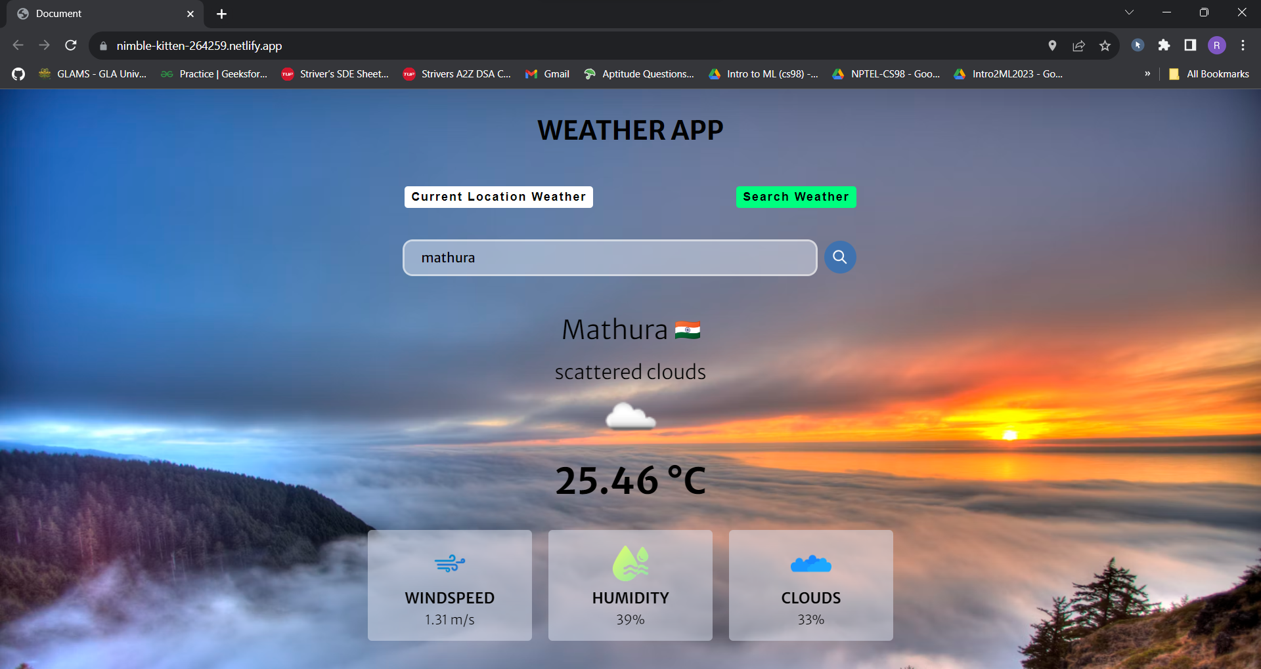

Slide 9
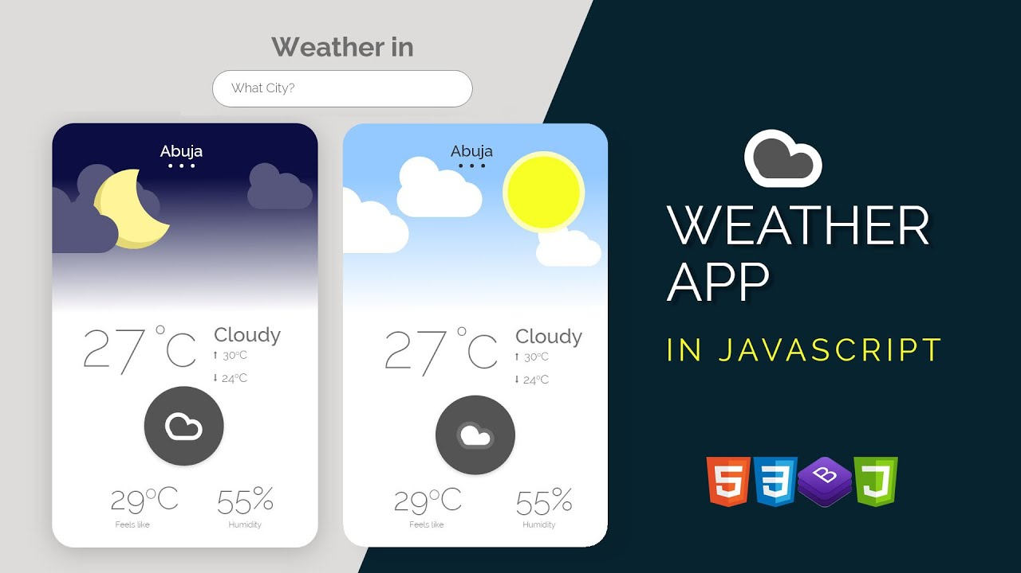
How we did it ?

Slide 10
Features
When we input a name of a city or access our location ,we can easily see:-
Current Temperature
Humidity
Pressure
Description

Slide 11
Benefits
This website enables you to make better preparation for the day in relation to giving accurate daily weather forecast.
This site able to identify the thermal energy from the sun that is exposed in atmosphere

Slide 12
FUTURE WORK
The website we created in this project can be further developed into a mobile application so that it can give timely weather updates. These updates will be received in the form of notification in the user’s mobile based on the location they are present in. So, the users don’t even have to get into that particular application to know the weather and it saves their valuable time.

Slide 13
CONCLUSION
In the era of the global warming, research in weather measurement, monitoring and forecasting are become more and more relevant. This research demonstrates the design and implementation of an affordable mini weather monitoring system that ensures flexibility, portability, stability and user-friendly operations which can provide data of some weather variables including temperature, humidity and pressure. With the advancement of technology weather forecasting has developed to its level best, but there is yet to develop, as far as a nature is so unpredictable. Weather forecasts are increasingly accurate and useful, and their benefits extend widely across the economy. While much has been accomplished in improving weather forecasts, there remains much room for improvement. Simultaneously, they are developing new technologies and observational networks that can enhance forecaster skill and the value of their services to their users.

Slide 14
ACKNOWLEDGEMENTS
We would like to extend our sincere appreciation and gratitude to all the individuals and organizations who have contributed to the successful completion of this mini project. First and foremost, we would like to express our heartfelt thanks to our esteemed mentor “Mr. Farhan Khan Sir” for his unwavering support, valuable guidance, and insightful feedback throughout the duration of this project. His expertise and encouragement have been pivotal in shaping the direction of our work and have inspired us to deliver our best. We would also like to acknowledge the collaborative efforts and contributions of each member of our group. Working together as a team has not only enriched our project with diverse perspectives but has also fostered a spirit of camaraderie and mutual support. Each member’s unique skills and dedication have played a crucial role in achieving our shared goals. Furthermore, we are grateful to our friends and family for their understanding, encouragement throughout this endeavor. Their constant support has been a source of motivation during challenging times. Lastly, we would like to thank the university administration for providing us with access to essential resources and facilities, which have been instrumental in the successful execution of our project.

Slide 15

Q&A

Slide 16

THANK YOU!

