Slide 1

C++ Templates
Understanding All Aspects and Scenarios with Examples

Slide 2
📘 What's Included:
Introduction
Function, Class and Variable templates
Template parameters (type, non-type, default)
Template specialization
Full, partial template specialization
Use cases and best practices

Slide 3
Introduction to C++ Templates
Templates allow writing generic and reusable code.
Enable functions, classes and variables to operate with generic types.
Define Templates:
template <typename A, typename B, ...>
entity_definition
Instantiate Templates:
entity_name<type1, type2, ...>

Slide 4

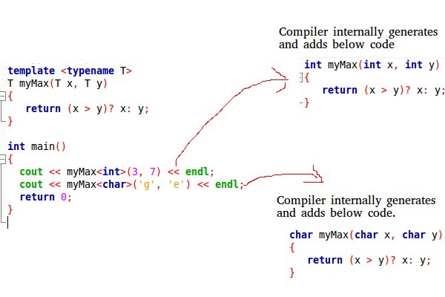
Working of Templates
Expanded at compiler time
Notes:
//g++ -std=c++17 -fdump-tree-original your_file.cpp --> dump compiled code with comments

Slide 5
Function Templates
Used to define a generic function.
Example:
template<typename T>
T add(T a, T b) {
return a + b;
}

Slide 6
Class Templates
Used to define a generic class.
useful for classes like LinkedList, BinaryTree, Stack, Queue, Array, etc.
Example:
template<typename T>
class Box {
T value;
};

Slide 7
Variable Templates (C++14)
Used to define a generic variable.
Variable that can work with any type specified when the variable is used
Example:
template <typename T>
T pi = T(3.14159);

Slide 8
Template Specialization
Allows customizing template behavior for specific types.
Types :
Full Specialization
Partial Specialization
Generic Template -> Specialized Template -> Custom Behavior

Slide 9
Template Parameters
Default parameters:
template <class T1, class T2 = double>
entity_definition
Type & Non-type parameters:
template <class T, int N>
entity_definition
- non-type parameters must be const

Slide 10
Template Argument Deduction
Automatically deduces the data type of the argument passed to the templates.
Function Template Arguments Deduction
Class Template Arguments Deduction (C++17 Onwards)
Example:
template<typename T>
class Box{
public:
Box(T val){ cout<<val; }
};
Box obj(10); //supported C++17 onwards

Slide 11
Template Metaprogramming
Template perform computation at the compile time rather than runtime.
Uses recursive template structures where templates call other templates during compilation.
Example:
// Template metaprogramming for calculating factorial at compile-time
template <int N>
struct Factorial { static const int value = N * Factorial<N - 1>::value; };
// Specialization for the base case (Factorial<0>)
template <>
struct Factorial<0> { static const int value = 1; };

Slide 12
Scenarios and Use Cases
Generic containers and algorithms
Type-safe operations
Code reuse and abstraction
Custom behavior for specific types
Default Template Arguments

Slide 13
Limitations and Best Practices
Limitations:
Increased complexity
Code duplication risk
Template Specialization for Variable not allowed
Best Practices:
Use templates for generic behavior
Use specialization only when necessary
Prefer partial over full specialization

Slide 14
Thank You
https://www.geeksforgeeks.org/cpp/templates-cpp/
https://en.cppreference.com/w/cpp/language/templates.html

