Slide 1
Word-vector regularization for text classification algorithms
RAMKISHAN PANTHENA
MS in DATA SCIENCE
Khoury College of Computer Sciences

Slide 2
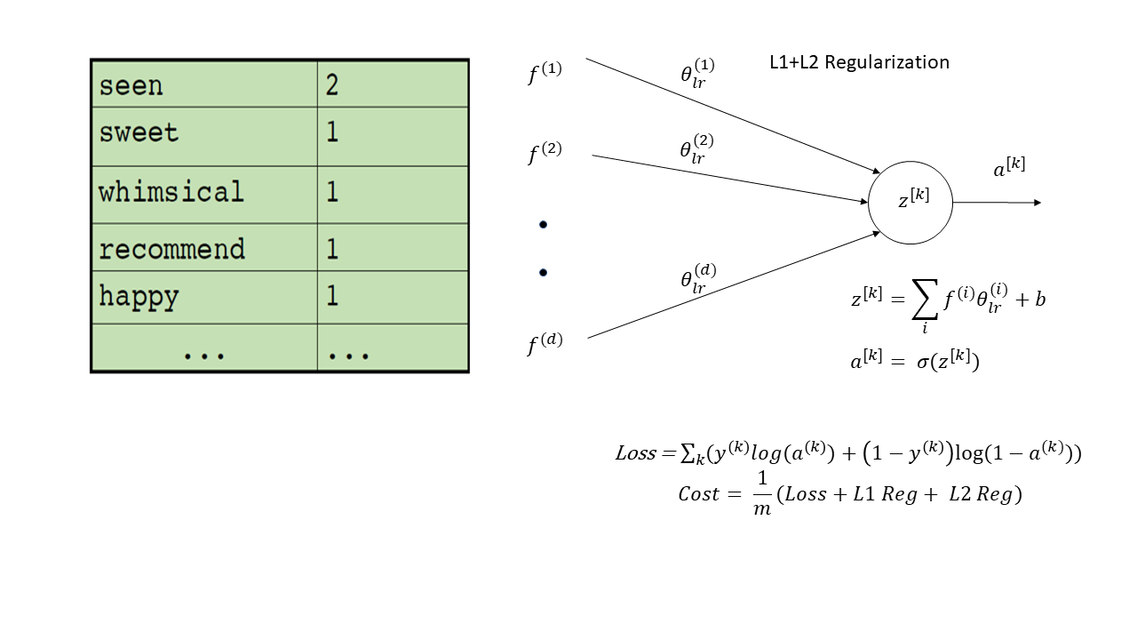
Introduction
Bag-of-words model represents text as bag of words disregarding word order
Commonly used for text classification with each word used as a feature

Slide 3
Problem Statement
Bag-of-words limitations:
Large vocabulary causes extremely sparse representations that are hard to train
Large number of classes and highly imbalanced distribution of instances across different classes
Limited data makes matters worse

Slide 4
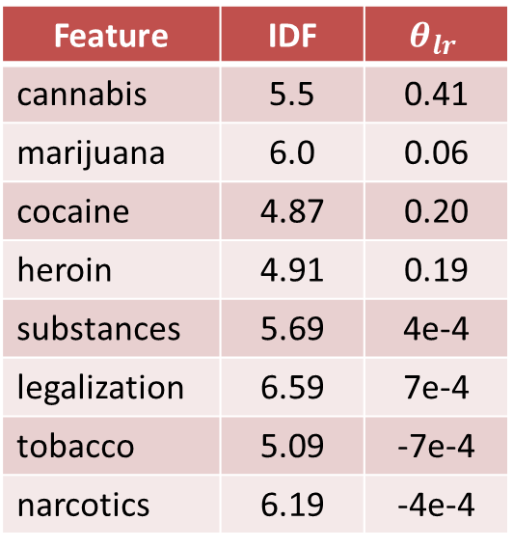
Example Case
Drug classification problem
Guardian dataset
Feature | IDF | $$θ_{lr}$$
cannabis | 5.5 | 0.41
marijuana | 6.0 | 0.06
cocaine | 4.87 | 0.20
heroin | 4.91 | 0.19
substances | 5.69 | 4e-4
legalization | 6.59 | 7e-4
tobacco | 5.09 | -7e-4
narcotics | 6.19 | -4e-4

Slide 5
Proposed Idea
Constrain weights of rare features by similar, more frequent ones, using semantic similarity
This would enforce similar words to have similar weights thereby improving test performance
Use word-vectors to assign semantic similarity

Slide 6
Word embeddings
Represent words as a vector that captures the word’s meaning and semantically similar words have similar vectors
Wheel and engine should have similar word vectors to the word car
This leads to interesting math operations:
king – man + woman = queen

Slide 7
4 Logistic Regression models
Continuous word vector feature model
Word vector coefficients model
Logistic Regression with word vector regularization
Modified Logistic Regression model

Slide 8
Continuous word vector feature model
Compute mean of word vectors across document terms
Obtain 300 document features
Train logistic regression on these features

Slide 9
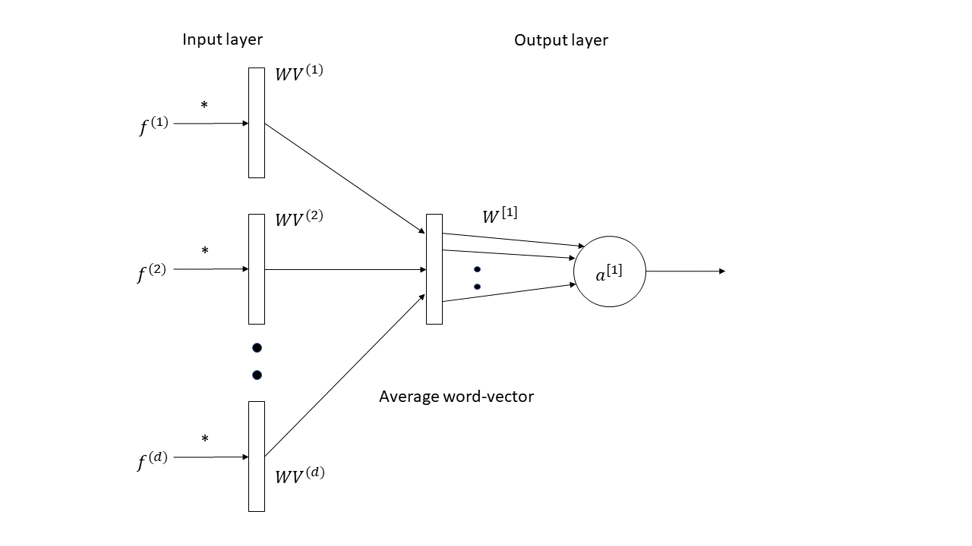
Continuous word vector feature model

Slide 10
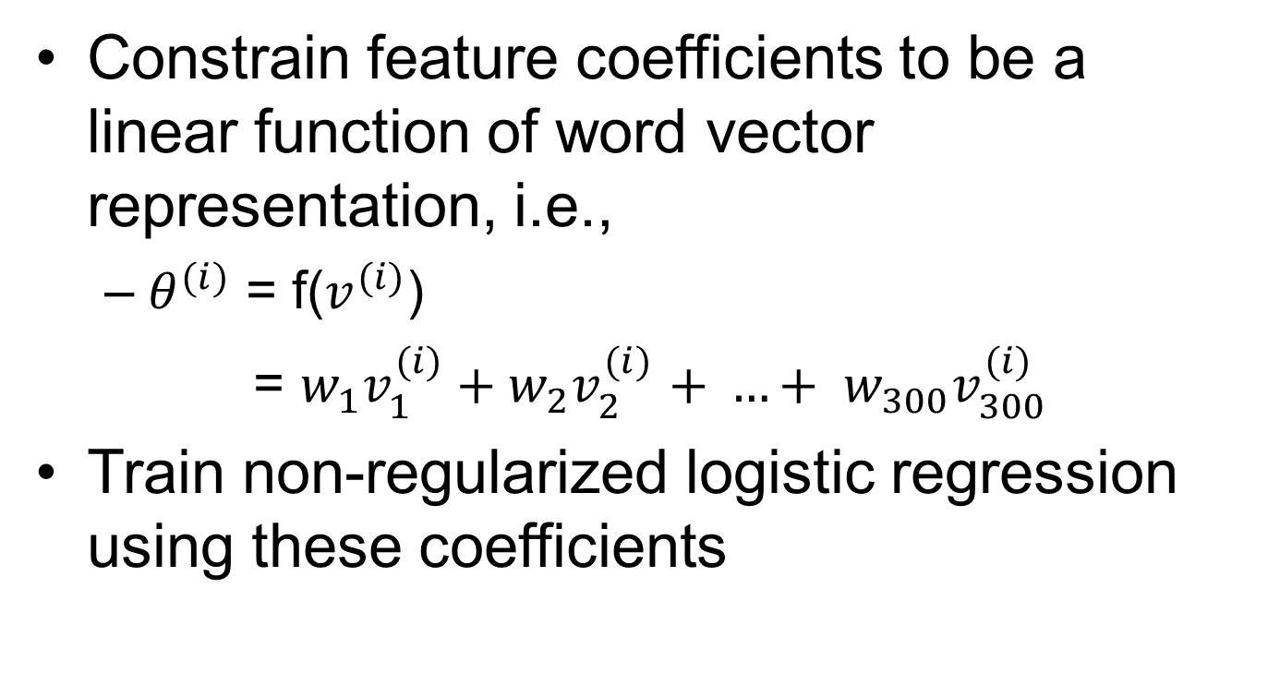
Word vector coefficients model
Constrain feature coefficients to be a linear function of word vector representation, i.e.,
$θ^{(i)}$ = f($v^{(i)}$)
= $w_{1}v_{1}^{(i)}+w_{2}v_{2}^{(i)}$ $+ …+ w_{300}v_{300}^{(i)}$
Train non-regularized logistic regression using these coefficients

Slide 11
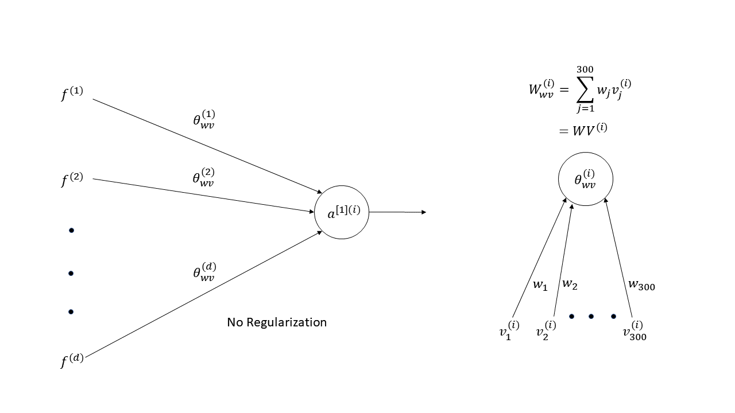
Word vector coefficients model

Slide 12
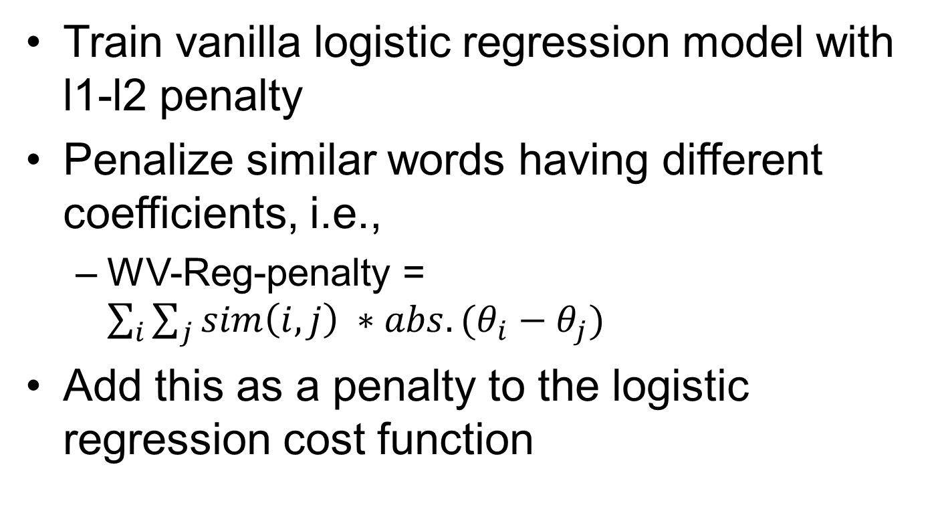
Word vector regularization
Train vanilla logistic regression model with l1-l2 penalty
Penalize similar words having different coefficients, i.e.,
WV-Reg-penalty = $\sum_{i}{\sum_{j}{sim\left(i, j\right) ∗abs. (θ_{i}−θ_{j})}}$
Add this as a penalty to the logistic regression cost function

Slide 13
Word vector regularization
Challenges faced
Expensive to compute the cost at the end of every mini-batch cycle
Mitigated the expense by computing the weight differences for a fixed set of features

Slide 14
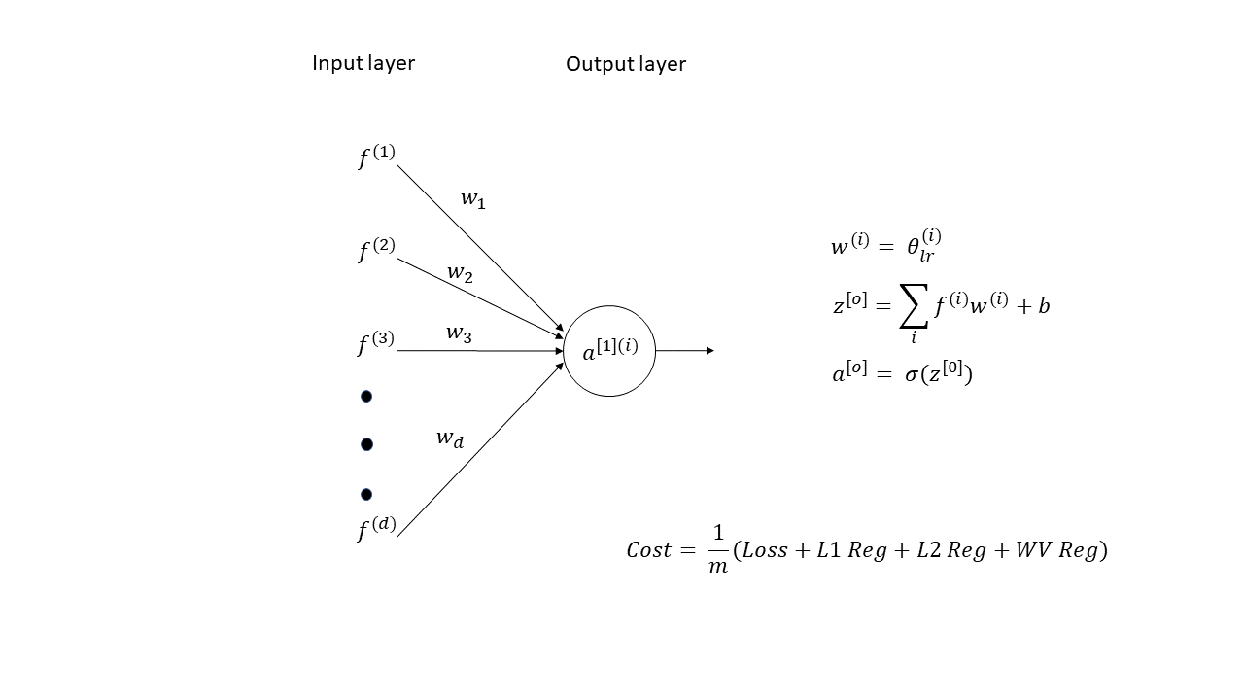
Word vector regularization

Slide 15
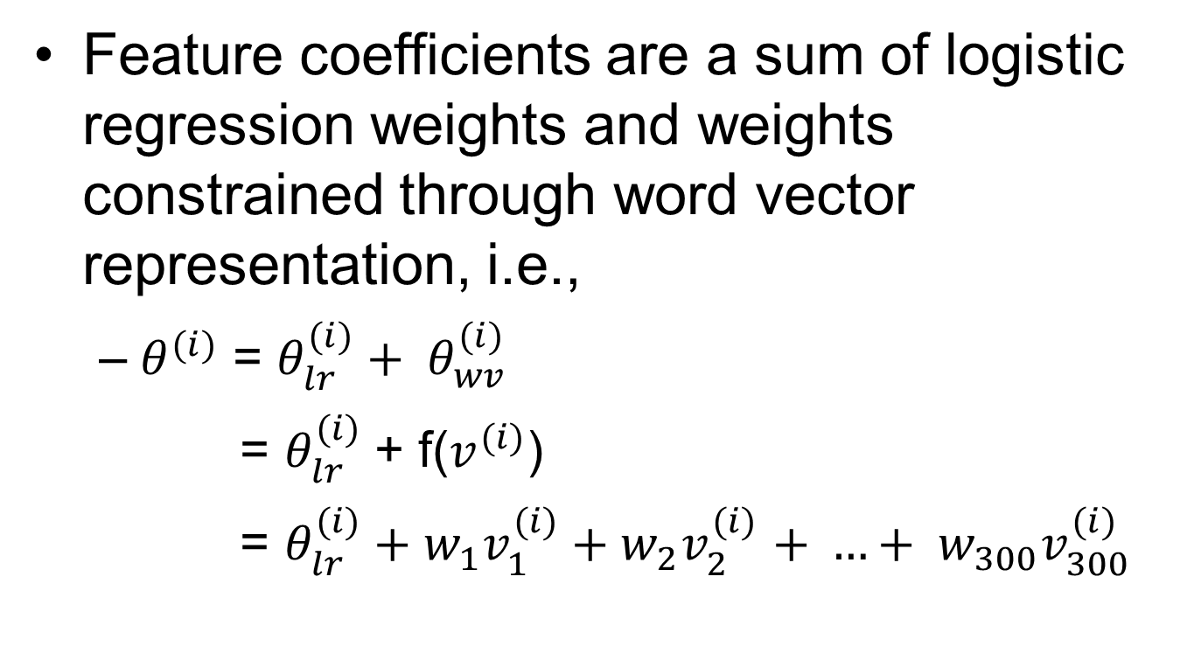
Modified logistic regression model
Feature coefficients are a sum of logistic regression weights and weights constrained through word vector representation, i.e.,
$θ^{(i)}$ = $θ_{lr}^{(i)}+ θ_{wv}^{(i)}$
= $θ_{lr}^{(i)}$+ f($v^{(i)}$)
= ${θ_{lr}^{(i)}+w}_{1}v_{1}^{(i)}+w_{2}v_{2}^{(i)}$ $+ …+ w_{300}v_{300}^{(i)}$

Slide 16
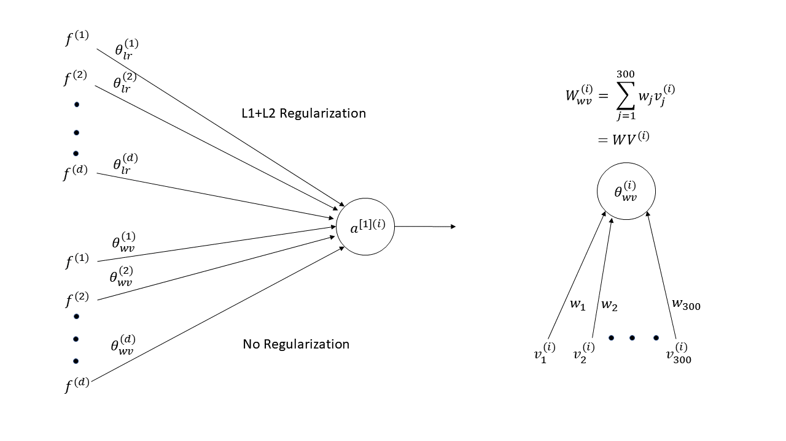
Modified logistic regression model

Slide 17
Experimental setup
Generated bag-of-words model on text
Re-trained word vectors on individual datasets using Google’s pre-trained model as a prior
Trained model at scale using TensorFlow
Trained the model on multi-class and multi-label datasets

Slide 18
Evaluation for multi-label data
Set-accuracy: ratio of perfectly matched instances to total number of instances
Instance-F1: evaluate performance of partially correct predictions averaged over all instances
Label-F1: evaluate performance of partially correct predictions average over all labels

Slide 19
Datasets
IMDb:
Movie plot text summaries labelled with genres sourced from IMDb
35,000 documents across 25 different genres
Assign multiple genres to a movie description
20 Newsgroup:
Dataset of 20,000 newsgroup documents across 20 different newsgroups

Slide 20
Datasets
Medical dataset:
MGH radiology patient data
2670 classes which are diagnosis codes to bill the insurance company
11,000 features and 650k datapoints
Guardian:
British newspaper containing articles on topics like World news, Culture, Politics, etc.
All data has been manually crawled from Guardian website with document and its tags
23,000 features, 400 classes

Slide 21
Guardian – Overall
 | Set Accuracy | Instance F1
Continuous wv embedding (LR) | 43.65 | 60.61
WV-coefficeints (LR) | 42.36 | 59.65
Vanilla LR | 53.46 | 65.61
Modified LR Model | 59.3 | 69.41

Slide 22
Guardian – Individual Labels
Label | Vanilla LR (Label F1) | Our model (Label F1) | Improvement
Drugs | 80.5 | 88.75 | 8.25
Mental Health | 69.23 | 76.8 | 7.57
Global economy | 56.34 | 62.69 | 6.35
LGBT | 76.84 | 82.9 | 6.06
Blogging | 77.3 | 82.72 | 5.42
Public finance | 48.24 | 53.33 | 5.09
Premier League | 90 | 95.03 | 5.03

Slide 23
Guardian – Deeper Analysis
Drugs | Orig. LR | F1 | TN | FP | FN | TP
Vanilla LR | train | 92.46 | 10632 | 19 | 60 | 485
 | test | 80.50 | 1463 | 15 | 16 | 64
Modified LR | train | 94.91 | 10639 | 12 | 42 | 503
 | test | 88.75 | 1469 | 9 | 9 | 71
Global Economy | Orig. LR | F1 | TN | FP | FN | TP
Vanilla LR | train | 87.36 | 10541 | 50 | 97 | 508
 | test | 56.33 | 1456 | 30 | 32 | 40
Modified LR | train | 88.31 | 10575 | 16 | 114 | 491
 | test | 62.69 | 1466 | 20 | 30 | 42

Slide 24
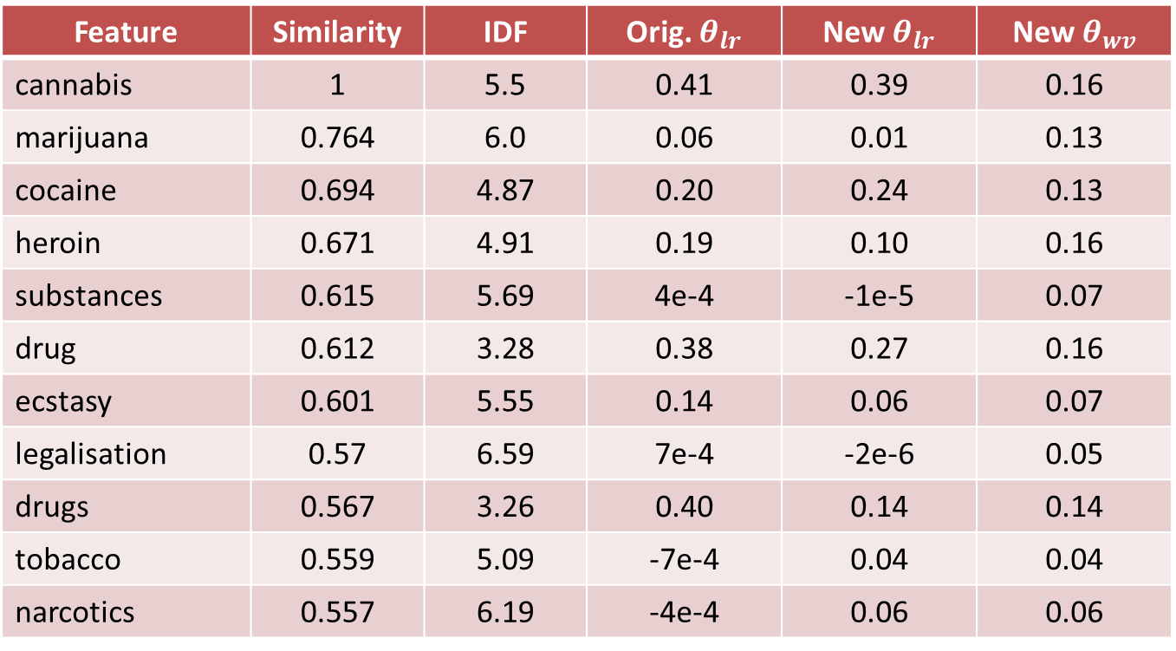
Guardian – Drugs class
Feature | Similarity | IDF | Orig. $θ_{lr}$ | New $θ_{lr}$ | New $θ_{wv}$
cannabis | 1 | 5.5 | 0.41 | 0.39 | 0.16
marijuana | 0.764 | 6.0 | 0.06 | 0.01 | 0.13
cocaine | 0.694 | 4.87 | 0.20 | 0.24 | 0.13
heroin | 0.671 | 4.91 | 0.19 | 0.10 | 0.16
substances | 0.615 | 5.69 | 4e-4 | -1e-5 | 0.07
drug | 0.612 | 3.28 | 0.38 | 0.27 | 0.16
ecstasy | 0.601 | 5.55 | 0.14 | 0.06 | 0.07
legalisation | 0.57 | 6.59 | 7e-4 | -2e-6 | 0.05
drugs | 0.567 | 3.26 | 0.40 | 0.14 | 0.14
tobacco | 0.559 | 5.09 | -7e-4 | 0.04 | 0.04
narcotics | 0.557 | 6.19 | -4e-4 | 0.06 | 0.06

Slide 25
IMDb – Overall
 | Set Accuracy | Instance F1
Continuous wv embedding (LR) | 7.3 | 45.2
WV-coefficeints (LR) | 6.1 | 45.69
LR + WV Reg. | 17.19 | 56.32
Vanilla LR | 18.21 | 57.87
Modified LR Model | 20.30 | 58.52

Slide 26
IMDb – Individual Labels
Label | Vanilla LR (Label F1) | Our model (Label F1) | Improvement
News | 0.00 | 50.00 | 50.00
Musical | 33.54 | 43.78 | 10.24
Animation | 44.66 | 50.23 | 5.57
Sport | 61.65 | 67.13 | 5.47
Film Noir | 25.31 | 30.23 | 4.91
War | 58.64 | 62.92 | 4.27
Sci-Fi | 68.83 | 72.73 | 3.89

Slide 27
IMDb – Deeper Analysis
News | Orig. LR | F1 | TN | FP | FN | TP
Vanilla LR | train | 0.00 | 22412 | 0 | 9 | 0
 | test | 0.00 | 3114 | 1 | 3 | 0
Modified LR | train | 100.00 | 22412 | 0 | 0 | 9
 | test | 50.00 | 3115 | 0 | 2 | 1
Musical | Orig. LR | F1 | TN | FP | FN | TP
Vanilla LR | train | 82.88 | 21730 | 4 | 198 | 489
 | test | 33.54 | 2984 | 25 | 82 | 27
Modified LR | train | 85.07 | 21724 | 10 | 171 | 516
 | test | 43.79 | 2986 | 23 | 72 | 37

Slide 28
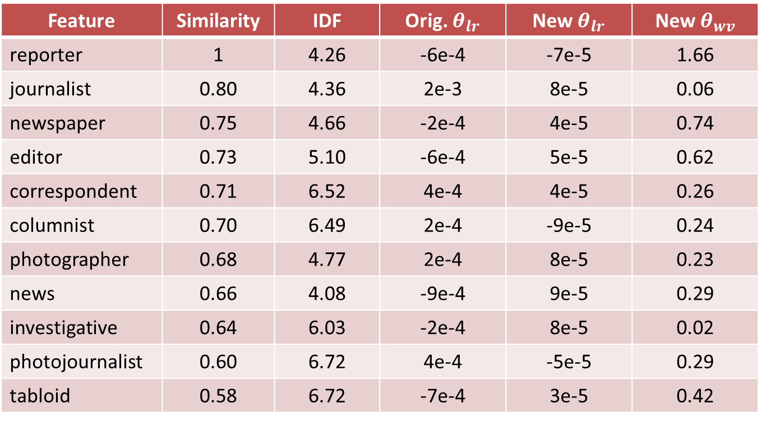
IMDb – News class
Feature | Similarity | IDF | Orig. $θ_{lr}$ | New $θ_{lr}$ | New $θ_{wv}$
reporter | 1 | 4.26 | -6e-4 | -7e-5 | 1.66
journalist | 0.80 | 4.36 | 2e-3 | 8e-5 | 0.06
newspaper | 0.75 | 4.66 | -2e-4 | 4e-5 | 0.74
editor | 0.73 | 5.10 | -6e-4 | 5e-5 | 0.62
correspondent | 0.71 | 6.52 | 4e-4 | 4e-5 | 0.26
columnist | 0.70 | 6.49 | 2e-4 | -9e-5 | 0.24
photographer | 0.68 | 4.77 | 2e-4 | 8e-5 | 0.23
news | 0.66 | 4.08 | -9e-4 | 9e-5 | 0.29
investigative | 0.64 | 6.03 | -2e-4 | 8e-5 | 0.02
photojournalist | 0.60 | 6.72 | 4e-4 | -5e-5 | 0.29
tabloid | 0.58 | 6.72 | -7e-4 | 3e-5 | 0.42

Slide 29
Medical dataset – Overall
 | Set Accuracy | Instance F1
Vanilla LR | 8.83 | 10.18
Modified LR Model | 37.4 | 51.04

Slide 30
Medical dataset – Individual Labels
 | Label | Vanilla LR (Label F1) | Our model (Label F1) | Improvement
Nontoxic goiter | icd10_E04 | 2.24 | 89.98 | 87.74
Abnormal findings | icd10_R91 | 19.59 | 82.85 | 63.26
Osteoarthritis knee | icd10_M17 | 17.20 | 80.10 | 62.89
Soft tissue disorders | icd10_M798 | 10.91 | 69.57 | 58.66
Primary osteoarthritis | icd10_M190 | 17.14 | 73.59 | 56.45
Pleural effusion | icd10_J90 | 23.61 | 78.1 | 54.49
Cough | icd10_R05 | 31.43 | 85.86 | 54.43
Pneumothorax | icd10_J93 | 42.18 | 75.56 | 33.38
Dyspnea | icd10_R060 | 23.77 | 49.01 | 25.24
Malignant neoplasm of breast | icd10_Z123 | 95.86 | 99.87 | 3.98

Slide 31
Medical dataset – Deeper Analysis
icd10_E04 | Orig. LR | F1 | TN | FP | FN | TP
Vanilla LR | train | 3.62 | 644631 | 11 | 6685 | 126
 | test | 2.24 | 93807 | 0 | 959 | 11
Modified LR | train | 89.84 | 644165 | 477 | 867 | 5944
 | test | 89.98 | 93728 | 79 | 112 | 858
icd10_Z123 | Orig. LR | F1 | TN | FP | FN | TP
Vanilla LR | train | 95.64 | 610019 | 690 | 2776 | 37968
 | test | 95.88 | 89236 | 87 | 351 | 5103
Modified LR | train | 99.48 | 610669 | 40 | 382 | 40362
 | test | 99.87 | 89322 | 1 | 13 | 5441

Slide 32
20 Newsgroup – Overall
 | F1 Score/Accuracy
Continuous wv embedding (LR) | 45.8
WV-coefficeints (LR) | 49.5
LR + WV Reg. | 55.48
Vanilla LR | 55.75
Modified LR Model | 58.8

Slide 33
20 Newsgroup – Individual Labels
Label | Vanilla LR (Label F1) | Our model (Label F1) | Improvement
comp.sys.ibm.pc.hardware | 48.98 | 56.68 | 7.7
soc.religion.christian | 58.24 | 64.09 | 5.85
talk.politics.misc | 46.45 | 51.9 | 5.45
comp.os.ms-windows.misc | 55.17 | 60.3 | 5.13
comp.graphics | 51.81 | 56 | 4.19
comp.windows.x | 67 | 71 | 4
sci.electronics | 51.04 | 55.03 | 3.99

Slide 34
20 Newsgroup – Deeper Analysis
pc hardware | Orig. LR | F1 | TN | FP | FN | TP
Vanilla LR | train | 95.81 | 12435 | 1 | 55 | 641
 | test | 48.98 | 1782 | 47 | 53 | 48
Modified LR | train | 98.54 | 12436 | 0 | 20 | 676
 | test | 56.68 | 1796 | 33 | 48 | 53
politics talk | Orig. LR | F1 | TN | FP | FN | TP
Vanilla LR | train | 96.03 | 12582 | 2 | 40 | 508
 | test | 46.45 | 1811 | 31 | 52 | 36
Modified LR | train | 97.95 | 12584 | 0 | 22 | 526
 | test | 51.9 | 1813 | 29 | 47 | 41

Slide 35
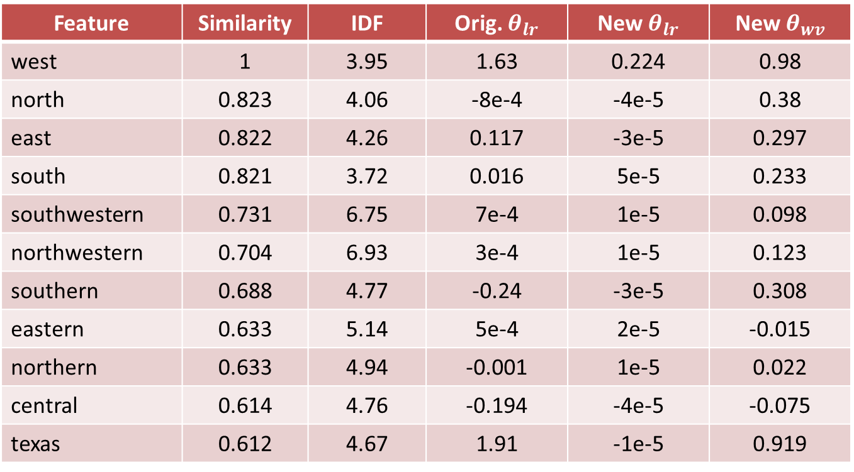
IMDb – Western class
Feature | Similarity | IDF | Orig. $θ_{lr}$ | New $θ_{lr}$ | New $θ_{wv}$
west | 1 | 3.95 | 1.63 | 0.224 | 0.98
north | 0.823 | 4.06 | -8e-4 | -4e-5 | 0.38
east | 0.822 | 4.26 | 0.117 | -3e-5 | 0.297
south | 0.821 | 3.72 | 0.016 | 5e-5 | 0.233
southwestern | 0.731 | 6.75 | 7e-4 | 1e-5 | 0.098
northwestern | 0.704 | 6.93 | 3e-4 | 1e-5 | 0.123
southern | 0.688 | 4.77 | -0.24 | -3e-5 | 0.308
eastern | 0.633 | 5.14 | 5e-4 | 2e-5 | -0.015
northern | 0.633 | 4.94 | -0.001 | 1e-5 | 0.022
central | 0.614 | 4.76 | -0.194 | -4e-5 | -0.075
texas | 0.612 | 4.67 | 1.91 | -1e-5 | 0.919

Slide 36
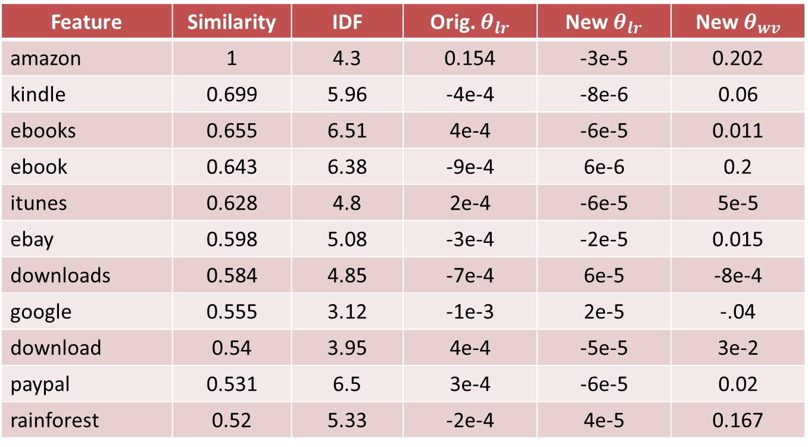
Guardian – Brazil class
Feature | Similarity | IDF | Orig. $θ_{lr}$ | New $θ_{lr}$ | New $θ_{wv}$
amazon | 1 | 4.3 | 0.154 | -3e-5 | 0.202
kindle | 0.699 | 5.96 | -4e-4 | -8e-6 | 0.06
ebooks | 0.655 | 6.51 | 4e-4 | -6e-5 | 0.011
ebook | 0.643 | 6.38 | -9e-4 | 6e-6 | 0.2
itunes | 0.628 | 4.8 | 2e-4 | -6e-5 | 5e-5
ebay | 0.598 | 5.08 | -3e-4 | -2e-5 | 0.015
downloads | 0.584 | 4.85 | -7e-4 | 6e-5 | -8e-4
google | 0.555 | 3.12 | -1e-3 | 2e-5 | -.04
download | 0.54 | 3.95 | 4e-4 | -5e-5 | 3e-2
paypal | 0.531 | 6.5 | 3e-4 | -6e-5 | 0.02
rainforest | 0.52 | 5.33 | -2e-4 | 4e-5 | 0.167

Slide 37
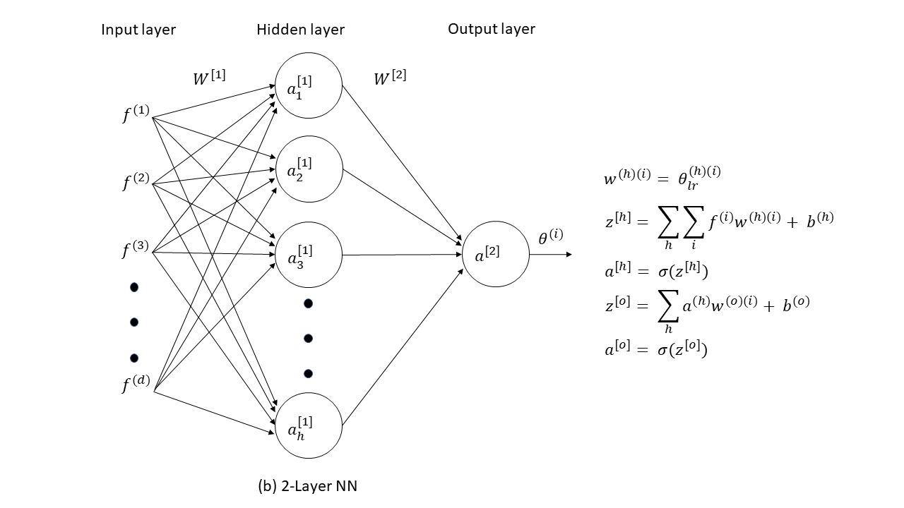
Feed-forward NN (no word-vectors)
Added a hidden layer to train a feed-forward neural network

Slide 38
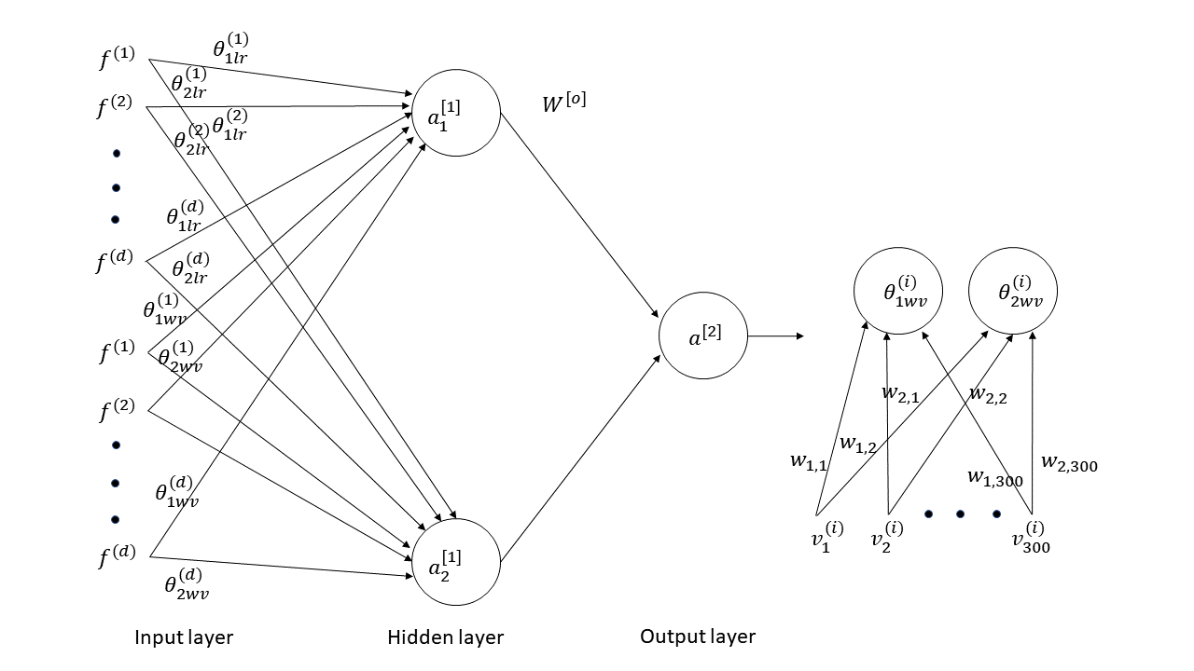
Feed-forward NN (with word-vectors)
Added a hidden layer to train a feed-forward neural network

Slide 39
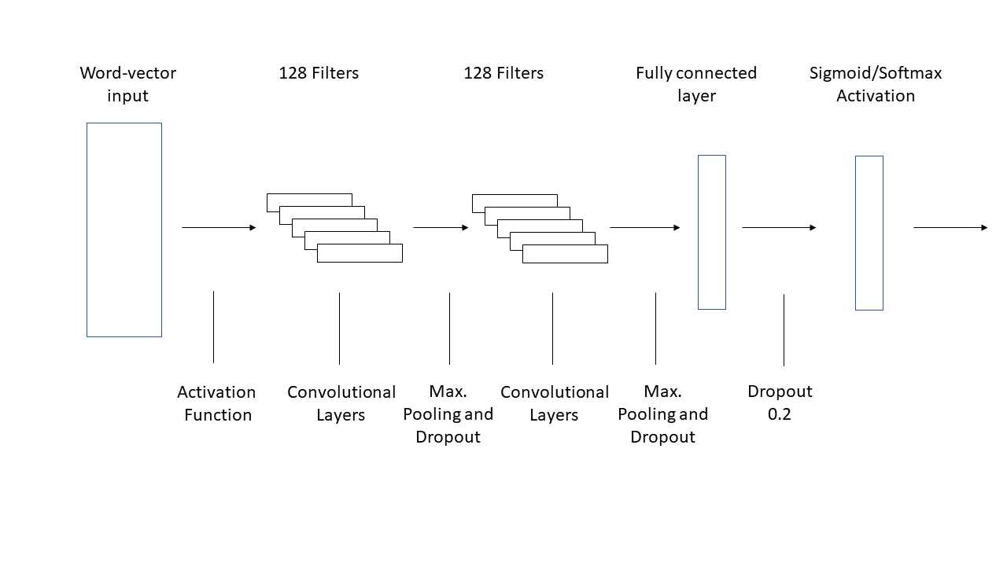
1D CNN
2 x 1D CNN with 128 filters, MaxPooling, Dropout and fully connected layer

Slide 40
Performance – Neural Networks
- IMDb dataset
IMDb | Set Accuracy | Instance F1
2 layer NN | 17.76 | 56.83
2 layer NN with wv | 19.63 | 60.21
CNN | 17.43 | 56.92
- 20 Newsgroup
20 Newsgroup | F1
2 layer NN | 56.72
2 layer NN with wv | 58.97
CNN | 57.59

Slide 41
Further work
Some models are not trained enough
TensorFlow designed for dense vectors? I loaded sparse vectors but it took longer than other LR implementations

Slide 42
Related Work
Incorporate features using dictionaries and encyclopedias - Mavroeidis et. al(2005)
Enrich Bag-of-words model with related terms found in a word vector model - Heal et. Al(2017)
Use part-of-speech tags associated with words contained in a document – Scott and Matwin (1998)

