Slide 1
Word-vector regularization for text classification algorithms
RAMKISHAN PANTHENA
MS in DATA SCIENCE
Khoury College of Computer Sciences

Slide 2
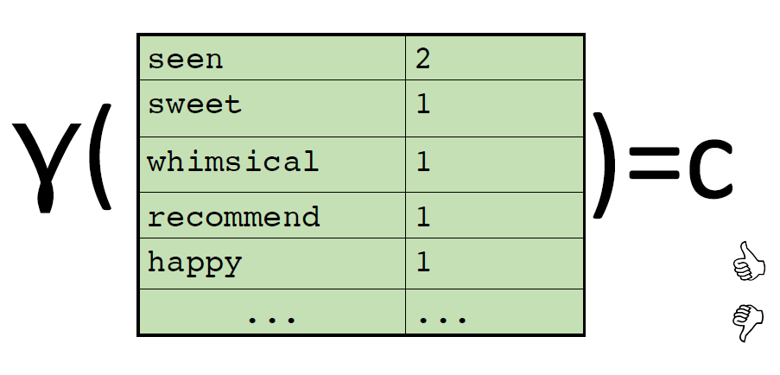
Introduction
Bag-of-words model represents text as bag of words disregarding word order
Commonly used for text classification with each word used as a feature

Slide 3
Problem Statement
Bag-of-words model although widely used, contains several limitations:
Large vocabulary increases total number of unique words in the vocabulary
Causes extremely sparse representations that are hard to train
Large number of classes and highly imbalanced distribution of instances across different classes

Slide 4
Example Case
Drug classification problem
Guardian dataset
Feature | Doc. count
cannabis | 350
marijuana | 7
cocaine | 18
heroin | 63
substances | 16
tobacco | 33
narcotics | 7

Slide 5
Proposed Idea
Constrain weights of rare features by similar, more frequent ones, using semantic similarity
This would enforce similar words to have similar weights thereby improving test performance
Use word-vectors to assign semantic similarity

Slide 6
4 Logistic Regression models
Continuous word vector feature model
Word vector coefficients model
Logistic Regression with word vector regularization
Modified Logistic Regression model

Slide 7
Continuous word vector feature model
Compute mean of word vectors across document terms
Obtain 300 document features
Train logistic regression on these features

Slide 8
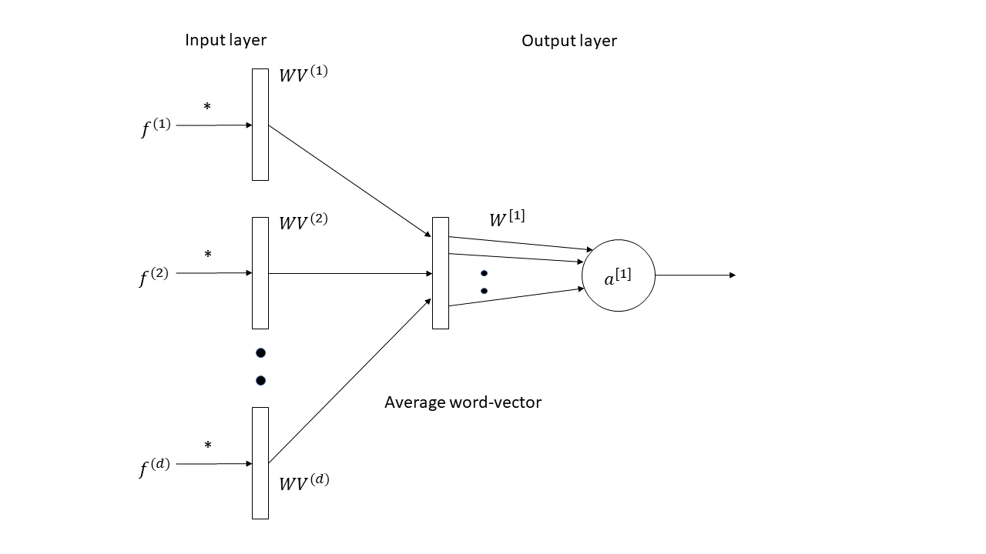
Continuous word vector feature model

Slide 9
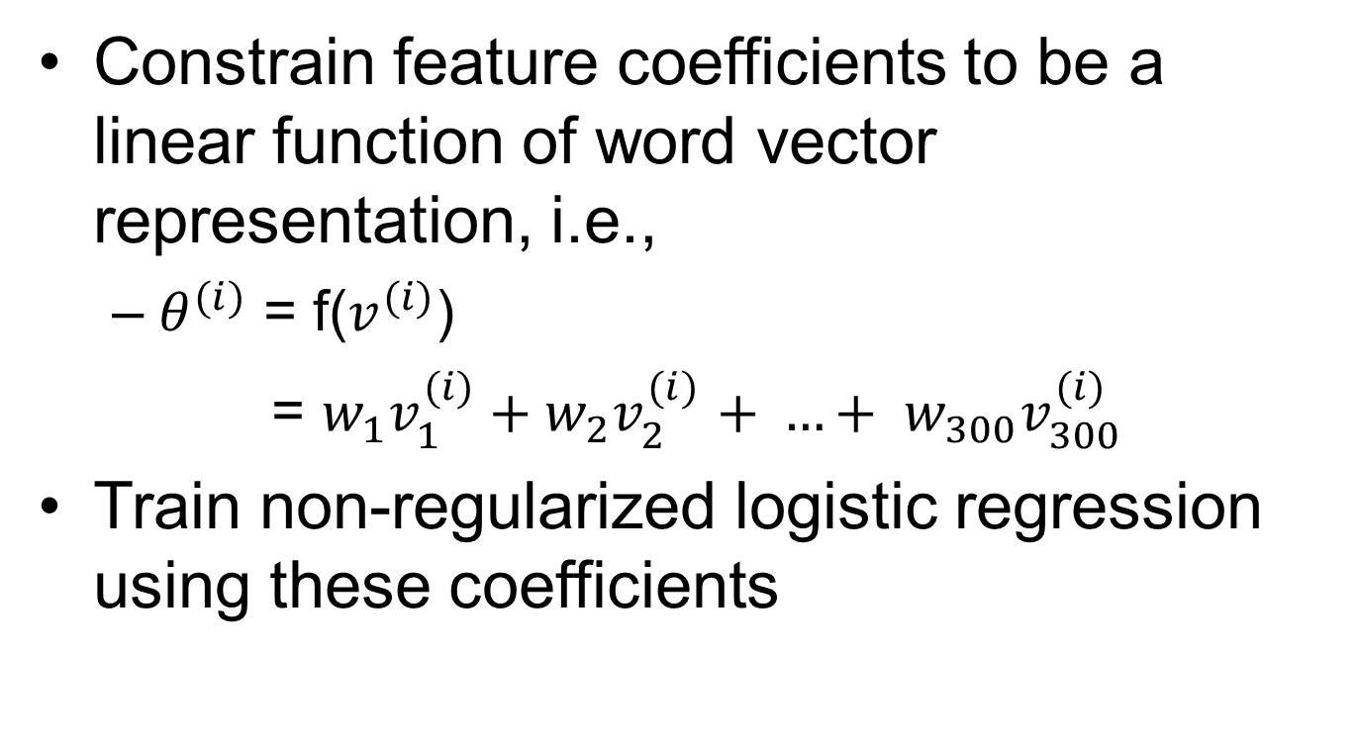
Word vector coefficients model
Constrain feature coefficients to be a linear function of word vector representation, i.e.,
$θ^{(i)}$ = f($v^{(i)}$)
= $w_{1}v_{1}^{(i)}+w_{2}v_{2}^{(i)}$ $+ …+ w_{300}v_{300}^{(i)}$
Train non-regularized logistic regression using these coefficients

Slide 10
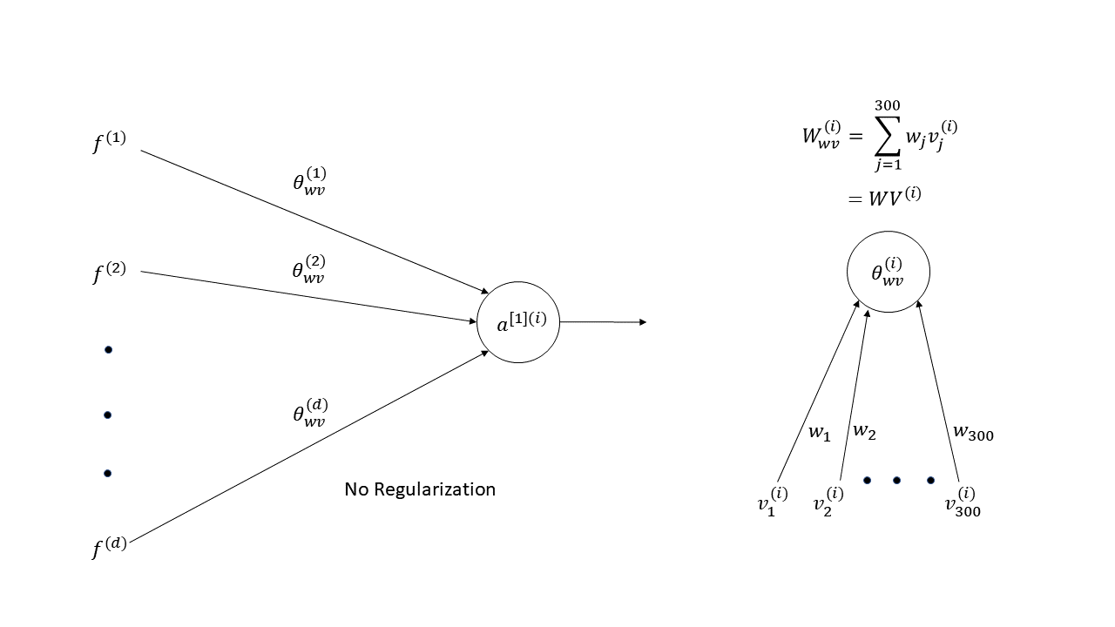
Word vector coefficients model

Slide 11
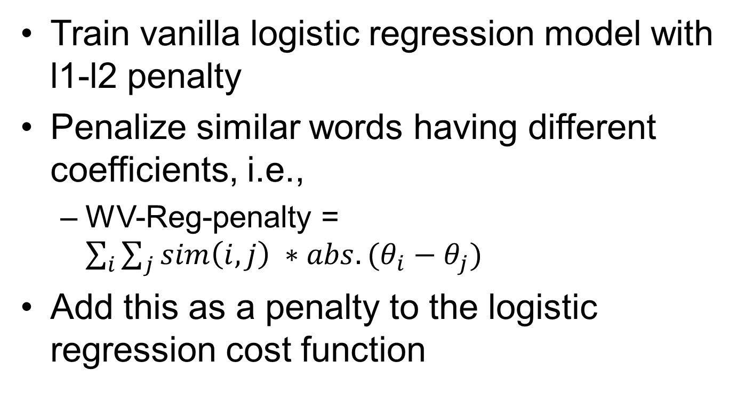
Word vector regularization
Train vanilla logistic regression model with l1-l2 penalty
Penalize similar words having different coefficients, i.e.,
WV-Reg-penalty = $\sum_{i}{\sum_{j}{sim\left(i, j\right) ∗abs. (θ_{i}−θ_{j})}}$
Add this as a penalty to the logistic regression cost function

Slide 12
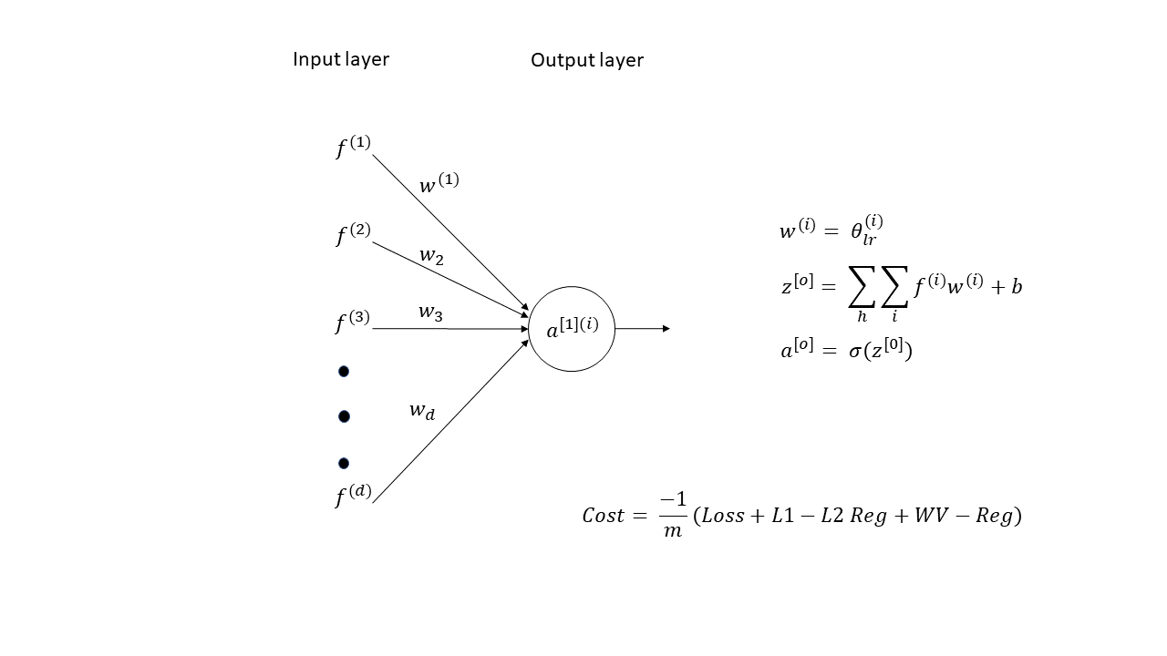
Word vector regularization

Slide 13
Word vector regularization
Challenges faced
Expensive to compute the cost at the end of every mini-batch cycle
Mitigated the expense by computing the weight differences for a fixed set of features

Slide 14
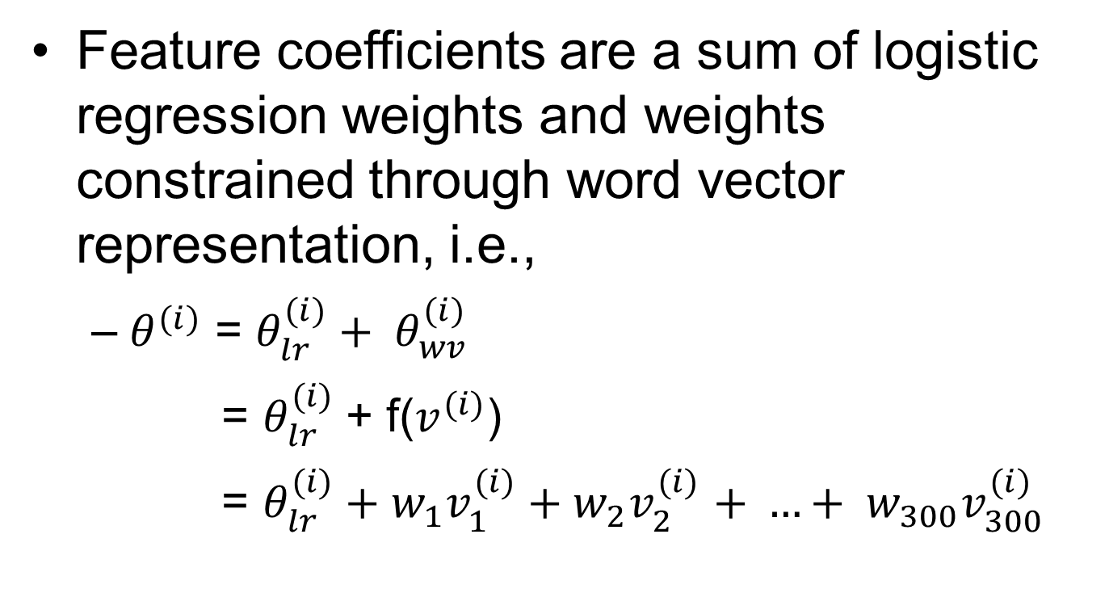
Modified logistic regression model
Feature coefficients are a sum of logistic regression weights and weights constrained through word vector representation, i.e.,
$θ^{(i)}$ = $θ_{lr}^{(i)}+ θ_{wv}^{(i)}$
= $θ_{lr}^{(i)}$+ f($v^{(i)}$)
= ${θ_{lr}^{(i)}+w}_{1}v_{1}^{(i)}+w_{2}v_{2}^{(i)}$ $+ …+ w_{300}v_{300}^{(i)}$

Slide 15
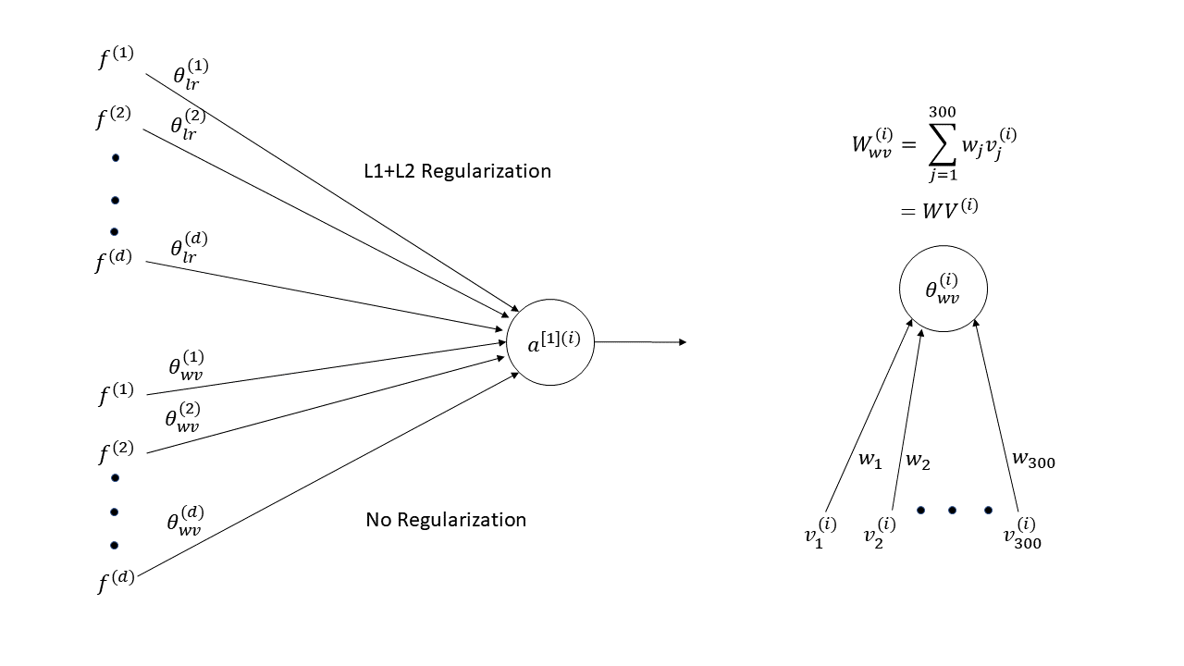
Modified logistic regression model

Slide 16
Experimental setup
Generated bag-of-words model on text
Re-trained word vectors on individual datasets using Google’s pre-trained model as a prior
Trained the model on multi-class and multi-label datasets

Slide 17
Evaluation for multi-label data
Set-accuracy: ratio of perfectly matched instances to total number of instances
Instanct-F1: evaluate performance of partially correct predictions averaged over all instances
Label-F1: evaluate performance of partially correct predictions average over all labels

Slide 18
Datasets
IMDb:
Movie plot text summaries labelled with genres sourced from IMDb
35,000 documents across 25 different genres
Assign multiple genres to a movie description
20 Newsgroup:
Dataset of 20,000 newsgroup documents across 20 different newsgroups

Slide 19
Datasets
Medical dataset:
Guardian:
British newspaper containing articles on topics like World news, Culture, Politics, etc.
All data has been manually scrapped from Guardian website with document and its tags

Slide 20
IMDb - Overall
 | Set Accuracy | Instance F1
Continuous wv embedding (LR) | 7.3 | 45.2
WV-coefficeints (LR) | 6.1 | 45.69
LR + WV Reg. | 17.19 | 56.32
Vanilla LR | 18.21 | 57.87
Modified LR Model | 20.30 | 58.52

Slide 21
IMDb - Individual Labels
Label | Vanilla LR (Label F1) | Our model (Label F1) | Improvement
News | 0.00 | 50.00 | 50.00
Musical | 33.54 | 43.78 | 10.24
Animation | 44.66 | 50.23 | 5.57
Sport | 61.65 | 67.13 | 5.47
Film Noir | 25.31 | 30.23 | 4.91
War | 58.64 | 62.92 | 4.27
Sci-Fi | 68.83 | 72.73 | 3.89

Slide 22
IMDb – Deeper Analysis
News | Orig. LR | F1 | TN | FP | FN | TP
Vanilla LR | train | 0.00 | 22412 | 0 | 9 | 0
 | test | 0.00 | 3114 | 1 | 3 | 0
Modified LR | train | 100.00 | 22412 | 0 | 0 | 9
 | test | 50.00 | 3115 | 0 | 2 | 1
Musical | Orig. LR | F1 | TN | FP | FN | TP
Vanilla LR | train | 82.88 | 21730 | 4 | 198 | 489
 | test | 33.54 | 2984 | 25 | 82 | 27
Modified LR | train | 85.07 | 21724 | 10 | 171 | 516
 | test | 43.79 | 2986 | 23 | 72 | 37

Slide 23
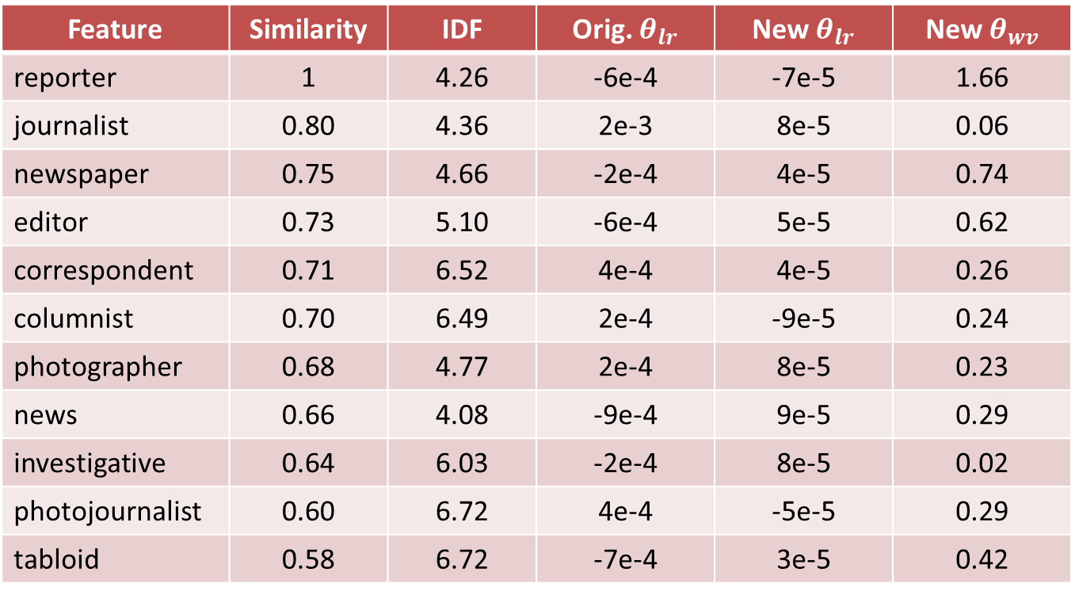
IMDb – News class
Feature | Similarity | IDF | Orig. $θ_{lr}$ | New $θ_{lr}$ | New $θ_{wv}$
reporter | 1 | 4.26 | -6e-4 | -7e-5 | 1.66
journalist | 0.80 | 4.36 | 2e-3 | 8e-5 | 0.06
newspaper | 0.75 | 4.66 | -2e-4 | 4e-5 | 0.74
editor | 0.73 | 5.10 | -6e-4 | 5e-5 | 0.62
correspondent | 0.71 | 6.52 | 4e-4 | 4e-5 | 0.26
columnist | 0.70 | 6.49 | 2e-4 | -9e-5 | 0.24
photographer | 0.68 | 4.77 | 2e-4 | 8e-5 | 0.23
news | 0.66 | 4.08 | -9e-4 | 9e-5 | 0.29
investigative | 0.64 | 6.03 | -2e-4 | 8e-5 | 0.02
photojournalist | 0.60 | 6.72 | 4e-4 | -5e-5 | 0.29
tabloid | 0.58 | 6.72 | -7e-4 | 3e-5 | 0.42

Slide 24
20 Newsgroup - Overall
 | F1 Score/Accuracy
Continuous wv embedding (LR) | 45.8
WV-coefficeints (LR) | 49.5
LR + WV Reg. | 55.48
Vanilla LR | 55.75
Modified LR Model | 58.8

Slide 25
20 Newsgroup - Individual Labels
Label | Vanilla LR (Label F1) | Our model (Label F1) | Improvement
comp.sys.ibm.pc.hardware | 48.98 | 56.68 | 7.7
soc.religion.christian | 58.24 | 64.09 | 5.85
talk.politics.misc | 46.45 | 51.9 | 5.45
comp.os.ms-windows.misc | 55.17 | 60.3 | 5.13
comp.graphics | 51.81 | 56 | 4.19
comp.windows.x | 67 | 71 | 4
sci.electronics | 51.04 | 55.03 | 3.99

Slide 26
20 Newsgroup – Deeper Analysis
pc hardware | Orig. LR | F1 | TN | FP | FN | TP
Vanilla LR | train | 95.81 | 12435 | 1 | 55 | 641
 | test | 48.98 | 1782 | 47 | 53 | 48
Modified LR | train | 98.54 | 12436 | 0 | 20 | 676
 | test | 56.68 | 1796 | 33 | 48 | 53
politics talk | Orig. LR | F1 | TN | FP | FN | TP
Vanilla LR | train | 96.03 | 12582 | 2 | 40 | 508
 | test | 46.45 | 1811 | 31 | 52 | 36
Modified LR | train | 97.95 | 12584 | 0 | 22 | 526
 | test | 51.9 | 1813 | 29 | 47 | 41

Slide 27
Guardian - Overall
 | Set Accuracy | Instance F1
Continuous wv embedding (LR) | 43.65 | 60.61
WV-coefficeints (LR) | 42.36 | 59.65
Vanilla LR | 53.46 | 65.61
Modified LR Model | 59.3 | 69.41

Slide 28
Guardian - Individual Labels
Label | Vanilla LR (Label F1) | Our model (Label F1) | Improvement
Drugs | 80.5 | 88.75 | 8.25
Mental Health | 69.23 | 76.8 | 7.57
Global economy | 56.34 | 62.69 | 6.35
LGBT | 76.84 | 82.9 | 6.06
Blogging | 77.3 | 82.72 | 5.42
Public finance | 48.24 | 53.33 | 5.09
Premier League | 90 | 95.03 | 5.03

Slide 29
Guardian – Deeper Analysis
Drugs | Orig. LR | F1 | TN | FP | FN | TP
Vanilla LR | train | 92.46 | 10632 | 19 | 60 | 485
 | test | 80.50 | 1463 | 15 | 16 | 64
Modified LR | train | 94.91 | 10639 | 12 | 42 | 503
 | test | 88.75 | 1469 | 9 | 9 | 71
Global Economy | Orig. LR | F1 | TN | FP | FN | TP
Vanilla LR | train | 87.36 | 10541 | 50 | 97 | 508
 | test | 56.33 | 1456 | 30 | 32 | 40
Modified LR | train | 88.31 | 10575 | 16 | 114 | 491
 | test | 62.69 | 1466 | 20 | 30 | 42

Slide 30
Medical dataset (Overall)

Slide 31
Medical dataset (Individual Labels)

Slide 32
Related Work
Incorporate features using dictionaries and encyclopedias
Enrich BoW model with related terms found in a word vector model
Use part-of-speech tags associated with words contained in a document

Slide 33
QA Prep
Why other 3 models don’t work?
Why not deep neural networks like CNN, LSTMs? (get stuck, need more tuning)
Why not bigrams/trigrams?

