Slide 1



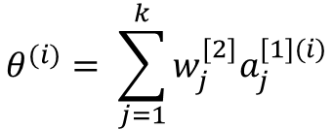




















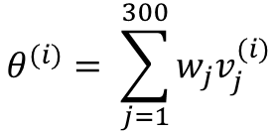

Input layer
Output layer
Input layer
Hidden layer
Output layer
$$W^{[1]}$$
$$a_{1}^{[1](i)}$$
$$W^{[2]}$$
$$v_{1}^{(i)}$$
$$v_{1}^{(i)}$$
$$w_{1}$$
$$a_{2}^{[1](i)}$$
$$v_{2}^{(i)}$$
$$v_{2}^{(i)}$$
$$w_{2}$$
$$v_{3}^{(i)}$$
$$w_{3}$$
$$θ^{(i)}$$
$$v_{3}^{(i)}$$
$$θ^{(i)}$$
$$a^{[1](i)}$$
$$a_{3}^{[1](i)}$$
$$a^{[2](i)}$$
$$w_{300}$$
$$θ^{(i)}= \sum_{j=1}^{300}{w_{j}v_{j}^{(i)}}$$
$$θ^{(i)}= \sum_{j=1}^{k}{w_{j}^{[2]}a_{j}^{[1](i)}}$$
$$v_{300}^{(i)}$$
$$=WV^{(i)}$$
$$v_{300}^{(i)}$$
$$=W^{[2]}a^{[1](i)}$$
$$a_{k}^{[1](i)}$$
(a) Regression
(b) 2-Layer NN

