Slide 1

Saree Trends Analysis

Slide 2
About me
Background ? (B-tech or M-tech)
Why you want to learn Data Science
Any work experience

Slide 3
Agenda
Business Problem and Use case domain understanding(If Required)
Objective of the Project
Web Scraping – Details (Websites, Processor you followed)
Summary of the Data
Web Scraping
Data Cleaning and Data Manipulation Steps
Data Analysis
Data Visualization
Observation
Challenges

Slide 4
Business Problem and Use case domain understanding
Problem statement:
Analyzing pricing, discounts, and product features in the online saree market.The goal is to uncover trends that guide better business, pricing, and marketing strategies.

Slide 5

Data Collection
Source : E-COMMERCE PLATFORM
libraries Used :
requests
BeautifulSoup
RegEx
pandas
Data Fields Extracted:
Brand, Design, Type, Fabric, Price, Actual Price, Discount, Percentage, DiscountPrice, Color

Slide 6



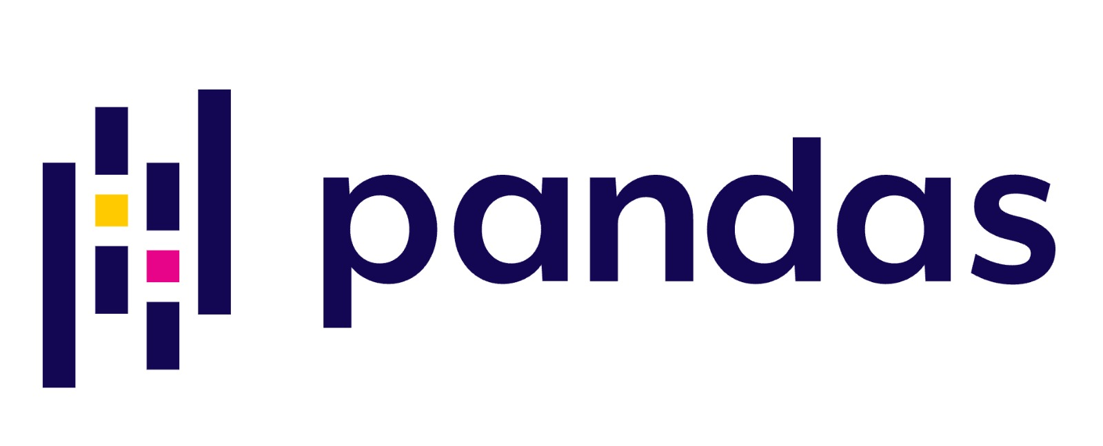
LIBRARIES
Requests : Fetched the HTML content from web pages
BeautifulSoup : Parsing and Extracting content from HTML
RegEx : Regular expressions for pattern matching
pandas : For storing and analyzing structured data

Slide 7
Data Overview
This Dataset is collected through WEB SCRAPPING using Python
Having 760 records and 8 features/columns
It has 2 Numerical Columns and 6 Categorical Columns
It has the information like brand name, color, type, discount, price etc..
Key Features:
Brand,Design,Type,Fabric,Color,ActualPrice,DiscountPercentage,DiscountPrice

Slide 8
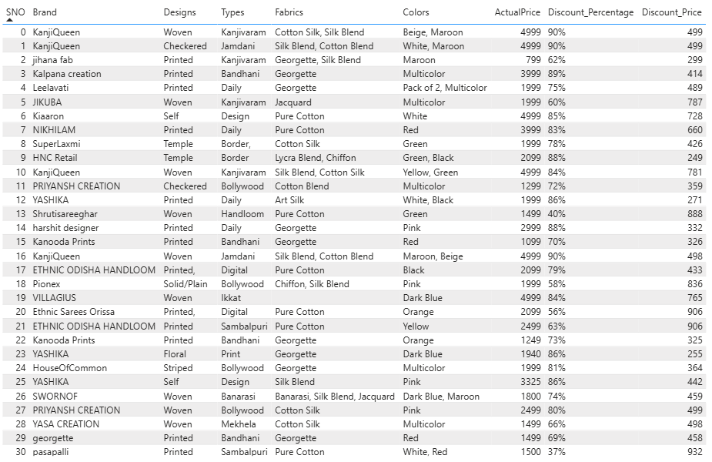

Slide 9
Data Cleaning
Removed duplicates and irrelevant entries
Handled missing values
Converted price and discount to numeric format for analysis

Slide 10
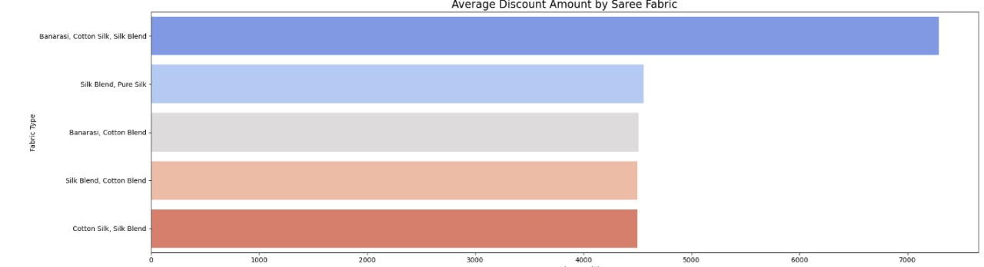
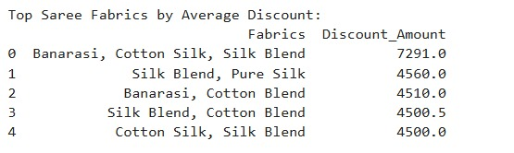
Data Analysis
Which saree fabric offers the highest average discount

Slide 11
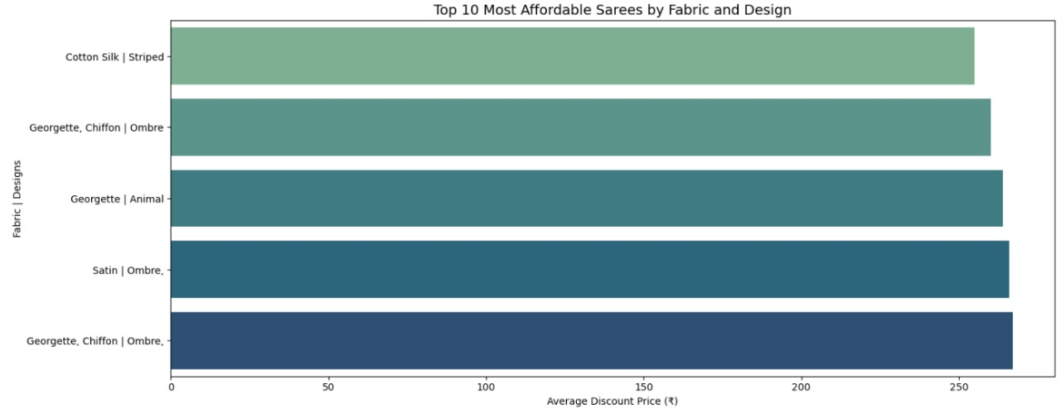
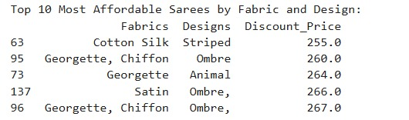
What are the most affordable sarees by fabric and design

Slide 12
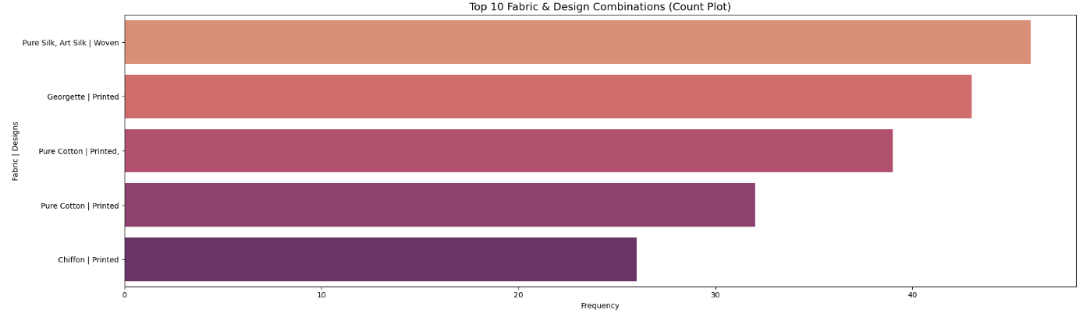
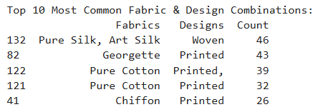
What combination of fabric and design is most common?

Slide 13
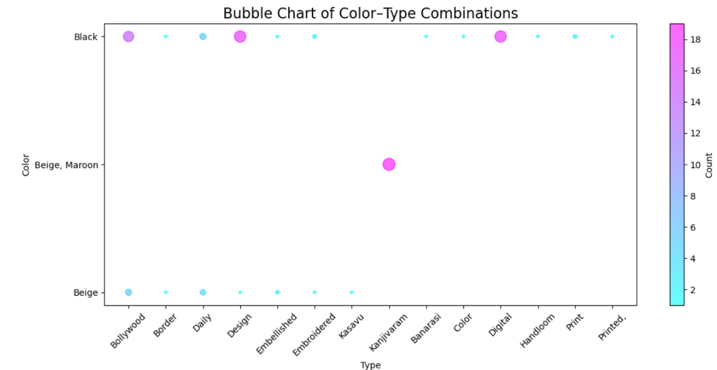
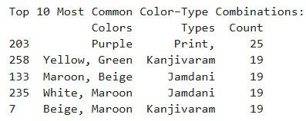
Are there specific color-type combinations that dominate sales

Slide 14
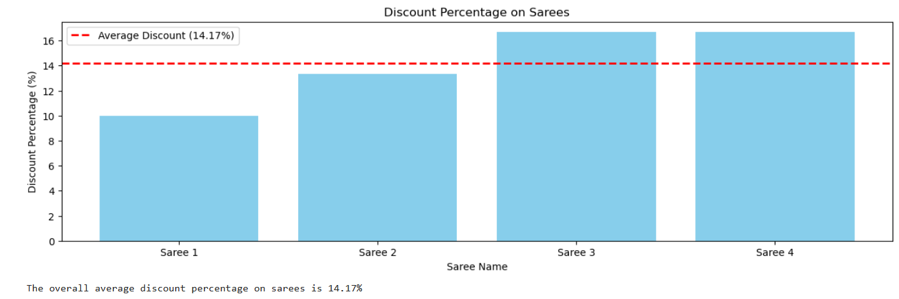
What is the overall average discount % offered on sarees?

Slide 15
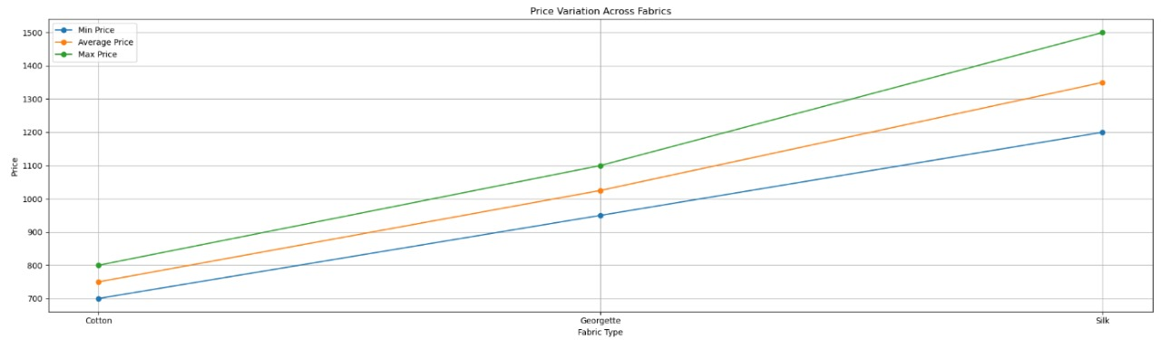
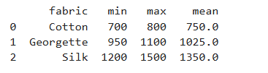
How do price ranges vary across different fabrics or designs?

Slide 16
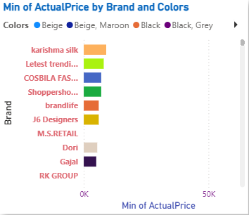
Visualization
Min of Actual Price by Brand and Colors
What it shows: The minimum price of sarees offered by each brand, with color combinations.
Example: Karishma Silk has the lowest-priced saree in colors like Multicolors.
Why it matters: Helps identify budget-friendly brands and popular affordable color choices.

Slide 17
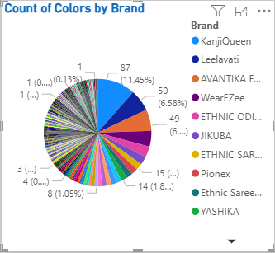
Count of Brand by Types
What it shows: How many color options each brand provides.
Insight: Brands like KanjiQueen and Leelavati offer the highest number of color variations.
Why it matters: Indicates brand diversity and appeal to wider customer preferences.

Slide 18
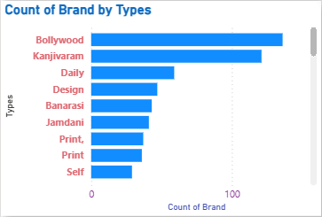
Count of Brand by Types
What it shows: How many brands are offering each type of saree
Insight: Bollywood type is offered by 136 Brands
Why it matters: Shows which type of sarees are offered by more Brands

Slide 19
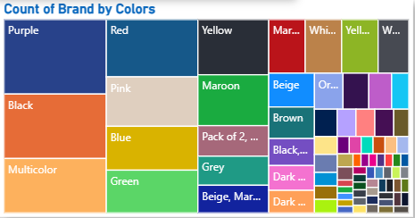
Count of Brand by Colors
What it shows: How many brands use each color in their sarees.
Insight: Purple, Black, and Multicolor are used by many brands—indicating popularity.
Why it matters: Color trends are crucial for marketing and inventory decisions.

Slide 20
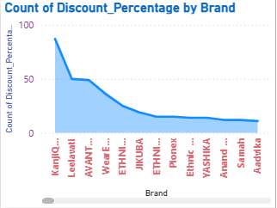
Count of Discount_Percentage by Brand
What it shows: Number of discount entries per brand.
Insight: KanjiQueen, Leelavati, and AVANTIKA FASHION appear to offer frequent discounts.
Why it matters: Brands with frequent discounts might be using price as a key promotional tool.

Slide 21
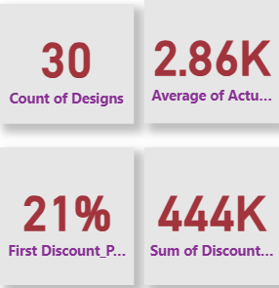
KPI Cards
Average of Actual Price: ₹2.86K – The average price across all sarees.
First Discount Percentage: 21% – A likely starting discount across brands.
Sum of Discount: ₹444K – The total cumulative discount from all products.
Why it matters: These KPIs give a quick, high-level view of overall pricing and promotional strategies.

Slide 22
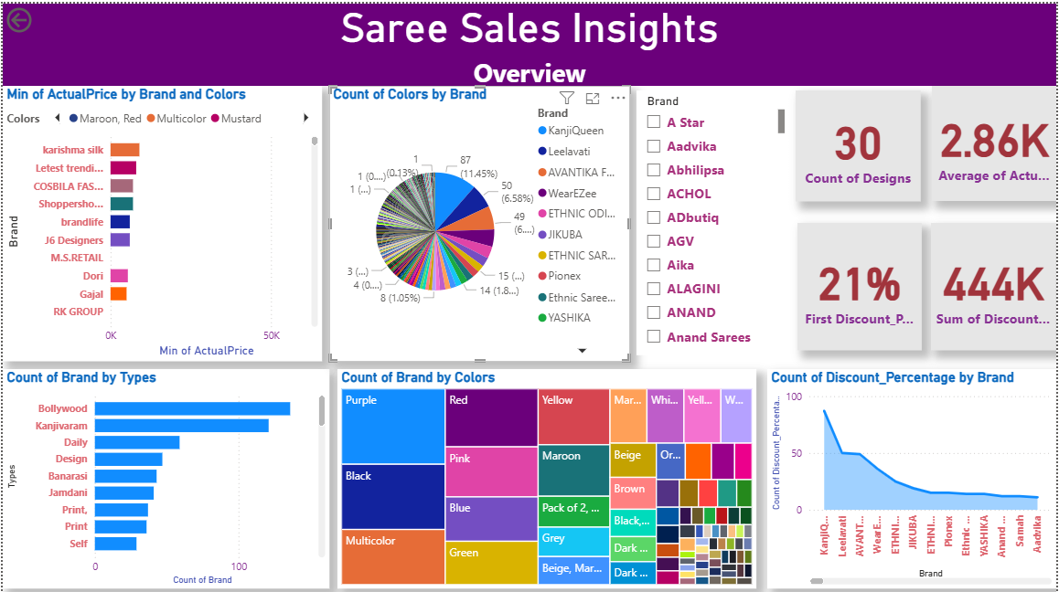

Slide 23
Dashboard Overview
This interactive Power BI dashboard provides a comprehensive analysis of saree products listed on Flipkart, extracted through web scraping. It visualizes key patterns in pricing, discounting, brand variety, color popularity, and product types to uncover market trends and consumer preferences.
Key Components of the Dashboard:
Minimum Actual Price by Brand and Color → Identifies affordable brands and popular color combinations.
Brand Count by Saree Type → Reveals which saree types (e.g., Bollywood, Kanjivaram) are most common among sellers.
Color Variations by Brand → Highlights which brands offer the widest color choices.
Color Popularity Across Brands → Shows the most frequently used colors in the saree segment.
Discount Distribution by Brand → Analyzes which brands offer the most discounts and how frequently.
KPI Cards → Show average actual price, average discount percentage, and total discounts offered across listings.
Purpose & Business Value:
To understand consumer demand patterns, such as preferred saree types and colors.
To assess competitor pricing and discount strategies.
To support inventory planning, marketing campaigns, and pricing optimization.
To enable data-driven decisions for enhancing customer satisfaction and boosting sales in the online saree market.

Slide 24
Challenges
Web Scraping Challenges
Website Structure Complexity: Flipkart's dynamic content and complex HTML might make it
hard to extract consistent data
Incomplete or Missing Data: Not all products may have all fields (e.g., missing discount info),
requiring handling of null values.
Data Cleaning & Preparation Challenges
Duplicate and Irrelevant Entries: Required filtering to ensure accurate analysis.
Data Type Conversions: Prices and discount values needed conversion from strings to numeric formats,
which can be error-prone.

Slide 25
Insights and Business Decisions
Affordable Brands Attract More Interest
High Demand for Bollywood and Kanjivaram Types
Purple, Black, and Multicolor Are Leading Color Trends
Brands with Greater Color Variety Are More Competitive
Discounts Are a Key Purchase Driver
Pricing Sweet Spot and Discount Strategy

Slide 26

THANK YOU

