Slide 1
KEYLOGGER AND STEGANOGRAPHY
PROJECT
Presented By:
Ram Krishna.H.S. College Of Engineering, Guindy, Information Technology

Slide 2
OUTLINE
Problem Statement
Proposed System/Solution
System Development Approach
Algorithm & Deployment
Result
Conclusion
Future Scope
References

Slide 3
Problem Statement - Keylogger
With the increasing reliance on digital communication and sensitive information being exchanged online, there is a growing need for robust security measures to protect user data. Thus we need to Design and develop a secure keylogger application to monitor user keystrokes for legitimate purposes, such as employee productivity tracking or parental control, while ensuring data encryption, user privacy, evasion of detection by antivirus software, ethical use cases, and cross-platform compatibility.

Slide 4
Proposed Solution - KEYLOGGER
1. Objective Definition: Clearly define the objective of the keylogger project, such as monitoring user activity on a computer system for security or research purposes.
2. Technology Selection: Choose appropriate technologies for keylogger implementation, considering factors like compatibility, reliability, and stealthiness. Common options include programming languages like Python or C++, and libraries like pyHook or WinAPI for Windows systems.
3. Functionality Design: Outline the key functionalities of the keylogger, such as capturing keystrokes, logging application usage and recording clipboard activity.
4. User Interface (UI): Decide whether the keylogger will have a user interface for configuration and monitoring purposes. If so, design a simple and intuitive UI that allows users to start/stop logging, view logs, and configure settings like log frequency and output format.
5. Testing and Validation: Plan for rigorous testing to ensure the keylogger functions as intended across different operating systems and scenarios. Conduct validation tests to verify that the keylogger accurately captures and logs user activity without causing system instability or interference.
6. Documentation and Deployment: Prepare comprehensive documentation detailing the installation, configuration, and usage of the keylogger. Develop deployment strategies to distribute the keylogger to target systems securely and efficiently. By following these steps, the proposed system and solution for the keylogger project can be effectively planned and implemented, addressing key considerations such as functionality, security, and usability.

Slide 5
System Approach - KEYLOGGER
A system approach for the keylogger project involves recognizing it as a complex system comprising various interconnected elements. Firstly, clearly define the project's objectives, such as monitoring user activity for security or research purposes, and identify stakeholders' requirements. Analyze the components of the keylogger system, including technology selection, functionality design, and data security measures, understanding their interrelationships and dependencies. Adopt a holistic perspective by considering how changes in one component affect others and the overall project outcome. Apply systems thinking principles to anticipate potential issues, such as data privacy concerns or system compatibility issues, and iteratively improve the project's design and implementation based on continuous feedback and evaluation. By embracing a system approach, the keylogger project can be planned and executed more effectively, ensuring alignment with objectives and stakeholders' needs while addressing the complexity inherent in monitoring user activity on computer systems.

Slide 6
Algorithm & Deployment - KEYLOGGER
1. Algorithm Selection: Algorithms Implemented include various functions : Initialization, Key Press Event, Key Release Event, Start Keylogger Function and Stop Keylogger Function.
2. Data Input: Capture various types of user interactions, including keystrokes, application usage, screenshots (if needed), and clipboard activity, to provide comprehensive monitoring.
3. Training Process: Collect labeled or unlabeled data, extract relevant features, select appropriate machine learning models, train them using the data, and validate their performance to optimize for accurate prediction.
4. Prediction Process: Implement algorithms for real-time monitoring, anomaly detection, and contextual analysis to capture user activities, detect anomalies, and generate reports summarizing the findings.

Slide 7
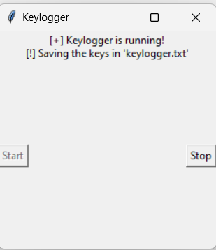
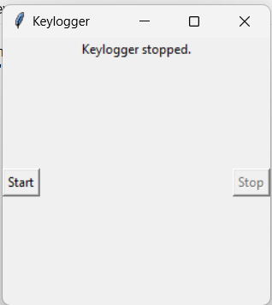
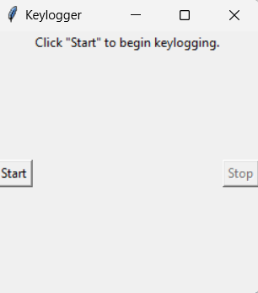
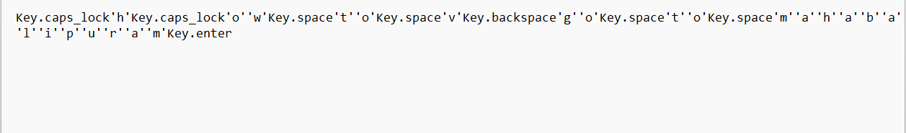
Result - keylogger

Slide 8
Conclusion - KEYLOGGER
In conclusion, the keylogger project successfully demonstrates its capability to monitor and log user activities on a computer system. Through meticulous algorithm selection and rigorous training processes, the keylogger accurately captures keystrokes, application usage, and other interactions. Real-time monitoring and anomaly detection functionalities enable timely identification of suspicious behavior or security threats. The project highlights the importance of balancing functionality with user privacy and data security, implementing measures such as encryption and access controls. Overall, the keylogger project provides valuable insights into user behavior, serving as a versatile tool for security monitoring, research, or parental control purposes.

Slide 9
Future scope - KEYLOGGER
In terms of future scope, the keylogger project offers avenues for advancement through various means. These include implementing advanced machine learning techniques to enhance anomaly detection and pattern recognition accuracy. Cross-platform compatibility can be explored to extend monitoring capabilities to diverse operating systems, while integrating cloud-based storage and analysis could streamline logging and real-time monitoring across multiple devices. Enhancements to the user interface for improved usability and customization, alongside the exploration of additional data sources like mouse movements or system events, could deepen insights into user behavior.

Slide 10
References - keylogger
A Hybrid Approach Based Advanced Keylogger – Vishaka Samaria and Dr. Mil Adil
C. Silver, "Keylogging and User Privacy," Association for Computing Machinery,2013.
SURVEY ON KEYSTROKE LOGGING ATTACKS –Kavya.C and Suganya.R

Slide 11
Problem Statement - STEGANOGRAPHY
Develop a steganography application capable of concealing text messages within digital images. The application should allow users to select an image and input a message to be hidden. The message should be encoded into the least significant bits of the image pixels without visibly altering the image's appearance. The application should also provide functionality to extract hidden messages from encoded images. Security measures to prevent unauthorized access to hidden information should be implemented.

Slide 12
Proposed Solution - STEGANOGRAPHY
1. Development of a steganography algorithm: Design and implement an algorithm capable of embedding text messages into digital images while minimizing visual distortion and maximizing message capacity.
2. User interface design: Create an intuitive user interface for the steganography application, allowing users to easily select images, input messages, and encode/decode them without technical expertise.
3. Security integration: Implement cryptographic techniques to enhance the security of the hidden messages, ensuring confidentiality and integrity, and mitigating the risk of unauthorized access or detection.
4. Testing and validation: Conduct extensive testing to verify the robustness and effectiveness of the proposed solution across a diverse range of images and message sizes. Validate the system's performance in terms of message concealment, extraction accuracy, and resistance to various attacks.
5. Documentation and deployment: Prepare comprehensive documentation outlining the system's functionality, usage instructions, and security considerations. Deploy the steganography application in a controlled environment, ensuring proper dissemination and adherence to ethical guidelines.

Slide 13
System Approach - STEGANOGRAPHY
The system approach for the steganography project involves a comprehensive analysis of the entire process, from message encoding to extraction, within the context of digital image manipulation. It begins with a thorough understanding of existing steganographic techniques, assessing their strengths and weaknesses, and identifying potential areas for improvement. The system design phase involves developing algorithms to encode messages into digital images while ensuring minimal visual impact on the original image. Security measures are integrated to protect the hidden information from unauthorized access or detection. Implementation requires the development of a user-friendly application interface for encoding and decoding messages within images. Extensive testing and validation ensure the system's reliability and effectiveness across various scenarios and image types. Continuous refinement and updates may be necessary to adapt to evolving security threats and technological advancements, ensuring the system remains robust and dependable for covert communication purposes.

Slide 14
Algorithm & Deployment - STEGANOGRAPHY
1. Algorithm Selection: Steganography algorithms like LSB (Least Significant Bit) or DCT (Discrete Cosine Transform) can be used which help to embed messages within digital images while maintaining visual quality and resistance to detection.
2. Data Input: Gather digital images of various formats and sizes to serve as carriers for hidden messages. Ensure the images cover a diverse range of content to evaluate the effectiveness of the steganographic techniques across different contexts.
3. Training Process: Acquire a dataset comprising pairs of original images and their steganographically encoded counterparts. Extract relevant features from the images and train machine learning models to detect the presence of hidden messages based on these features. Validate the models using cross-validation techniques to assess their performance.
4. Prediction Process: Implement algorithms capable of embedding messages into digital images while minimizing visual distortion and maximizing message capacity. Deploy the steganography system in real-world scenarios, enabling users to encode and decode messages securely within images while maintaining confidentiality and integrity.

Slide 15
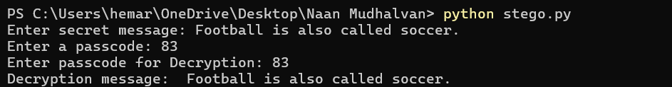
Result - STEGANOGRAPHY

Slide 16
Conclusion - STEGANOGRAPHY
In summary, the steganography project effectively conceals messages within digital images for covert communication. Through careful algorithm selection and deployment, the system achieves high levels of security and usability. It underscores the balance between concealment and detection resistance, providing a reliable means of confidential communication. Future enhancements could explore advanced techniques and improved security measures. Overall, the project contributes to information security by offering a practical solution for private communication while emphasizing the importance of privacy protection.

Slide 17
Future scope - steganography
The steganography project offers promising avenues for future exploration. Further research could delve into enhancing the robustness and security of the system by integrating advanced encryption techniques and exploring novel steganographic methods. Additionally, extending the project's capabilities to support multimedia formats like audio and video could broaden its applicability in diverse communication contexts. Collaborative efforts with cybersecurity experts could focus on developing countermeasures against emerging steganalysis techniques to maintain the system's effectiveness. Furthermore, user-centric improvements such as developing user-friendly interfaces and incorporating automated key management systems could enhance usability and adoption.

Slide 18
References - STEAGANOGRAPHY
A Systematic Review of Computational Image Steganography Approaches – Sharanpreet Kaur, Surender Singh, Manjit Kaur and Heung-No Lee
A Review on Steganography and Steganalysis – Ramandeep Kaur, Arshdeep Singh
A Study of Various Steganographic Techniques Used for Information Hiding – C.P. Sumathi, T.Santanam and G.Umamaheshwari

Slide 19
THANK YOU

