Slide 1
Detecting Depression Through Tweets
By Ramkrishna Kamble
190020094

Slide 2
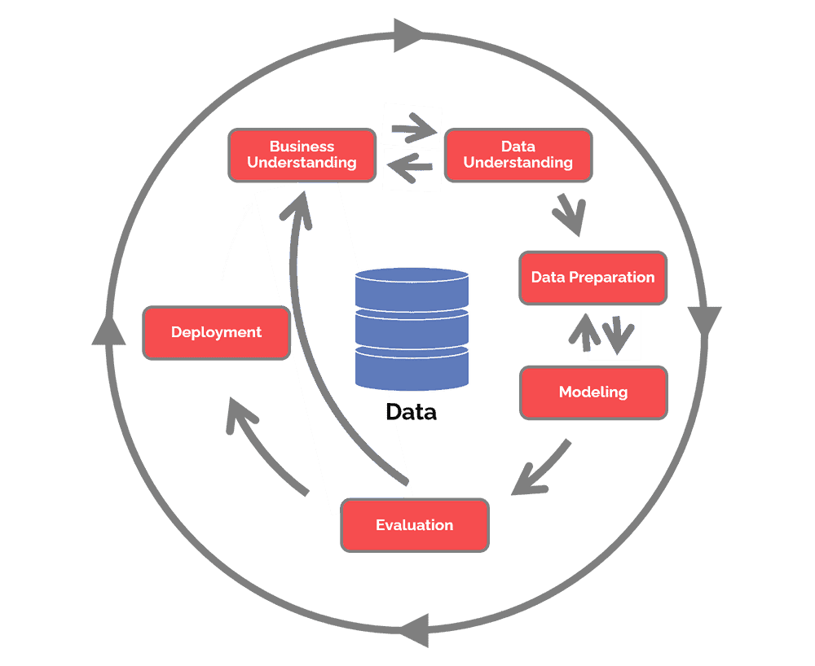
General Idea For ML Project
Business understanding: An important question is if do we need ML for the project. The goal of the project has to be measurable.
Data understanding: Analyze available data sources, and decide if more data is required.
Data preparation: Clean data and remove noise applying pipelines, and the data should be converted to a tabular format, so we can put it into ML.
Modeling: training Different models and choose the best one. Considering the results of this step, it is proper to decide if is required to add new features or fix data issues.
Evaluation: Measure how well the model is performing and if it solves the business problem.
Deployment: Roll out to production to all the users. The evaluation and deployment often happen together - online evaluation.

Slide 3
Business Understanding
Social media are main sources to gather information about people’s opinion and sentiment towards different topics. Here our goal is to develop a model to predict mental behaviour/ Depression in people by looking at their tweets. Twitter is rich source of information to learn about people’s opinion and Sentiment. Our model will determine by looking whether the tweet is negative, positive or neutral

Slide 4
Data Understanding
Here we are using dataset from kaggle(Sentiment Analysis Dataset 2). This dataset contains following columns:
ItemID : Unique ID for tweets
Sentiment : 1 if tweet is of depression sentiment, 0 if not
SentimentSource : Source of tweet extraction
SentimentText : Raw text of tweet
Only “Sentiment” and “SentimentText” are useful in our case.

Slide 5
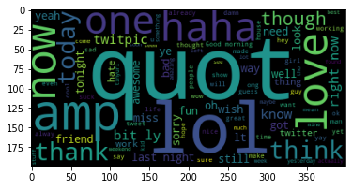
Data Understanding….
Wordcloud for complete dataset:-

Slide 6
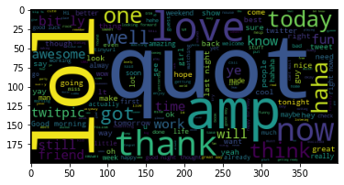
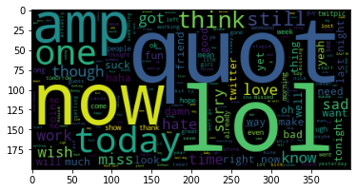
Data Understanding….
Wordcloud for positive sentiment cases:-
Wordcloud for positive sentiment cases:-

Slide 7
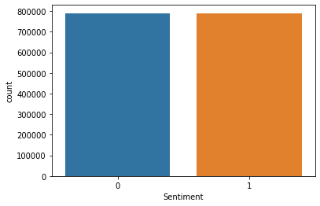
Data Understanding….
Count plot for negative and Positive Sentiments:-

Slide 8
Data Preparation
Following steps are done to process the data before predictions:-
Removing punctuations like . , ! $( ) * % @
Removing URLs
Removing Stop words
Lower casing
Tokenization
Stemming
Lemmatization

Slide 9
Modelling
3 different models are used for making predictions on the data
Logistic regression is considered as baseline model. Further improvements are done wrt. to this model.
Simple LSTM model is used to predict sentiment.
LSTM model using word2vec converting tweets into vectors and passing as weights in model

Slide 10
Evaluation
Using accuracy_score, classification_report, confusion_matrix as evaluation metric, LSTM model with Word2Vec embedding has highest accuracy (about 60%). Further hyperparameters are tune are tuned to increase accuracy to about 70%. Further tuning can increase accuracy.

Slide 11
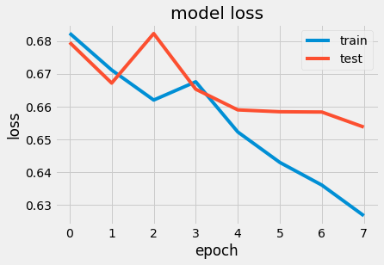
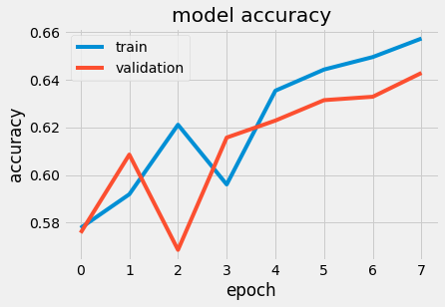
Plots for accuracy and loss for training and validation:-

Slide 12
Conclusion
More accurate model can be made by either tuning hyperparameters or choosing different model. For example using CNN with LSTM may also increase accuracy.

