Slide 1
Predicting House Price

Slide 2
ABSTRACT
People looking to buy a new home tend to be more conservative with their budgets and market strategies.
This project aims to analyze various parameters like locality, avg area etc. and predict the house price accordingly.
For the price prediction we will be using keras Algorithm.
The functioning of this project involves some good amount of dataset on which prediction can be done.

Slide 3
INTRODUCTION
Linear regression is a basic and commonly used type of predictive analysis.
regression is to examine two things:
The overall idea of
does a set of predictor variables do a good job in predicting an outcome (dependent) variable?
Which variables in particular are significant predictors of the outcome variable, and in what way do they–indicated by the magnitude and sign of the beta estimates–impact the outcome variable?
These regression estimates are used to explain the relationship between one dependent variable and one or more independent variables.
Three major uses for regression analysis are:
determining the strength of predictors.
forecasting an effect.
trend forecasting.

Slide 4
NEED FOR PROJECT
To provide a better and fast way of performing operations.
To provide proper house price to the customers.
To eliminate need of real estate agent to gain information regarding house prices.
To provide best price to user without getting cheated.
To enable user to search home as per the budget.

Slide 5
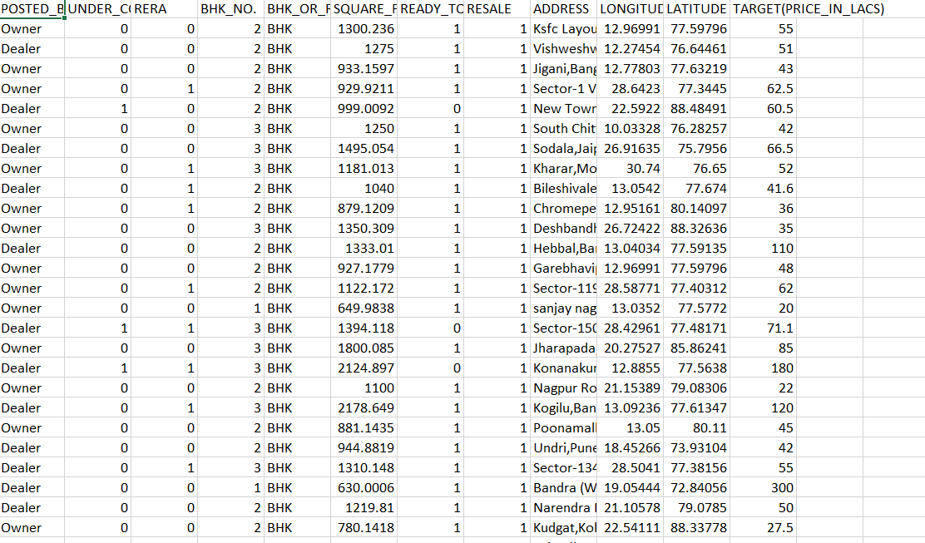
DATA

Slide 6
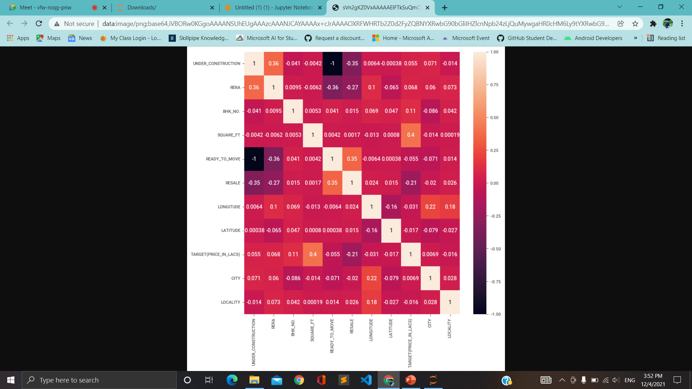
Heat map plot:

Slide 7
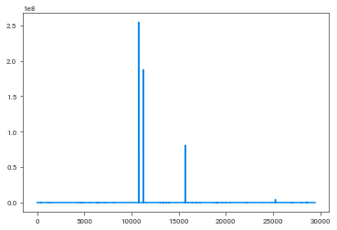

Slide 8
CONCLUSION
Thus, we studied and applied the concept of keras Algorithm in real time implementation so as to ease the life of human.
Determining the price of property without complete knowledge about the surrounding is quite riskier for both customer and the seller.
In order to overcome this problem, we have tried to develop application which determines the price of the property based on various parameters of the surrounding.
Data provide us with the complete data about the surrounding in the form of dataset.
Dataset helps to get the insight of the surrounding and machine learning model helps to predict the price of the property based on the training provided by the dataset.

Slide 9


