Slide 1
SOLID principle
In software development, Object-Oriented Design plays a crucial role when it comes to writing flexible, scalable, maintainable, and reusable code. There are so many benefits of using OOD but every developer should also have the knowledge of the SOLID principle for good object-oriented design in programming. The SOLID principle was introduced by Robert C. Martin, also known as Uncle Bob and it is a coding standard in programming. This principle is an acronym of the five principles which is given below…
Single Responsibility Principle (SRP)
Open/Closed Principle
Liskov’s Substitution Principle (LSP)
Interface Segregation Principle (ISP)
Dependency Inversion Principle (DIP)

Slide 2
Single Responsibility Principle
This principle states that “a class should have only one reason to change”.
which means every class should have a single responsibility or single job or single purpose.
Most of the time it happens that when programmers have to add features or new behavior they implement everything into the existing class which is completely wrong. It makes their code lengthy, complex and consumes time when later something needs to be modified. Use layers in your application and break God classes into smaller classes or modules.

Slide 3
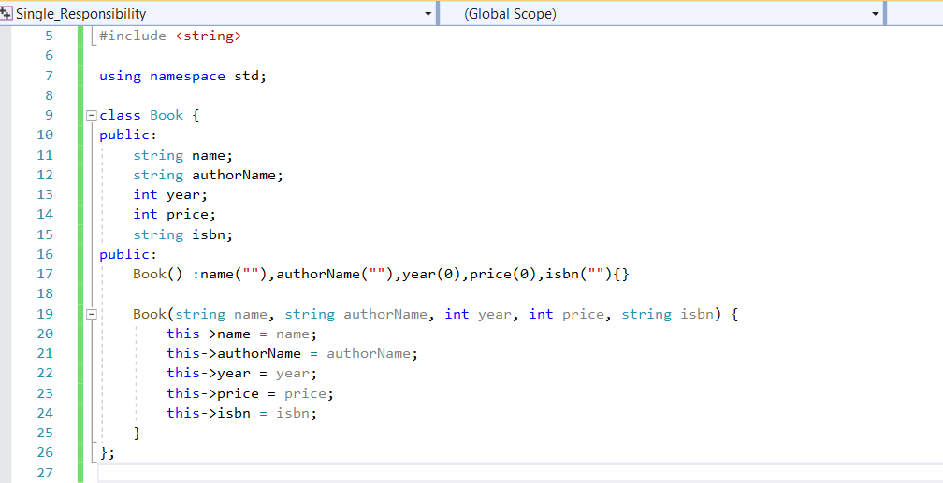
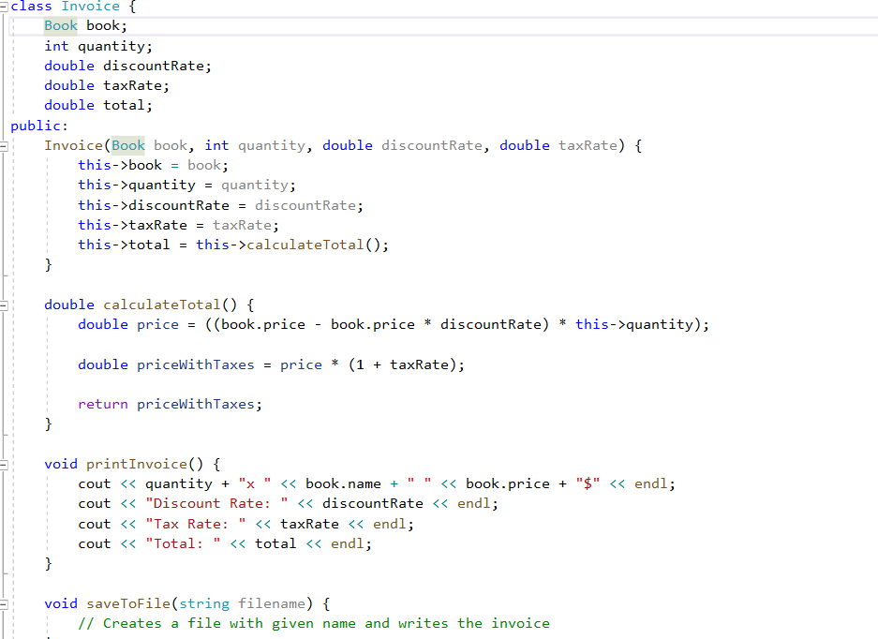

Slide 4
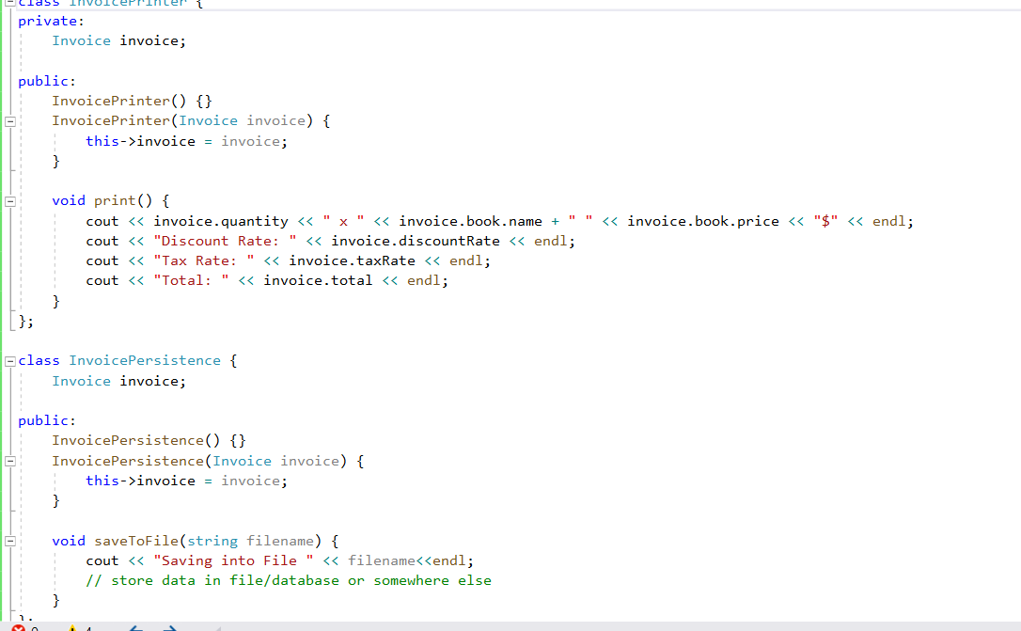
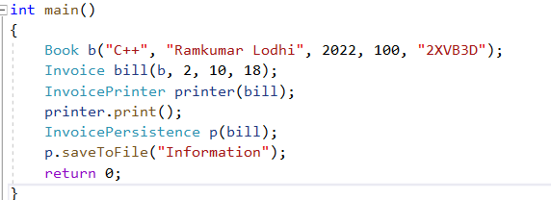
what's going on here?
Our class violates the Single Responsibility Principle in multiple ways The first violation is the printInvoice method, which contains our printing logic the saveToFile method

Slide 5
Open/Closed Principle
This principle states that “software entities (classes, modules, functions, etc.) should be open for extension, but closed for modification”.
Which means you should be able to extend a class behavior, without modifying it.
Modification means changing the code of an existing class, and extension means adding new functionality. But how are we going to add new functionality without touching the class, you may ask. It is usually done with the help of interfaces and abstract classes.

Slide 6
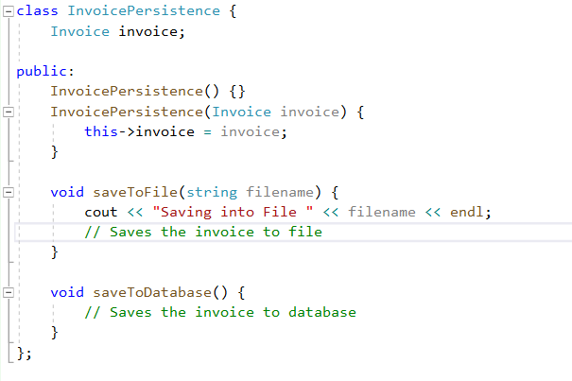
So, In order to add this` SaveToDatabase feature, we have modified the InvoicePersistence class. How to solve this?

Slide 7
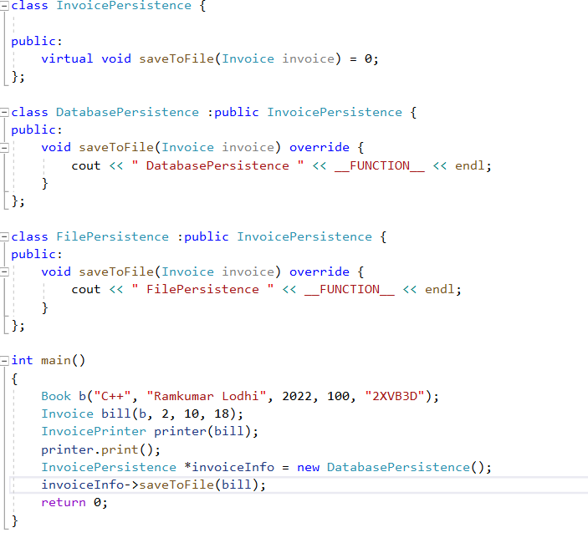

Slide 8
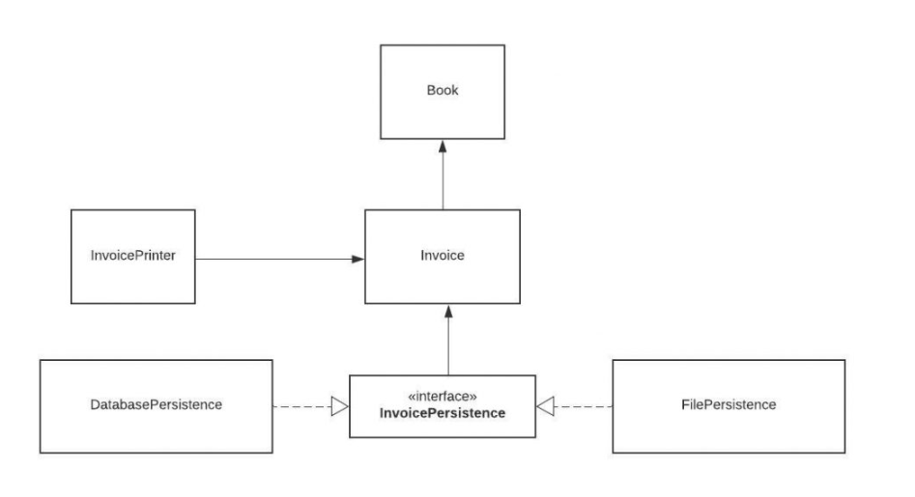
Class Structure

Slide 9
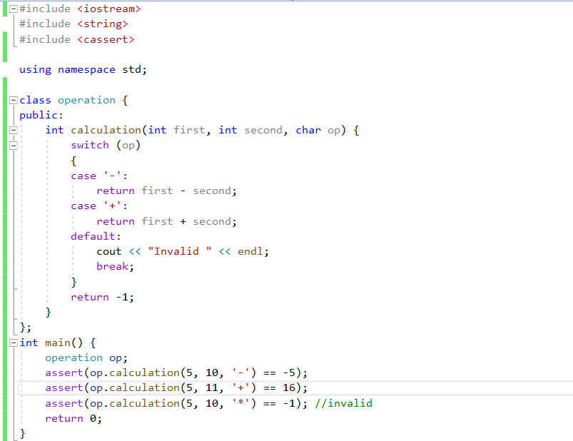
What’s wrong?

Slide 10
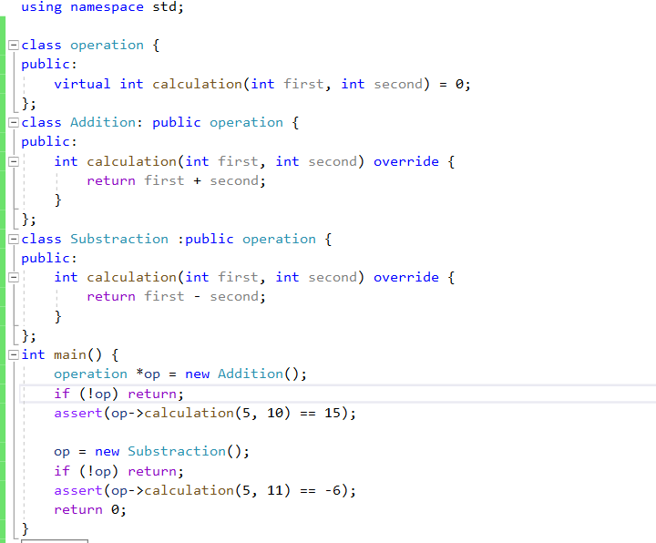
Follow OECM principle

Slide 11
Liskov’s Substitution Principle
The Liskov Substitution Principle states that subclasses should be substitutable for their base classes.
This principle ensures that any class that is the child of a parent class should be usable in place of its parent without any unexpected behavior.

Slide 12
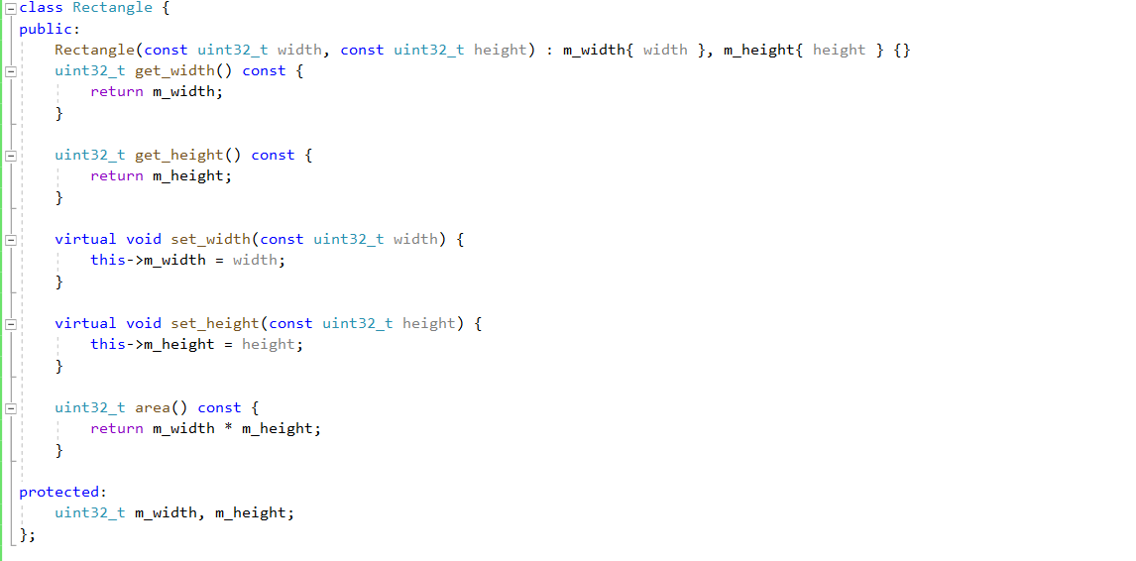

Slide 13
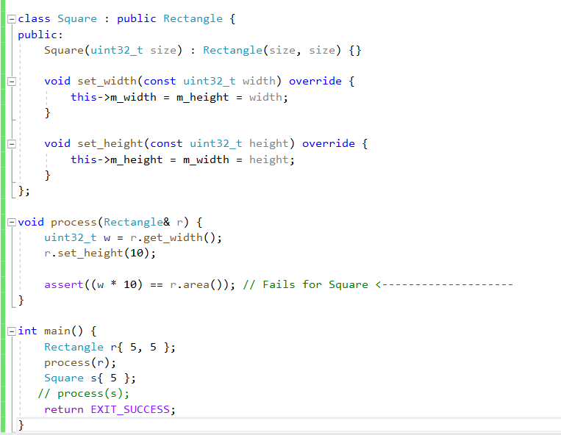
What’s wrong?

Slide 14
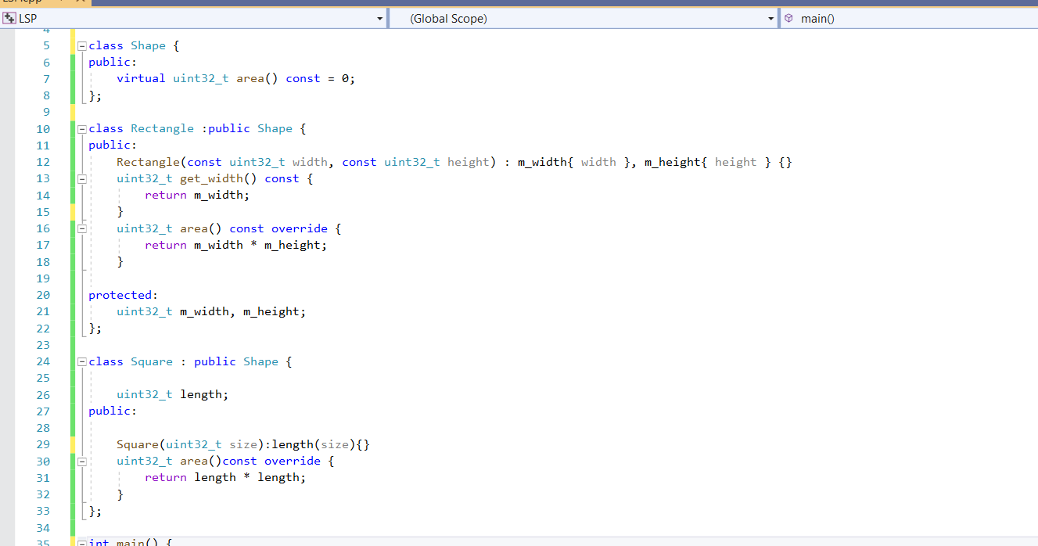
What’s wrong?

Slide 15
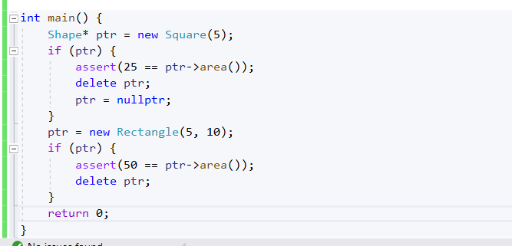

Slide 16
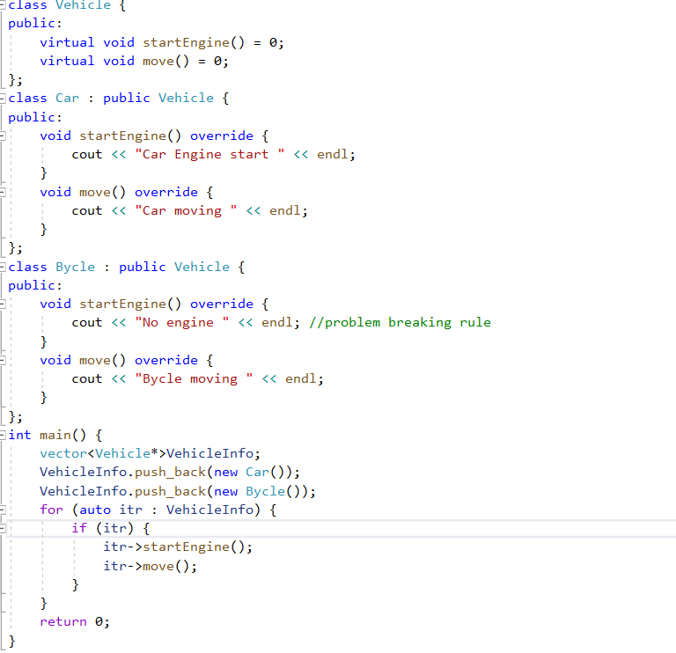
Another example : LSP

Slide 17
Interface Segregation Principle
It states that “do not force any client to implement an interface which is irrelevant to them“.
Here your main goal is to focus on avoiding fat interface and give preference to many small client-specific interfaces

Slide 18
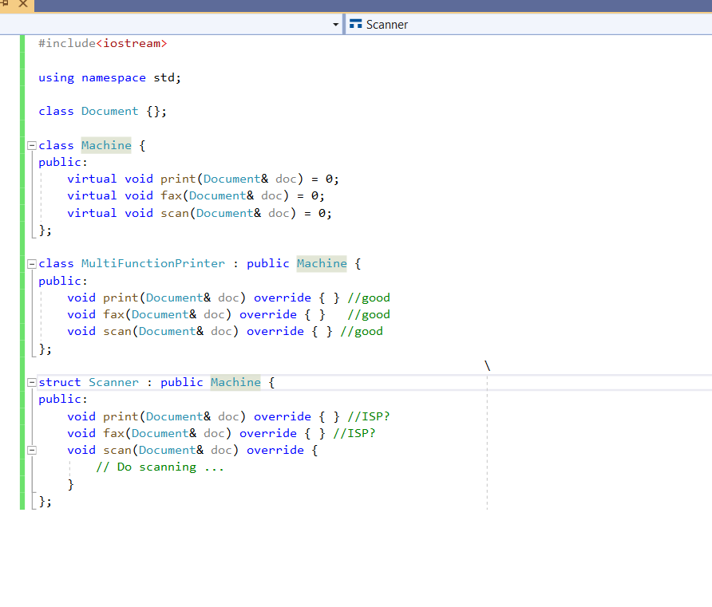
What’s wrong?

Slide 19
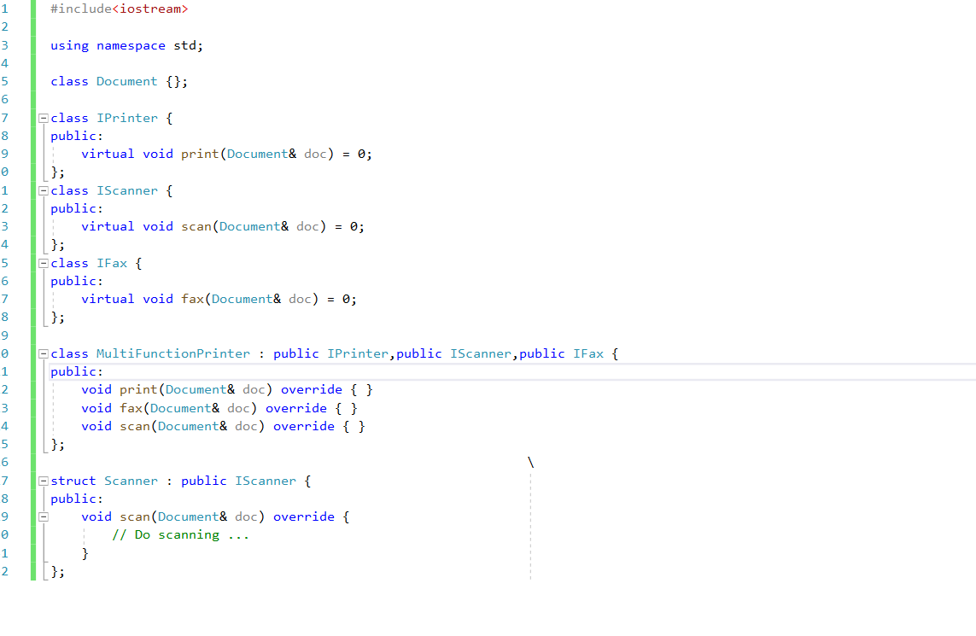
ISP

Slide 20
Dependency Inversion Principle
This principle says
High-level modules/classes should not depend on low-level modules/classes. Both should depend upon abstractions.
The Dependency Inversion principle states that our classes should depend upon interfaces or abstract classes instead of concrete classes and function.

Slide 21
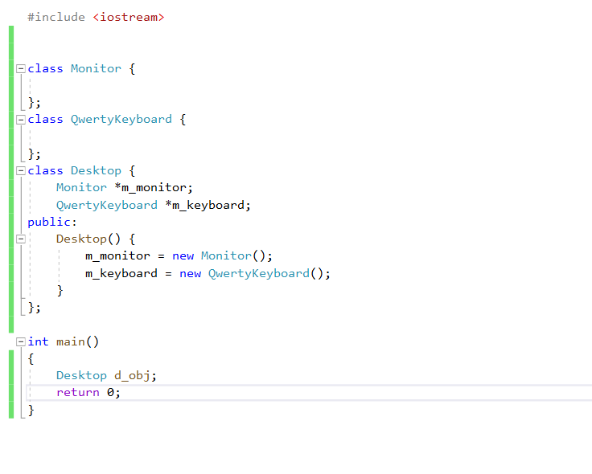

Slide 22
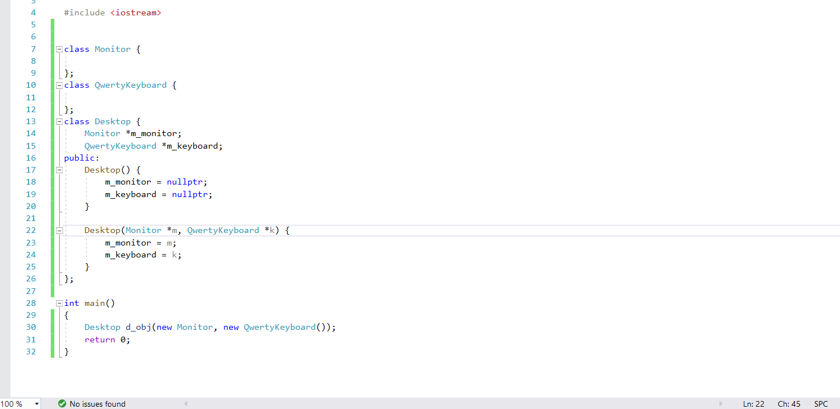
Removed dependency

Slide 23
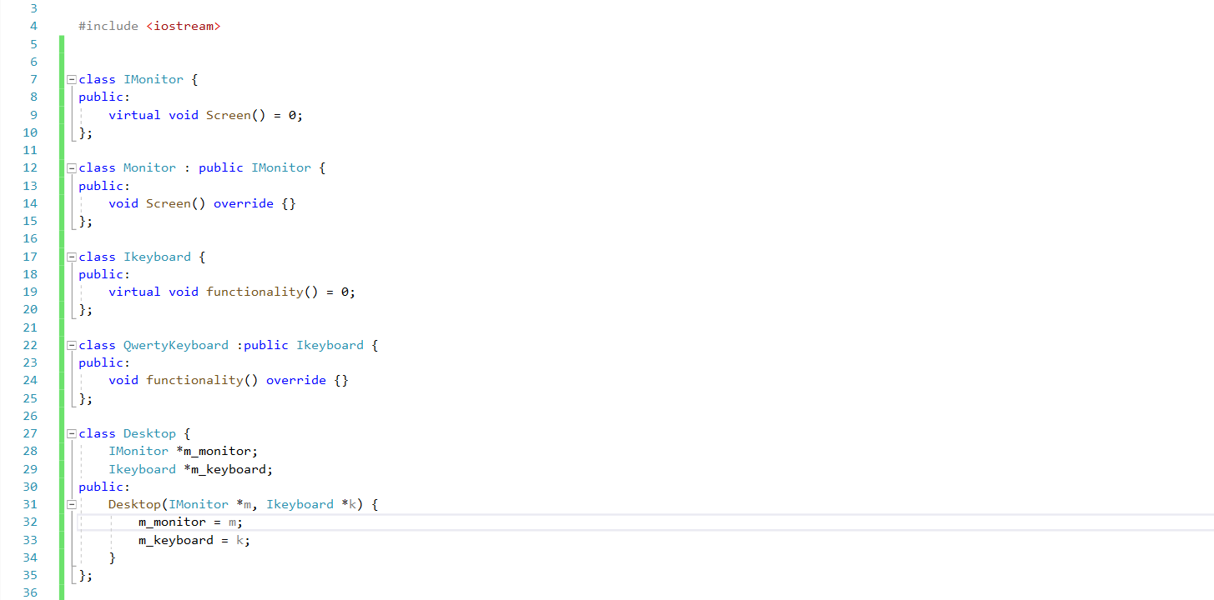
Depend upon abstraction

