Slide 1


SHANMUGANATHAN ENGINEERING COLLEGE (Accredited by NAAC, an ISO 9001:2015 Certified Institution) ARASAMPATTI – 622 507 DEPARTMENT OF ELECTRONICS AND COMMUNICATION ENGINEERING DESIGN A SAAS ARCHITECTURE FOR AN E-COMMERCE PLATFORM
PRESENTED BY:
S.RAJESHWARAN (912421106013)
R.RAMKUMAR (912421106014)
SHANMUGANATHAN ENGINEERING COLLEGE

Slide 2
INTRODUCTION
An e-commerce platform is the backbone of any online retail business, providing the essential infrastructure to facilitate the buying and selling of products and services over the internet.
A well-designed e-commerce platform encompasses a range of features, from product catalog management, secure payment processing, and order tracking to marketing tools, customer management, and analytics.

Slide 3
OBJECTIVES
The objectives of an e-commerce website are multi-faceted, each aimed at enhancing the shopping experience, building customer loyalty, and driving revenue growth. Here are some key objectives:
1.Increase Sales and Revenue: The primary objective of any e-commerce website is to maximize sales by making it easy for customers to discover, browse, and purchase products or services online.
2.Expand Market Reach: E-commerce websites enable businesses to reach a broader audience beyond geographical limitations. The goal is to grow the customer base by attracting new markets and offering 24/7 accessibility, allowing customers to shop at their convenience.
3.Collect Customer Data for Insights: E-commerce platforms allow businesses to gather valuable data on customer behaviors, preferences, and purchase history. This data helps inform decision-making, improve product offerings, and personalize marketing efforts.

Slide 4
4.Support Marketing and Promotion: An e-commerce website provides opportunities to showcase promotions, discounts, and new arrivals, and can be integrated with marketing tools such as SEO, email marketing, and social media sharing to drive traffic and increase sales.
5.Facilitate Customer Communication and Engagement: Engaging customers through reviews, feedback forms, and customer support options directly on the site helps businesses respond to customer needs and create a community around the brand.

Slide 5
METHODOLGY
Developing an e-commerce website requires a structured methodology that ensures all aspects of the project, from planning and design to implementation and testing, are effectively managed.
1. Requirement Analysis and Planning
Define Objectives: Identify the purpose, goals, and KPIs (key performance indicators) for the website. This might include sales targets, customer retention goals, or specific user experience features.
Research the Market and Audience: Conduct market research to understand competitors, industry standards, and customer expectations. Define the target audience to inform design and functionality.

Slide 6
2.Technology Selection
Backend and Frontend Technology: Decide on backend (e.g.,PHP) and frontend (e.g., HTML, CSS, frameworks) technologies that support scalability, security, and performance.
3. Development
Frontend Development: Build the user interface (UI) components, ensuring they are responsive and optimized for various devices. Implement interactive elements such as navigation menus, product galleries, and forms.
Backend Development: Develop server-side functionalities, including database management, product inventory, user authentication, order processing, and payment integration.

Slide 7
PROJECT IMPLEMENTATION
FRONT-END :
HTML
CSS
BACK-END :
PHP
DATABASE:
MYSQL USING XAMPP

Slide 8
Here in our Project for E-commerce platform , we created 3 html pages with a distinct and unique design with unique function.
Each Page has various function to engage the use
Main page / index of the platform
Login page to customers to login into the platform
Register page for Engage the new users

Slide 9
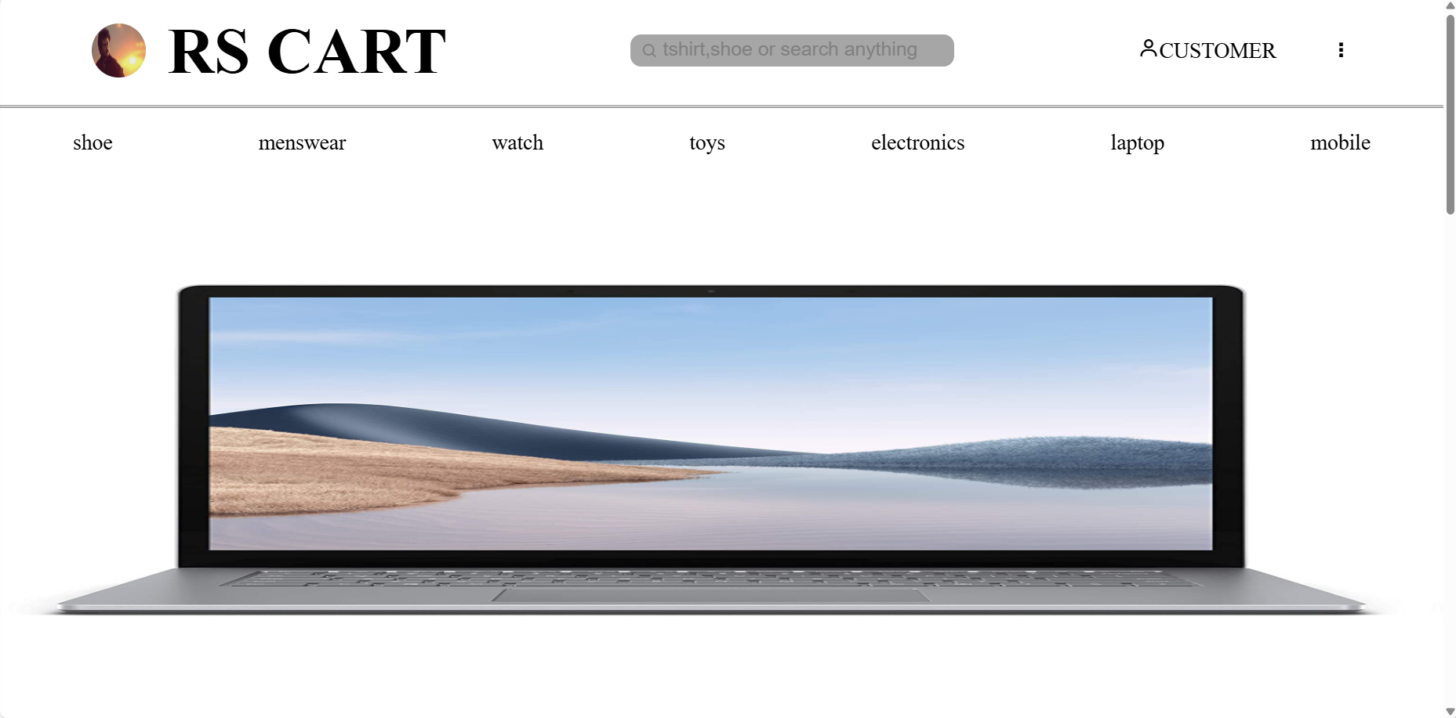
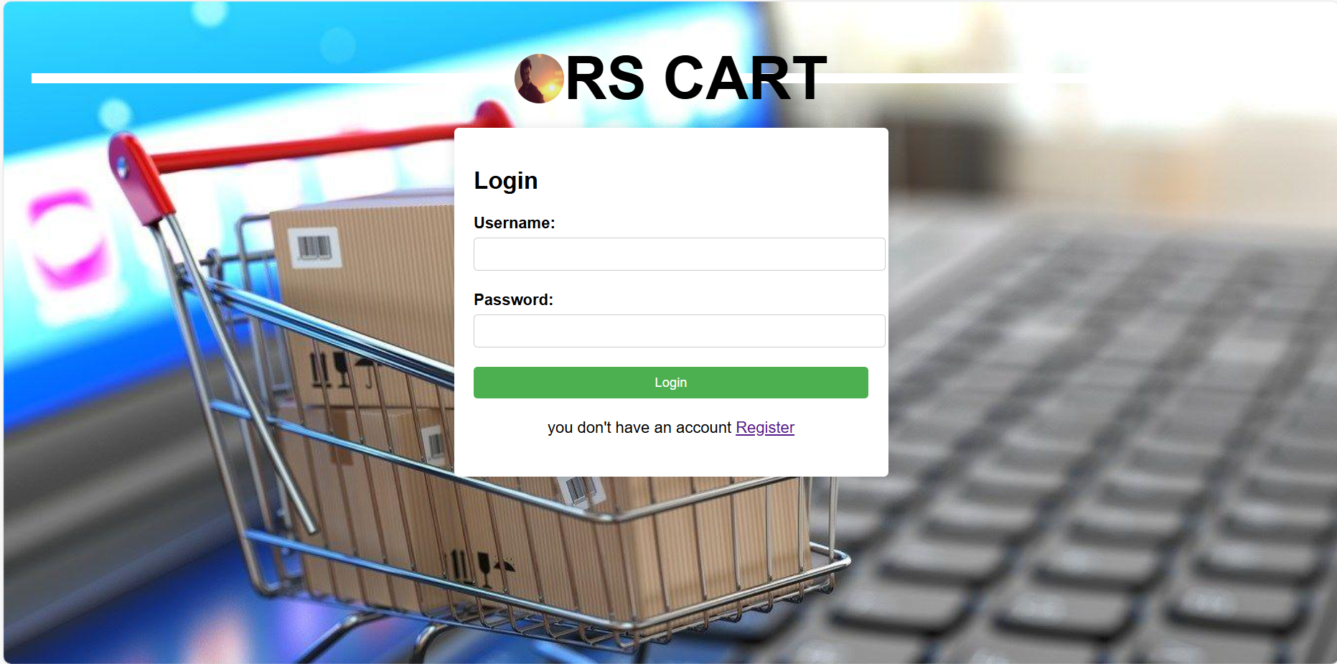
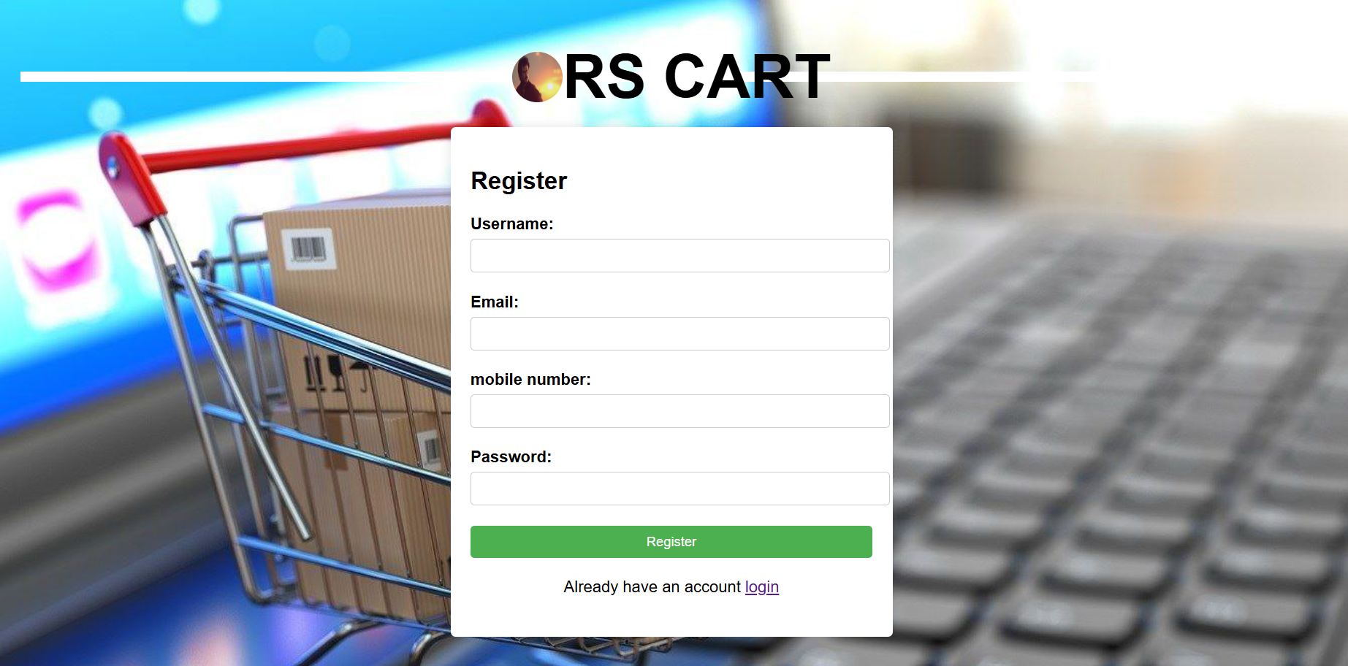
INDEX PAGE
LOGIN PAGE
REGISTERATION PAGE

Slide 10
The Back-End plays the major role while we submits our register form or login form, the back-end is used to validate our forms.
The back-end validates our forms which was compared to our desired Database
Here, we were using PHP as a back-end tool and Mysql via XAMPP server as the effective way of us to attain our project.
Back-end is done by many ways such as python ,node.js ,but the reason for using PHP is we can easily integrate our Database with the front-end

Slide 11
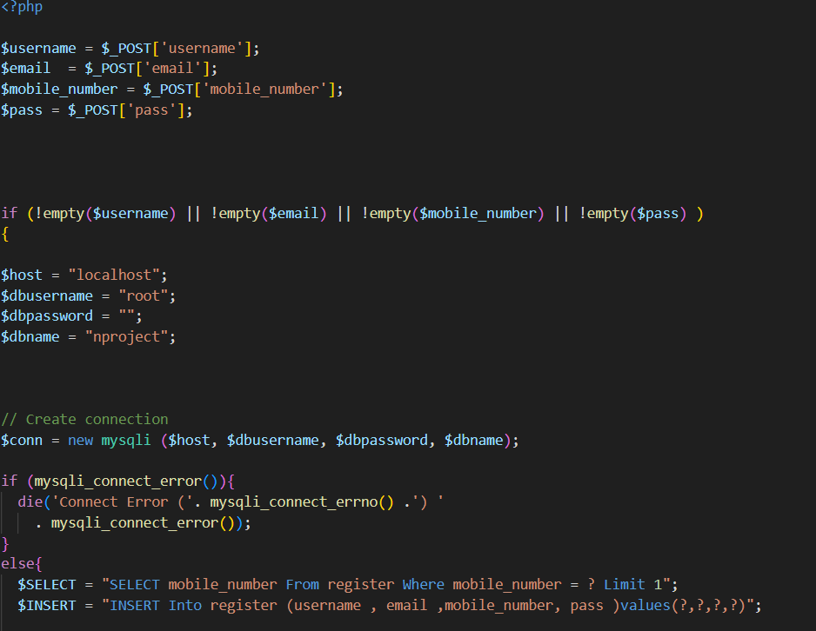
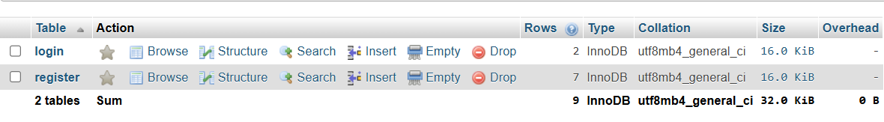
MYSQL DATABASE
BACK-END PHP CODE TO CONNECT WITH MYSQL DATABASE

Slide 12
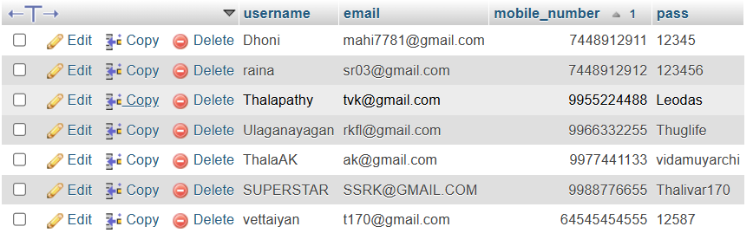

REGISTER FORM DATABASE
LOGIN FORM DATABASE

Slide 13
CONCLUSION
Implementing an eCommerce website using HTML, CSS, and PHP offers a flexible and foundational approach to building a functional online store.
HTML and CSS handle the structure and style, providing the visual layout and user experience, while PHP offers powerful back-end functionality to handle dynamic content, manage databases, and support essential eCommerce features like shopping carts, product listings, and user authentication.
By following best practices in secure coding and efficient database management, this HTML-CSS-PHP stack can be a solid solution for developing a responsive, engaging, and secure eCommerce website that meets user needs effectively.

Slide 14
THANK YOU

