Slide 1
Exploratory data analysis of Walmart Weekly sales

Slide 2
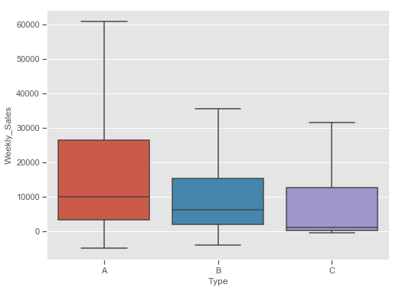
BOX PLOT: Type vs Weekly_Sales

Slide 3
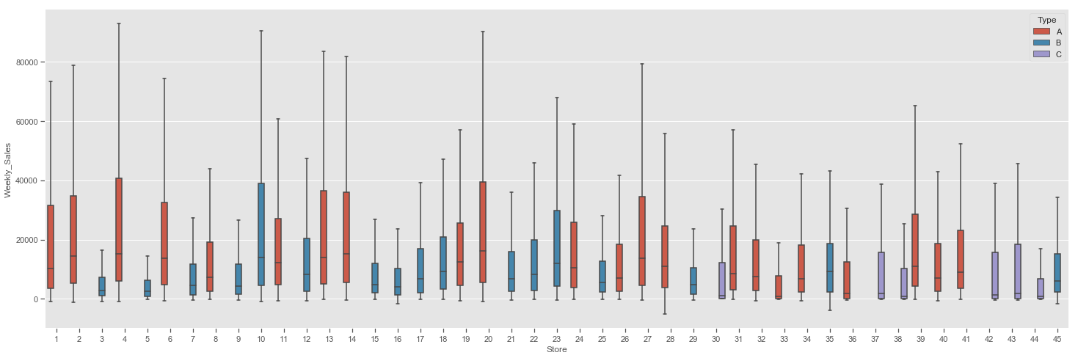
BOX PLOT: Store vs Weekly_Sales data = pd.concat([train['Store'], train['Weekly_Sales'], train['Type']], axis=1) f, ax = plt.subplots(figsize=(25, 8)) fig = sns.boxplot(x='Store', y='Weekly_Sales', data=data, showfliers=False, hue="Type")

Slide 4
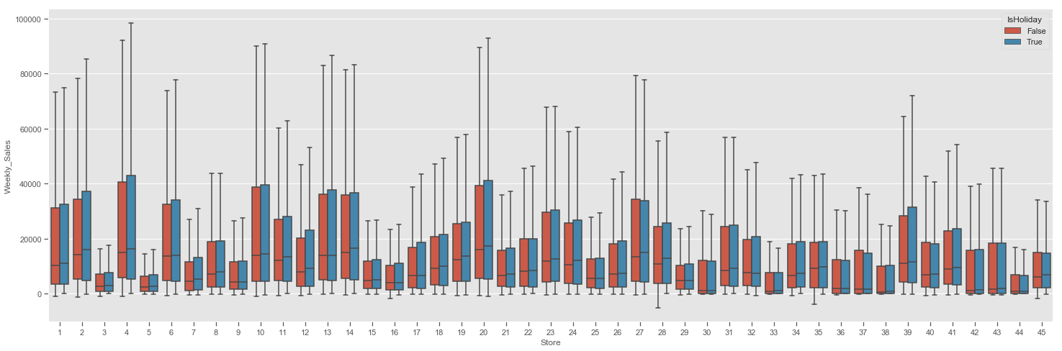
BOX PLOT: Store vs Weekly_Sales data = pd.concat([train['Store'], train['Weekly_Sales'], train['IsHoliday']], axis=1) f, ax = plt.subplots(figsize=(25, 8)) fig = sns.boxplot(x='Store', y='Weekly_Sales', data=data, showfliers=False, hue="IsHoliday")

Slide 5
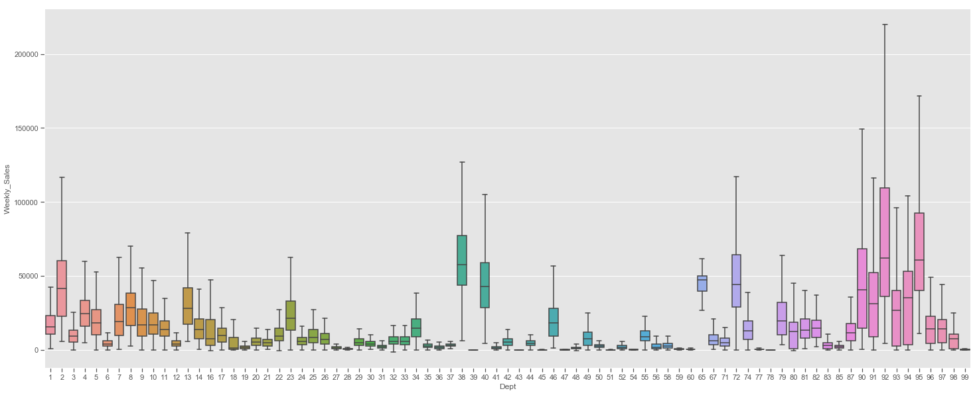
BOX PLOT: Dept vs Weekly_Sales data = pd.concat([train['Dept'], train['Weekly_Sales'], train['Type']], axis=1) f, ax = plt.subplots(figsize=(25, 10)) fig = sns.boxplot(x='Dept', y='Weekly_Sales', data=data, showfliers=False)

Slide 6
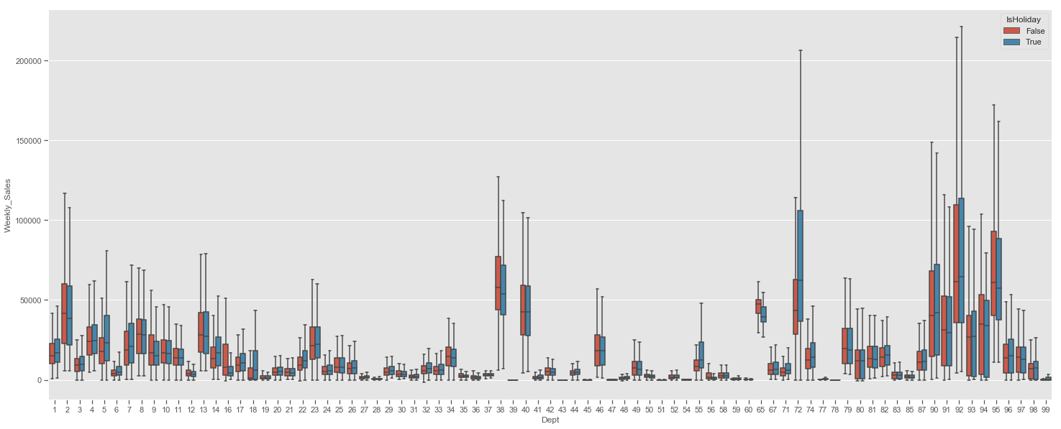
BOX PLOT: Dept vs Weekly_Sales vs IsHoliday data = pd.concat([train['Dept'], train['Weekly_Sales'], train['IsHoliday']], axis=1) f, ax = plt.subplots(figsize=(25, 10)) fig = sns.boxplot(x='Dept', y='Weekly_Sales', data=data, showfliers=False, hue="IsHoliday")

Slide 7
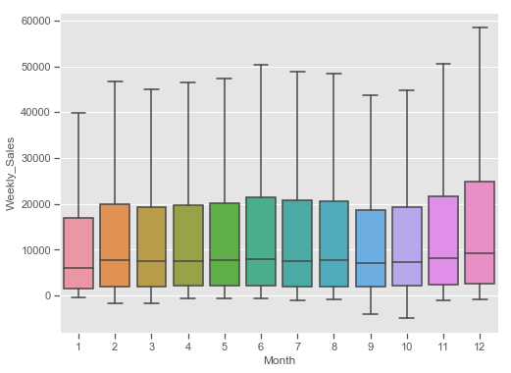
BOX PLOT: Month vs Weekly_Sales data = pd.concat([train['Month'], train['Weekly_Sales']], axis=1) f, ax = plt.subplots(figsize=(8, 6)) fig = sns.boxplot(x='Month', y="Weekly_Sales", data=data, showfliers=False)

Slide 8
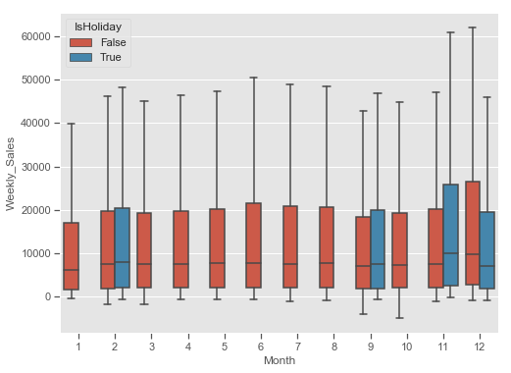
BOX PLOT: Month vs Weekly_Sales vs IsHoliday data = pd.concat([train['Month'], train['Weekly_Sales'],train['IsHoliday']], axis=1) f, ax = plt.subplots(figsize=(8, 6)) fig = sns.boxplot(x='Month', y="Weekly_Sales", data=data, showfliers=False, hue='IsHoliday')

Slide 9
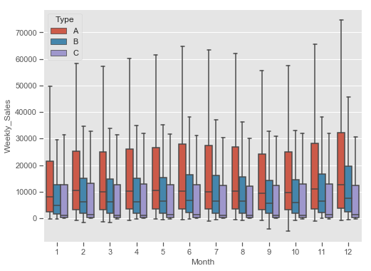
BOX PLOT: Month vs Weekly_Sales vs Type data = pd.concat([train['Month'], train['Weekly_Sales'],train['Type']], axis=1) f, ax = plt.subplots(figsize=(8, 6)) fig = sns.boxplot(x='Month', y="Weekly_Sales", data=data, showfliers=False, hue='Type')

Slide 10
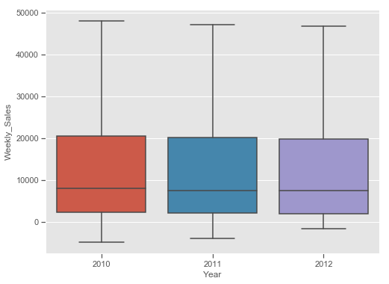
BOX PLOT: Year vs Weekly_Sales data = pd.concat([train['Year'], train['Weekly_Sales']], axis=1) f, ax = plt.subplots(figsize=(8, 6)) fig = sns.boxplot(x='Year', y="Weekly_Sales", data=data, showfliers=False)

Slide 11
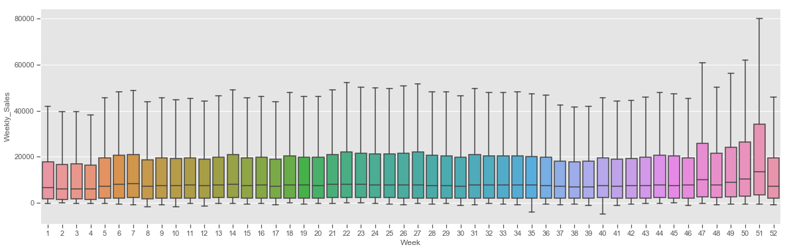
BOX PLOT: Week vs Weekly_Sales data = pd.concat([train['Week'], train['Weekly_Sales']], axis=1) f, ax = plt.subplots(figsize=(20, 6)) fig = sns.boxplot(x='Week', y="Weekly_Sales", data=data, showfliers=False)

Slide 12
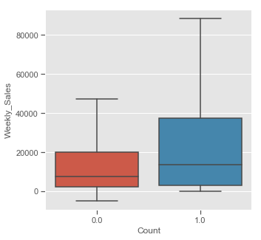
BOX PLOT: Count vs Weekly_Sales data = pd.concat([train['Count'], train['Weekly_Sales'], train['Store']], axis=1) f, ax = plt.subplots(figsize=(5, 5)) fig=sns.boxplot(x='Count', y="Weekly_Sales", data=data, showfliers=False)

Slide 13
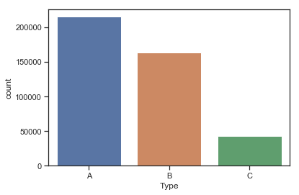
Count plot : Type vs count sns.countplot(one_ruler['Type'])

Slide 14
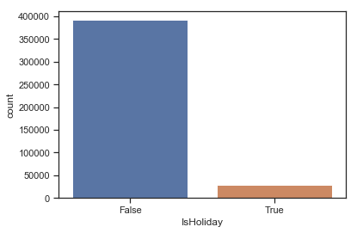
Count plot : IsHoliday vs count sns.countplot(one_ruler['IsHoliday'])

Slide 15
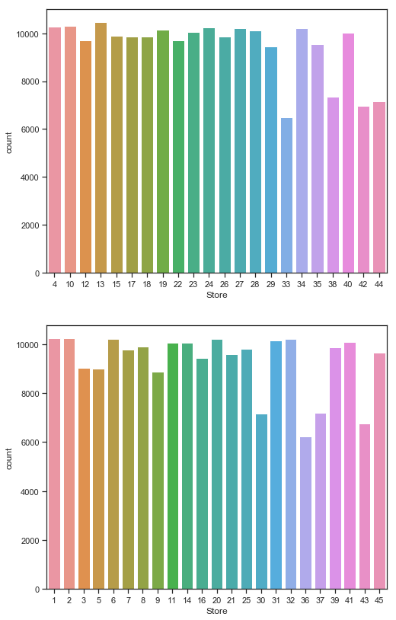
Count plot : Store vs count df1 = one_ruler[one_ruler.CPI < 160] df2 = one_ruler[one_ruler.CPI >= 160] fig, ax = plt.subplots(2, 1, figsize=(8,14)) sns.countplot(df1['Store'], ax=ax[0]) sns.countplot(df2['Store'], ax=ax[1])

Slide 16
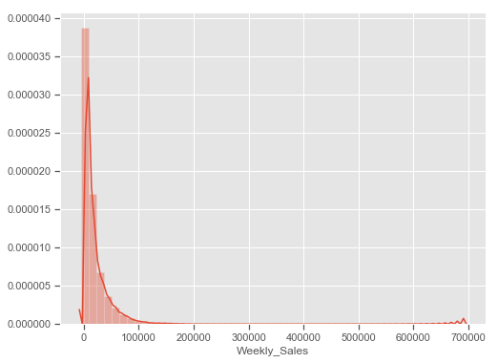
Distplot:Weekly_Sales f, ax = plt.subplots(figsize=(8, 6)) sns.distplot(train['Weekly_Sales'])

Slide 17
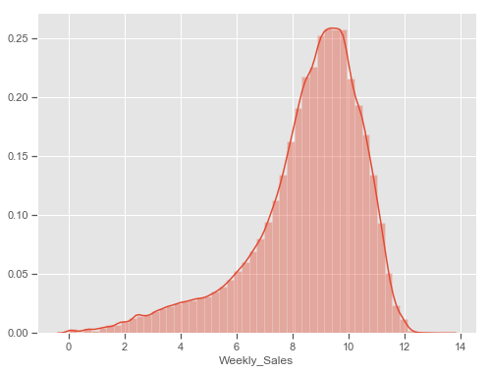
Distplot:Weekly_Sales train_over_zero=train[train['Weekly_Sales']>0] train_below_zero=train[train['Weekly_Sales']<=0] sales_over_zero = np.log1p(train_over_zero['Weekly_Sales']) f, ax = plt.subplots(figsize=(8, 6)) sns.distplot(sales_over_zero)

Slide 18
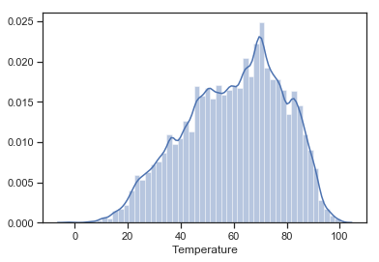
Distplot:Temperature sns.distplot(one_ruler['Temperature'])

Slide 19
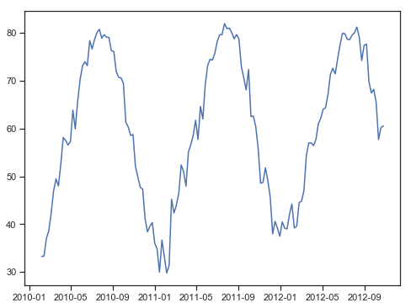
Lineplot:year df = one_ruler df['dt'] = pd.to_datetime(one_ruler['Date']) df_to_plot = df.groupby(['dt'])['Temperature'].mean() fig, ax = plt.subplots(1, 1, figsize=(8,6)) sns.lineplot(data=df_to_plot, ax=ax)

Slide 20
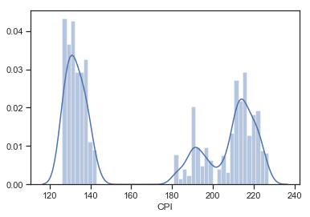
Distplot:CPI sns.distplot(one_ruler['CPI'])

Slide 21
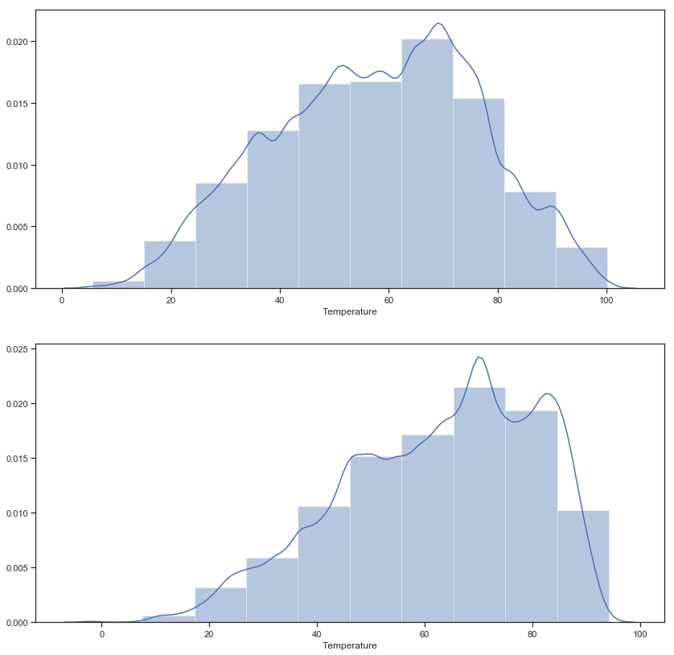
Distplot:Temperature fig, ax = plt.subplots(2, 1, figsize=(14,14)) sns.distplot(df1['Temperature'],bins=10, ax=ax[0]) sns.distplot(df2['Temperature'], bins=10, ax=ax[1])

Slide 22
Jointplot Program : sns.jointplot( 'Weekly_Sales', 'Fuel_Price', data=df_to_plot, kind='hex', gridsize=30) sns.jointplot( 'Weekly_Sales', 'Size', data=df_to_plot, kind='hex', gridsize=30) sns.jointplot( 'Weekly_Sales', 'CPI', data=df_to_plot, kind='hex', gridsize=30) sns.jointplot( 'Weekly_Sales', 'Dept', data=df_to_plot, kind='hex', gridsize=30) sns.jointplot( 'Weekly_Sales', 'Temperature', data=df_to_plot, kind='hex', gridsize=30) sns.jointplot( 'Weekly_Sales', 'Unemployment', data=df_to_plot, kind='hex', gridsize=30)

Slide 23
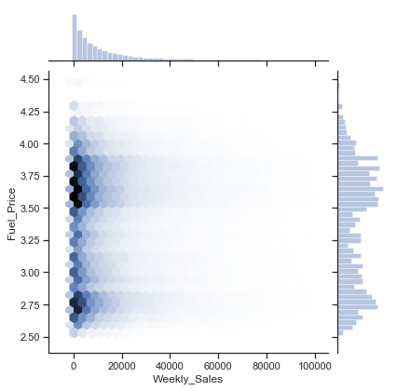
Jointplot:Weekly_Sales vs Fuel_Price

Slide 24
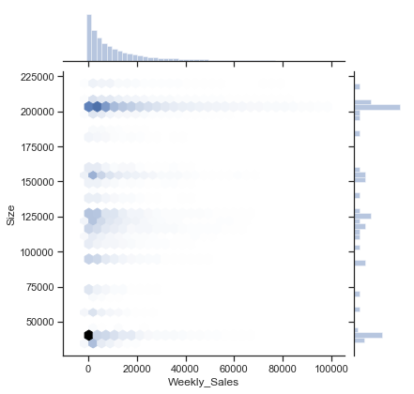
Jointplot:Weekly_Sales vs Size

Slide 25
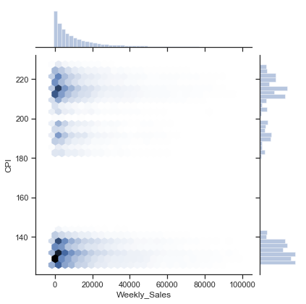
Jointplot:Weekly_Sales vs CPI

Slide 26
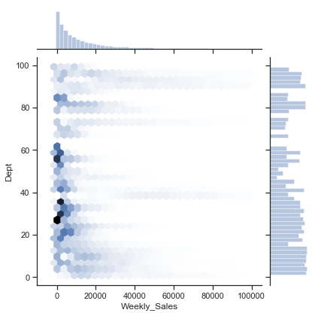
Jointplot:Weekly_Sales vs Fuel_Price

Slide 27
Jointplot:Weekly_Sales vs Dept

Slide 28
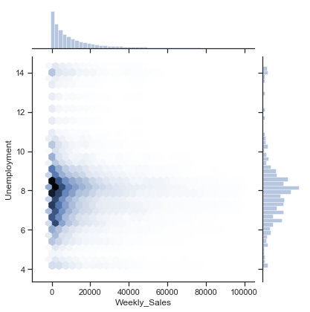
Jointplot:Weekly_Sales vs Unemployment

Slide 29
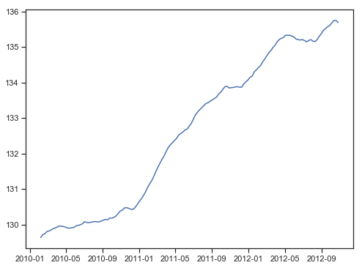
Lineplot:year df = df1 df['dt'] = pd.to_datetime(df['Date']) df_to_plot = df.groupby(['dt'])['CPI'].mean() fig, ax = plt.subplots(1, 1, figsize=(8,6)) sns.lineplot(data=df_to_plot, ax=ax)

Slide 30
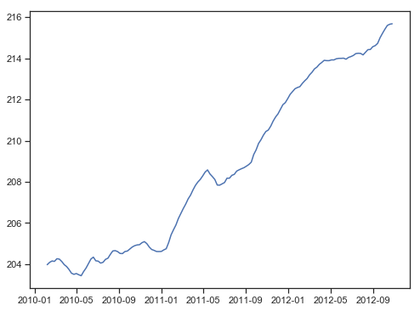
Lineplot:year df = df2 df['dt'] = pd.to_datetime(df['Date']) df_to_plot = df.groupby(['dt'])['CPI'].mean() fig, ax = plt.subplots(1, 1, figsize=(8,6)) sns.lineplot(data=df_to_plot, ax=ax)

Slide 31
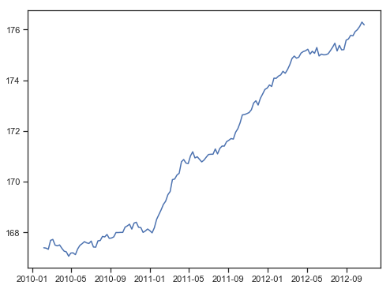
Lineplot:year df = one_ruler df['dt'] = pd.to_datetime(one_ruler['Date']) df_to_plot = df.groupby(['dt'])['CPI'].mean() fig, ax = plt.subplots(1, 1, figsize=(8,6)) sns.lineplot(data=df_to_plot, ax=ax)

Slide 32
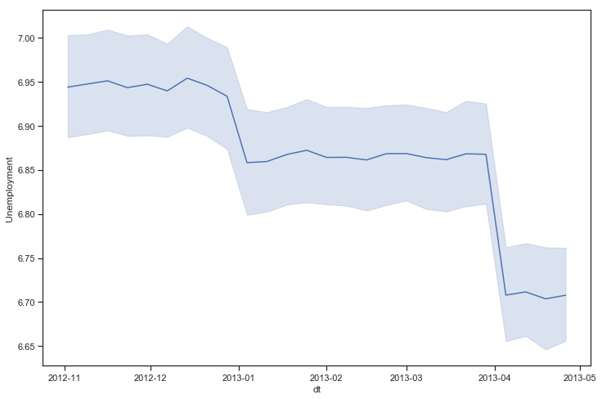
Lineplot:year vs Unemployment fig, ax = plt.subplots(1, 1, figsize=(12,8)) sns.lineplot(x='dt',y='Unemployment',data=test_df, ax=ax)

Slide 33
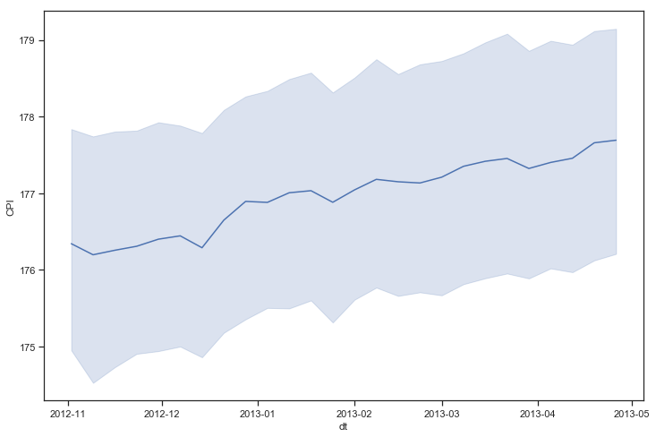
Lineplot:year vs CPI fig, ax = plt.subplots(1, 1, figsize=(12,8)) sns.lineplot(x='dt',y='CPI',data=test_df, ax=ax)

Slide 34
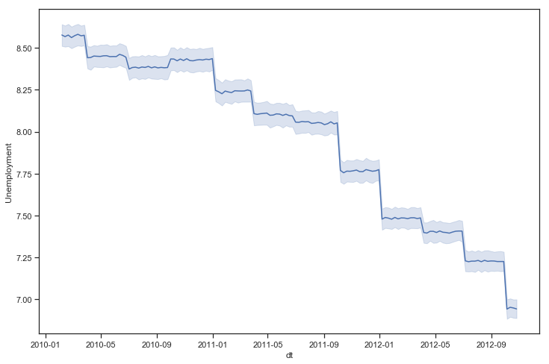
Lineplot:year vs Unemployment fig, ax = plt.subplots(1, 1, figsize=(12,8)) sns.lineplot(x='dt',y='Unemployment',data=one_df_to_rule_them_all, ax=ax)

Slide 35
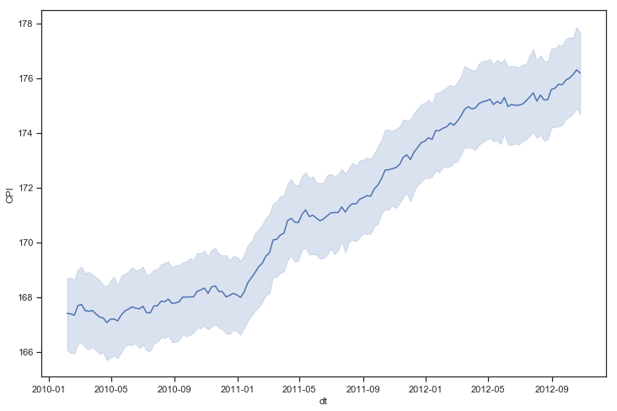
Lineplot:year vs CPI fig, ax = plt.subplots(1, 1, figsize=(12,8)) sns.lineplot(x='dt',y='CPI',data=one_df_to_rule_them_all, ax=ax)

Slide 36
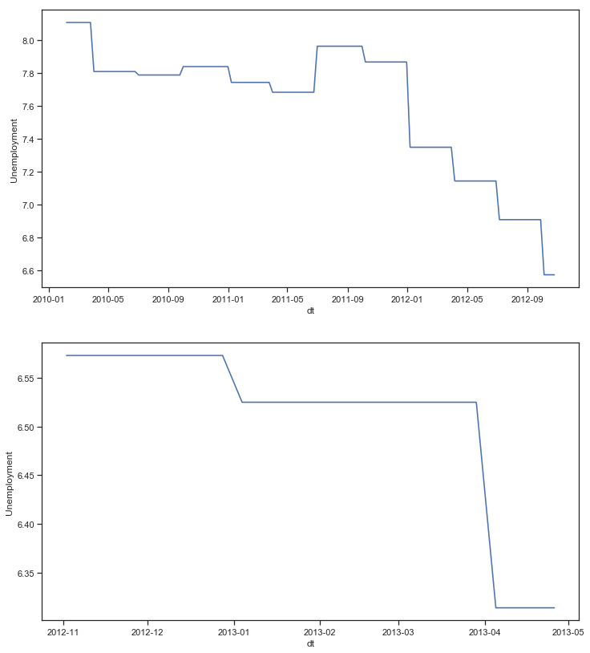
Lineplot:year vs Unemployment dfs1_train = one_df_to_rule_them_all[one_df_to_rule_them_all.Store == 1] dfs1_test = test_df[test_df.Store == 1] fig, ax = plt.subplots(2, 1, figsize=(12,14)) sns.lineplot(x='dt',y='Unemployment',data=dfs1_train, ax=ax[0]) sns.lineplot(x='dt',y='Unemployment',data=dfs1_test, ax=ax[1])

Slide 37
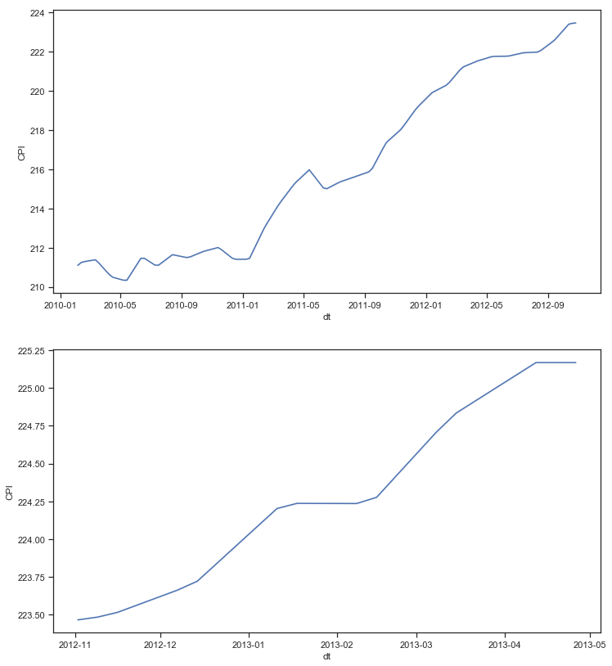
Lineplot:year vs CPI fig, ax = plt.subplots(2, 1, figsize=(12,14)) sns.lineplot(x='dt',y='CPI',data=dfs1_train, ax=ax[0]) sns.lineplot(x='dt',y='CPI',data=dfs1_test, ax=ax[1])

Slide 38
Scatterplot Program: def scatter_(df, column): plt.figure() plt.scatter(df[column] , df['Weekly_Sales']) plt.ylabel('Weekly_Sales') plt.xlabel(column) scatter_(one_ruler, 'Fuel_Price') scatter_(one_ruler, 'Size') scatter_(one_ruler, 'CPI') scatter_(one_ruler, 'Type') scatter_(one_ruler, 'IsHoliday') scatter_(one_ruler, 'Unemployment') scatter_(one_ruler, 'Temperature') scatter_(one_ruler, 'Store') scatter_(one_ruler, 'Dept’)

Slide 39
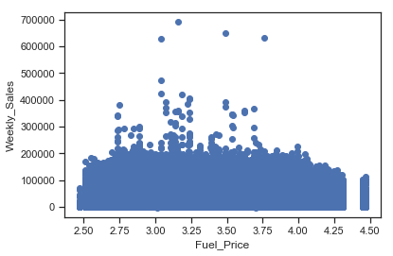
Scatterplot:Fuel_Price vs Weekly_Sales

Slide 40
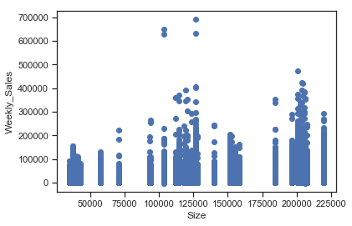
Scatterplot:Size vs Weekly_Sales

Slide 41
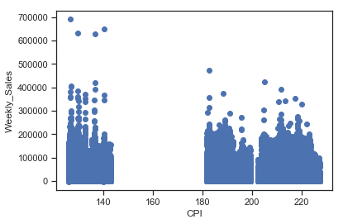
Scatterplot:CPI vs Weekly_Sales

Slide 42
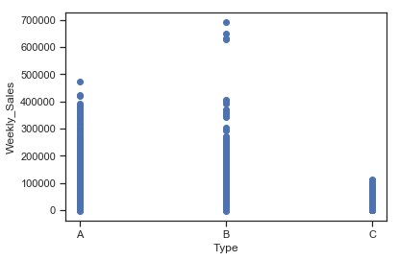
Scatterplot:Type vs Weekly_Sales

Slide 43
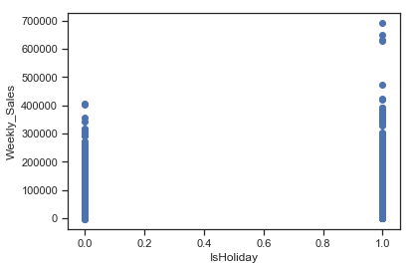
Scatterplot:IsHoliday vs Weekly_Sales

Slide 44
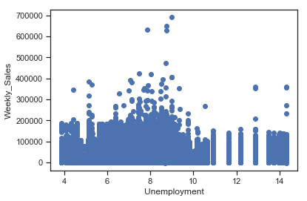
Scatterplot:Unemployment vs Weekly_Sales

Slide 45
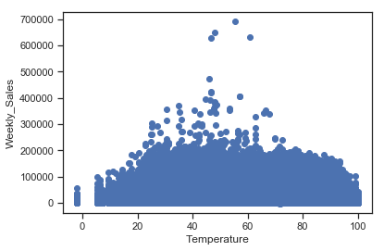
Scatterplot:Temperature vs Weekly_Sales

Slide 46
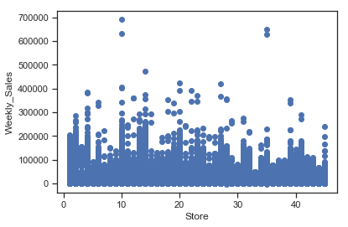
Scatterplot:Store vs Weekly_Sales

Slide 47
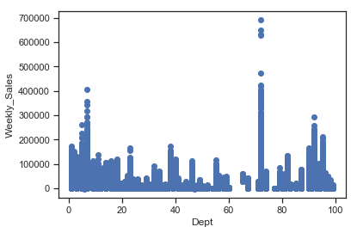
Scatterplot:Dept vs Weekly_Sales

Slide 48
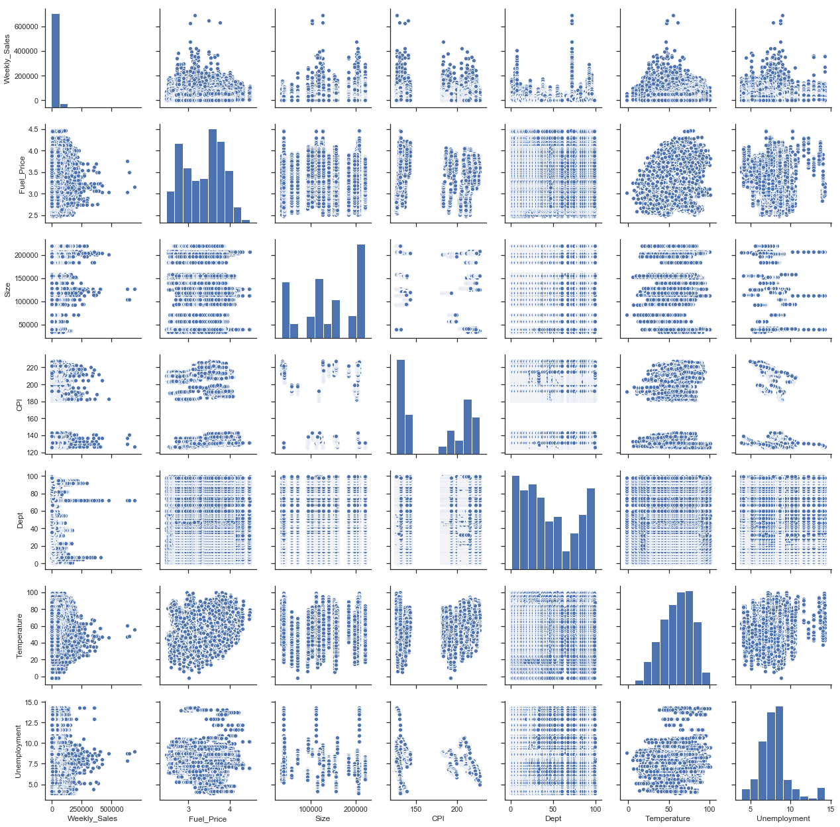
Pairplot sns.pairplot(one_ruler, vars=['Weekly_Sales', 'Fuel_Price', 'Size', 'CPI', 'Dept', 'Temperature', 'Unemployment'])

Slide 49
Pieplot Program: plt.style.use('ggplot') labels=['A store','B store','C store'] sizes=grouped.describe()['Size'].round(1) sizes=[(22/(17+6+22))*100,(17/(17+6+22))*100,(6/(17+6+22))*100] # convert to the proportion fig, axes = plt.subplots(1,1, figsize=(10,10)) wprops={'edgecolor':'black', 'linewidth':2} tprops = {'fontsize':30} axes.pie(sizes, labels=labels, explode=(0.02,0,0), autopct='%1.1f%%', pctdistance=0.6, labeldistance=1.2, wedgeprops=wprops, textprops=tprops, radius=0.8, center=(0.5,0.5)) plt.show()

Slide 50
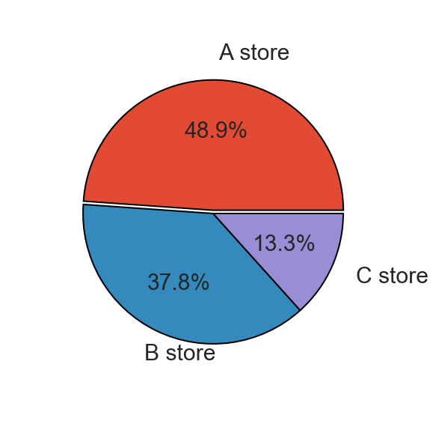
Piechart : Store

Slide 51
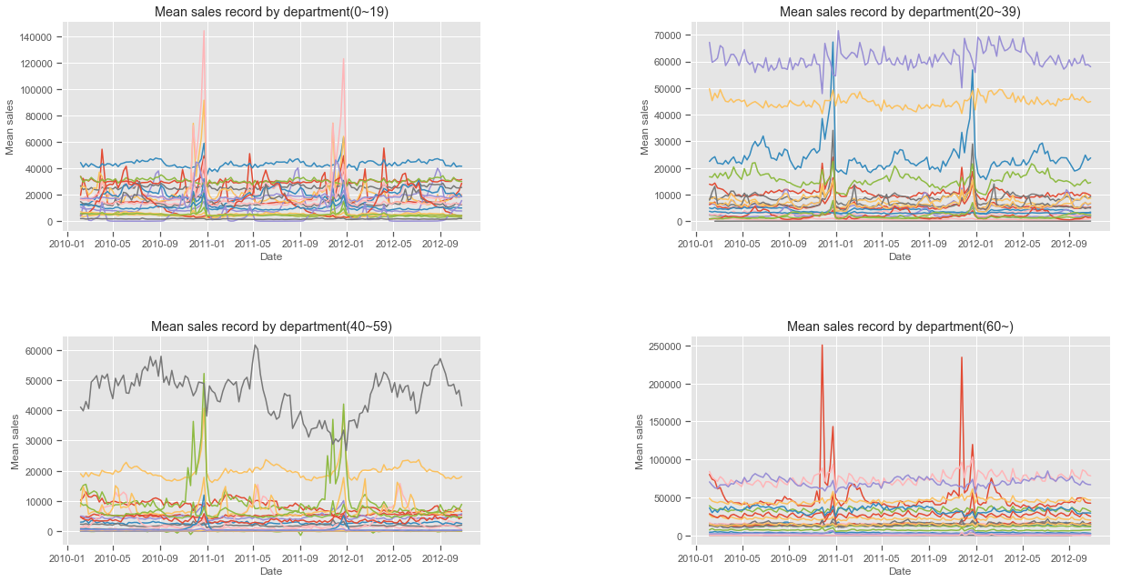
Subplots:Date vs Mean sales

