Slide 1


HMPV RISK IDENTIFICATION AND ADVICE SYSTEM
Presented by:
Name : KUNDRAPU RAM KUMAR Reg No : 23P31F00C3
ADITYA COLLEGE OF ENGINEERING AND TECHNOLOGY
Internal Guide: Ms.Mohammad Gousia

Slide 2
INDEX
ABSTRACT
EXISTING SYSTEM
DISADVANTAGES
PROPOSED SYSTEM
ADVANTAGES
SYSTEM ARCHITECTURE
MODULES
FUNCTIONAL REQUIREMENTS
NON-FUNCTIONAL REQUIREMENTS
MINIMUM SOFTWARE REQUIREMENTS
MINIMUM HARDWARE REQUIREMENTS
UML DIAGRAMS
SCREENSHOTS
CONCLUSION

Slide 3
ABSTRACT
The Hmpv Risk Identification and advice system project seeks to address the urgent need for effective monitoring and management of human metapneumovirus (HMPV) infections, particularly in vulnerable populations such as infants and the elderly. Current diagnostic and tracking methods are often insufficient, leading to delayed interventions and increased health risks. The project aims to develop a user-friendly Android application using Flutter and Dart to provide real-time tracking of HMPV symptoms, access to educational resources, and the ability to connect with healthcare professionals for timely advice and treatment. By leveraging mobile technology, the Hmpv Shield app empowers users to proactively manage their health and reduce the risk of severe respiratory illnesses caused by HMPV.
The Hmpv Risk Identification and advice system app will include key features such as real-time news updates on HMPV outbreaks, a directory of nearby hospitals for immediate care, a comprehensive list of symptoms to monitor, and prevention tips to reduce the risk of infection. In addition, the app will provide valuable educational resources to help users understand HMPV, its transmission, and effective management strategies. This holistic approach aims to engage users in proactive health management, promote timely intervention, and improve overall community health by making essential health information more accessible and actionable.

Slide 4
EXISTING SYSTEM
Many current systems and apps are designed for tracking common respiratory illnesses like COVID-19 or the flu. However, they are not specifically tailored to manage Human Metapneumovirus (HMPV) infections, which have unique symptoms and require distinct management strategies.
Most apps offer general awareness and prevention tips for respiratory viruses but fail to focus on the specific needs of HMPV, such as symptom tracking, real-time outbreak alerts, or professional consultations for this particular virus.

Slide 5
DISADVANTAGES
Limited Information:
Most apps do not display detailed virus-specific symptoms, leading to a lack of awareness about HMPV specifically.
No Healthcare Integration:
Current systems do not integrate with healthcare providers for quick consultations or
health support.
Lack of Updates and News:
Limited or no live updates regarding the HMPV virus, its spread, and preventive
measures.
Generic Information:
Existing apps tend to focus on general virus education rather than providing specific,
relevant information on HMPV.

Slide 6
PROPOSED SYSTEM
HMPV Risk Identification And Advice System is an Android app designed to keep users informed and protected against the HMPV virus. It offers detailed information on the symptoms of the virus, along with preventive tips and health advice to help users stay safe. The app also sends updates and news related to HMPV outbreaks, ensuring users are aware of the latest developments. Additionally, it uses GPS to show nearby hospitals, making it easier for users to find medical help if needed. This combination of features provides users with the resources they need to stay healthy and informed.

Slide 7
ADVANTAGES
Detailed Virus Information
Users get accurate information on HMPV symptoms and how to recognize the virus early.
Real-time Updates
The app provides notifications and news regarding outbreaks, preventive measures, and health updates.
Health Support Integration
Users can find nearby hospitals and healthcare centers for immediate support.
Educational Content
The app educates users by debunking myths and providing facts about the
virus.
Localized Service
Uses geolocation to help users access local healthcare facilities.

Slide 8
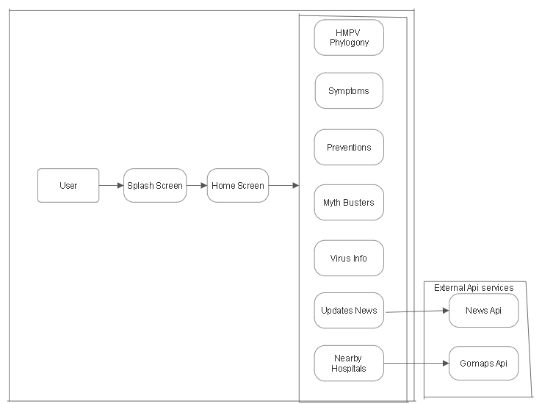
SYSTEM ARCHITECTURE

Slide 9
MODULES
Splash Screen
Displays the app’s logo and tagline before transitioning to the main screen.
Home Screen
The main dashboard that links to all features: Symptoms, Prevention, Myths, Virus Info,
Updates, and Nearby Hospitals.
Symptoms Information
Shows a list of common symptoms associated with HMPV, allowing users to understand the virus better.
Prevention Tips
Provides users with real-time tips and guidelines for protecting themselves from HMPV.

Slide 10
Myth Busters:
Educates users by debunking common myths about HMPV, backed by scientific information
Virus Information:
Offers detailed information about HMPV, including its symptoms, causes, and possible
treatments.
Updates:
Delivers live news and updates on HMPV outbreaks, government health advisories, and
research findings.
Nearby Hospitals & Doctors:
Uses GPS to help users locate nearby hospitals and doctors for consultations or medical emergencies.
Symptom Risk Assessment:
Based user given input symptoms it assess the risk.

Slide 11
FUNCTIONAL REQUIREMENTS
Displays a list of symptoms for the HMPV virus.
Displays a list of Preventions for the HMPV virus.
It displays the general myths about hmpv and distingus between myths and facts.
Allows users to find hospitals based on their location
Based on user given input symptoms it assess the risk.
If the risk is high or medium we can find nearby doctors based on user location.

Slide 12
NON-FUNCTIONAL REQUIREMENTS
Performance: The app should load quickly and provide real-time updates on user progress and activities.
Usability: The app should be easy to use, with an intuitive interface and minimal
learning curve.
Scalability: The system should be able to handle a large number of users and data.
Compatibility: The app should be compatible with most Android devices (Android 6.0 and above).

Slide 13
MINIMUM SOFTWARE REQUIREMENTS
Operating System Dev Environment IDE
Additional Tools
: Android 5.0 (Lollipop) or higher
: Flutter SDK and Dart SDK
: Visual Studio Code or Android Studio
: Android Emulator or a physical device for testing

Slide 14
MINIMUM HARDWARE REQUIREMENTS
Device Processor Storage
: Android smartphone or tablet with at least 2 GB RAM
: Quad-core 1.5 GHz or higher
: Minimum 16 GB of available storage
Connectivity : Internet access (Wi-Fi or mobile data)

Slide 15
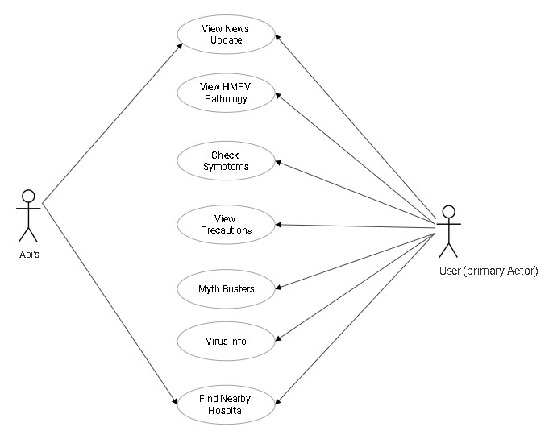
UML Diagrams
Fig: Use Case Diagram for system

Slide 16
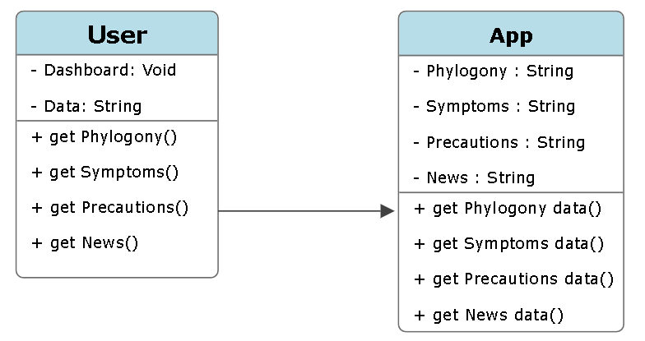
Fig: Class Diagram for system

Slide 17
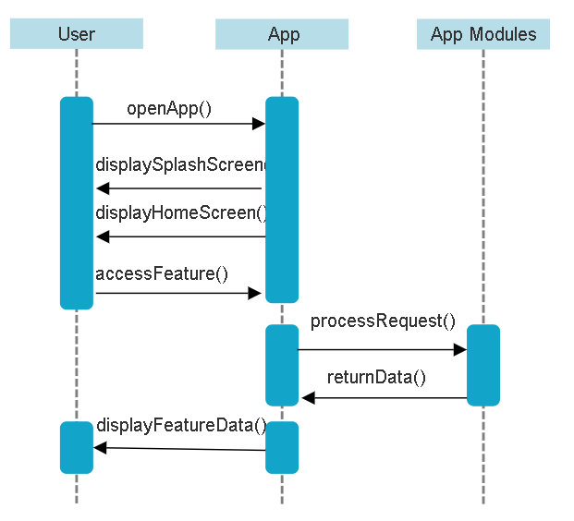
Fig: Sequence Diagram for system

Slide 18
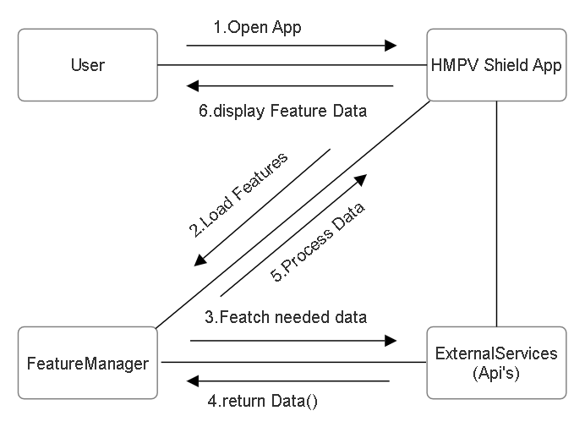
Fig: Collaboration Diagram for system

Slide 19
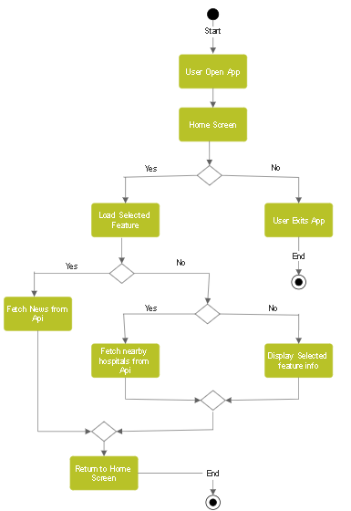
Fig: Activity Diagram for system

Slide 20
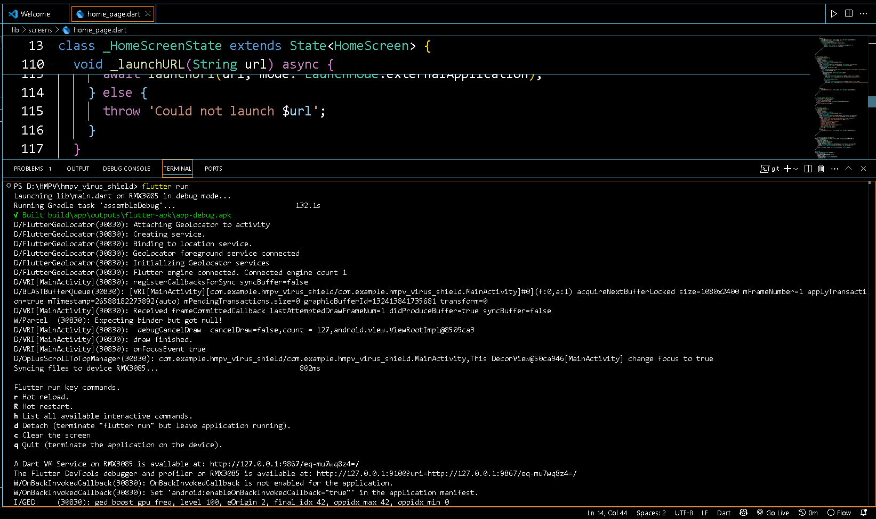
Screen Shots
r
execution
Fig: Project execution

Slide 21
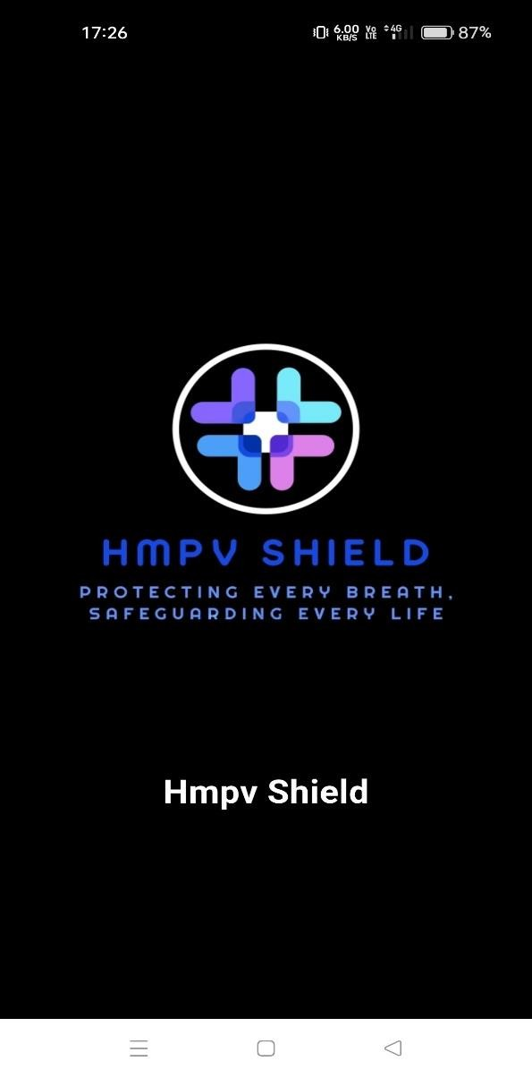
Fig: App splash screen

Slide 22
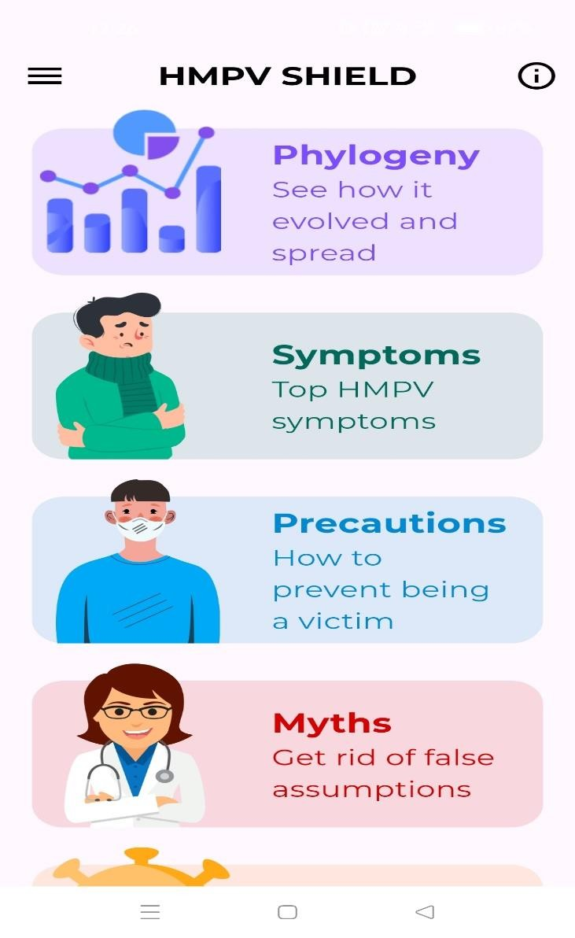
Fig: Home screen

Slide 23
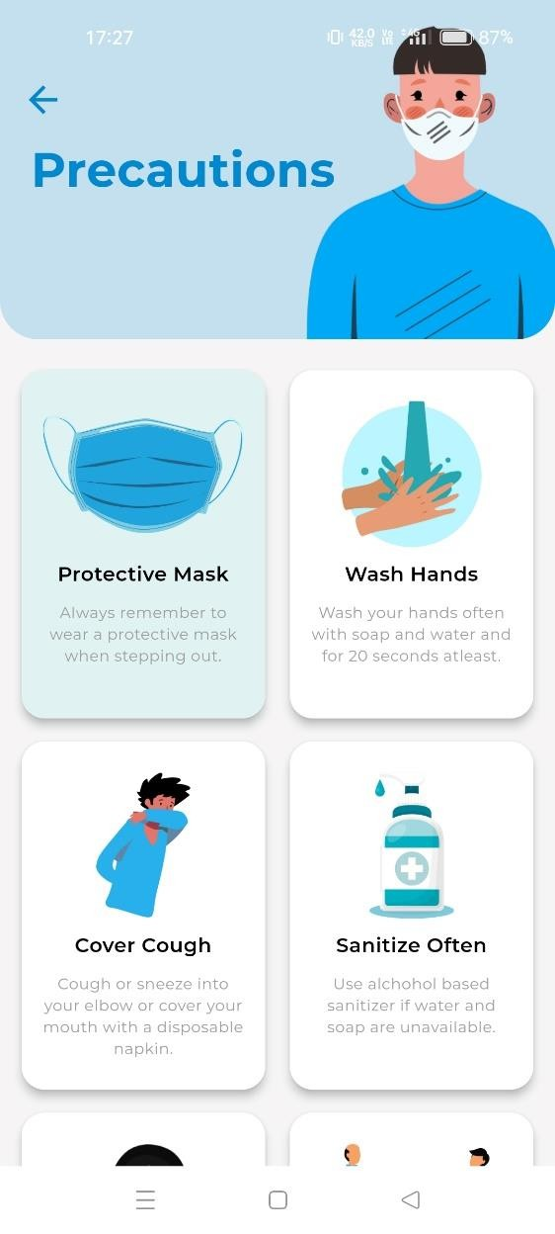
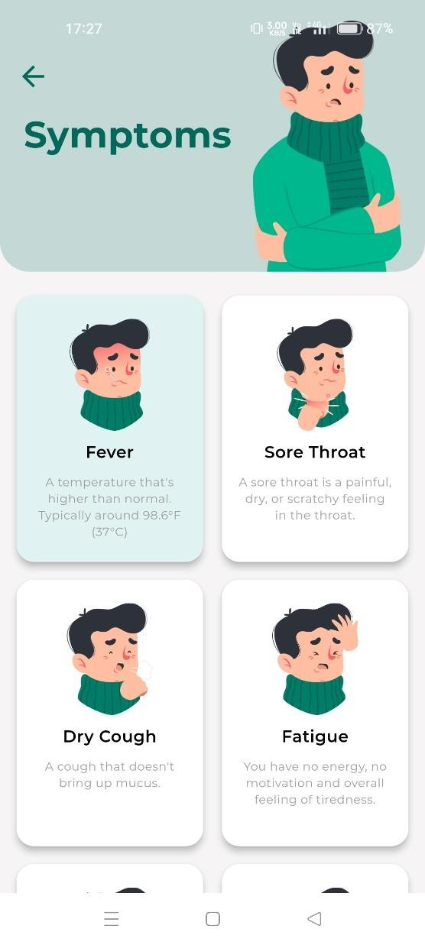
Fig: Precautions & Symptoms

Slide 24
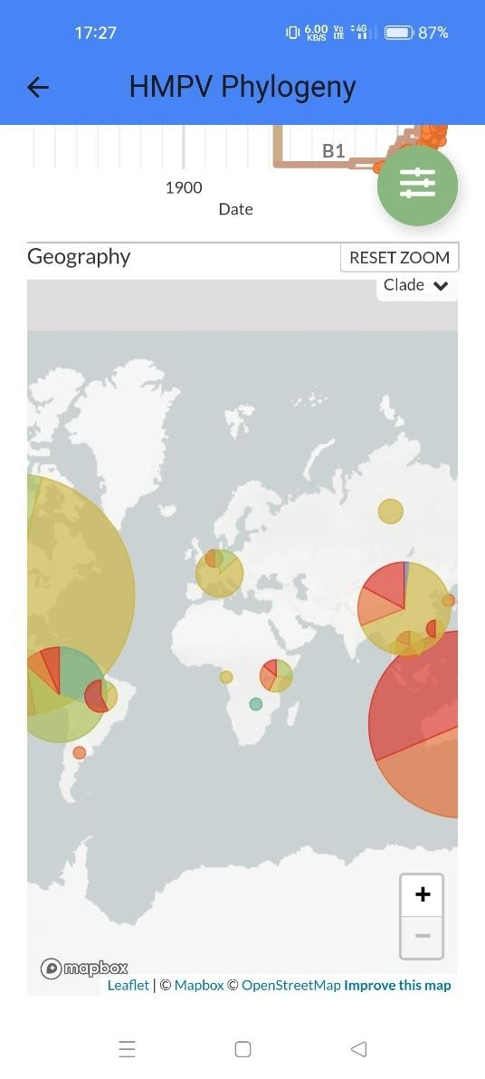
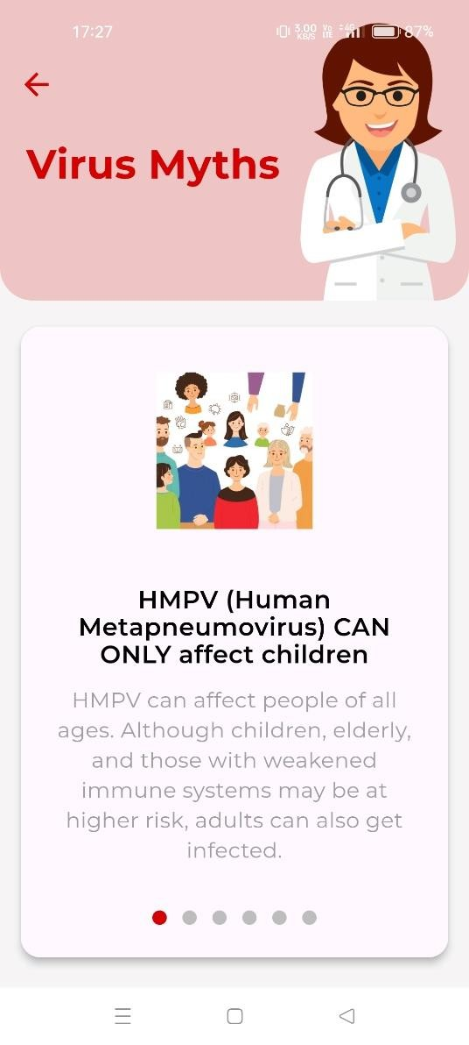
Fig: Phylogeny & Myths tabs

Slide 25
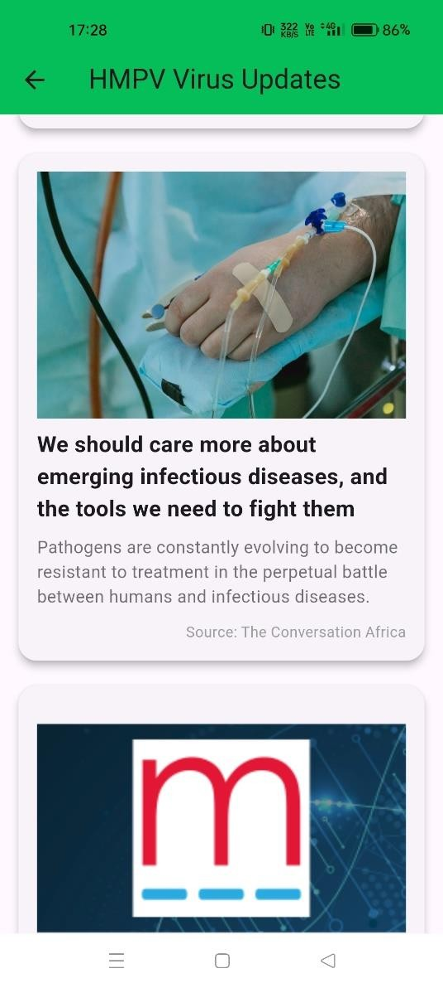
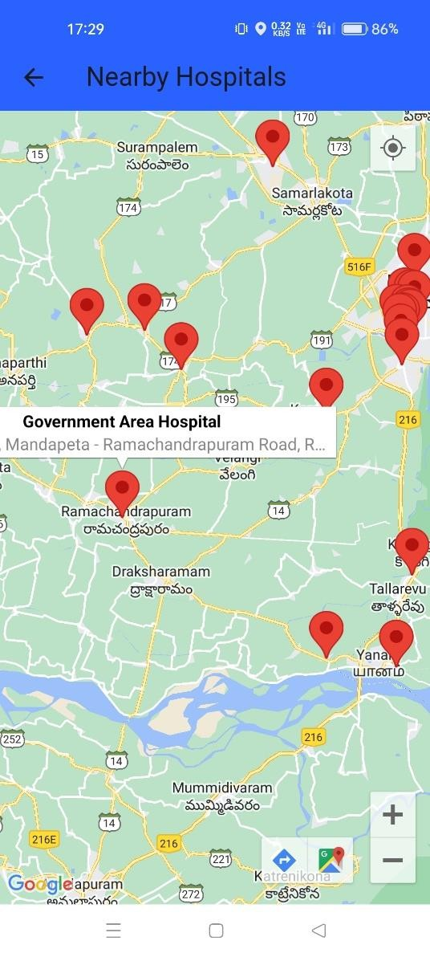
Fig: Virus updates & Nearby hospitals

Slide 26
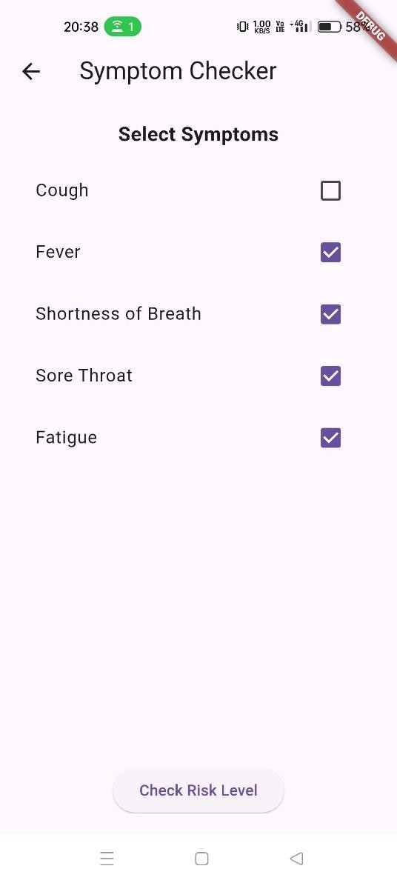
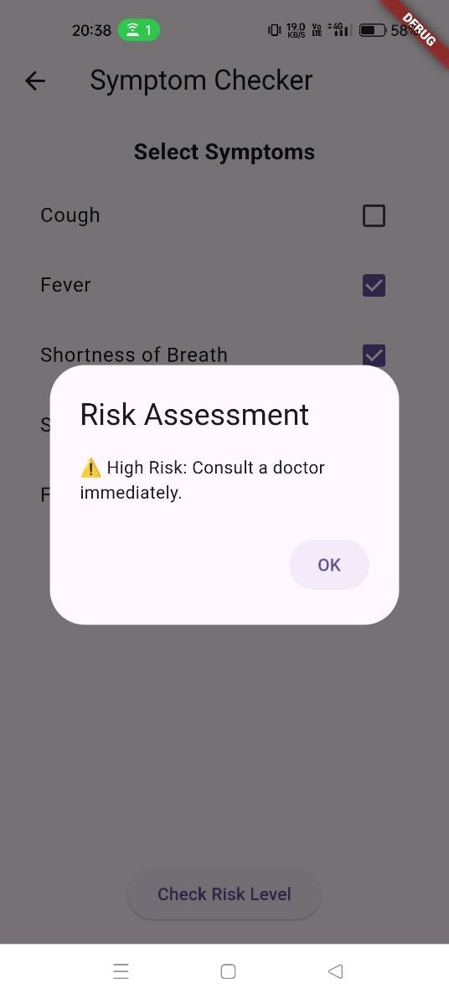
Fig: symptom risk checker

Slide 27
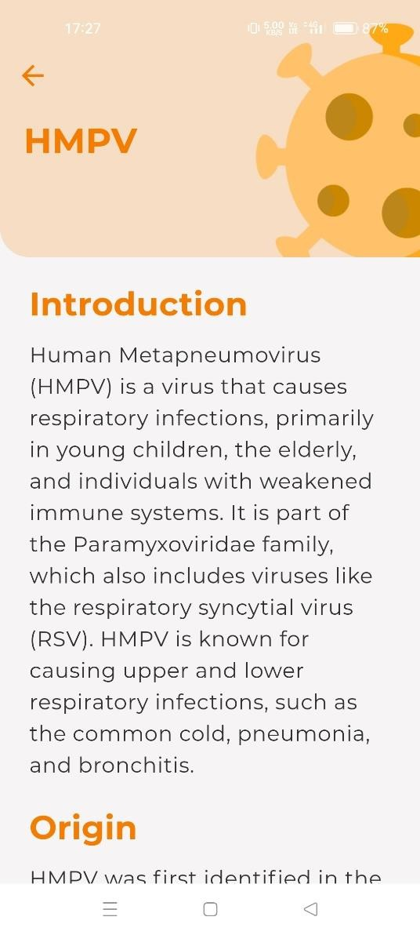
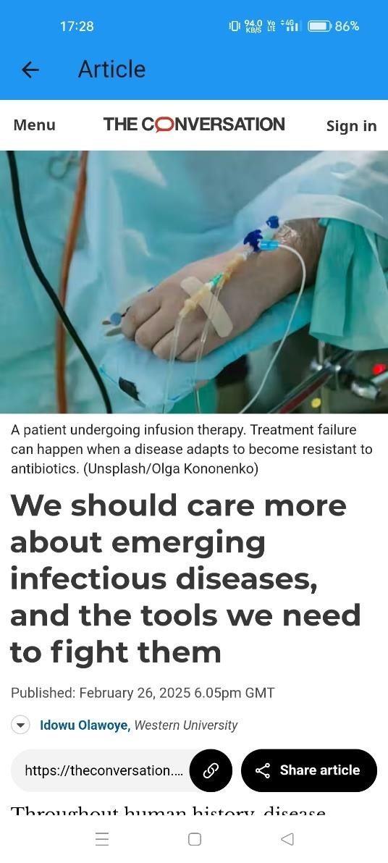
Fig: Virus Info & Articles

Slide 28
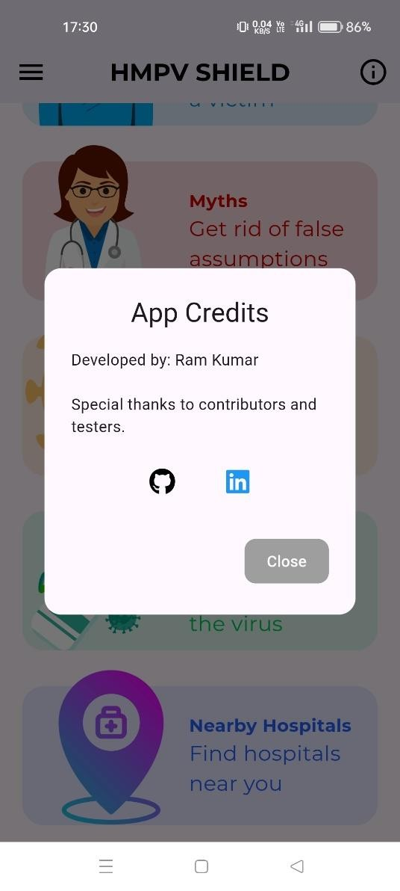
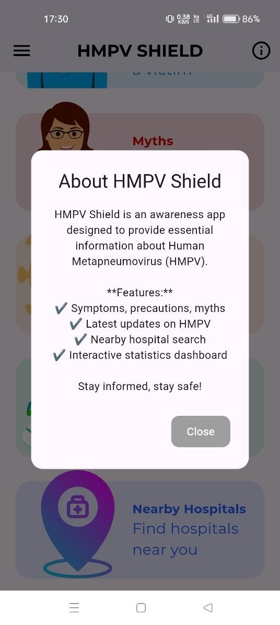
Fig: App credits & About app

Slide 29
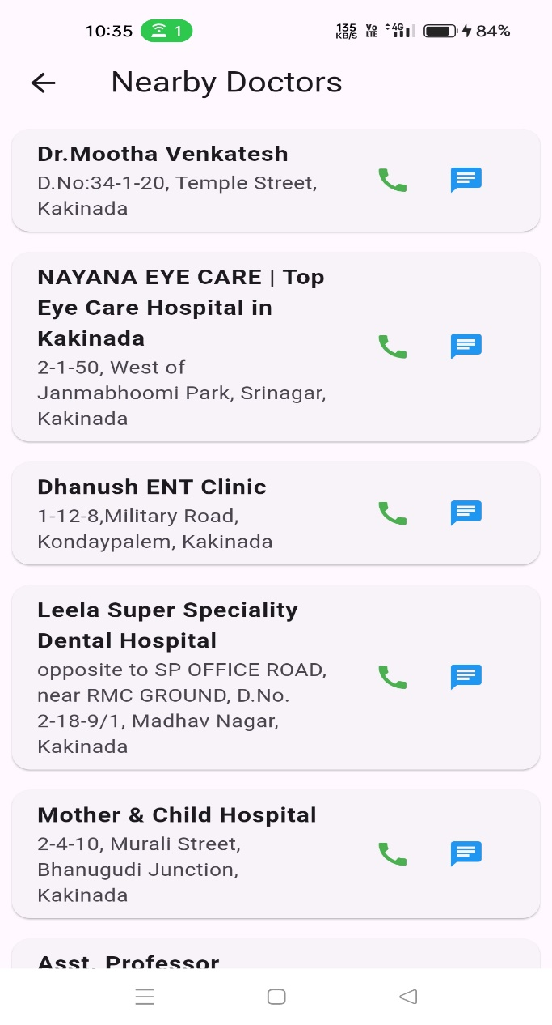
Fig: Nearby doctors

Slide 30
CONCLUSION
The HMPV Risk Identification and Advice System is a comprehensive and user-friendly solution aimed at spreading awareness and providing crucial information about the Human Metapneumovirus (HMPV). By integrating features such as phylogeny, symptoms, precautions, myths, virus information, latest updates, and nearby hospital locators, the app serves as a valuable resource for users seeking accurate and timely health-related data.
Through this project, we have successfully developed an application that enhances public awareness and assists in early detection and prevention of HMPV infections. The inclusion of real-time updates ensures that users stay informed about new developments, while the nearby hospital feature aids in quick access to medical facilities.

Slide 31
THANK YOU

Slide 32
ANY QUERIES

