Slide 1
Fandango movie rating discrepancy analysis
CAPSTONE PROJECT
Presented By:
1. S.Ramkumar-8144-Sudharsan Engineering College - EEE

Slide 2
OUTLINE
Problem Statement
Proposed System/Solution
System Development Approach
Algorithm & Deployment
Result
Conclusion
Future Scope
References

Slide 3
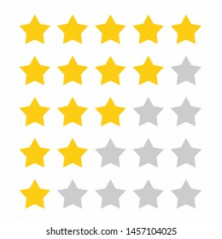
Problem Statement
Detailed analysis of the problem: Highlighting the discrepancies found in Fandango's movie ratings.Examples and evidence showcasing instances of inflated ratings compared to other platforms or user perceptions.Impact on consumers and the movie industry.

Slide 4
Proposed Solution
Explanation of the proposed system to address the rating discrepancies.Implementation of a robust rating verification mechanism to ensure accuracy and transparency.
Integration of user feedback mechanisms to continuously improve rating credibility.

Slide 5
System Approach
Building the proposed solution would involve a combination of data procrssing, feature engineering ,and machine learning,
Here are the key system and library requirements
System requirements
1.Hardware
A computer with sufficient processing power preferably with mulpile cores or a GPU for faster traning of machine learning models .
2. Software
An operating system compatible with the required machine learning libraries.
Eg- windows Linux
Library Requirements:
1.Data Processing and Analysis
-Pandas: For data manipulation and analysis
-Numpy: For numerical operation on data
2.Data visualization
-Mathplotlib and seaborn: For creating visualizations to understand data patterns
-Plotly or Bokeh : Interactive visualization libraries for more comple visualizations

Slide 6
Algorithm & Deployment
Description of the algorithm used for rating verification and discrepancy detection.Details on the deployment process across Fandango's platforms.
Integration with existing systems and databases.
plt.figure(figsize=(10,5),dpi=200)
sns.histplot(data=all_sites,x='Rotten_Diff',kde=True,bins=20)
plt.title("RT Critics Score minus RT User Score")

Slide 7
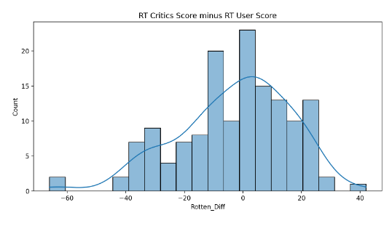
Result
Presentation of the results obtained post-implementation of the proposed system.Comparison of the before and after scenarios regarding rating accuracy.
Feedback from users and stakeholders on the effectiveness of the solution..

Slide 8
Conclusion
Summary of key findings and takeaways from the analysis and solution implementation.Reinforcement of the importance of accurate and transparent movie ratings for consumers and the industry.
Expression of confidence in the effectiveness of the proposed solution

Slide 9
Future scope
Exploration of potential enhancements and future developments.
Incorporation of advanced analytics and machine learning for real-time rating analysis.
Collaboration opportunities with other industry stakeholders for standardization of rating systems.

Slide 10
References
List of References: Citations for relevant literature, datasets, and tools used in the analysis.
Acknowledgments: Thank collaborators, advisors, and contributors to the project for their support and guidance.

Slide 11
THANK YOU

