Slide 1
Mutual Fund Analytics
Bluestock Fintech • Capstone Project
Cleaning the data, measuring fund performance, and understanding investor behaviour.
Mutual Fund Analytics Capstone | 01

Slide 2
Problem & Objective
What we wanted the analysis to answer.
• Can the raw mutual-fund files be turned into a consistent analysis dataset?
• How do funds compare on return and risk-adjusted performance?
• What does the investor transaction data say about SIP behaviour?
• Where are concentration and risk visible in the portfolio data?
• Can the results be presented clearly in a Power BI dashboard?
Mutual Fund Analytics Capstone | 02

Slide 3
Data Sources
Main files used in the project.
Fund master
01_fund_master.csv
Scheme, category, benchmark, expense ratio and risk fields.
NAV history
02_nav_history.csv
Historical NAV used for returns and risk calculations.
Scheme performance
07_scheme_performance.csv
Performance and scheme-level fields.
Investor transactions
08_investor_transactions.csv
SIP, redemption and lumpsum activity.
The processed layer contains cleaned NAV history, scheme performance and investor transactions.
Mutual Fund Analytics Capstone | 03

Slide 4
Analysis Flow
The project was built as a sequence rather than one large notebook.
1
Raw files
2
Clean & validate
3
EDA
4
Performance
5
Advanced analytics
6
Power BI
• Outputs include cleaned CSVs, charts, performance reports, advanced analytics and the dashboard.
Mutual Fund Analytics Capstone | 04

Slide 5
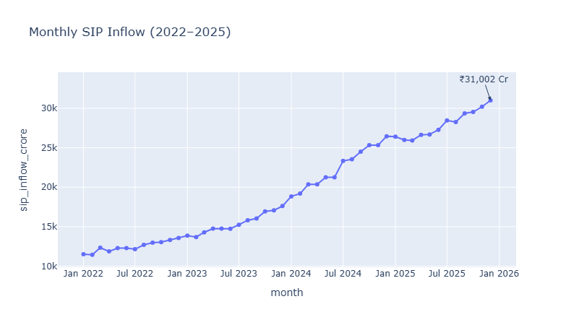
EDA — SIP Activity
SIP inflow shows a clear upward trend in the source series.
SIP transactions
19,716
Transactions classified as SIP.
Investors with 6+ SIPs
1,362
Threshold used for the continuity analysis.
• Monthly SIP inflow rises to ₹31,002 Cr at the end of the displayed series.
• There is a small dip around early 2025, followed by renewed growth.
Mutual Fund Analytics Capstone | 05

Slide 6
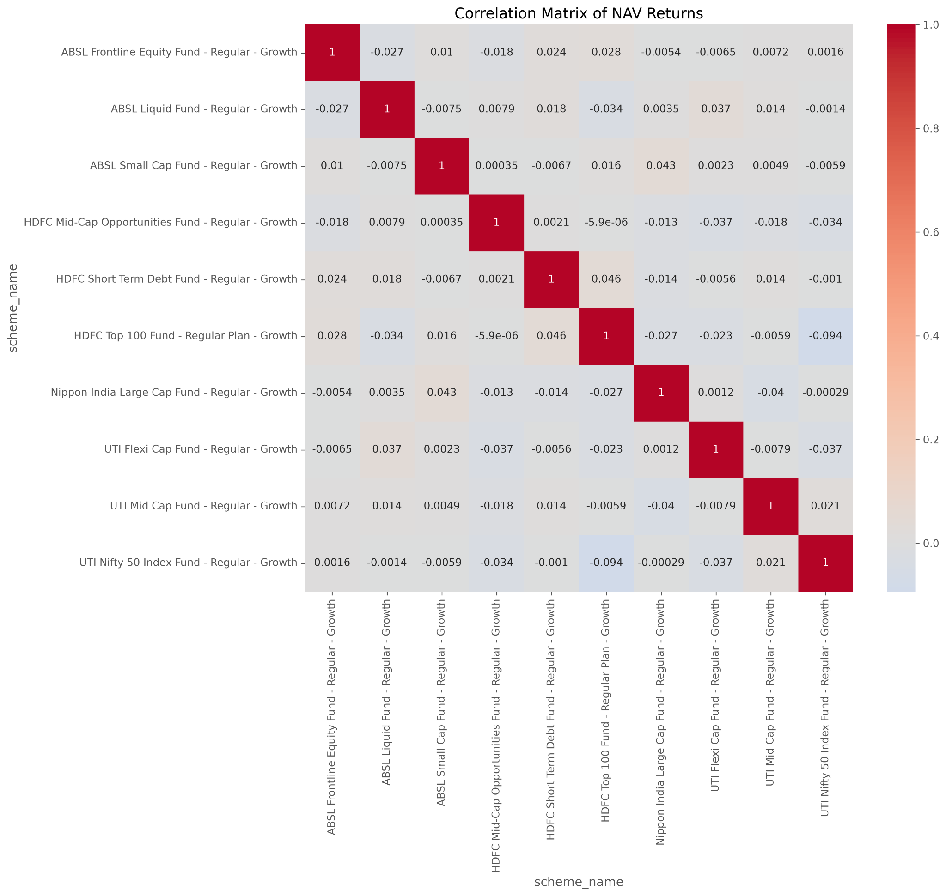
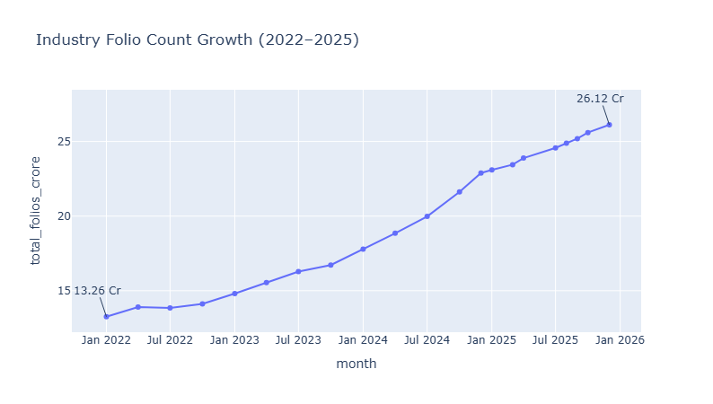
EDA — Relationships & Participation
Two useful signals from the exploratory analysis.
• Most off-diagonal correlations in the displayed sample are close to zero.
• The strongest negative value shown is about -0.094.
• Industry folio count rises from 13.26 Cr to 26.12 Cr.
Mutual Fund Analytics Capstone | 06

Slide 7
Performance — Risk-Adjusted Ranking
The recommender used Sharpe ratio as one of the screening measures.
Rank 1
1.235
Mirae Asset Tax Saver Fund
Rank 2
1.180
ICICI Pru Midcap Fund
Rank 3
1.132
DSP Midcap Fund
• Top three from the project output: Mirae Asset Tax Saver, ICICI Pru Midcap and DSP Midcap.
• This is an analytical ranking, not a personal investment recommendation.
Mutual Fund Analytics Capstone | 07

Slide 8
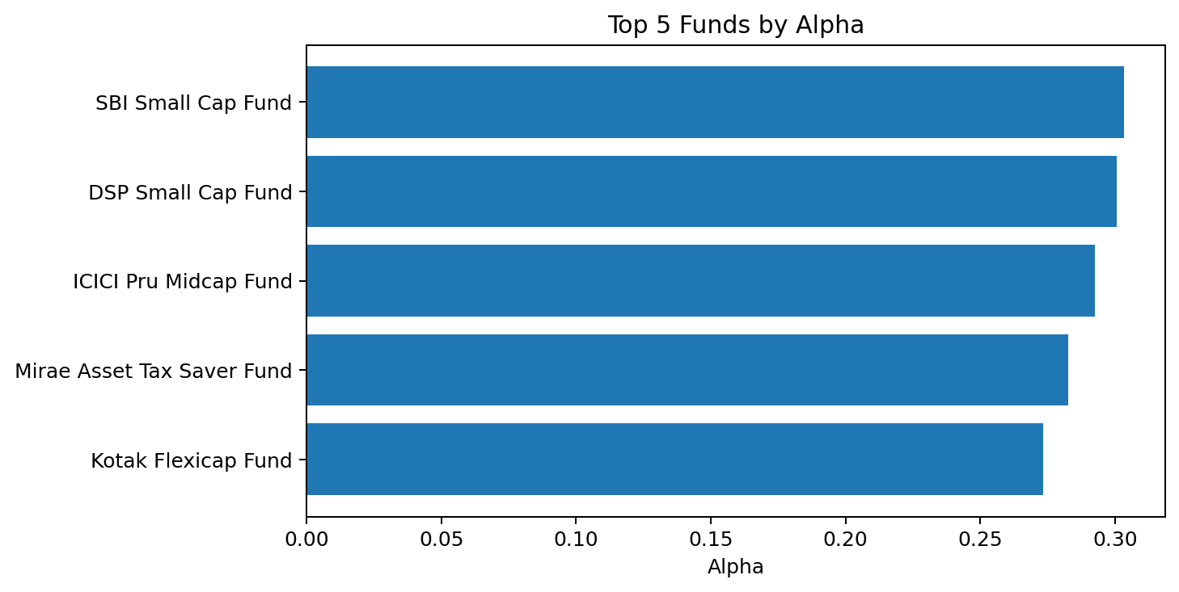
Performance — Alpha & Beta
Values below come directly from alpha_beta.csv.
Schemes
40
Rows in alpha_beta.csv
Mean Alpha
0.159
Min Alpha
0.029
Max Alpha
0.303
• Highest Alpha in the file: SBI Small Cap Fund - Regular Plan - Growth (0.303).
• Alpha and Beta should be read together with the chosen benchmark and analysis period.
Mutual Fund Analytics Capstone | 08

Slide 9
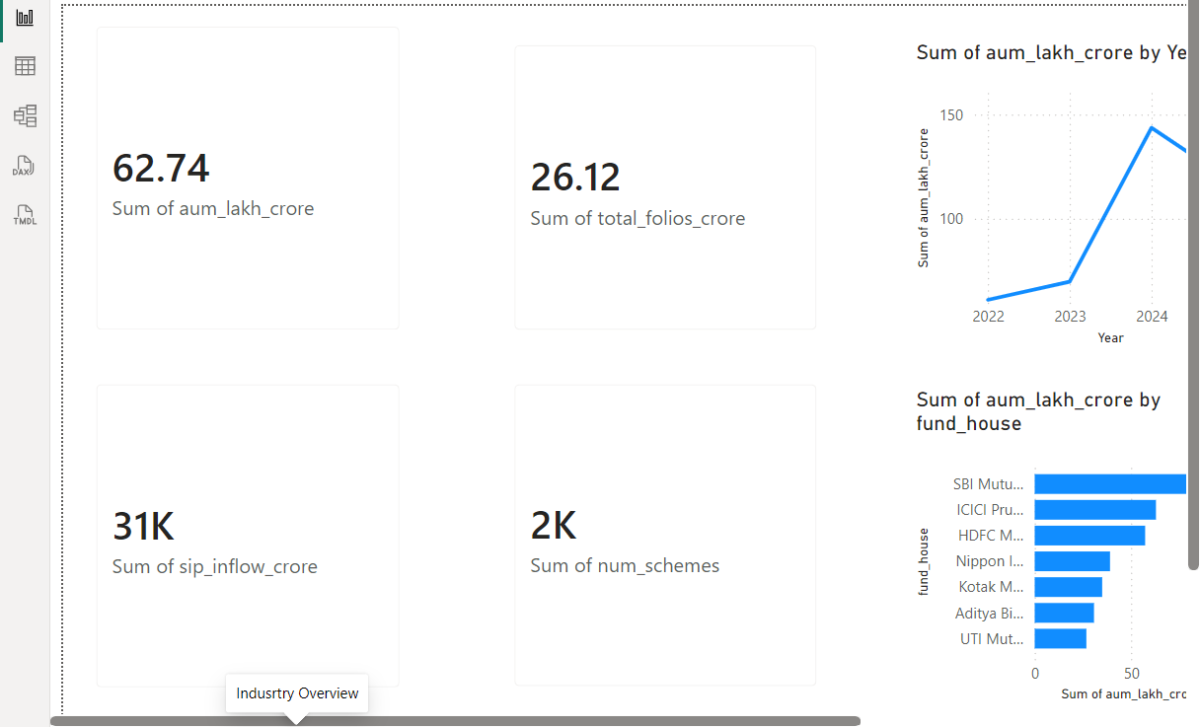
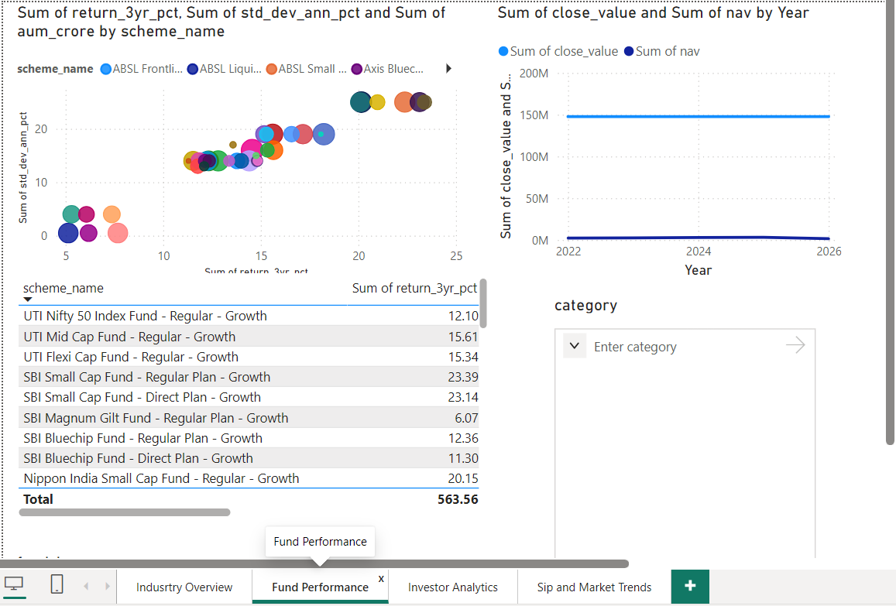
Dashboard — Overview & Fund Performance
Actual Power BI screens from the project.
Industry Overview
Fund Performance
Mutual Fund Analytics Capstone | 09

Slide 10
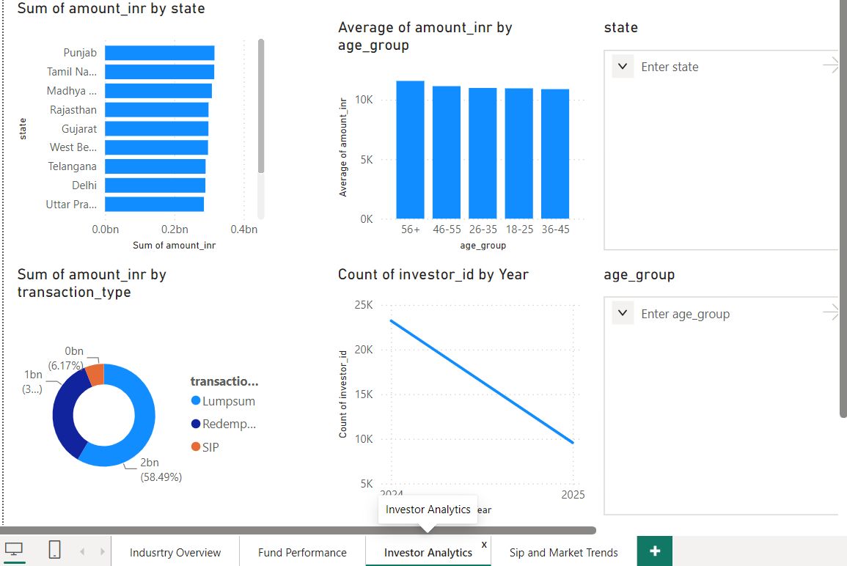
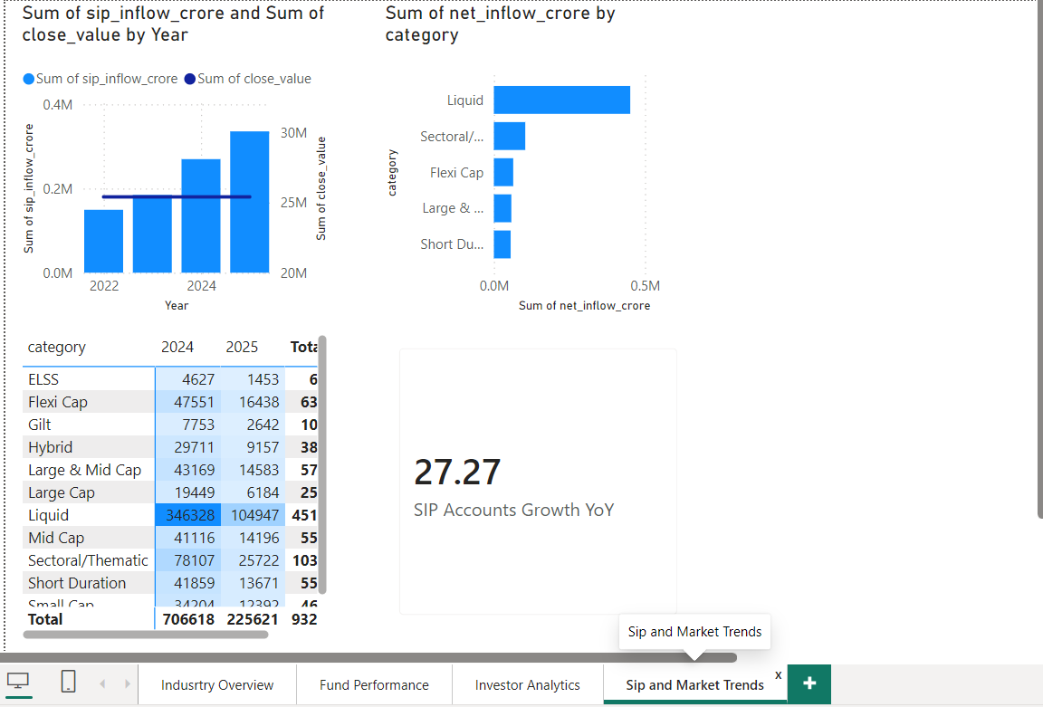
Dashboard — Investor & SIP Views
The remaining two dashboard pages.
Investor Analytics
SIP and Market Trends
Mutual Fund Analytics Capstone | 10

Slide 11
Key Findings
The main points we would take away from the project.
1
SIP growth
Monthly SIP inflow reaches ₹31,002 Cr at the end of the displayed series.
2
Investor continuity
1,362 investors meet the 6+ SIP transaction threshold.
3
Fund screening
The top three Sharpe recommendations are Mirae Asset Tax Saver, ICICI Pru Midcap and DSP Midcap.
4
Portfolio relationships
The displayed fund-return correlations are mostly weak.
5
Advanced analysis
Cohort analysis, SIP continuity, sector HHI and VaR/CVaR were added beyond basic EDA.
Mutual Fund Analytics Capstone | 11

Slide 12
Thank you
Mutual Fund Analytics Capstone
Data → cleaning → analysis → dashboard
Mutual Fund Analytics Capstone | 12

