Slide 1


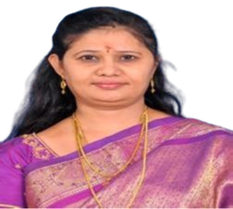
St.John’s College, Palayamkottai (Re-Accredited by NAAC with ‘A’ grade) Department of Computer Science
World day against
cyber censorship
Presided By:
Dr.G.Andrews, Ph.D.,
Principal,
St.John’s College,
Palayamkottai.
Chief Guest:
Dr.B.N.Prathibha,M.C.A.,M.Phil.,PhD.,NET., Assistant Professor,
Sadakathullah Appa college,
Tirunelveli,
Tamilnadu, India.
Venue: Department of Computer Science
Time: 02.30 pm
Date: 12/03/2025

