Slide 1

Chatbot with Watson
Phase 1: Problem Definition and Design Thinking

Slide 2
TEAM DETAILS
TEAM NAME: Proj_229908_Team_1
NAME | REGISTER NO | EMAIL ID
Karan Kumar B | 312821205301 | 22le-it01@act.edu.in
Ramkumar K S | 312821205033 | 21it40@act.edu.in
Mohamed Alifdeen R | 312821205018 | 21it25@act.edu.in
Yokesh B |  | yokeshyoki34@gmail.com
Rukmangathan D | 312821205036 | 21it42@act.edu.in
Nandha kumar A | 312821205021 | 21it28@act.edu.in

Slide 3
AGENDA
Problem Statement
Problem Objective
Design and thinking
Flowchart
Procedure
Technologies

Slide 4
PROBLEM STATEMENT
Chatbot Deployment with IBM Cloud Watson Assistant

Slide 5
Problem Objective
The project involves creating a chatbot using IBM Cloud Watson Assistant. The goal is to develop a virtual guide that assists users on messaging platforms like Facebook Messenger and Slack.
The chatbot should provide helpful information, answer frequently asked questions (FAQs), and offer a friendly conversational experience. The project includes designing the chatbot's persona, configuring responses, integrating with messaging platforms, and ensuring a seamless user experience.

Slide 6
Design Thinking
The important 6 parts of design thinking for our project are:
      Persona Design
      User Scenarios
      Conversation Flow
      Response Configuration
      Platform Integration
      User Experience

Slide 7
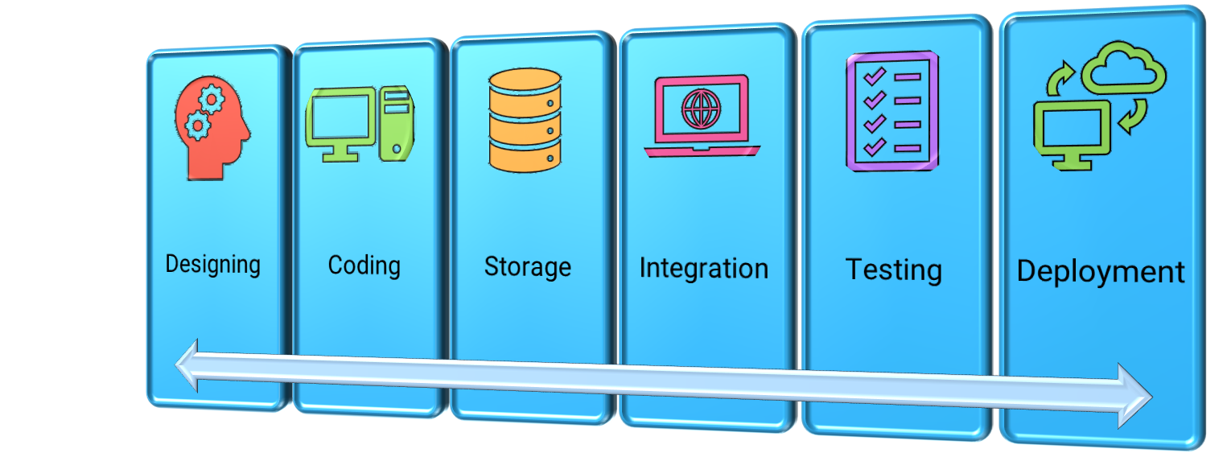
FLOWCHART

Slide 8
PROCEDURE
Persona Design
  Name:
    A name will be provided that reflects the chatbot's purpose and is easy to remember.
  Tone and Personality:
  Determine the bot's tone and personality traits. Is it friendly or professional.
  Friendly tone with the users.
  Style of Communication:
    Defines how the chatbot will communicate with users. Will it use formal language or casual language.

Slide 9
User Scenarios
    Provide Guidance.
    User Support
    Friendly Chats
    Virtual Assistant
    Entertainment
    Survey and feedback

Slide 10
Conversation Flow
  Define Conversation Goals:
    We will determine the primary goals of the chatbot. The main objectives it aims to achieve through conversations.
  Identify Key User Queries:
    List the common queries or prompts users are likely to initiate. These could be questions, requests for information, or specific actions.
  User Feedback and Surveys:
    Integrate opportunities for users to provide feedback or take surveys within the conversation flow.

Slide 11
Test and Iterate:
  Gather feedback from real users and iterate on the flow to improve user experience.
Multichannel Considerations:
  If the chatbot is deployed on multiple messaging platforms (e.g., Facebook Messenger, Slack), adapt the conversation flow for each platform to ensure consistency.
Documentation:
  Document the entire conversation flow, including intents, responses, and conditional logic, for reference and future updates.

Slide 12
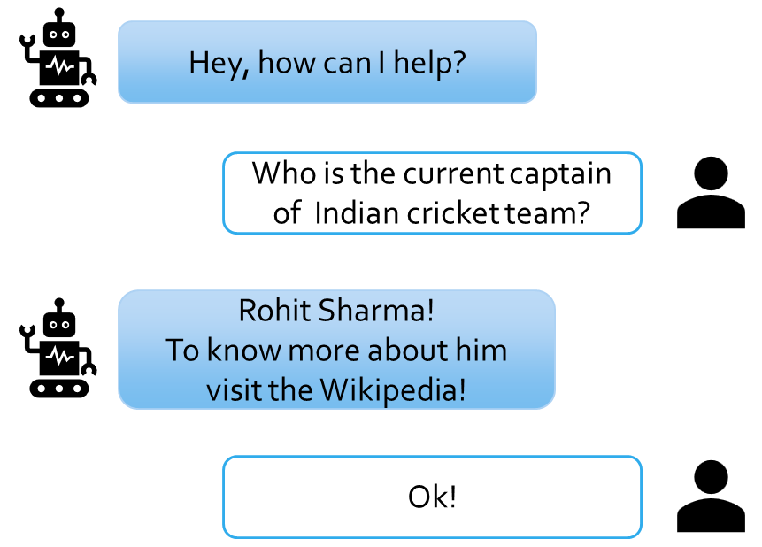
Response Configuration
  Chatbot's responses using Watson Assistant's intents, entities, and dialog nodes
  This virtual assistant provide the exact answers
  It also provides the additional contents related to it.

Slide 13
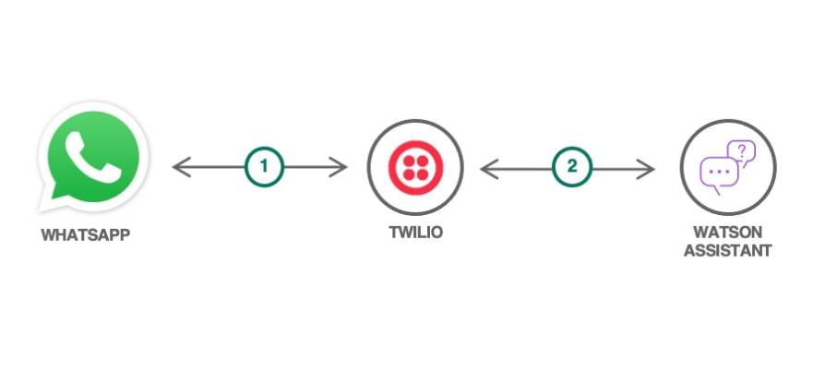
Platform Integration
  We will integrate chatbot with third party integration in Watson.
  Link the integrated Watson with the messenger applications.
  Example linking Watson with Twilio and integrate with WhatsApp.

Slide 14
User Experience
  The chatbot’s design, functionality, personality, tone, and responsiveness will be a major criteria for best user experience.
  We will provide the design and functionality which will give a user a prominent and wonderful experience.
  To create such a user experience we will taking a online survey from various groups of users for our application.

Slide 15
Technologies:
Front End: Html, CSS, JavaScript
Backend: Flask
Database: IBM Db2
Dependencies: IBM Watson

Slide 16
Thank You!

