Slide 1
Claimforge
Gemini AI Patent Search & Analysis Agent

Slide 2
Problem Statement
Manual patent searches are:
Time-consuming
Prone to missing relevant documents
Even if a relevant document is found, a human being might overlook a critical part of a large document
Need: An automated assistant that can search and analyze patents using AI

Slide 3
🔍 Understanding Patents & ClaimForge
Inventors receive a legal monopoly to use their invention for a limited time (typically up to 20 years).
This right only applies if the inventor is truly the original creator of the idea.
Prior Art refers to any existing documentation or evidence that the invention was already known or published.
If Prior Art exists, a patent can be challenged or invalidated.
Traditional prior art discovery is a manual, time-consuming process handled by experts.
ClaimForge automates this process using Gemini-powered AI agents to assist in searching and analyzing prior art.

Slide 4
🛠️ Solution Overview: Claimforge: Gemini Patent Search Agent
AI-Powered Patent Search Utilizes advanced large language models (LLMs) combined with resilient search tools to automate patent prior art discovery.
Multi-Tool Pipeline Integrates multiple tools such as:
Patent query sanitization and normalization
Robust patent search using Google Patents or fallback public APIs
Final AI-driven report generation summarizing search results and analysis
Interactive Agent Loop The agent iteratively plans, searches, analyzes, and refines its queries, mimicking human expert workflows to improve accuracy.
Resilience and Reliability Uses retry mechanisms (via Tenacity) to handle network errors and API limits, ensuring stable operation.
Modular & Extensible Design Easily extendable toolset and prompt templates allow adapting to new patent data sources or evolving AI models.
User-Friendly Outputs Produces structured, comprehensive final reports to support patent analysts in making informed decisions faster.

Slide 5
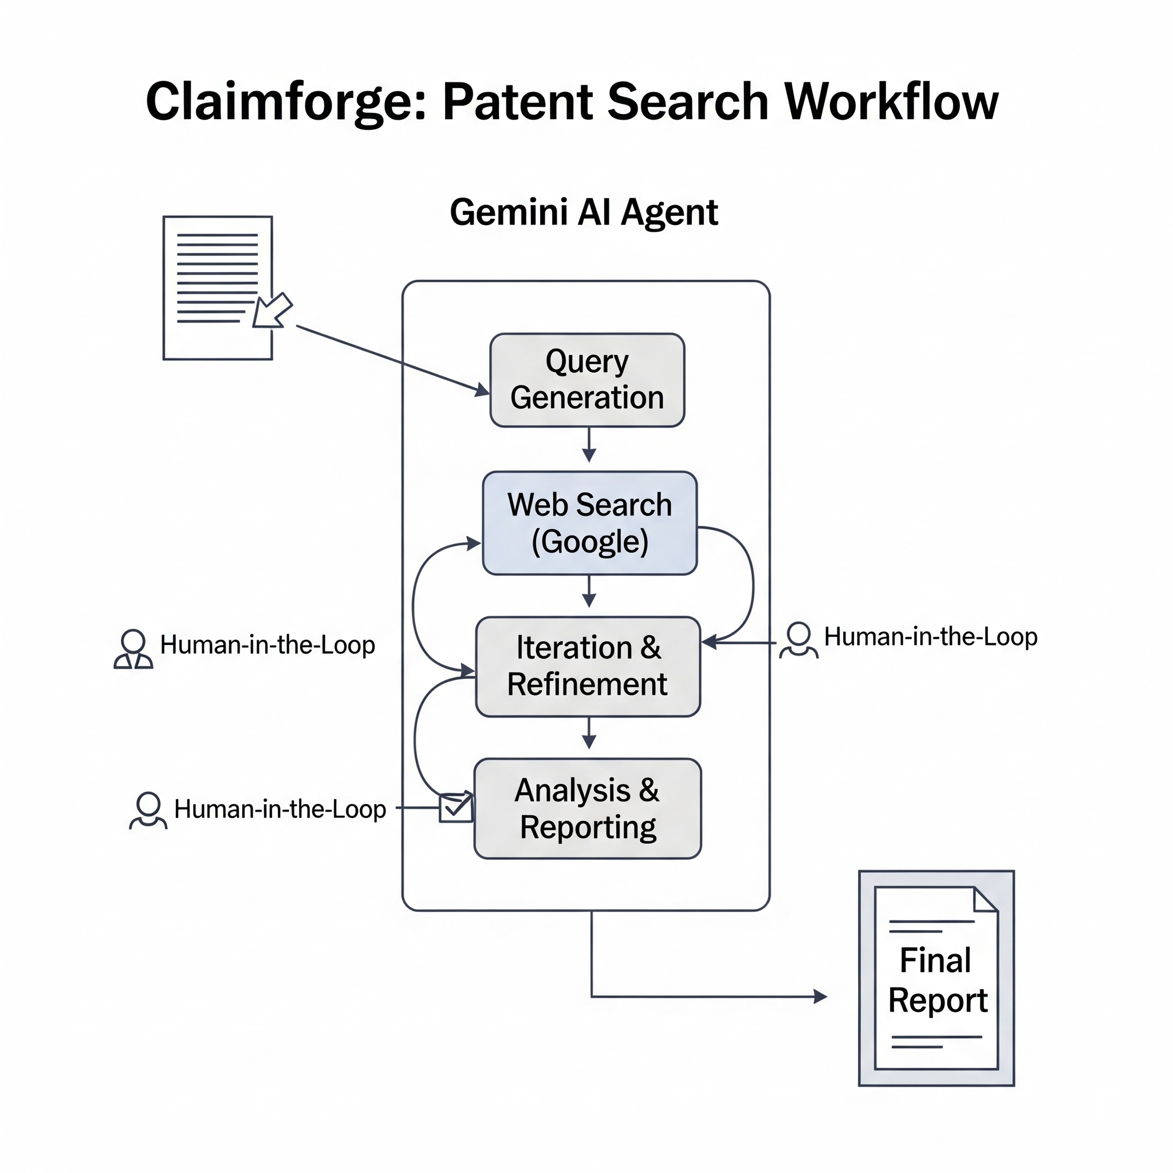
🛠️

Slide 6
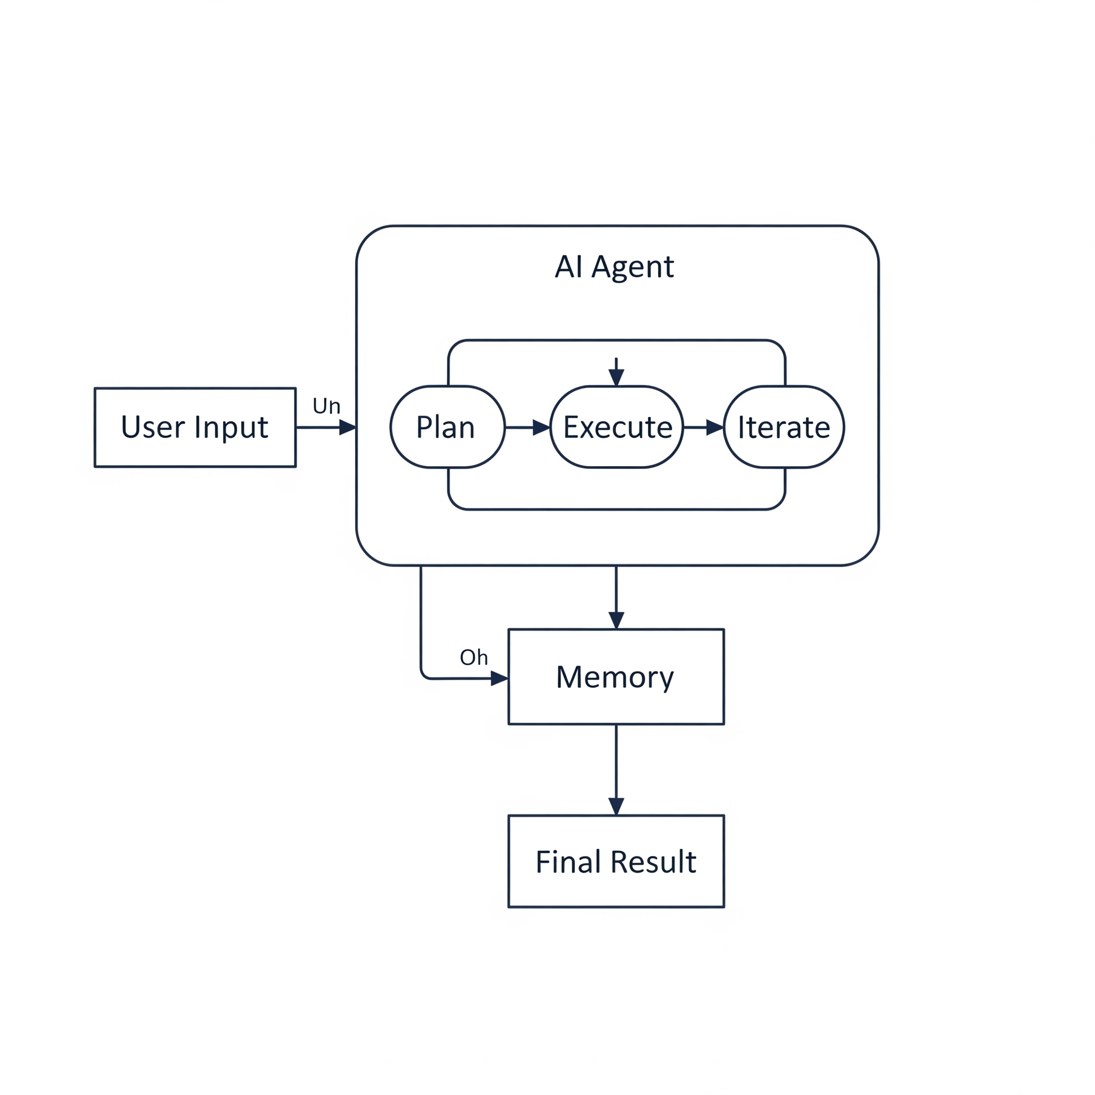
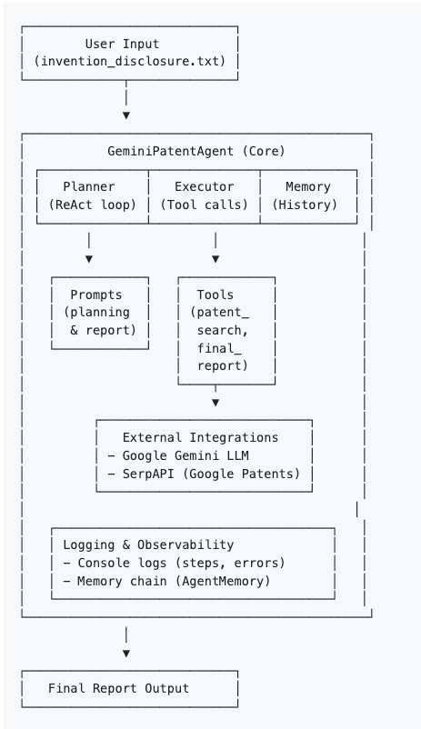
🛠️ Architecture Diagram

Slide 7
Tech Stack
🔷 Language: Python
🔷 AI Model: Gemini via Google Generative API
🔷 Patent Data: Google Patents via SerpAPI
🔷 Retry/Resilience: Tenacity
🔷 Memory: Custom LLM memory for iterative planning
🔷 UI/API Framework: Flask, Jinja2

Slide 8
Challenges
Limited and Unreliable Free Patent APIs Many open patent data sources have restrictions or frequent downtime.
Restricted Availability of Tools Most patent professionals work standard business hours, but some tools may be inaccessible outside 9-to-5.
Instability of PyPatents Initially functional during our hackathon, but became unavailable after a few hours due to maintenance or patching.
SerpAPI Dependency on API Keys Access to SerpAPI’s Google Patents requires a paid API key, limiting open usage.
Blocked Web Scraping of Google Patents Direct scraping is often blocked, necessitating fallback to official structured APIs for reliable data.
Complexity in LLM Prompt Design and Tool Coordination Effective automation requires well-crafted prompts and clear sequencing of tool calls — with examples to guide usage.

Slide 9
Results
✅ Successfully Found Real Patents The system reliably searches patent databases and retrieves actual, relevant patents matching the user’s query.
✅ AI-Generated Analytical Reports Using the search results, our AI creates clear, concise, and insightful reports that summarize patent relevance and key details.
✅ End-to-End Automation From user input to final report, the prototype demonstrates a seamless workflow combining search, data extraction, and natural language analysis.
✅ Robust Error Handling & Retry Logic Built-in mechanisms ensure stable operation even when network or API hiccups occur.

Slide 10
Future Enhancements
Use vector search with embeddings for fuzzy matches
Add PDF download of the final report
Integrate with USPTO API during hours their API is available
Improve UI (streamlit / web interface)

Slide 11
ClaimForge Team
Ramla Suhra - ramlais@gmail.com
Tom Plunkett - thomaskplunkett@gmail.com
Robert Cocker - rcocker87@gmail.com
Hamza Abbas - hamzaabbasai@protonmail.com
Lehlohonolo Pakeng - fresherscode@gmail.com

Slide 12
Thank you!

